Slide 1
Microservices: Why & How
Sondre Bjellås
Effera AS

Slide 2
Why?

Slide 3
Why Not Microservices?
Don’t do Microservices because it’s «hot».
Don’t do Microservices if you don’t have the skills (or time to aquire them).
Don’t do Microservices if you don’t need it.

Slide 4
Why is it hard?
Distributed systems is much harder to develop and maintain.
Eventual consistenty of data.
Operational complexity.

Slide 5
Why microservices?
Strong boundries between your modules.
Independent deployment and development.
Technology diversity.

Slide 6
Why: Zero downtime
With Microservices it is possible to have zero downtime, even with continuous upgrades of production environment.

Slide 7
How?

Slide 8
How not to do microservices
Do not roll your own implementation.
Do not make nano-services (why not?).
Do expect issues and complexity you’ve never faced before (like what?).

Slide 9
How to do microservices
Investigate available options and try if it fit your needs.
Just because it is a microservice platform, doesn’t mean they are remotely similar.

Slide 10
Fallacies of distributed computing
The network is reliable.
Latency is zero.
Bandwidth is infinite.
The network is secure.
Topology doesn't change.
There is one administrator.
Transport cost is zero.
The network is homogeneous.
https://en.wikipedia.org/wiki/Fallacies_of_distributed_computing

Slide 11
HOW: Good practices & patterns
Implement Correlation ID and Message/Event ID
Use global unique identifier for all entities
API Gateway
http://microservices.io/patterns/apigateway.html
Mediator?
Retry Logic (you are crossing network boundaries)

Slide 12
HOW: Upgrades
Service API and message/data schemas must be handled with care.
Breaking changes must often be deployed in 2 stages
Release with duplicate data and migrate
Release with removal of old data

Slide 13

Azure Service fabric
Used for mission-critical cloud services by Microsoft since 2010.
Foundational technology that runs Azure core infrastructure, powering Skype for Business, InTune, Azure Event Hubs, Azure Data Factory, Azure DocumentDB, Azure SQL Database and Cortana.
Infrastructure-agnostic, runs on-premises, on Azure and other clouds.
Platform-agnostic, runs on Windows & Linux, can host any .exe and language (.NET, .NET Core, Node.js, Java, ++).

Slide 14
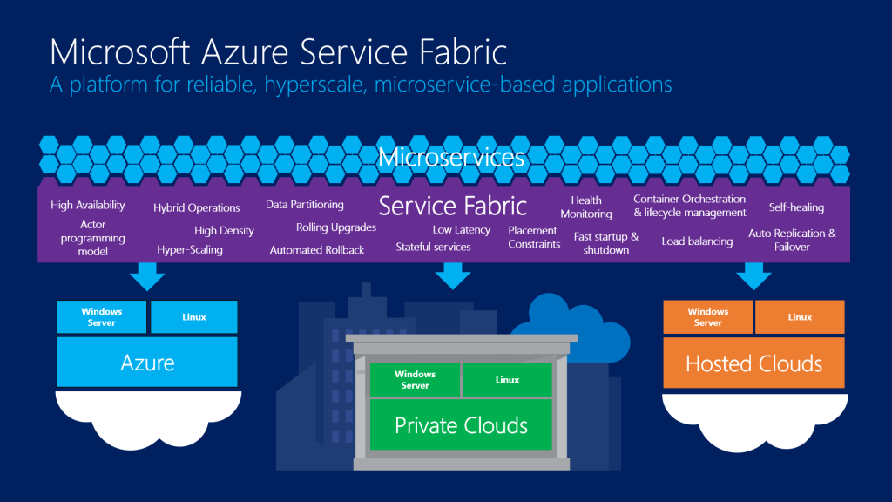

Slide 15
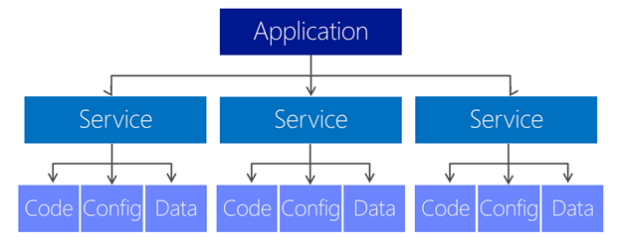

Slide 16
Communication
Default communication channel is remoting, high performance and binary serialization
Only supported on .NET Framework, no .NET Core support
Service interfaces must expose known types, no generics or interfaces for messages

Slide 17
Reliable collections
Collections – Single-machine, Single-threaded.
Concurrent Collections – Single-machine, multi-threaded.
Reliable Collections – Multi-machine, replicated, persistence, async, transactional

Slide 18
Stateless & stateful (service & actor)
Services can be either stateless or stateful
Services can be either a service or an actor
Services can be partitioned

Slide 19
Partitioning
Very hard to get right. Use time and effort to investigate, test and verify.
How do you even plan for unknown future storage and usage demands?
Plan for immediate future, plan for migration in the long run.

Slide 20
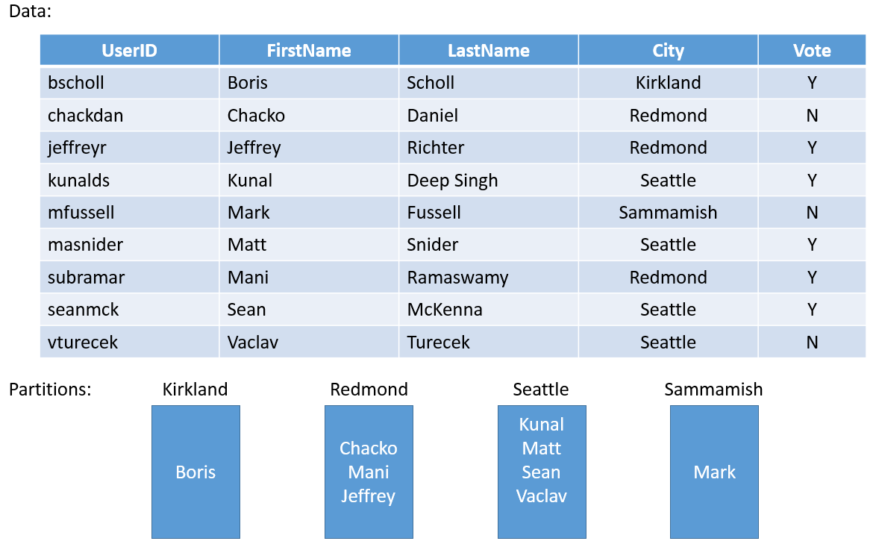
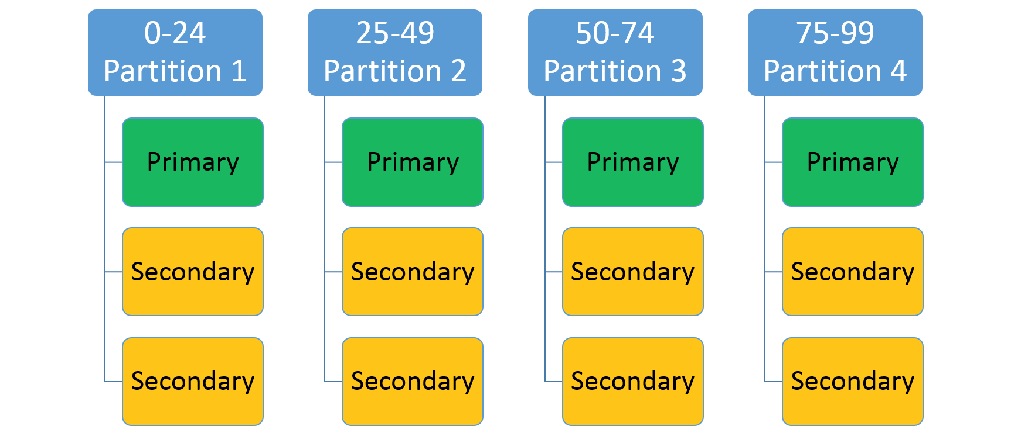
Partitioned services
SingletonPartition – Single or multiple instances, with replicas
Partitioned – Can be number or string based partitions.
Consider MurmurHash for sharding.

Slide 21
Not so dynamic configuration
When using <DefaultServices> you are limited on configuration changes.
Can use PowerShell to change a lot of settings at runtime.
Use variables to change default services during deployment (e.g. <PlacementConstraints>)
Partition configuration on partitioned services cannot be changed.

Slide 22
Why & how?
Why: Because it gives you extreme power and scalability
How: Use any microservice platform and write code as services

Slide 23
Resources
Azure videos:
https://azure.microsoft.com/en-us/resources/videos/index/?services=service-fabric
Overview of Azure Service Fabric:
https://docs.microsoft.com/en-us/azure/service-fabric/service-fabric-overview
Microservice Trade-Offs
https://martinfowler.com/articles/microservice-trade-offs.html
Service Fabric terminology overview
https://docs.microsoft.com/en-us/azure/service-fabric/service-fabric-technical-overview

Slide 24

Questions?

Slide 25
Thank you!
Sondre Bjellås
sb@effera.no

Slide 26
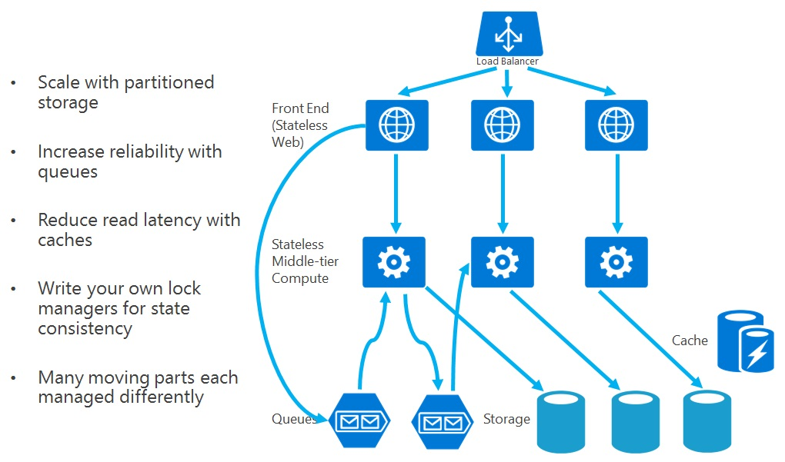

Slide 27
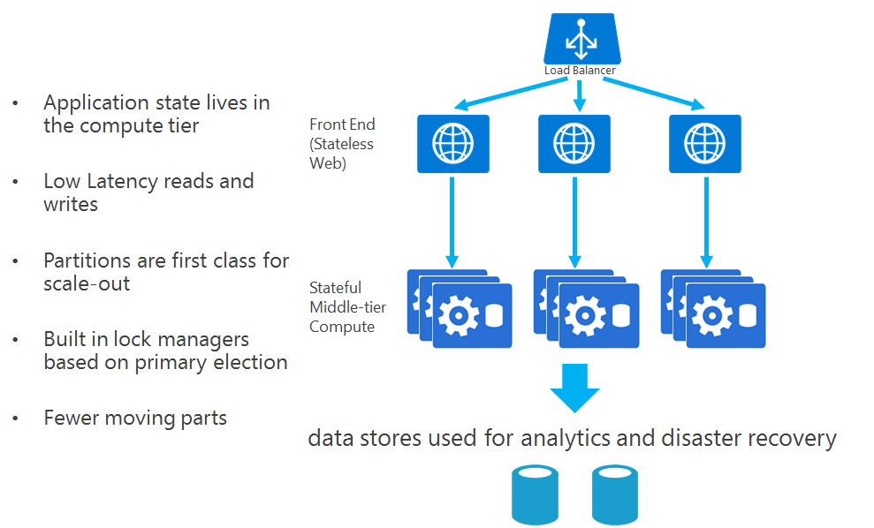

Slide 28
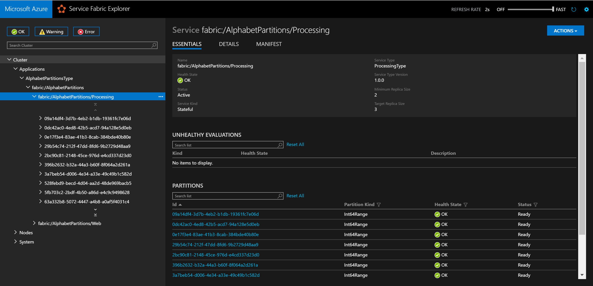

Slide 29
