Slide 1
מעבדות מדעי הנתונים
מעבדה 3
Visualization
Written by Noa Eyal

Slide 2
ggplot2 library
Notes:
install.packages("ggplot2")
library(ggplot2)

Slide 3
Qplot()
qplot(x, y, data=, color=, shape=, size=, alpha=, geom=, method=, formula=, facets=, xlim=, ylim= xlab=, ylab=, main=)
x,y - Specifies the variables placed on the horizontal and vertical axis. For univariate plots (e.g., histograms), omit y.
Data – the dataframe.
main, xlab, ylab – title and axis's labels.
xlim, ylim - Two-element numeric vectors giving the minimum and maximum values for the horizontal and vertical axes, respectively.
Geom – i.e. "point", "smooth", "boxplot", "line", "histogram", "density", "bar", and "jitter".
color, shape, size, fill
alpha - Alpha transparency for overlapping elements (0-1).
…
Notes:
# color, shape, size, fill - Associates the levels of variable with symbol color, shape, or size. For line plots, color associates levels of a variable with line color. For density and box plots, fill associates fill colors with a variable. Legends are drawn automatically.
# Facets - Creates a trellis graph by specifying conditioning variables. Its value is expressed as rowvar ~ colvar. To create trellis graphs based on a single conditioning variable, use rowvar~. or .~colvar)
# method, formula - If geom="smooth", a loess fit line (Locally Weighted Scatterplot Smoothing) and confidence limits are added by default. When the number of observations is greater than 1,000, a more efficient smoothing algorithm is employed. Methods include "lm" for regression, "gam" for generalized additive models, and "rlm" for robust regression. The formula parameter gives the form of the fit. For example, to add simple linear regression lines, you'd specify geom="smooth", method="lm", formula=y~x. Changing the formula to y~poly(x,2) would produce a quadratic fit. Note that the formula uses the letters x and y, not the names of the variables. For method="gam", be sure to load the mgcv package. For method="rml", load the MASS package.

Slide 4
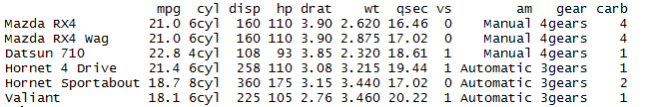
mtcars datafreme
> head(mtcars)
create factors with value labels
> library(ggplot2)
> mtcars$gear <- factor(mtcars$gear,levels=c(3,4,5), labels=c("3gears","4gears","5gears"))
> mtcars$am <- factor(mtcars$am,levels=c(0,1), labels=c("Automatic","Manual"))
> mtcars$cyl <- factor(mtcars$cyl,levels=c(4,6,8), labels=c("4cyl","6cyl","8cyl"))

Slide 5
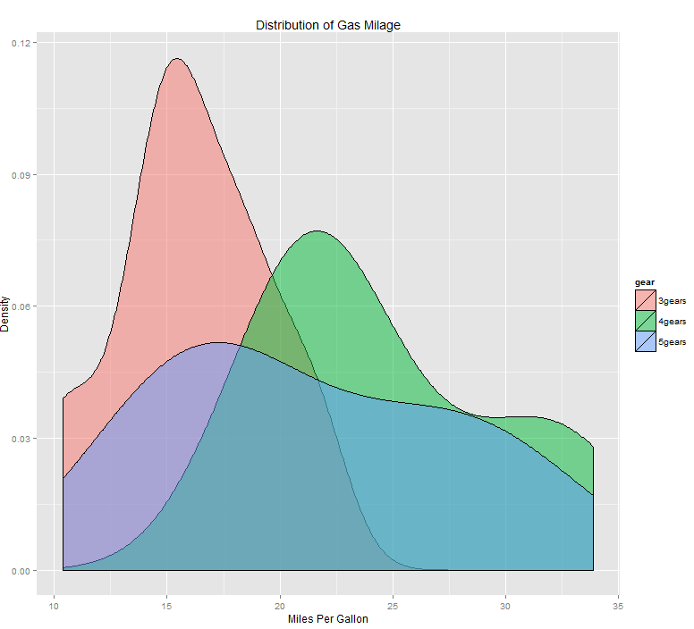
Kernel Density Plot
Kernel density plots for mpg grouped by number of gears (indicated by color)
> qplot(mpg, data=mtcars, geom="density", fill=gear, alpha=I(.5), main="Distribution of Gas Milage", xlab="Miles Per Gallon", ylab="Density")
Notes:
kernel density estimation (KDE) is a non-parametric way to estimate the probability density function of a random variable.

Slide 6
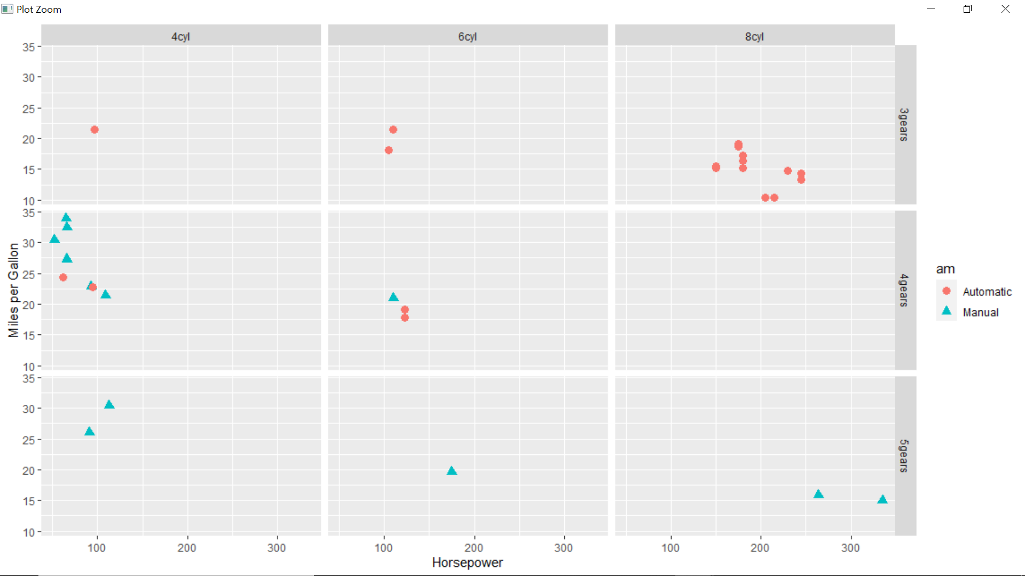
Scatterplot of mpg vs. hp
Scatterplot of mpg vs. hp for each combination of gears and cylinders in each facet, transmittion type is represented by shape and color.
> qplot(hp, mpg, data=mtcars, shape=am, color=am, facets=gear~cyl, size=I(3), xlab="Horsepower", ylab="Miles per Gallon")

Slide 7
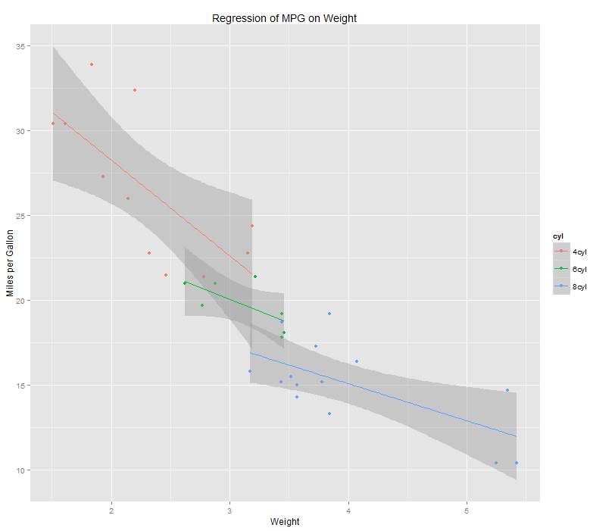
Regression
Separate regressions of mpg on weight for each number of cylinders.
> qplot(wt, mpg, data=mtcars, geom=c("point", "smooth"), method="lm", formula=y~x, color=cyl, main="Regression of MPG on Weight", xlab="Weight", ylab="Miles per Gallon")

Slide 8
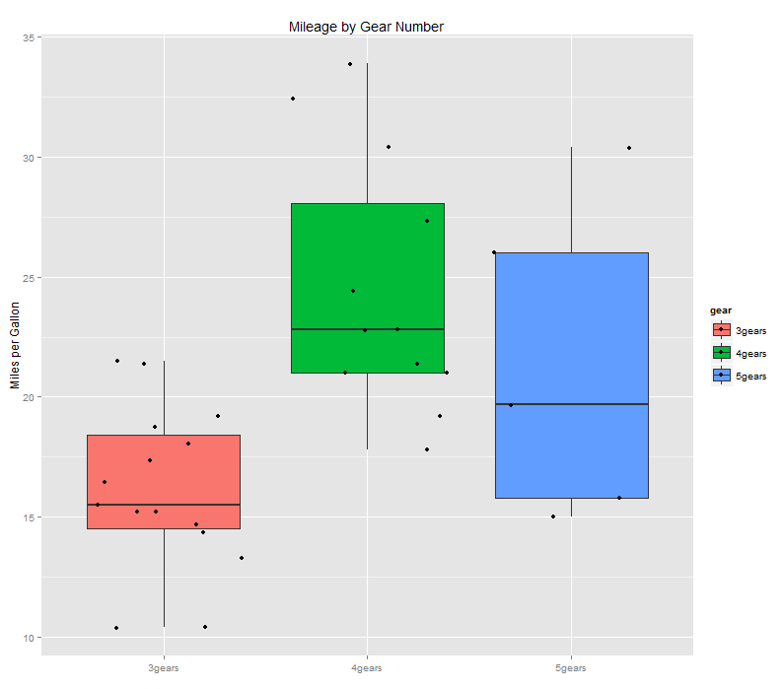
Boxplots
Boxplots of mpg by number of gears observations (points) are overlayed and jittered.
> qplot(gear, mpg, data=mtcars, geom=c("boxplot", "jitter"), fill=gear, main="Mileage by Gear Number", xlab="", ylab="Miles per Gallon")

