Slide 1
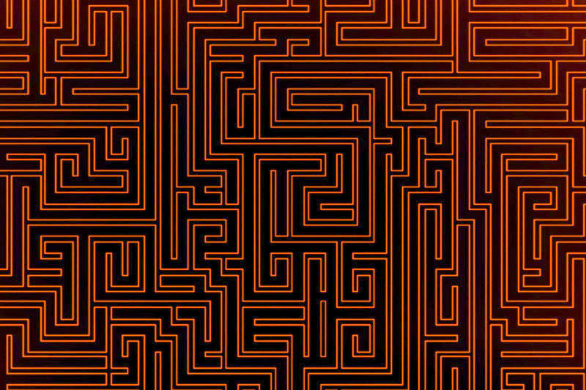



© Noam Cohen Maguri & Shiri Itach

Slide 2


Slide 3
©
Shiri Itach
Noam Cohen Maguri
©
Shiri Itach
Noam Cohen Maguri

Slide 4



