Slide 1
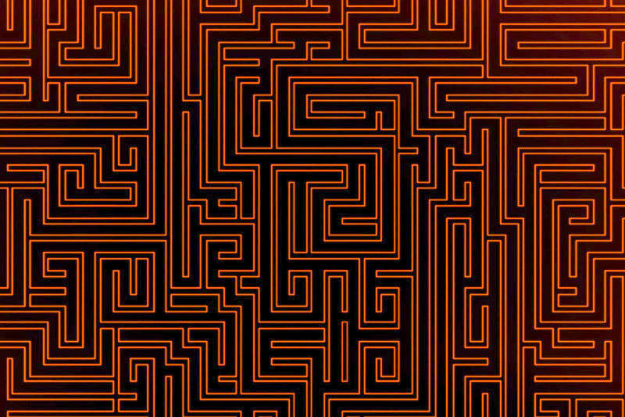



© Noam Cohen Maguri & Shiri Itach

Slide 2


