Slide 1

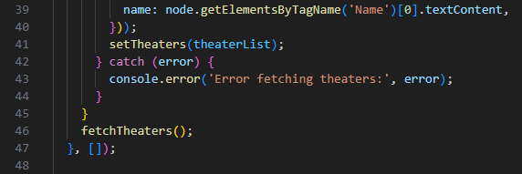
Working as a Group
a
What is our project?
A full-stack web application where you can search for movies and showtimes using the Finnkino Open API for upcoming movies, and TMDB for older movies.
How did we do it?
Our group of 4 people divided the tasks among ourselves, and with weekly meetings about the next week's sprint and the product development queue, we kept track of the project development.
Group members:
Roosa Karjalainen
Saku Kallioinen
Sofiia Pliushch
Antti Myllymäki

Slide 2
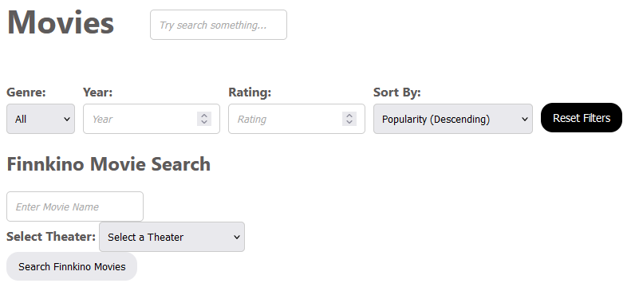
Personal Development
Roles in the Project
Every member of our group was assigned a specific role to fulfill.
Each member had the opportunity to learn something new
that they hadn’t tried or done before, which was one of our key priorities.
Time Spent Learning and Doing
With the limited time we had, our group managed
to learn and adapt to the challenges posed
by new technologies and tight deadlines.

Slide 3
Summary of Our Work
Success
As a group, we successfully developed a working product while improving our skills and expanding our understanding of the systems and tools we utilized.
Challenges
We faced several challenges, from being new to the systems to starting late. Communication was also slow at the beginning as we adjusted to working together as a team.
What Did We Learn?
The most valuable lessons came from working as a team and learning how to tackle challenges we weren’t sure we could solve. We also gained important skills in time management and full-stack development.

