Slide 1
Modelin Tokenomics Made Easy
@ ETH Shanghai Hackathon

Slide 2




Tokenomics
Dilution Plan
SH
SH
SH
SH
time
Properties for decisions:
Decentralized enough?
Too much dump?
Distribution Plan
While Tokenomics is often the key to the success of a web3 project, the design process of it is poorly supported.

Slide 3



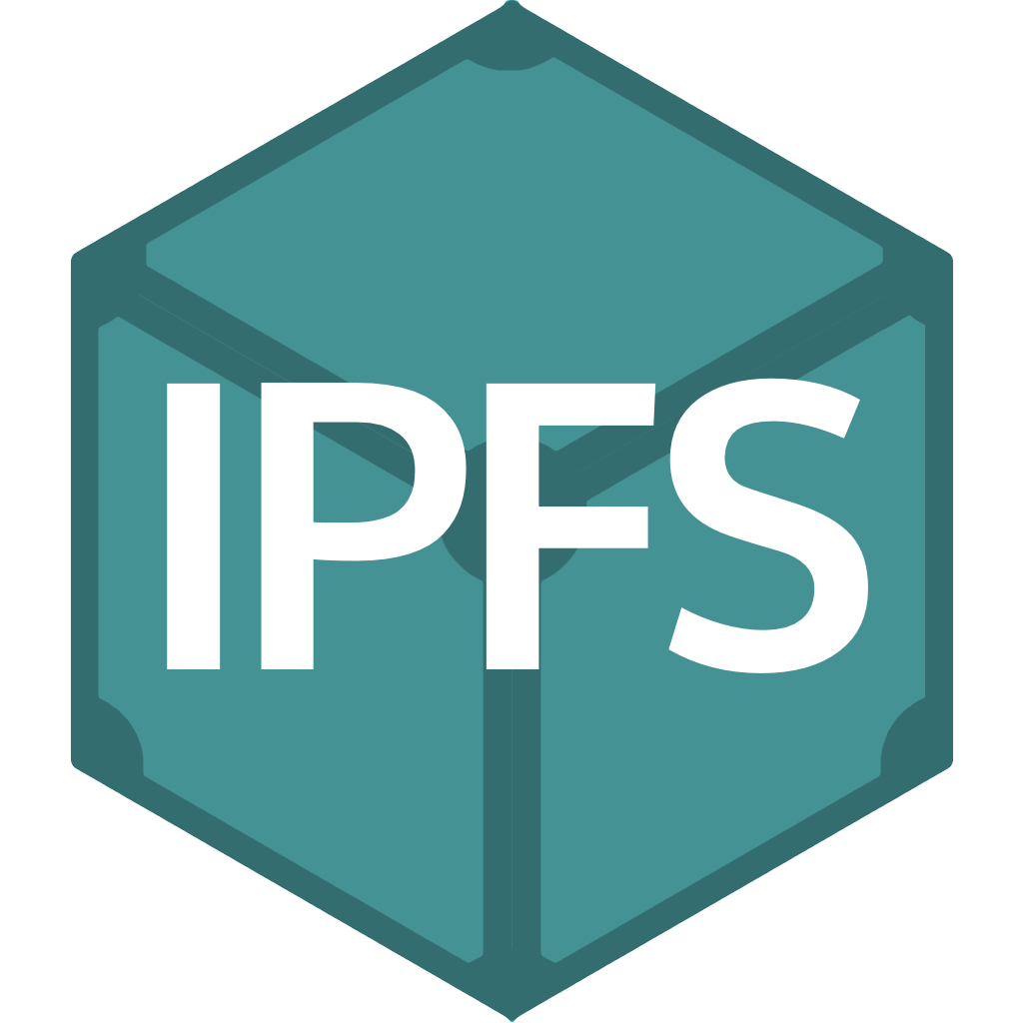
Modelin: Model & Insight
Features
Domain-Specific Language (DSL) for designing tokenomics
Visual modeling workspace with public models and private insights
IST as the native NFT
Ownership of an IST guarantees rights to (1) view insight metadata and (2) set price of it.
Incentives to dig out insights
Trading royalty to creators of model and insight
Modelin Workspace
DSL framework
DSL runtime
Tokenomics MODEL
Insight NFT IST
Insight Owner
Insight Creator
Metadata
Model Creator
Easy Tokenomics + Consistent Views + Deep Understanding

