Slide 1
Module Sharing and Encapsulation
Ross Tate

Slide 2
WebAssembly Program

Slide 3
Loaded
On-Demand
Component
Shared
Shared
Language Runtime
Main
3rd Party
Library
Loaded
On-Demand
Component
Linking Infrastructure

Slide 4
Update
Component
Update
Update
Language Runtime
Main
3rd Party
Library
Incremental Compilation
Component
Linking Infrastructure

Slide 5
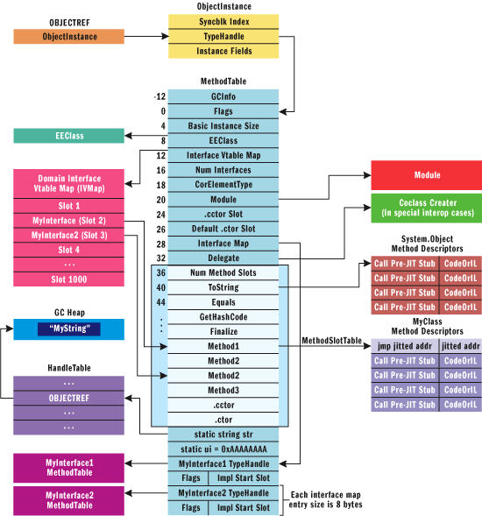
Memory Layout
for C# .NET 1.1

