Slide 1
(Un)Decidability of Bounded Quantification
Ross Tate

Slide 2


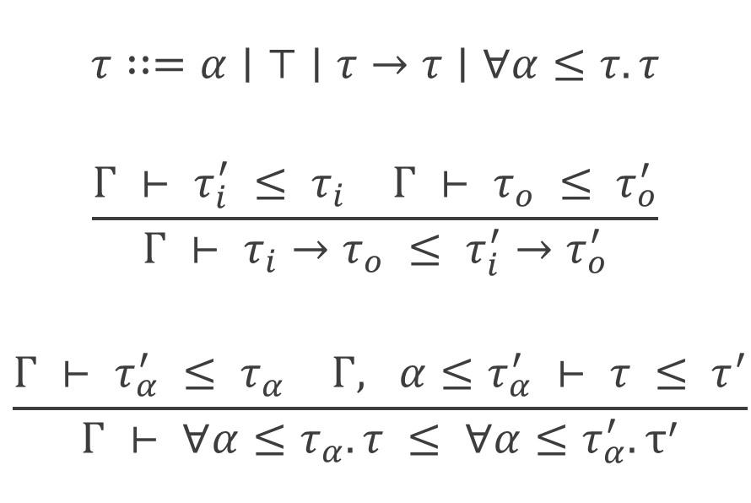

System F≤
No Type Recursion
$$τ∷=α∣⊤∣τ→τ∣∀α≤τ. τ$$
$$\frac{\begin{matrix}Γ ⊢ τ_{i}^{′} ≤ τ_{i} & Γ ⊢ τ_{o} ≤ τ_{o}^{′}\end{matrix}}{Γ ⊢ τ_{i}→τ_{o} ≤ τ_{i}^{′}→τ_{o}^{′}}$$
$$\frac{\begin{matrix}Γ ⊢ τ_{α}^{′} ≤ τ_{α} & Γ, α≤τ_{α}^{′} ⊢ τ ≤ τ^{′}\end{matrix}}{Γ ⊢ ∀α≤τ_{α}. τ ≤ ∀α≤τ_{α}^{′}.τ^{′}}$$
$$\frac{ }{Γ ⊢α ≤α}$$
$$\frac{Γ ⊢Γ(α) ≤τ′}{Γ ⊢α ≤τ′}$$
$$\frac{ }{Γ ⊢τ ≤⊤}$$
Undecidable!
[Pierce ‘92]

Slide 3
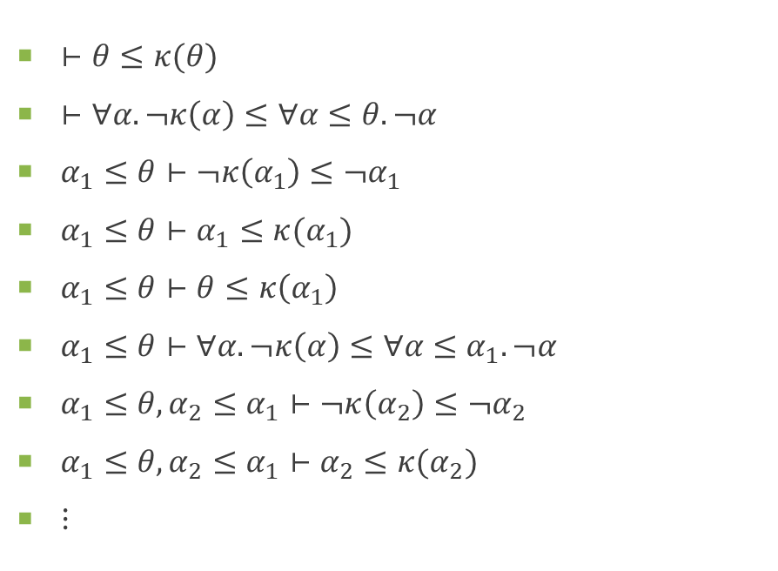

Non-Terminating Example
$¬τ=τ→⊤ \text{or} ∀α≤τ. α$ (anything contravariant)
$κ\left(τ\right)=∀α≤τ. ¬α$
$θ=∀α. ¬κ(α)$
$⊢θ≤κ(θ)$
$⊢∀α. ¬κ\left(α\right)≤∀α≤θ. ¬α$
$α_{1}≤θ⊢¬κ\left(α_{1}\right)≤¬α_{1}$
$α_{1}≤θ⊢α_{1}≤κ(α_{1})$
$α_{1}≤θ⊢θ≤κ\left(α_{1}\right)$
$α_{1}≤θ⊢∀α. ¬κ\left(α\right)≤∀α≤α_{1}. ¬α$
$α_{1}≤θ, α_{2}≤α_{1}⊢¬κ\left(α_{2}\right)≤¬α_{2}$
$α_{1}≤θ, α_{2}≤α_{1}⊢α_{2}≤κ(α_{2})$
⋮

Slide 4
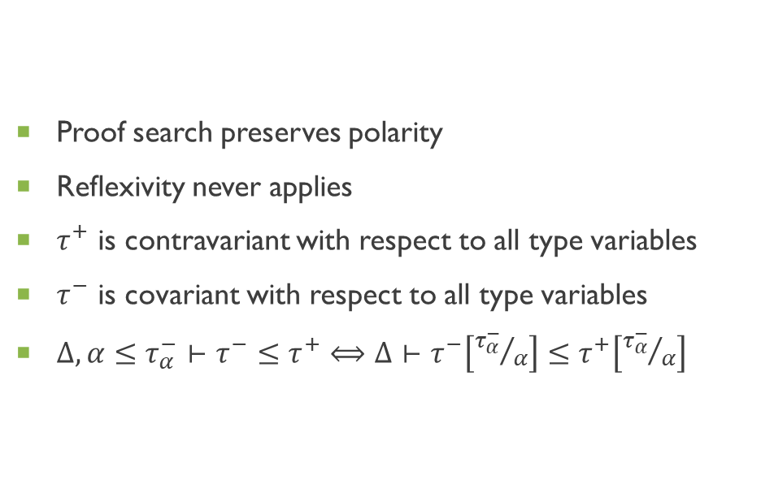
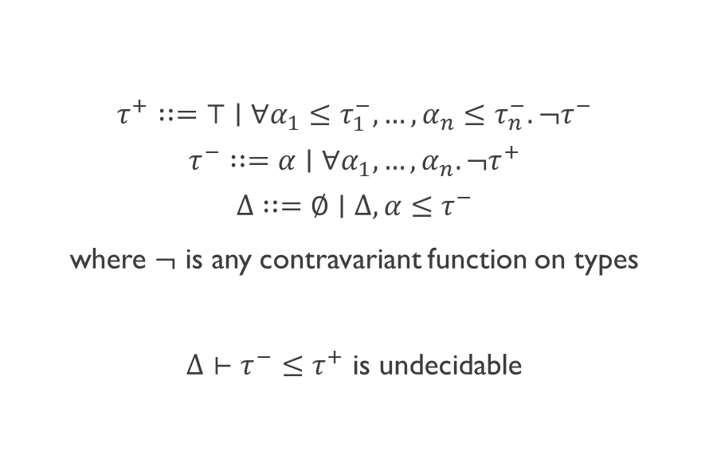
Polarizing F≤
$$τ^{+}∷=⊤∣∀α_{1}≤τ_{1}^{−}, …, α_{n}≤τ_{n}^{−}. ¬τ^{−}$$
$$τ^{−}∷=α∣∀α_{1},…, α_{n}. ¬τ^{+}$$
$$Δ∷=∅∣Δ, α≤τ^{−}$$
where $¬$ is any contravariant function on types
$Δ⊢τ^{−}≤τ^{+}$ is undecidable
Proof search preserves polarity
Reflexivity never applies
$τ^{+}$ is contravariant with respect to all type variables
$τ^{−}$ is covariant with respect to all type variables
$Δ, α≤τ_{α}^{−}⊢τ^{−}≤τ^{+}⟺Δ⊢τ^{−}\left[{τ_{α}^{−}}/α\right]≤τ^{+}\left[{τ_{α}^{−}}/α\right]$
No Type Recursion

Slide 5







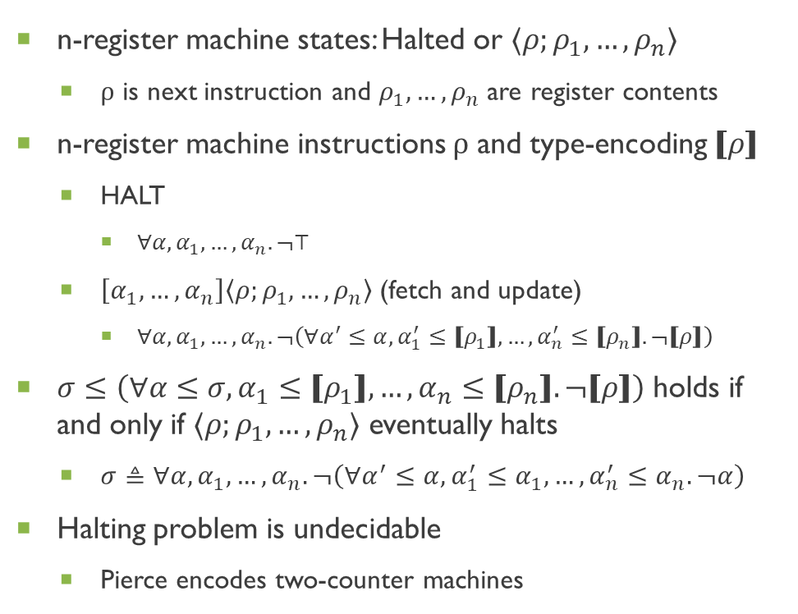

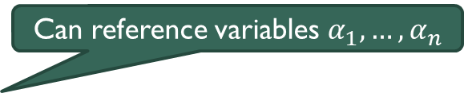


F≤ as a Register Machine
$$\frac{ }{τ^{−}≤⊤}$$
$$\frac{τ^{−}\left[{τ_{1}^{−}}/{α_{1}},…, {τ_{n}^{−}}/{α_{n}}\right]≤τ^{+}\left[{τ_{1}^{−}}/{α_{1}},…, {τ_{n}^{−}}/{α_{n}}\right]}{∀α_{1},…, α_{n}. ¬τ^{+}≤∀α_{1}≤τ_{1}^{−},…, α_{n}≤τ_{n}^{−}. ¬τ^{−}}$$
n-register machine states: Halted or $⟨ρ;ρ_{1},…,ρ_{n}⟩$
ρ is next instruction and $ρ_{1},…,ρ_{n}$ are register contents
n-register machine instructions ρ and type-encoding $⟦ρ⟧$
HALT
$∀α, α_{1},…, α_{n}. ¬⊤$
$\left[α_{1},…,α_{n}\right]\left\langle ρ;ρ_{1},…,ρ_{n}\right\rangle$ (fetch and update)
$∀α,α_{1},…,α_{n}. ¬\left(∀α^{′}≤α,α_{1}^{′}≤⟦ρ_{1}⟧,…, α_{n}^{′}≤⟦ρ_{n}⟧. ¬⟦ρ⟧\right)$
$σ≤\left(∀α≤σ, α_{1}≤⟦ρ_{1}⟧,…, α_{n}≤⟦ρ_{n}⟧. ¬⟦ρ⟧\right)$ holds if and only if $⟨ρ;ρ_{1},…,ρ_{n}⟩$ eventually halts
$σ≜∀α,α_{1},…,α_{n}. ¬\left(∀α^{′}≤α,α_{1}^{′}≤α_{1},…,α_{n}^{′}≤α_{n}. ¬α\right)$
Halting problem is undecidable
Pierce encodes two-counter machines
Can reference variables $α_{1},…,α_{n}$

Slide 6
Implications for WebAssembly

Slide 7

Inheritance and Generic Methods
abstract class Kappa<in T> { virtual void func<A≤T>(A); }
$κ\left(τ\right)=∀α≤τ. ¬α$
class Theta : Kappa<Theta> { override void func<A>(Kappa<A>) {} }
$θ=∀α. ¬κ(α)$
Is the inheritance clause valid?
Nominally: yes (using decidable type recursion)
Structurally: $θ≤κ(θ)$ loops forever (without type recursion)

Slide 8
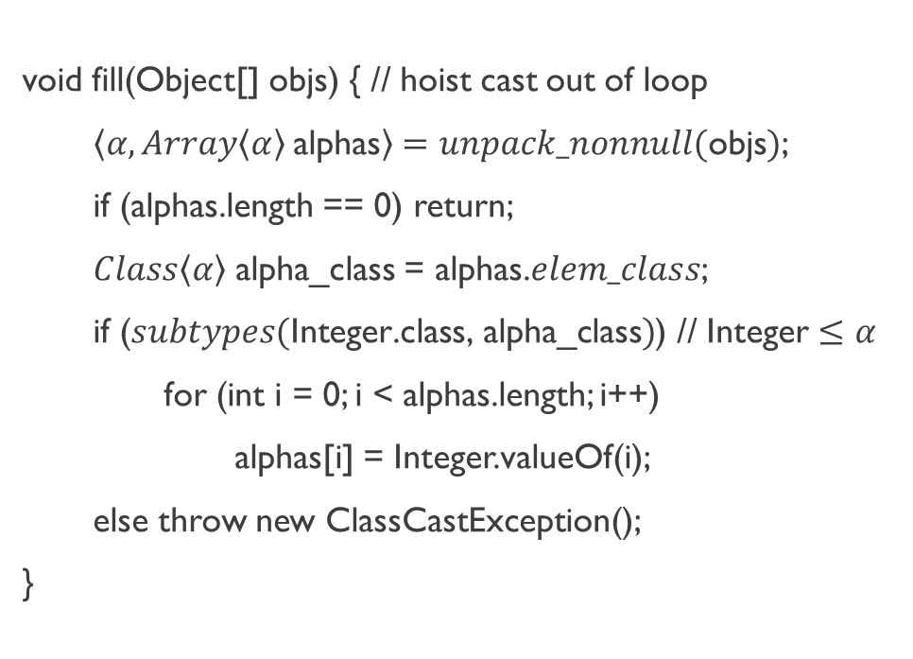
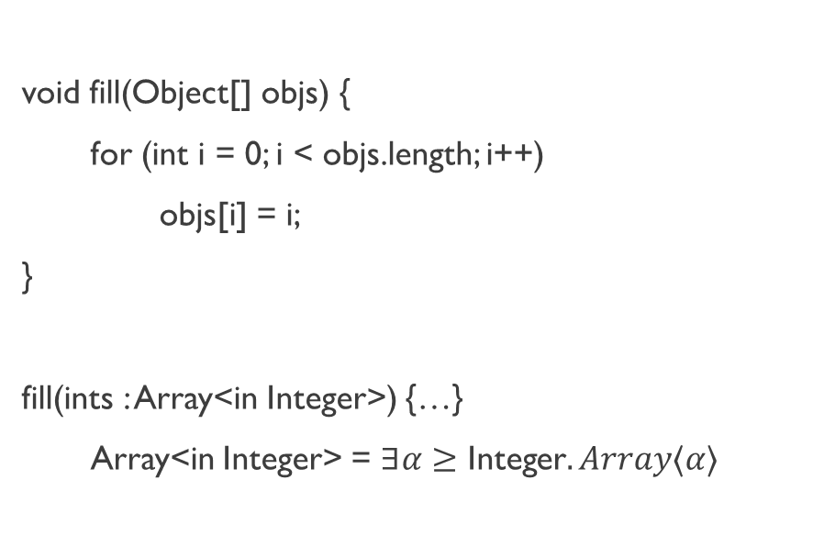
Writing to Java/C#/Kotlin Arrays
void fill(Object[] objs) {
for (int i = 0; i < objs.length; i++)
objs[i] = i;
}
fill(ints : Array<in Integer>) {…}
Array<in Integer> = $∃α≥\text{Integer}. Array⟨α⟩$
void fill(Object[] objs) { // hoist cast out of loop
$\left\langle α, Array\left\langle α\right\rangle \text{alphas}\right\rangle =unpack_nonnull(\text{objs})$;
if (alphas.length == 0) return;
$Class\left\langle α\right\rangle$ alpha_class = alphas.$elem_class$;
if ($subtypes(\text{Integer}\text{.}\text{class}\text{, }\text{alpha}\text{_}\text{class}\text{)}$) // $\text{Integer}≤α$
for (int i = 0; i < alphas.length; i++)
alphas[i] = Integer.valueOf(i);
else throw new ClassCastException();
}
Naively requires a cast on every assignment
Lower-Bounded Existential Subtyping is Undecidable!
Type-checks with loop-hoised cast

Slide 9
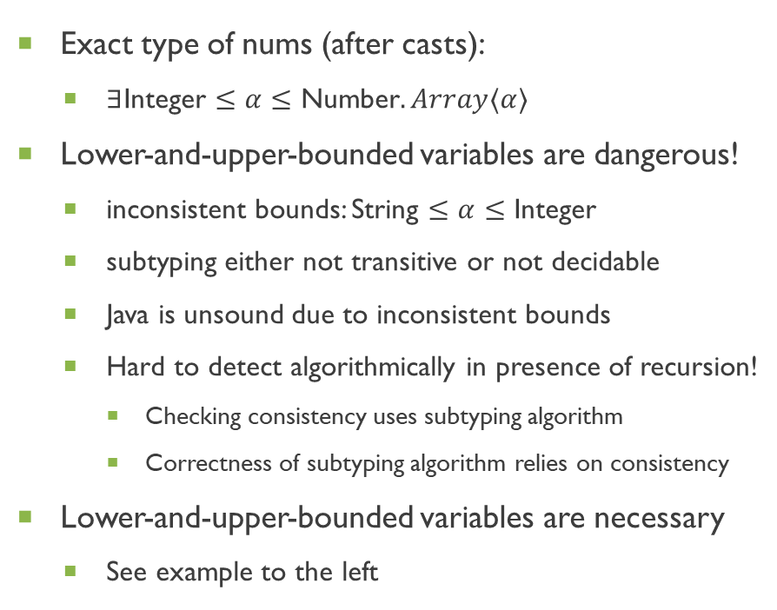
Reading and Writing Java/C#/Kotlin Arrays
void intify(Number[] nums) {
for (int i = 0; i < nums.length; i++)
nums[i] = nums[i].intValue();
}
Exact type of nums (after casts):
$∃\text{Integer}≤α≤\text{Number}. Array⟨α⟩$
Lower-and-upper-bounded variables are dangerous!
inconsistent bounds: String $≤α≤$ Integer
subtyping either not transitive or not decidable
Java is unsound due to inconsistent bounds
Hard to detect algorithmically in presence of recursion!
Checking consistency uses subtyping algorithm
Correctness of subtyping algorithm relies on consistency
Lower-and-upper-bounded variables are necessary
See example to the left

Slide 10
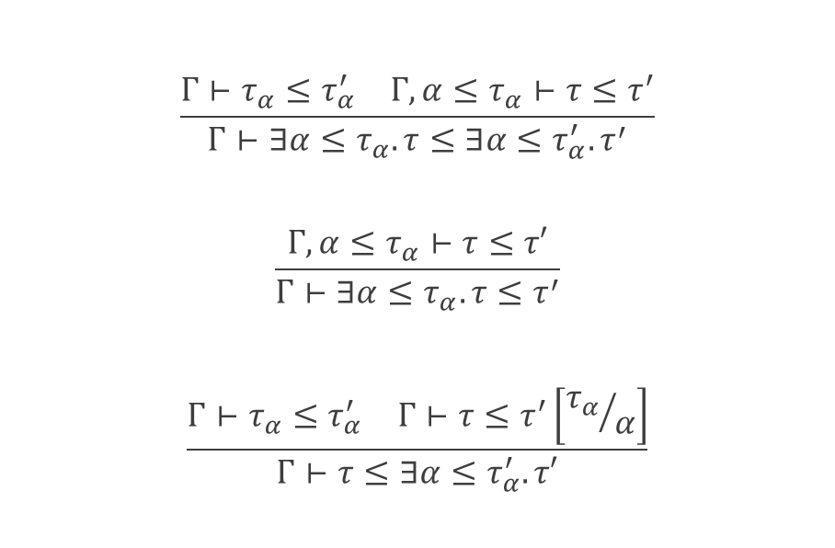

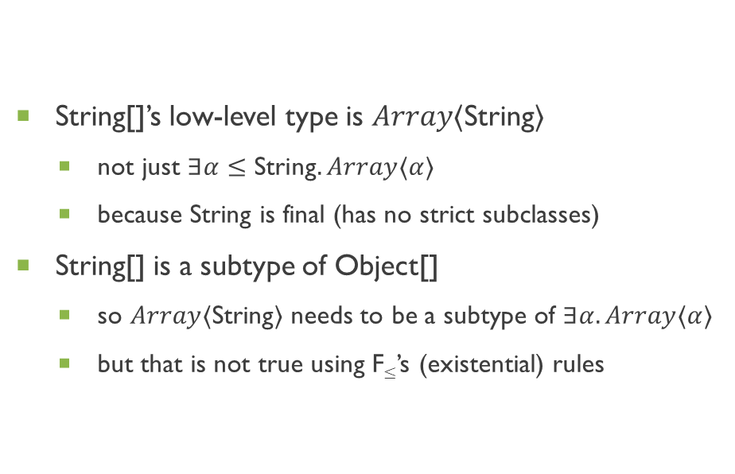
F≤ is Too Weak
String[]’s low-level type is $Array⟨\text{String}⟩$
not just $∃α≤\text{String}. Array⟨α⟩$
because String is final (has no strict subclasses)
String[] is a subtype of Object[]
so $Array⟨\text{String}⟩$ needs to be a subtype of $∃α.Array⟨α⟩$
but that is not true using F≤’s (existential) rules
$$\frac{\begin{matrix}Γ⊢τ_{α}≤τ_{α}^{′} & Γ, α≤τ_{α}⊢τ≤τ^{′}\end{matrix}}{Γ⊢∃α≤τ_{α}. τ≤∃α≤τ_{α}^{′}. τ^{′}}$$
$$\frac{Γ, α≤τ_{α}⊢τ≤τ′}{Γ⊢∃α≤τ_{α}. τ≤τ^{′}}$$
$$\frac{\begin{matrix}Γ⊢τ_{α}≤τ_{α}^{′} & Γ⊢τ≤τ^{′}\left[{τ_{α}}/α\right]\end{matrix}}{Γ⊢τ≤∃α≤τ_{α}^{′}. τ′}$$
Non-Deterministic!

Slide 11
Decidable Bounded Quantification

Slide 12
Stratifying Subtyping
abstract class Kappa<in T> { virtual void func<A≤T>(A); }
class Theta : Kappa<Theta> { override void func<A>(Kappa<A>) {} }
Is the inheritance clause valid?
For every method of Kappa<Theta>:
Is there a corresponding method in Theta?
Is that method’s signature a subtype?
Is “void <A>(Foo<A>)” a subtype of “void <A≤T>(A)”?
Assuming A ≤ Theta, is “void (Foo<A>)” a subtype of “void (A)”?
Assuming A ≤ Theta, is A a subtype of Foo<A>?
a nominal subtyping question!
Structural subtyping always reduces to nominal subtyping
Uses stratification to make subtyping decidable

Slide 13
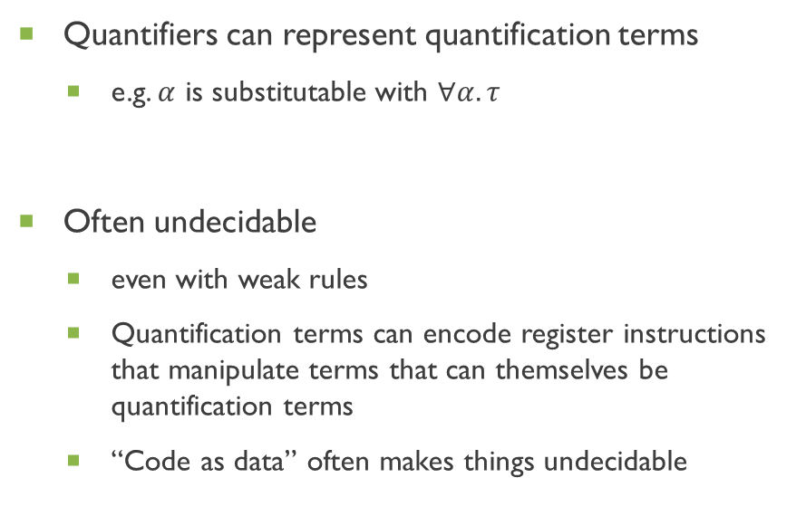
Cause of Undecidability
Impredicative Quantification
Predicative Quantification
Quantifiers can represent quantification terms
e.g. $α$ is substitutable with $∀α. τ$
Often undecidable
even with weak rules
Quantification terms can encode register instructions that manipulate terms that can themselves be quantification terms
“Code as data” often makes things undecidable
Quantification is stratified
e.g. structural types of classes have quantifiers, but those only quantify over nominal types, and nominal types do not have quantifiers
Decidable with care
either use weak rules
or address non-determinism in strong rules
Stratification keeps “code” and “data” separate

Slide 14
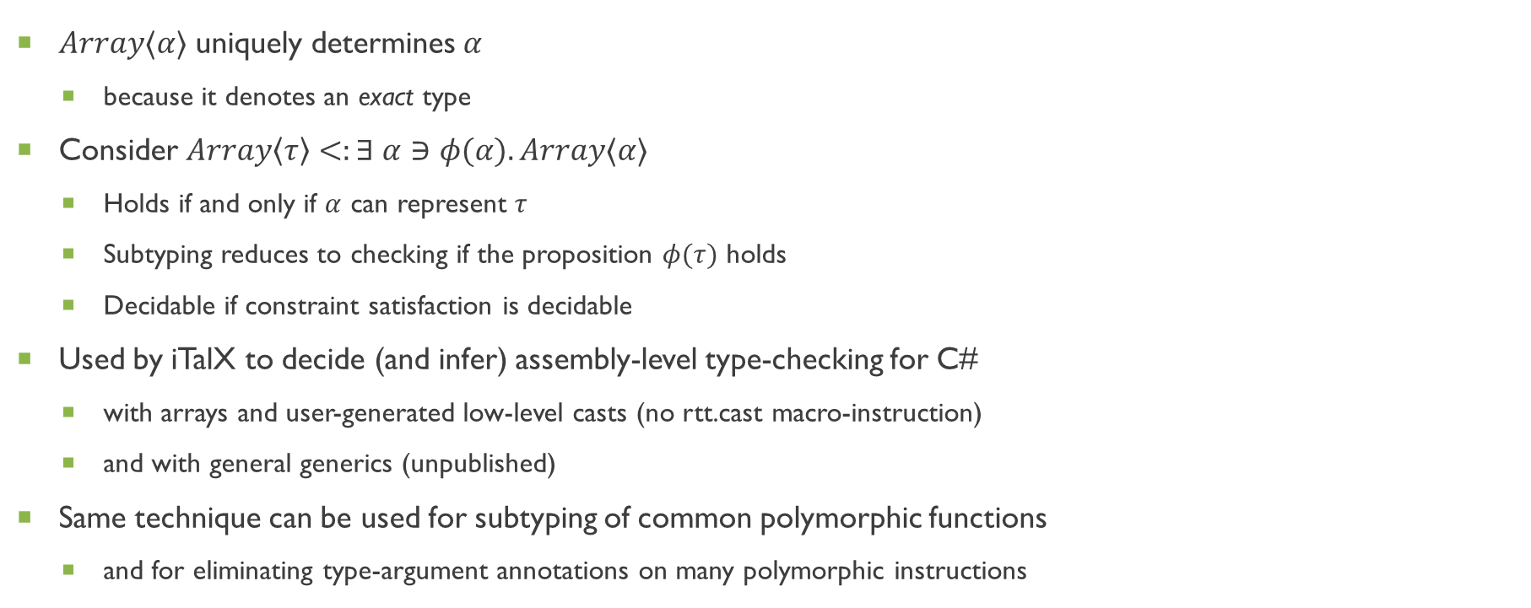
Exact Types to the Rescue
$Array⟨α⟩$ uniquely determines $α$
because it denotes an exact type
Consider $Array\left\langle τ\right\rangle <:∃ α∋φ(α). Array⟨α⟩$
Holds if and only if $α$ can represent $τ$
Subtyping reduces to checking if the proposition $φ(τ)$ holds
Decidable if constraint satisfaction is decidable
Used by iTalX to decide (and infer) assembly-level type-checking for C#
with arrays and user-generated low-level casts (no rtt.cast macro-instruction)
and with general generics (unpublished)
Same technique can be used for subtyping of common polymorphic functions
and for eliminating type-argument annotations on many polymorphic instructions

