Slide 1

Experiments with AOT Compilation
Ross Tate

Slide 2
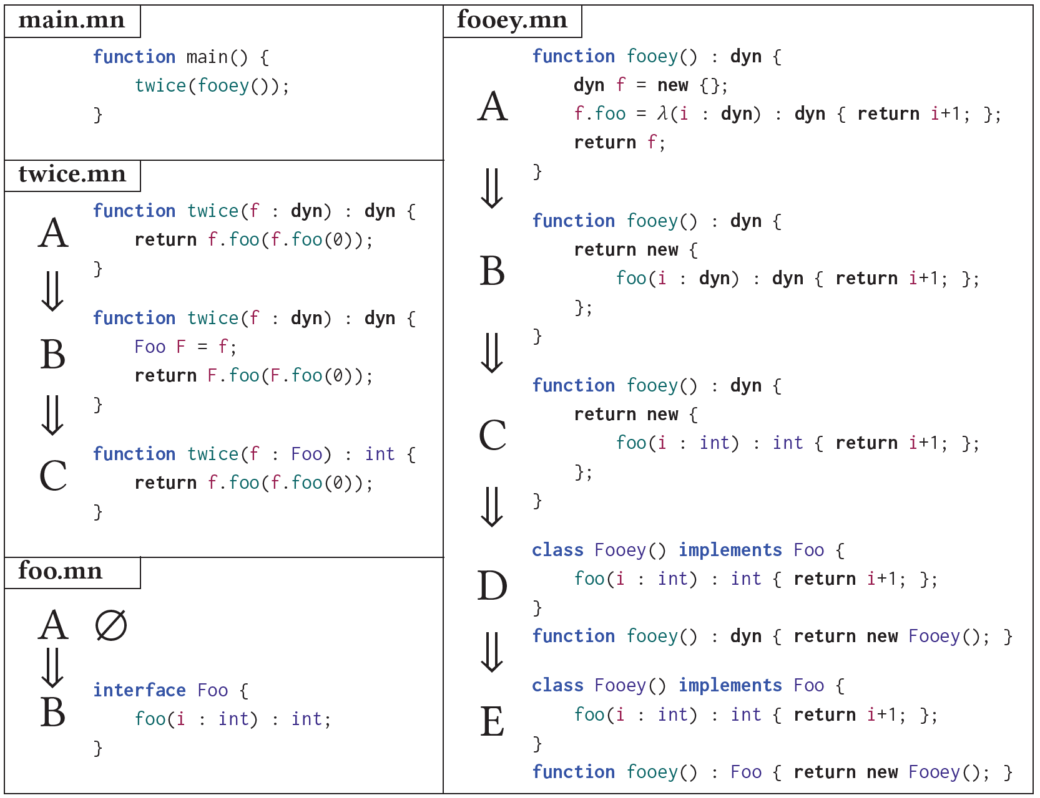

Slide 3
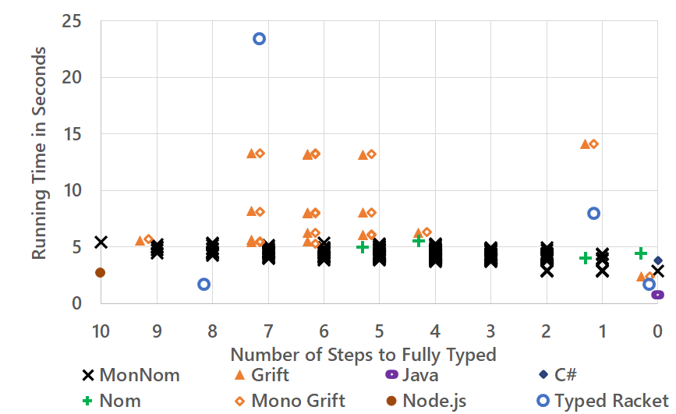
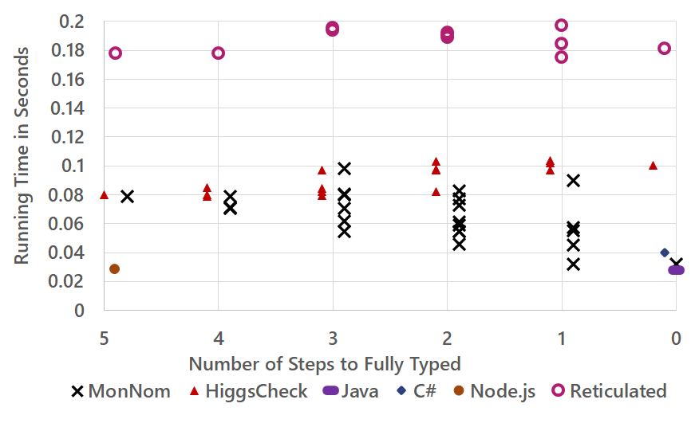
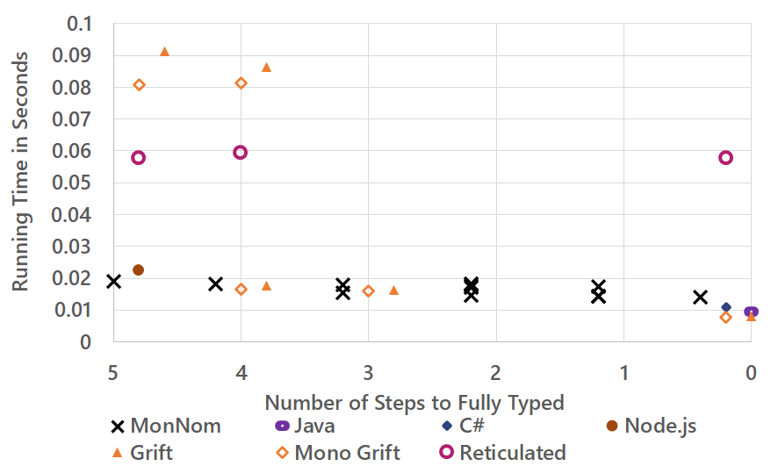
Lambdas and Short-Lived Objects
Classes and Interfaces
Hypothesis: WebAssembly should be able to match JavaScript without advanced optimizations
64-Bit Floats

Slide 4
Caching
Observation: The L1 cache is amazing
Typically no performance benefit gained from eliminating a load from the L1 cache
Even chained loads
Hypothesis: Module-instance data should be quickly accessible if in L1

Slide 5
Call Tags
We implemented interface methods and lambdas using call tags
Used call-tag switching to handle conflicts between interface methods
Used defaults to support typed-untyped interop (e.g. casting and representation conversion)
Class methods implemented using standard typed code pointers
Experiment:
Replace all interfaces with classes in benchmark where each interface is implemented by only one class
Effect on implementation: replaces uses of call tags with uses of typed code pointers
Impact on performance: None
Hypothesis: Typed-function references add complexity without adding performance or expressiveness benefits
Hypothesis: Call tags add both performance and expressiveness benefits

