Slide 1
Minimal Change to Nominalize the MVP
Ross Tate

Slide 2
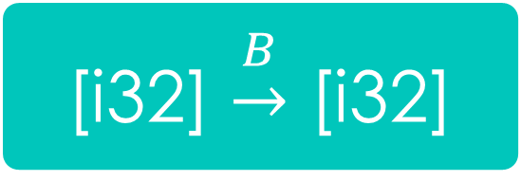
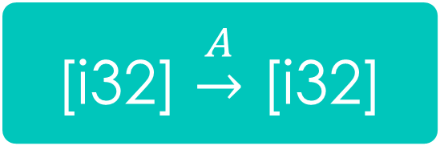
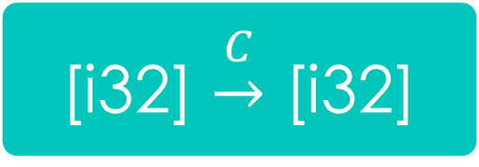
Low-Level Systems
int (*)(int)
[i32] $\underset{→}{A}$ [i32]
[i32] $\underset{→}{B}$ [i32]
[i32] $\underset{→}{C}$ [i32]
input/output in register r5
input/output in register r3
input/output on stack

Slide 3
Low-Level Conflicts
JS ref
Smis
Wasm ref
i31ref
anyref

Slide 4
Centralizing Coordination
WebAssembly already requires module centralization within an application
All modules needs within an application need to use/import the same exception event
Exception events are nominal for composability
Do not want exception events of different systems to interfere
Nominal heap types provide composability
Representation/casting constraints of different systems do not interfere
Since application-central module instance is already necessary
Use it to coordinate types/RTTs for primitive reference types
High-level modules are coordinated by the language runtime
In WebAssembly, that language runtime is now its own module, the application-central one

Slide 5
Understanding rtt.canon (and rtt.sub)
rtt.canon $type : [] -> [(rtt $type)]
Represent $type as an automaton
Minimize that automaton
Canonicalize that minimization
Hash that canonicalization
Look for preexisting rtt for that type in process-global hashtable
If $type uses an imported type, do this per instantiation
Post-MVP extends with parametric polymorphism
Rtts for type arguments are supplied at run time
Above process is done at run time (e.g. per call of polymorphic function constructing pairs in Post-MVP)

Slide 6
Concerns with Structural Typing
Unknown how to scale to major languages (#116)
Whether Post-MVP has practical decidable restriction is longstanding open research problem
Post-MVP cast mechanisms cannot express, for example, Java/C# arrays
Concerns about compile-time performance (#117)
Low-level structural types are large, and structural subtyping is quadratic
Parametric polymorphism would reduce applicability of memoization
Issues with composing implementations
Unclear if it can be extended with pointer-tagging or unboxed nullary variants (#118)
i31ref conflicts with Smis in externref if both are subtypes of anyref (#76/#130)

Slide 7
Observations
Bottlenecked by dynamic type system
Every “this” pointer must be cast
Elements of arrays must be cast
Dynamic type system is nominal
RTTs have distinct identities and explicit hierarchy
Low-level nominal types…
have been demonstrated to scale to major languages and existing compilers
benefit from fast compile-time and run-time subtyping
avoid clashing distinct low-level systems

Slide 8
Suggestion
Specify hierarchy in types section
make heap types generative rather than applicative (i.e. two defs always makes two types)
make “sub” relation explicit in type declarations rather than deduced through equi-recursion
remove anyref
Possibly
Remove rtt type
Separate rtt into GC descriptors (i.e. object headers) and type identifiers (i.e. magic numbers)
Enrich GC descriptors to store other meta-data, e.g. v-table

