Slide 1
Type Recursion and (Un)Decidability
Ross Tate

Slide 2
Generics with Variance
Enumerator<String> <: Enumerator<Object>
Enumerator is covariant: Enumerator<out T>
Property<Object> <: Property<String>
Property is contravariant: Property<in T>
Array<Number> <: Array<in Integer out Object>
Array is invariant, but has contravariant and covariant “projections”
You can put Integers in to an Array<Number>
You can get Objects out of an Array<Number>
Map<K, out V> <: Enumerable<Pair<K,V>>
Inheritance

Slide 3
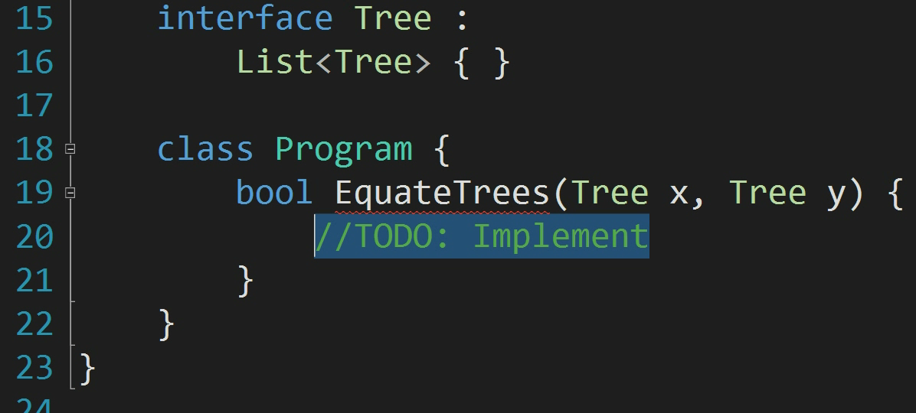
Generics in C#

Slide 4

Theory of Undecidability

Slide 5
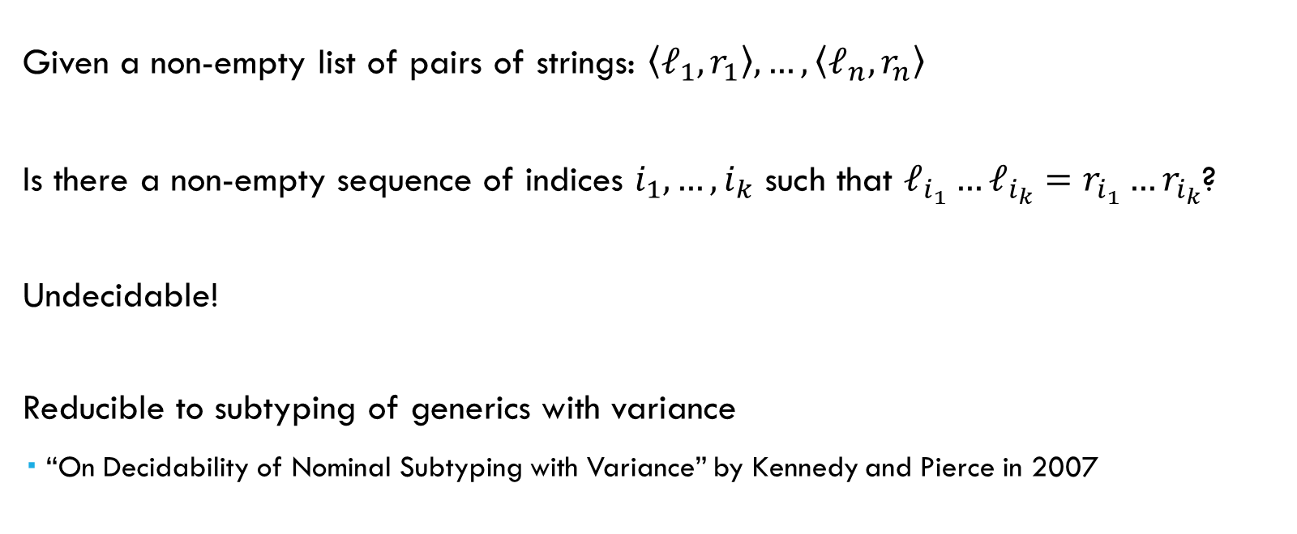
Post-Correspondence Problem
Given a non-empty list of pairs of strings: $\left\langle ℓ_{1},r_{1}\right\rangle ,…,\left\langle ℓ_{n}, r_{n}\right\rangle$
Is there a non-empty sequence of indices $i_{1},…, i_{k}$ such that $ℓ_{i_{1}}…ℓ_{i_{k}}=r_{i_{1}}…r_{i_{k}}$?
Undecidable!
Reducible to subtyping of generics with variance
“On Decidability of Nominal Subtyping with Variance” by Kennedy and Pierce in 2007

Slide 6
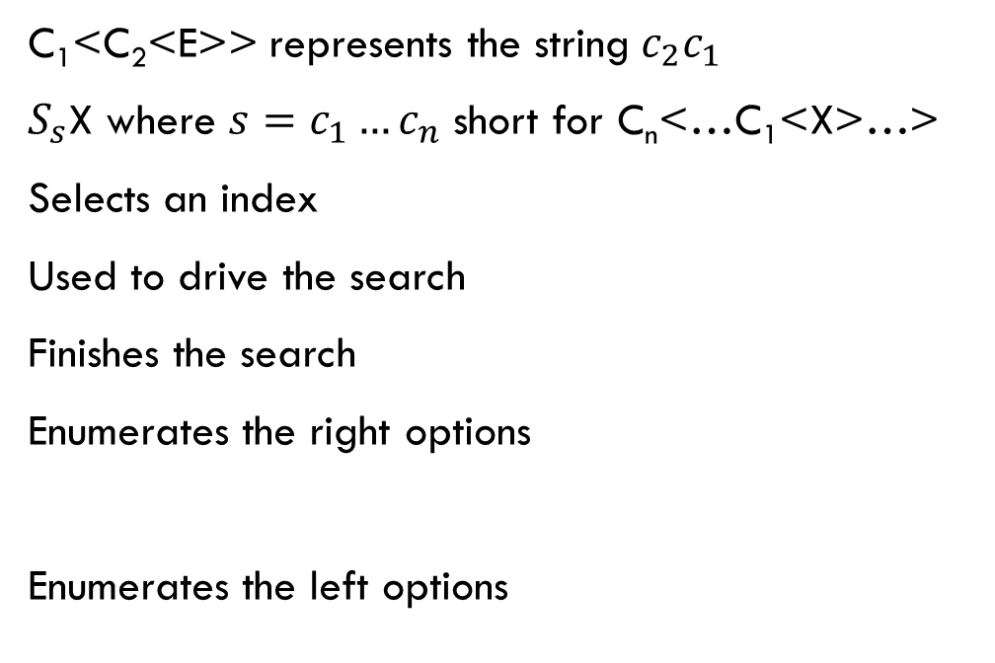
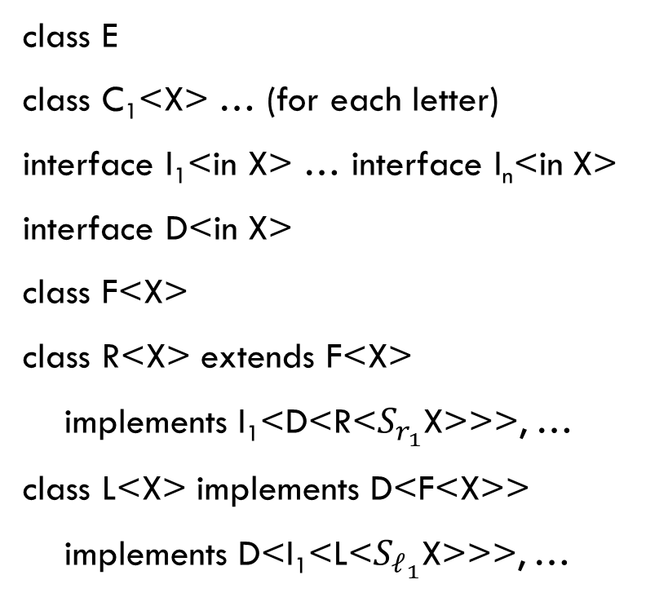
Undecidability of Generics with Variance
class E
class C₁<X> … (for each letter)
interface I₁<in X> … interface I_{n}<in X>
interface D<in X>
class F<X>
class R<X> extends F<X>
implements I₁<D<R<$S_{r_{1}}$X>>>, …
class L<X> implements D<F<X>>
implements D<I₁<L<$S_{ℓ_{1}}$X>>>, …
C₁<C₂<E>> represents the string$c_{2}c_{1}$
$S_{s}$X where $s=c_{1}…c_{n}$ short for C_{n}<…C₁<X>…>
Selects an index
Used to drive the search
Finishes the search
Enumerates the right options
Enumerates the left options

Slide 7
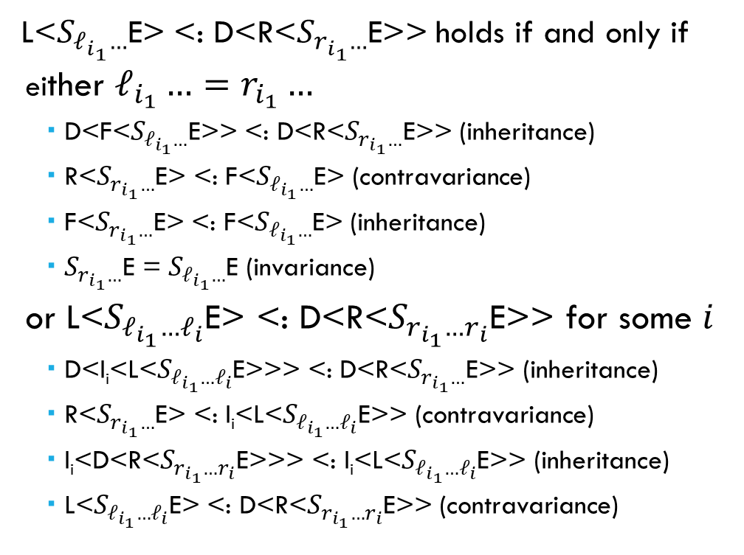
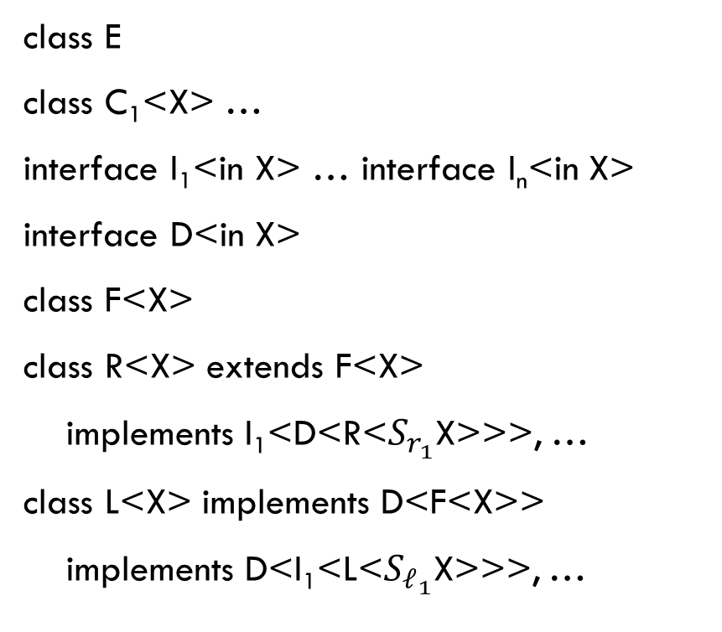
Undecidability of Generics with Variance
class E
class C₁<X> …
interface I₁<in X> … interface I_{n}<in X>
interface D<in X>
class F<X>
class R<X> extends F<X>
implements I₁<D<R<$S_{r_{1}}$X>>>, …
class L<X> implements D<F<X>>
implements D<I₁<L<$S_{ℓ_{1}}$X>>>, …
L<$S_{ℓ_{i_{1}}…}$E> <: D<R<$S_{r_{i_{1}}…}$E>> holds if and only if
either $ℓ_{i_{1}}…=r_{i_{1}}…$
D<F<$S_{ℓ_{i_{1}}…}$E>> <: D<R<$S_{r_{i_{1}}…}$E>> (inheritance)
R<$S_{r_{i_{1}}…}$E> <: F<$S_{ℓ_{i_{1}}…}$E> (contravariance)
F<$S_{r_{i_{1}}…}$E> <: F<$S_{ℓ_{i_{1}}…}$E> (inheritance)
$S_{r_{i_{1}}…}$E = $S_{ℓ_{i_{1}}…}$E (invariance)
or L<$S_{ℓ_{i_{1}}…ℓ_{i}}$E> <: D<R<$S_{r_{i_{1}}…r_{i}}$E>> for some $i$
D<I_{i}<L<$S_{ℓ_{i_{1}}…ℓ_{i}}$E>>> <: D<R<$S_{r_{i_{1}}…}$E>> (inheritance)
R<$S_{r_{i_{1}}…}$E> <: I_{i}<L<$S_{ℓ_{i_{1}}…ℓ_{i}}$E>> (contravariance)
I_{i}<D<R<$S_{r_{i_{1}}…r_{i}}$E>>> <: I_{i}<L<$S_{ℓ_{i_{1}}…ℓ_{i}}$E>> (inheritance)
L<$S_{ℓ_{i_{1}}…ℓ_{i}}$E> <: D<R<$S_{r_{i_{1}}…r_{i}}$E>> (contravariance)

Slide 8
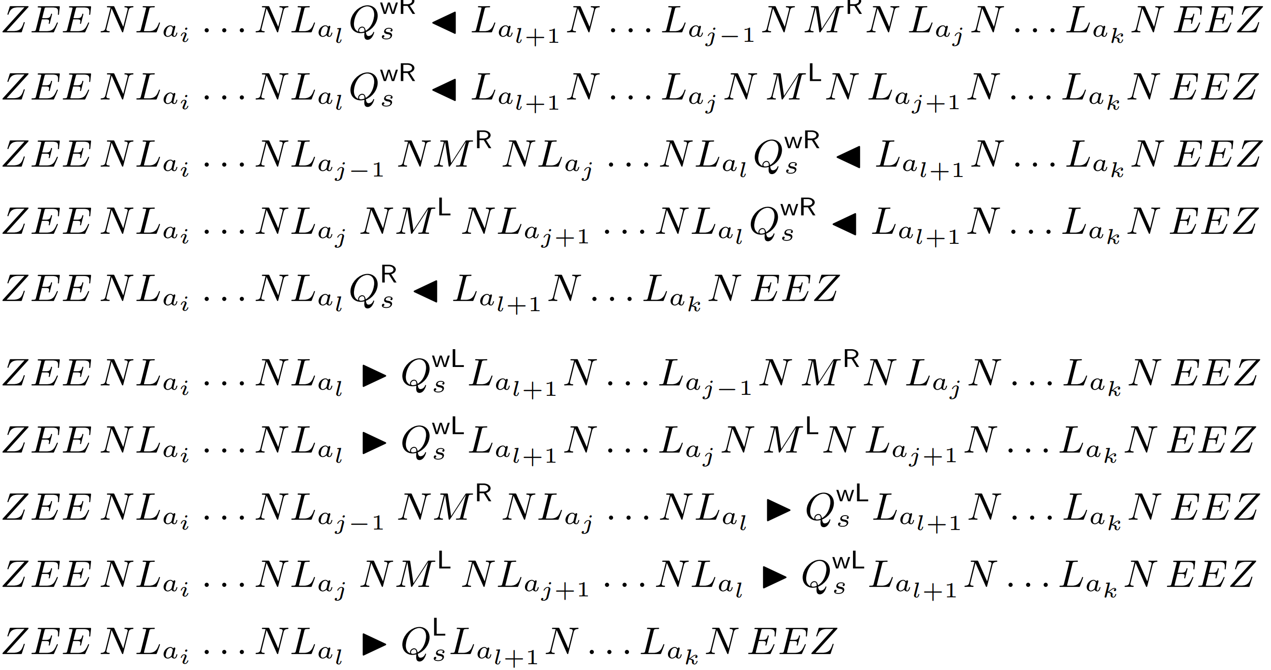
Undecidability Of Single-Instantiation Inheritance
“Java Generics are Turing Complete” by Radu Grigore, 2017

Slide 9
Undecidability of Expansive-Recursive Types
Whole-program implementation of interface-method dispatch:
Every v-table has a table of interface method implementations
Every interface method is assigned an offset within that table
Such that no two methods implemented by the same class have the same offset
If an object has a certain interface type, that guarantees the offsets corresponding to its methods have the expected function types
Interface-method dispatch simply loads appropriate offset and calls it
Key point: every interface has a corresponding structural type
if interface definitions are mutually recursive, so are their structural types

Slide 10
Undecidability of Expansive-Recursive Types
Suppose every interface has a corresponding method
Inputs of method correspond to the contravariant and invariant type parameters
Outputs correspond to the covariant and invariant type parameters
E.g. interface Foo<in I, out O, inv X> { foo : [I, X] → [O, X] }
Suppose every method is given its own index (i.e. no overlapping)
Single-instantiation inheritance ensures inherited methods have unique signature
τ is a nominal subtype of τ’
⇕
Structure of τ is a structural subtype of structure of τ’

Slide 11
Undecidability of Expansive-Recursive Types
(The illustrative example that should have been in the slides to help clarify.)
Hierarchy:
interface Foo<in X> { foo : [X] → [] }
interface Bar<out Y> extends Foo<Foo<Y>> { bar : [] → [Y] }
Interface Baz<Z> extends Bar<Baz<Z>> { baz : [Z] → [Z] }
Structure:
FOO<x> = (struct (struct (func [x] → []) anyref anyref))
BAR<y> = (struct (struct (func [FOO<y>] → []) (func [] → [y]) anyref))
BAZ<z> = (struct (struct (func [FOO<BAZ<z>>] → []) (func [] → [BAZ<z>]) (func [z] → [z]))

Slide 12
Practice of Decidability

Slide 13
Expansive Recursion
Restricting Inheritance
Kennedy and Pierce
Ensures recursion cycles
Used in CLI

Slide 14
Application of Expansive Inheritance
interface Equatable<in T> { bool equals(T that); }
class Integer : Equatable<Integer> { … }
interface List<out E>
: Equatable<List<Equatable<E>>> { … }
Challenge: make covariant lists equatable if their elements are equatable
Expansive inheritance!
Ceylon’s objection: Equatable is meant for constraining types, not values. List<Equatable<…>> is nonsense.

Slide 15
Expansive Recursion
Restricting Inheritance

Slide 16
Material-Shape Separation
Materials
Shapes
List, Integer, Comparator
Variable/Field/Return types
Type arguments
Equatable, Comparable
Recursive Inheritance
Recursive Type Constraints
Higher Kinds
Computable
Joins
No class/interface is both
a material and a shape
13.5 Million Lines of Java Code
Decidable
Subtyping


Slide 17
Conditional Methods and Satisfaction
Shapes can only be used to constrain types
List<Equatable<Integer>> is not a valid type because Equatable<…> is not a type
shape Equatable<in T> { bool equals(T that); }
shape Hashable<in T> extends Equatable<T> { int hash(); }
class Integer satisfies Hashable<Number> { … }
class HashSet<E satisfies Equatable<E>> { … }
interface List<out E>
satisfies Equatable<List<T>> ∀ T <: E where E satisfies Equatable<T> {
bool equals(List<T> that) ∀ T <: E where E satisfies Equatable<T>;
}
“satisfies” constraint ensures structure even though it is not a subtyping constraint
Decidable
Type-safe equality without type recursion

Slide 18
Implications for Structural Types
Key point: every interface has corresponding structural type
if interface definitions are mutually recursive, so are their structural types
Inheritance is irrelevant, so while restricting inheritance makes nominal subtyping decidable, it has no effect on structural subtyping!
Structural subtyping is undecidable for many real-world programs with decidable nominal types

Slide 19
Key Takeaways
Expansive recursion is undecidable
Recursive subtyping definitions are unnecessary
Stratified systems better capture common invariants
Non-subtyping constraints can ensure structure exists

