Slide 1
Stack and Control Primitives
Ross Tate

Slide 2
Key People
Arjun Guha
Andrew Myers
Heejin Ahn
Thomas Lively
Matthew Flatt

Slide 3
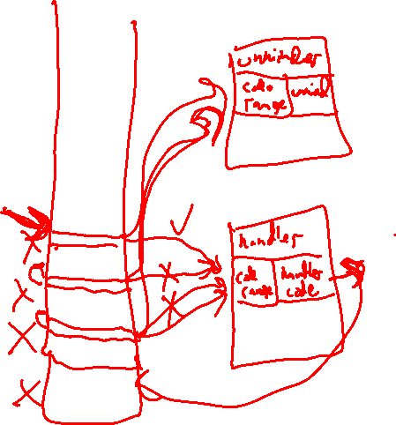
Exception Handling (Conceptually)
Stack Walk
Stack Tag
Invoke Tag
Redirect Control
Stack Unwind

Slide 4
Stack Marking (for GC without Refs)
declare mark gcrooter : [] -> []
void foo() { i32 newref1 = my_gc_alloc(12); i32 newref2 = my_gc_alloc(24); stack.mark gcrooter() { my_add_reachable(newref1); my_add_reachable(newref2); } within { … // do stuff with this mark on stack } }
little to no run-time overhead
using code-address ranges
mark is executable
in general, has params and results
not a first-class reference/value
no heap allocation or mem. management

Slide 5
Stack Walking (for GC without Refs)
void add_roots_on_stack() { stack.walk { while (true) [] { stack.next-mark gcrooter { stack.exec-mark(); } none { break; } [] } } }
stack.walk starts a stack walk
tracks a pointer into stack
initialized to bottom of stack
stack.next-mark walks up stack
must be within stack.walk
looks for a matching mark, e.g. gcrooter
uses “none” upon reaching top of stack
stack.exec-mark executes current mark
must be within stack.next-mark
param and result types from declaration

Slide 6
Stack Tracing
declare mark coderef : [] -> [string, i32] // file name, line #
mark coderef() { result(“Foo.lang”, 55); // not an instruct. } within { … // code that happens on that line }
trace get_stack_trace() { trace t = empty_trace; stack.walk { while (true) [] { stack.next-mark coderef { t = append(t, exec-mark()…); } none { return t; } [] } } }
coderef mark produces results
here coderef is used to get stack trace
traces refer to source code
rather than wasm code
could also be used by a debugger
no new stack primitives for traces

Slide 7
Applications (Without Redirecting Control)
Garbage collection
Stack tracing
Dynamic scoping
Debuggers
Stack-allocated closures
Generators
C# out/ref parameters
Scala’s lazy parameters
Optimized higher-order programming

Slide 8
Redirecting Control (Escape Hatch - Intro)
escape $hatch { … // run the body escape-to(val*) $hatch; // redirect … // more body } hatch(t_{h}*) { … // execute with val if escaped-to } [t_{o}*] // output type of both body & hatch
hatch is only entered if escaped to
val* must have type t_{h}*
similar to block, loop, and if
encodable using block (for now)
but no need for input types for main body
but what about stack unwinding?

Slide 9
Stack Unwinding (Escape Hatch – Full)
mark unwinder : [] -> [];
escape $hatch { … // run the body escape-to(val*) $hatch; // redirect … // more body } unwind unwinder { // [t_{h}*] -> [t_{h}*] stack.exec-mark(); } hatch(t_{h}*) { … // execute after unwinding } [t_{o}*] // output type of both body & hatch
add unwinder marks for unwinding code
e.g. destructors, finally, .NET’s abort
just a convention
unwind clause(s)
specifies a mark
ran on matching marks as stack unwinds
can update the t_{h}* values for the hatch
can have multiple clauses for diff marks
hatch executed after unwinding

Slide 10
Exception Handling
Stack Walk
Stack Tag
Invoke Tag
Redirect Control
Stack Unwind
Erlang
C++
C#
Python

Slide 11
Erlang
try Body of _ -> IfNoThrow catch throw:Thrown -> Handler
throw(thrown)
stack.walk { while (true) { stack.next_mark throw_catcher { stack.exec-mark(e); } // no none! trap/debug at top } }
mark throw_catcher : [eref] -> []
escape $hatch { mark throw_catcher(eref Thrown) { escape-to(Thrown) $hatch; } within { Body } IfNoThrow // executed only if no throw } hatch(eref Thrown) { // no unwind! Handler }

Slide 12
C++
mark cpp_destructor : [] -> []; mark cpp_catcher : [i32] -> []; mark cpp_handler : [] -> [i32];
escape $hatch { stack.mark cpp_catcher(i32 e) { if (rtti_of(i32) == MyException) escape-to(e) $hatch; } within { … // body } } unwind cpp_destructor { stack.exec-mark(); } hatch(i32 e) { mark cpp_handler() { respond(e); } within { … // handler } }
try { … // body } catch (MyException err) { … // handler }
throw e;
function cpp_throw(i32 e) { stack.walk { while (true) { stack.next_mark cpp_catcher { stack.exec-mark(e); } } } }
throw;
stack.walk { stack.next_mark cpp_handler { cpp_throw(stack.exec-mark()); } }

Slide 13
Python
escape $hatch { mark py_finally() { … // unwinder } within { mark py_except(pyexc e, pyref v, pytrace t) { escape-to(e, v, t) $hatch; } within { … // body } … // unwinder } } unwind(pyexc e, pyref v, pytrace t) py_finally { stack.exec-mark(); } unwind(pyexc e, pyref v, pytrace t) py_code_ref { t := add_to_trace(t, stack.exec-mark()); } hatch(pyexc e, pyref v, pytrace t) { mark py_handle() { respond(e, v, t); } within { … // handler } }
try: … // body except: … // handler finally: … // unwinder
mark py_finally : [] -> []; mark py_except : [pyexc pyref pytrace] -> []; mark py_handle : [] -> [pyexc pyref pytrace]; mark py_code_ref : [] -> [pycoderef];
sys.exc_info(); // get caught exception
function sys_exc_info() { stack.walk { stack.next_mark py_handle { return stack.exec-mark(); } } }
raise;
py_throw_with_trace(sys_exc_info())

