Slide 1
Roadmaps
Ross Tate

Slide 2
Developing a Roadmap
Identify Goals
Determine Key Challenges
Design Strategy and Invariants
Stage Releases

Slide 3
Update
Component
Update
Update
Language Runtime
Main
3rd Party
Library
Incremental Compilation
Component
Linking Infrastructure

Slide 4
Developing a Roadmap
Identify Goals
Determine Key Challenges
Design Strategy and Invariants
Stage Releases

Slide 5
How to describe memory layouts?
Type Feature
Space Abstraction?
Prefix Subtyping
Record Subtyping
Nominal Typing
Cannot hide/reorder/change fields of superclasses
Cannot ensure same field is at same offset across references
Works (at least so far)

Slide 6
Improved Reusability
Without Space Abstraction
With Space Abstraction
Module Crypto { void encrypt(i32[] ints,
i32 from, i32 to); }
Not usable by most languages!
Diff languages have diff arrays
Module Crypto { import scheme $i32s with indexed field int : i32; void encrypt((gcref $i32s) ints,
i32 from, i32 to); }
Usable by most languages!
Including linear memory!

Slide 7
How?
Importing Wasm Module
Assembly with missing immediates
Assembly
Cache?
Immediates
Exporting Wasm Module
Module links against same runtime module
⇓
Cache hits
Cache?

Slide 8
Developing a Roadmap
Identify Goals
Determine Key Challenges
Design Strategy and Invariants
Stage Releases
Stage 1:
Export satisfies import only if fields in same order
Compatible with Single-Stage Compilation
Stage 2?
Export/import field order can differ
Requires Two-Stage Compilation if used

Slide 9
Developing a Roadmap
Identify Goals
Determine Key Challenges
Design Strategy and Invariants
Stage Releases
Test Validity

Slide 10
Existing Systems
Industry
Research
JVM
.NET
LISP/Scheme/Racket
LILC+SST
iTalX
jFlint
Nominal
Structural
anyref

Slide 11
Evaluating a Roadmap
Identify Goals
Determine Key Challenges
Design Strategy and Invariants
Stage Releases
Test Validity

Slide 12
Uniform Representation
Claim
functional languages will use funcref for closures
Reality
Many functional languages need examinable closures
E.g. Scheme uses “eq?” to compare function pointers
But funcref is not a subtype of eqref
E.g. Scheme can (optionally) serialize closures
But funcref provides no way to look at closed-over values

Slide 13
Evaluating a Roadmap
Identify Goals
Determine Key Challenges
Design Strategy and Invariants
Stage Releases
Test Validity

Slide 14
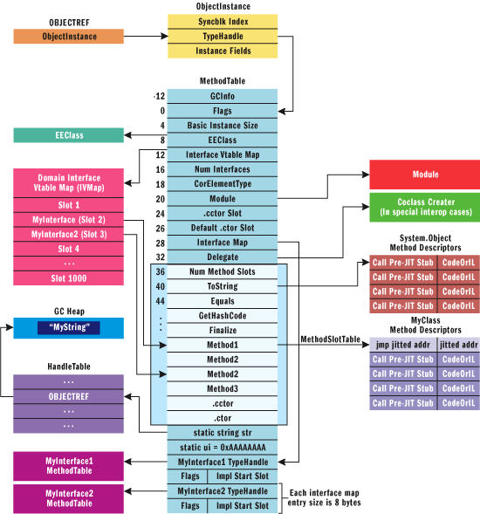
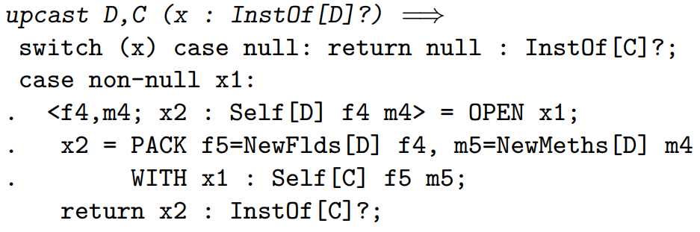
Frequent Efficient Casting
Structural casts
Heavy machinery & unpredictable
Nominally-tagged casts
Might as well use nominal types
Existential types
Burdensome and inexpressive without nominal types

Slide 15
Dynamic Languages
Scheme’s “equal?”
Deep equality
>10 cases
Structural/ Uniform
Cast anyref
>10 times
Nominal/ Specialized
Enumerate cases
Switch table

Slide 16
Evaluating a Roadmap
Identify Goals
Determine Key Challenges
Design Strategy and Invariants
Stage Releases
Test Validity
Unsolved critical challenges

Slide 17
Evaluating a Roadmap
Identify Goals
Determine Key Challenges
Design Strategy and Invariants
Stage Releases
Test Validity
Unsolved critical challenges
Unsolved key challenges
Everyone else went the other way after hitting a dead end
No language encodings
Shipping features with no known uses

