Slide 1

Tuxride Web Enthusiasts’ Club

Slide 2
So, what is MINIMAX algorithm?
Minimax — is a decision rule used in decision theory, game theory, statistics and philosophy for minimizing the possible loss for a worst case (maximum loss) scenario.

Slide 3
Lets consider a game...
To get a basic idea

Slide 4
A/B | B1 | B2 | B3
A1 | 4 | -2 | 3
A2 | 6 | 0 | -4
A3 | 3 | -1 | 5
So you start off first,
You have to maximize your gain knowing that the opponent is smart enough

Slide 5
Well done !!!
You Loose 1 $

Slide 6
MAXIMIZER: The player in the game who tries to maximize the payoff.
MINIMIZER: The player in the game who tries to minimize the payoff.
You were the MAXIMIZER and your friend the MINIMIZER.
The set of all possible moves taken by the MAXIMIZER and the MINIMIZER defines a game tree

Slide 7
-1
A1
A2
A3
3
-1
5
4
-2
3
6
0
-4

Slide 8
Now if the depth of the tree is d and at each move there are b choices then, the total number of terminal or leaf nodes is b^{d}
In the previous game there were 3² = 9
leaves.

Slide 9
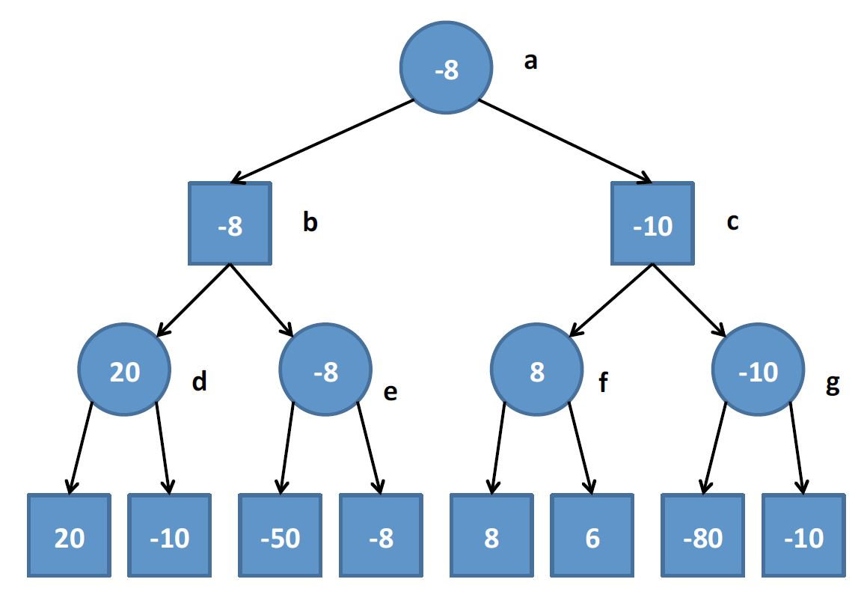
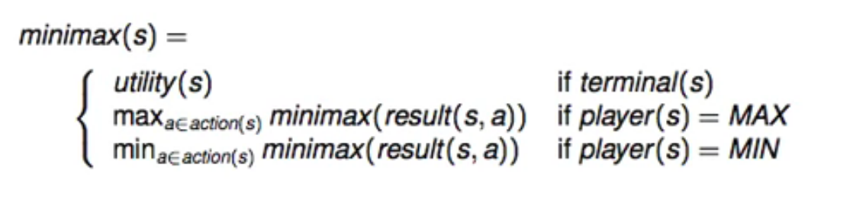
MAX
MIN
MAX
TERMINAL

Slide 10
How Are the values at each
node calculated?

Slide 11
Each node has a value that is calculated using static evaluation functions for the given game
Let f1, f2, f3...fn be the features of the state of the game,
then g(n) = c1.f1 + c2.f2 + c3.f3 ... + cn.fn
is the value of this function at that state.
Eg. For the game of chess it can be,
g(n) = c1 * material + c2 * mobility + c3 * king safety + c4 * center control + ...

Slide 12
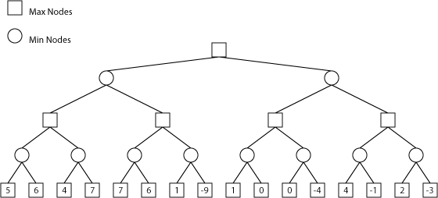

Slide 13
5
5
4

Slide 14
5
6
5
6
1
4

Slide 15
5
6
0
5
6
1
0
-4
4

Slide 16
5
6
0
-1
5
6
1
0
-4
-1
-3
4

Slide 17
5
-1
5
6
0
-1
5
6
1
0
-4
-1
-3
4

Slide 18
5
5
-1
5
6
0
-1
5
6
1
0
-4
-1
-3
4

Slide 19
In the game of chess the number of branches that a tree can have is roughly around 12-14, and the number of moves the game can go for is around 100,
Which is around 10¹²⁰ !!!
So instead of going in depth, we go level by level, and reach as far as possible depending on the computational resources we have.

