Slide 1
AJAP
What is AJAP?

Slide 2
A Joint Approach Project
A simple jQuery plug-in that lets high level computer users keep track of their learning on their own dashboard or blog so that they are motivated to keep learning even if they turned off their email notifications for each school

Slide 3
Who can use?
for you if you: study code
for you if you: have a blog or a personal website
for you if you: like to show off your accomplishments
for you if you: turned off email notifications
for you if you: want to keep track of your learning
for you if you: WANT to be a high level user

Slide 4
who can use? (cont’d)
not for everybody
better power up!

Slide 5
How to…
What you need to do
Involves simple cutting and pasting of code from InsigniaWebsite to
Simple customizations fro enhanced visusalisation. You can customize the plug-in background and color

Slide 6
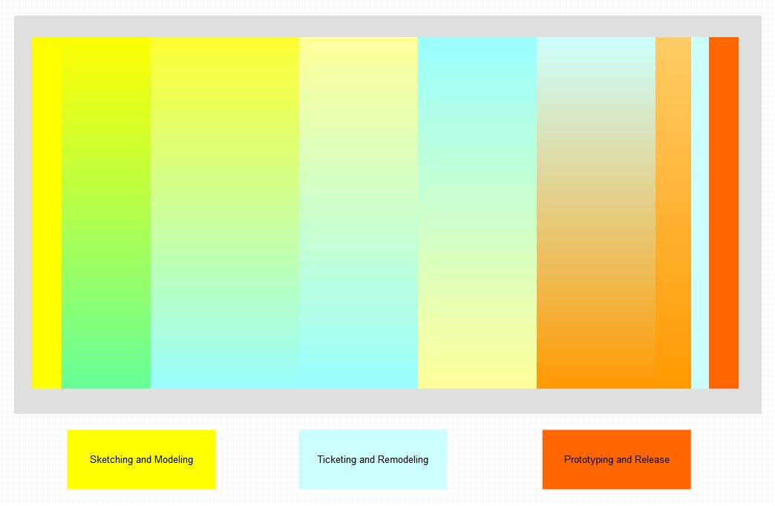
Thought Process (ideal)

Slide 7
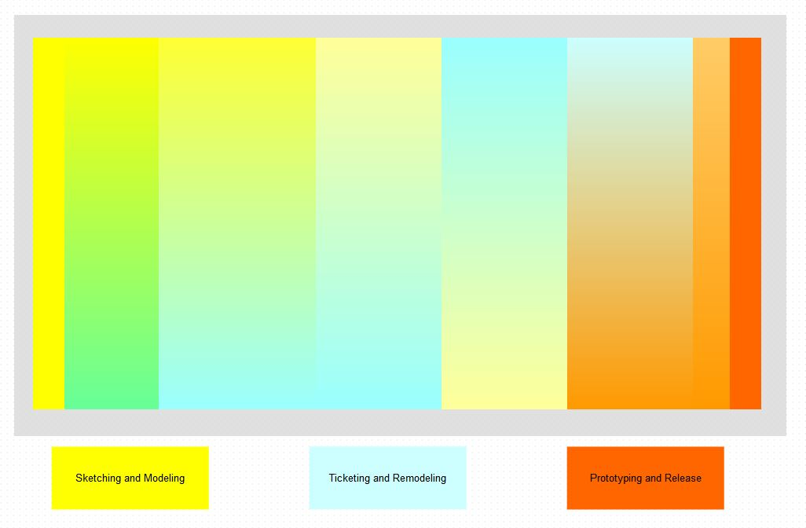
Thought Process (deadline)

