Slide 1

School of Electronics Engineering (SENSE)
Project-I (2026)
Smart Glove for Real-Time Sign Language to Speech Translation
Student Name(s):
V A Sri Harsha – 23BLC1024, Samarth Sudeep Jagtap – 23BLC1033, Pavan U Kulkarni – 23BLC1038
Guide's Signature with Date
Guide:
Dr. Venkatesan C, SENSE
Signature: _____________________
Programme / School:
B.Tech — SENSE, VIT Chennai
Date: _________________________
Review & Date:
Review-II · 30.09.2026 (Wednesday)
Approval is mandatory before every review. After signing, scan this slide and keep the scanned copy as Slide 1 of the presentation.
1

Slide 2
Introduction & Problem Recap
Problem recap
Existing glove systems classify one letter or gesture at a time, with a deliberate pause around it; natural signing has no pauses and no segment boundaries (co-articulation).
Real sentences mix fingerspelled names with whole-sign words freely, so the model must infer which mode it is in from the raw stream alone.
There is no public continuous, multi-signer flex + IMU corpus for ASL, so glove results are not reproducible or comparable across groups.
Reported accuracy is usually isolated-gesture and signer-dependent; the drop under continuous, signer-independent conditions is rarely published.
Core problem: turn an unsegmented 11-channel sensor stream into a correct English sentence, for a signer the model has never seen.
Objectives
Build reproducible hardware: 5 flex sensors + MPU-6050 + ESP32 glove with open BOM, wiring diagram, calibration routine and firmware.
Collect a continuous, multi-signer ASL dataset as raw flex + IMU, with isolated and sentence-level subsets and signer-disjoint splits.
Train a segmentation-free CNN → BiLSTM → CTC model that labels the whole stream with no hand-marked sign boundaries.
Decode mixed fingerspelling and lexical signs via lexicon-constrained beam search over one shared output vocabulary.
Convert gloss to fluent English: rule-based reordering baseline, then T5 / mBART fine-tuned on ASLG-PC12 if time allows.
Evaluate honestly: WER and BLEU on signer-independent splits, with isolated-gesture accuracy compared explicitly against continuous accuracy.
Refinements after Review-I feedback
Vocabulary fixed to a closed, realistic set — the 26 fingerspelled letters plus 20–40 lexical signs — rather than open-vocabulary ASL.
Per-signer calibration added to the capture pipeline after flex-sensor baseline drift was observed between wearers and across sessions.
Acquisition standardised to a fixed sampling rate with timestamped 11-channel frames, so windows are reproducible across recording sessions.
Recording protocol formalised before collection: scripted sentences for coverage plus free-form signing for natural co-articulation.
2

Slide 3
Detailed Literature Review
No. | Author(s) & Year | Title / Source | Method / Approach | Findings & Research Gap
1 | Zhang, Wang, Zhao & Yu (2019) | MyoSign: End-to-End Sign Language Recognition with Wearables — Proc. ACM IUI '19 | Myo armband (forearm EMG + IMU); multimodal CNN → BiLSTM trained end-to-end with CTC loss | 93.7% word and 93.1% sentence accuracy without manual segmentation. Gap: forearm EMG cannot resolve per-finger configuration; no fingerspelling mode.
2 | Zhang, Jing, Wang & Zhao (2022) | WearSign: Pushing the Limit of Sign Language Translation — Proc. ACM IMWUT, 6(1) | Encoder–decoder with intermediate gloss supervision over inertial + EMG wearables | Closes the gap between sensor signal and spoken-language grammar. Gap: same armband modality limitation; decoding overhead is heavy for an embedded target.
3 | PenSLR (2024) | PenSLR: Persian End-to-End Sign Language Recognition Using Ensembling — arXiv:2406.16388 | Glove with 5 flex sensors + 1 IMU; multi-model ensemble decoded with CTC, no pre-segmentation | Validates that 5 flex + 1 IMU carries enough information for continuous CTC decoding. Gap: Persian Sign Language, word level only, no fingerspelling channel.
4 | SpellRing (2025) | SpellRing: Recognizing Continuous Fingerspelling in ASL Using a Ring — arXiv:2502.10830 | Thumb-worn ring, acoustic sensing + IMU, CTC continuous decoding | 82.45% top-1 word accuracy over a 1,164-word set; CTC generalises to fingerspelling. Gap: fingerspelling only, no lexical-sign vocabulary.
5 | Nguyen Ngoc, Truong, Nguyen Duong, Nguyen & Phung (2026) | Multimodal Smart Glove for Sign Language Recognition Using Deep Learning — arXiv:2607.06996 | Glove with flex sensors + IMU plus a face camera; LSTM classifier deployed via TensorFlow Lite | Reports ~95% accuracy on an isolated-gesture set with on-device inference. Gap: isolated words only, no continuous decoding, and the camera reintroduces lighting and privacy constraints.
6 | IoT Assistive Glove (2024) | IoT-Enabled Assistive Glove for Real-Time Sign Language Translation — Int. J. Innovations in Science & Technology | 5 flex sensors + MPU-6050 on an Arduino Nano, CNN–RNN hybrid, results streamed over Wi-Fi | Demonstrates a low-cost wireless assistive glove pipeline. Gap: isolated ASL gestures only; no CTC, so the signer must pause between signs.
Themes: (a) end-to-end continuous recognition with CTC, (b) glove-based finger-level sensing, (c) fingerspelling-specific recognition.
3

Slide 4
Detailed Literature Review (contd.)
No. | Author(s) & Year | Title / Source | Method / Approach | Findings & Research Gap
7 | Wu, Sun & Jafari (2016) | A Wearable System for Recognizing ASL in Real-Time Using IMU and sEMG — IEEE J. Biomed. Health Informatics, 20(5) | Fusion of inertial and surface-EMG features with classical classifiers on a 80-sign vocabulary | Established that IMU + sEMG fusion outperforms either modality alone in real time. Gap: isolated signs, small vocabulary, signer-dependent evaluation.
8 | Ji, Wang, Miao, Fan & Ru (2023) | Dataglove for Sign Language Recognition via Wearable Inertial Sensors — Sensors, 23(15), 6693 | Purely inertial dataglove (no flex sensors) with deep classification of gesture segments | Shows inertial-only sensing can separate many gestures. Gap: without flex channels, handshapes with similar motion but different finger configuration are confusable; no continuous decoding.
9 | Hall-Effect Sensor Glove (2026) | Multi-Purpose Low-Cost Hall-Effect Sensor Glove for Sign Language Recognition — arXiv:2601.11539 | Magnetic Hall-effect transduction of joint angle in place of resistive flex sensors | Documents mechanical degradation of resistive ink under repeated bending as a reliability limit. Gap: still isolated-gesture level; motivates a calibration routine in our own flex-based design.
10 | Feng, Zhou, Huang, Luo & Wu (2023) | Design and Implementation of Gesture Recognition System Based on Flex Sensors — IEEE Sensors J., 23(24) | Flex-sensor circuit design, voltage-divider conditioning and gesture classification | Provides the signal-conditioning reference for our own voltage-divider front end. Gap: hardware-focused; no sequence modelling or sentence-level recognition.
11 | Wen, Zhang, He & Lee (2021) | AI-Enabled Sign Language Recognition and VR Bidirectional Communication Using Triboelectric Smart Glove — Nature Communications, 12, 5378 | Self-powered triboelectric sensing glove with deep-learning recognition and a VR interface | Explicitly frames single-gesture recognition as insufficient for daily communication. Gap: sentence-level recognition from a glove remains open.
12 | Umut & Kumdereli (2024) | Novel Wearable System to Recognize Sign Language in Real Time — Sensors, 24(14), 4613 | Real-time wearable recognition system evaluated across multiple signers | Reports the accuracy drop when the system meets signers outside the training set. Gap: confirms signer-independent evaluation is the weak point of the field.
Continued — glove and alternative-sensing literature that informs our hardware choice and its known failure mode.
4

Slide 5
Detailed Literature Review (contd.)
No. | Author(s) & Year | Title / Source | Method / Approach | Findings & Research Gap
13 | Khan, Jin, Lee, Arzu, Dang, Nguyen, Choi & Moon (2025) | Deep Learning Approaches for Continuous Sign Language Recognition: A Comprehensive Review | Survey of continuous SLR architectures, alignment losses and evaluation protocols | Confirms CTC and encoder–decoder alignment as the standard approaches for unsegmented input. Gap: the surveyed continuous work is overwhelmingly vision-based, not glove-based.
14 | Chen, Yao & Hung (2026) | Real-Time Sign Language Interpretation via Customized Sign Language Gloves and Motion Retrieval | Customised sensing glove with motion-retrieval matching for real-time interpretation | Demonstrates low-latency interpretation from a custom glove. Gap: retrieval against stored templates does not model co-articulation in continuous signing.
15 | Valarmathi, Ghousiya Begum & Manoj (2026) | Wearable Glove: Sign Language Interpretation With AI-Enabled Finger-Mounted Sensors | Finger-mounted sensor array with an AI classification stage for interpretation | Reinforces finger-level sensing as the right granularity for handshape. Gap: interpretation reported at gesture level, without a mixed fingerspelling and lexical vocabulary.
16 | Graves, Fernández, Gomez & Schmidhuber (2006) | Connectionist Temporal Classification — Proc. ICML '06 | CTC loss for labelling unsegmented sequence data with recurrent networks | The foundational method our pipeline depends on: removes the need for frame-level alignment. Included as the methodological basis rather than as a recent result.
17 | Raffel, Shazeer, Roberts et al. (2020) | Exploring the Limits of Transfer Learning with a Unified Text-to-Text Transformer — JMLR, 21(140) | T5 text-to-text transformer pretraining and fine-tuning framework | Basis for the planned gloss-to-English stage fine-tuned on ASLG-PC12. Gap: not sign-specific; gloss-to-English for ASL remains low-resource.
Research gaps identified: no glove system decodes lexical signs and fingerspelling in one vocabulary; no public continuous multi-signer flex + IMU corpus exists; signer-independent accuracy is rarely reported.
5

Slide 6
System Design & Architecture
ON-GLOVE — BUILT AND STREAMING
5 × Flex sensors
one per finger · voltage divider → ADC
ESP32
samples all 11 channels
fixed rate + timestamps
Host capture
serial / BLE stream
labelling utility
Dataset
26 letters + 20–40 words
raw 11-channel frames
MPU-6050 IMU
6-axis accel + gyro · I2C
MODEL AND DECODING — REMAINING WORK
Preprocessing
calibration, filtering,
normalisation, windows
1-D CNN
local handshape and
motion features
BiLSTM + CTC
bidirectional context,
no frame labels
Beam search
lexicon trie over one
shared vocabulary
Gloss → English
rule-based, then
T5 / mBART
Example — “my name is Maya” → unsegmented 11-channel stream → CTC gloss ME NAME M-A-Y-A → “My name is Maya.”
Green blocks are complete and validated at this review; grey blocks are the remaining 25%. The blank token in CTC absorbs transitions and co-articulation, so no sign boundaries are hand-marked.
6
Notes:
Insert your architecture / block diagram here.

Slide 7
Implementation Details
Modules developed and integrated
Sensing module — five resistive flex sensors in voltage-divider configuration, one per finger, plus an MPU-6050 mounted on the back of the hand; both fixed to the glove with custom mounts.
Firmware module (ESP32) — ADC sampling of the five flex channels and I2C acquisition of six IMU axes, merged into a single timestamped 11-channel frame at a fixed sampling rate.
Streaming module — serial / BLE transmission of frames to the host with no dropped or reordered frames observed over sustained recording sessions.
Host capture and labelling utility (Python) — records a stream, tags it with the class being signed, and writes raw sensor values, timestamps and labels to disk.
Dataset builder — organises recorded sessions into per-class folders with a manifest, ready for windowing and signer-disjoint splitting.
Algorithms implemented
Per-signer calibration — open-hand and closed-fist reference poses captured at session start; each flex channel is min–max normalised against its own baseline to absorb wearer and mounting variation.
Signal conditioning — moving-average smoothing on the flex channels and gravity-component handling on the accelerometer before normalisation.
Fixed-rate framing — timestamp-driven sampling loop so that window length in samples corresponds to a known duration, making windows reproducible across sessions.
Sliding-window segmentation — overlapping windows over the 11-channel stream, prepared as the input tensor format the CNN front end expects.
Label encoding — the 26 fingerspelled letters and the recorded lexical signs are mapped into one shared output vocabulary, so a single CTC output layer can emit either mode.
Model training (CNN → BiLSTM → CTC), lexicon-constrained beam search and the gloss-to-English stage are specified and scaffolded but not yet trained — see Challenges & Remaining Work.
7

Slide 8
Implementation Details (contd.)
ESP32 firmware — fixed-rate 11-channel acquisition
Host-side preprocessing and shared vocabulary
const uint8_t FLEX[5] = {32, 33, 34, 35, 36};
const uint32_t PERIOD_US = 10000; // 100 Hz fixed rate
uint32_t next_us;
void loop() {
uint16_t flex[5];
for (uint8_t i = 0; i < 5; i++)
flex[i] = analogRead(FLEX[i]); // per-finger bend
int16_t ax, ay, az, gx, gy, gz;
mpu.getMotion6(&ax, &ay, &az, &gx, &gy, &gz); // 6-axis IMU over I2C
Serial.printf("%lu,%u,%u,%u,%u,%u,%d,%d,%d,%d,%d,%d\n",
micros(), flex[0], flex[1], flex[2], flex[3], flex[4],
ax, ay, az, gx, gy, gz); // timestamped 11-channel frame
next_us += PERIOD_US; // drift-free scheduling
while ((int32_t)(micros() - next_us) < 0) { }
}
def calibrate(flex, lo, hi):
"""Min-max normalisation from open/closed reference poses."""
return np.clip((flex - lo) / (hi - lo + 1e-6), 0.0, 1.0)
def windows(frames, win=100, hop=25):
"""Overlapping windows over the 11-channel stream."""
for s in range(0, len(frames) - win + 1, hop):
yield frames[s:s + win] # shape (win, 11)
# one shared vocabulary: blank + 26 letters + lexical signs
VOCAB = ["<blank>"] + list(string.ascii_uppercase) + LEXICAL_SIGNS
stoi = {tok: i for i, tok in enumerate(VOCAB)}
Why these two pieces matter
Drift-free scheduling on the ESP32 keeps the sampling interval constant, so a window of N samples always represents the same duration — without this, CTC sees inconsistent time scales between sessions.
Per-signer calibration is what makes signer-independent evaluation possible later: raw flex values differ between wearers, normalised values do not.
A single shared vocabulary with one CTC blank token is the mechanism that lets the model emit a letter or a whole sign from the same output layer.
8

Slide 9
Results & Analysis (75%)
11 / 11
Channels streaming (5 flex + 6 IMU)
26
Fingerspelled letter classes recorded
20–40
Lexical sign classes recorded
75%
Of planned work complete
Dataset collected
Acquisition validated
Subset | Classes | Status
Fingerspelled alphabet | 26 letters (A–Z) | Recorded
Lexical signs | 20–40 whole-sign words | Recorded
Continuous sentences | Mixed letter + sign utterances | Protocol defined, collection in progress
Signer coverage | Multiple signers, signer-disjoint splits | Splits defined, not yet frozen
All five flex channels respond monotonically to joint bend, with clearly separated value bands between the fully open and fully closed positions.
The MPU-6050 returns six axes over I2C in the same frame as the flex values, giving hand orientation and motion alongside handshape.
Frames arrive at a constant rate with monotonic timestamps; no dropped or reordered frames were observed across sustained recording sessions.
Static handshapes produce visually repeatable multi-channel signatures across repetitions and across sessions after calibration.
Per-signer calibration removes the baseline offset seen between wearers, so the same handshape maps to a similar normalised vector.
Exact sample counts, repetitions per class and total recording duration are read from the capture manifest and inserted here before the review.
9
Notes:
Add your results here — graphs, tables, screenshots or outputs.

Slide 10
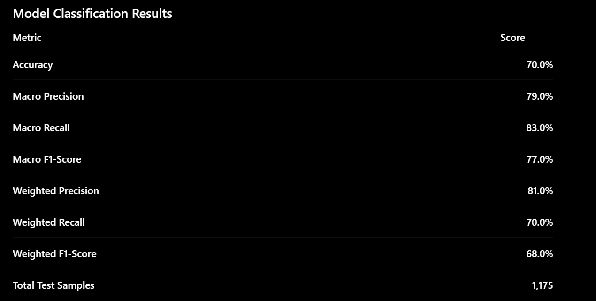
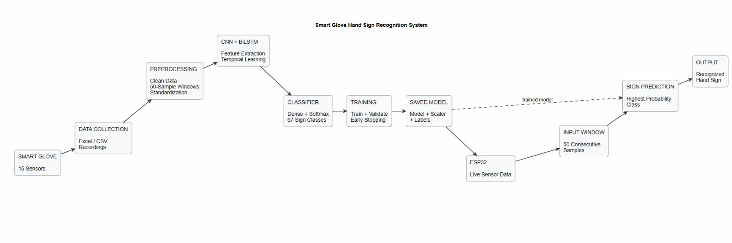
Results & Analysis (contd.)
Analysis at this stage
What these results establish: the sensing and capture layer is reliable enough to train on — channels are responsive, separable by handshape, stable across sessions, and consistently timed.
What they do not establish: no recognition accuracy is claimed yet. WER on continuous sentences, BLEU on gloss-to-English output, and the isolated-versus-continuous gap all require the trained model.
Those three numbers are the headline deliverables for Review-III; reporting them honestly, including the drop on unseen signers, is a stated objective of this project.
10
Notes:
Add your results here — graphs, tables, screenshots or outputs.

Slide 11
Challenges & Remaining Work
Challenges faced and solutions
Flex-sensor baseline drift — raw resistance varied between wearers and between sessions as the glove shifted. Solution: an open-hand / closed-fist calibration captured at the start of every session, with each channel min–max normalised against its own baseline.
Mechanical fragility of the resistive strips — documented in the literature as ink degradation under repeated bending. Solution: strain-relieved mounts so the sensor bends along its rated axis, plus a periodic recalibration check; sensor lifetime testing is planned.
Inconsistent sampling interval — a naive delay-based loop produced variable frame spacing, which would make windows represent different durations. Solution: drift-free timestamped scheduling in firmware at a fixed rate.
Noise on the analog channels — ADC readings jittered on long cable runs. Solution: shortened and secured wiring, stable supply, and moving-average smoothing before normalisation.
Labelling continuous recordings — there are no sign boundaries to mark in natural signing. Solution: the CTC formulation removes the requirement; only the utterance-level gloss sequence is recorded, not frame-level labels.
Remaining work (25%)
Complete the continuous sentence subset and freeze the signer-disjoint train / dev / test splits.
Train the CNN → BiLSTM → CTC model on the collected corpus, with augmentation (time warping, sensor noise, per-signer scaling) and hyperparameter search on dev signers.
Implement lexicon-constrained beam search over the shared vocabulary so fingerspelled runs resolve to valid words and names.
Build the gloss-to-English stage: rule-based reordering baseline, with T5 / mBART on ASLG-PC12 as a stretch goal.
Evaluate: WER and BLEU on signer-independent splits, plus the explicit isolated-versus-continuous comparison; assemble the demo and report.
Timeline for completion by Review-III (28.10.2026)
Week 1 (30 Sep – 06 Oct): finish continuous sentence recordings, freeze splits, publish the dataset manifest.
Weeks 2–3 (07 – 20 Oct): model training and tuning; first WER numbers on the dev signers.
Week 4 (21 – 27 Oct): constrained decoding, gloss-to-English baseline, signer-independent evaluation, demo and report.
Critical path: the continuous sentence subset. Training cannot start until those recordings and their gloss transcripts are complete.
11

Slide 12
References
[1] Q. Zhang, D. Wang, R. Zhao, and Y. Yu, “MyoSign: Enabling end-to-end sign language recognition with wearables,” in Proc. 24th Int. Conf. Intelligent User Interfaces (IUI), Marina del Rey, CA, USA, 2019, pp. 650–660.
[2] Q. Zhang, J. Jing, D. Wang, and R. Zhao, “WearSign: Pushing the limit of sign language translation using inertial and EMG wearables,” Proc. ACM Interact. Mob. Wearable Ubiquitous Technol., vol. 6, no. 1, pp. 1–27, 2022.
[3] “PenSLR: Persian end-to-end sign language recognition using ensembling,” arXiv:2406.16388, 2024.
[4] “SpellRing: Recognizing continuous fingerspelling in American Sign Language using a ring,” arXiv:2502.10830, 2025.
[5] A. T. Nguyen Ngoc, T. P. Truong, T. A. Nguyen Duong, V. L. Nguyen, and M. D. Phung, “Multimodal smart glove for sign language recognition using deep learning,” arXiv:2607.06996, 2026.
[6] “IoT-enabled assistive glove for real-time sign language translation using machine learning,” Int. J. Innovations Sci. Technol., 2024.
[7] J. Wu, L. Sun, and R. Jafari, “A wearable system for recognizing American Sign Language in real-time using IMU and surface EMG sensors,” IEEE J. Biomed. Health Inform., vol. 20, no. 5, pp. 1281–1290, 2016.
[8] A. Ji, Y. Wang, X. Miao, T. Fan, and B. Ru, “Dataglove for sign language recognition of people with hearing and speech impairment via wearable inertial sensors,” Sensors, vol. 23, no. 15, art. 6693, 2023.
[9] “Design and implementation of a multi-purpose low-cost Hall-effect sensor glove for sign language recognition,” arXiv:2601.11539, 2026.
IEEE format. All references above are cited in the Detailed Literature Review slides.
12

Slide 13
References (contd.)
[10] D. Feng, C. Zhou, J. Huang, G. Luo, and X. Wu, “Design and implementation of gesture recognition system based on flex sensors,” IEEE Sensors J., vol. 23, no. 24, pp. 31389–31398, 2023.
[11] F. Wen, Z. Zhang, T. He, and C. Lee, “AI enabled sign language recognition and VR space bidirectional communication using triboelectric smart glove,” Nature Communications, vol. 12, art. 5378, 2021.
[12] İ. Umut and Ü. C. Kumdereli, “Novel wearable system to recognize sign language in real time,” Sensors, vol. 24, no. 14, art. 4613, 2024.
[13] A. Khan, S. Jin, G.-H. Lee, G. Arzu, M. Dang, T. Nguyen, W. Choi, and H. Moon, “Deep learning approaches for continuous sign language recognition: A comprehensive review,” 2025.
[14] C.-H. Chen, C.-Y. Yao, and S.-H. Hung, “Real-time sign language interpretation via customized sign language gloves and motion retrieval,” 2026.
[15] R. Valarmathi, K. Ghousiya Begum, and R. D. Manoj, “Wearable glove: Sign language interpretation with AI-enabled finger-mounted sensors,” 2026.
[16] A. Graves, S. Fernández, F. Gomez, and J. Schmidhuber, “Connectionist temporal classification: Labelling unsegmented sequence data with recurrent neural networks,” in Proc. 23rd Int. Conf. Machine Learning (ICML), Pittsburgh, PA, USA, 2006, pp. 369–376.
[17] C. Raffel, N. Shazeer, A. Roberts, et al., “Exploring the limits of transfer learning with a unified text-to-text transformer,” J. Mach. Learn. Res., vol. 21, no. 140, pp. 1–67, 2020.
References [16] and [17] are methodological foundations (CTC loss and the T5 framework) rather than recent sign-language results.
13

Slide 14
Thank You
Project-I (2026) · SENSE · VIT Chennai
14

