Slide 1
BUILDING OUR DATABASE
We’ve dreamt it, now let’s build it…

Slide 2
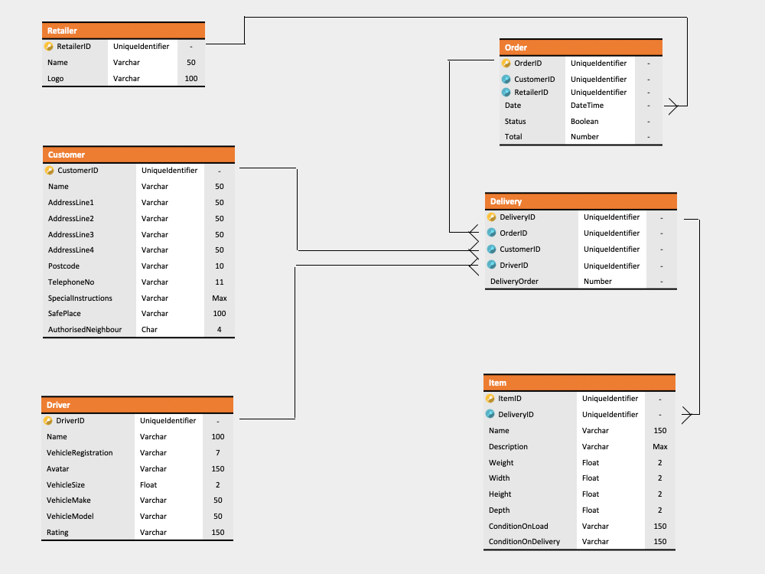
Here’s One We Made Earlier…

Slide 3
Let’s Look a Little Bit Closer
Take a closer look at our smallest Entity
Remember:
Entities are Tables
Properties are Columns
Volumes are Sizes
Our Retailer Table has 3 Columns: RetailerID, Name(50) & Logo(100) and our RetailerID is our Primary Key

Slide 4

Creating Our Physical Database
First we need the container which stores our tables, columns and rows
This is going to be our first Query
CREATE DATABASE DatabaseName;
That’s all there is to it!

Slide 5
Creating Our First Table
Now we have our Database Container we can think about creating our Tables
CREATE TABLE TableName (
IDColumn type NOT NULL PRIMARY KEY,
Column1 type,
Column2 type
);
So let’s see how that’s done with our Retailer Entity

Slide 6
Creating Our Retailer Table
Looking back at our Retailer Table, we only need 3 Columns:
CREATE TABLE Retailer (
RetailerID uniqueidentifier NOT NULL PRIMARY KEY,
Name varchar(50),
Logo varchar(100)
);
Now you can see your Retailer Table under the Tables folder in your management studio

Slide 7

CHALLENGE TIME!
Connect to your Database Server and create your Database
Using your Physical Model, create the rest of the tables from your model in your Azure Database
For bonus points, research another way you can add a Primary Key to a table using SQL
Share a screenshot of your created database and tables on our Discord Channel

