Slide 1
INTRODUCTION
What to learn

Slide 2
What are we doing today?
Pre-Requisites
HTML 101
A Little Bit of SASS
JavaScript Basics
Visual Studio Code

Slide 3
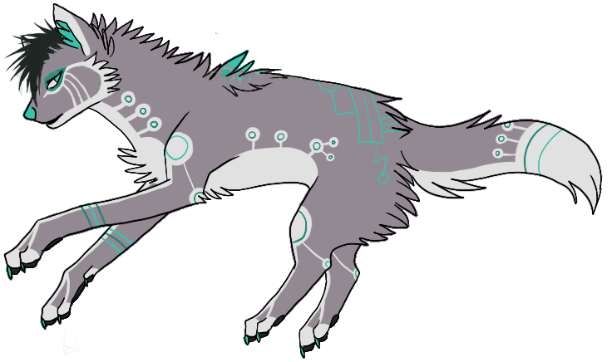
Need help?
Github:
http://www.github.com/webdevelopwolf/training
Twitter:
http://www.twitter.com/webdevelopwolf
Facebook:
http://www.facebook.com/webdevwolf
Slack Board:
http://webdevelopwolf.slack.com

Slide 4
PRE-REQUISITES
Arm yourself!

Slide 5
WHAT DO WE NEED TO HIT THE GROUND RUNNING?
An understanding of HTML
A little bit of SASS and a pinch of CSS
A cup of JavaScript
A sprinkling of Visual Studio Code

Slide 6
WEB DESIGN 101
It all starts here…

Slide 7

What is HMTL?
Hyper Text Mark-up Language
Structure of a webpage or document

Slide 8

Talking about Structure…
Think about a car – all cars are built on a similar structure. Elements can be moved and resized but this is always the same. Ultimately it needs a frame, engine bay and 4 wheels.
Engine Bay > Heading
Frame > Content
Wheels > Footer

Slide 9
Talking about Structure…
Yet to make the car more attractive and more functional we add parts to it, we’ll call these attributes. These are things like lights, windows, trim, paint etc. They are not essential to the forward motion of the car. Each one has its own set of customisations
Lights: Style (Angel Eye)
Paint: Colour (Orange)
Windows: Tint (50%)

Slide 10
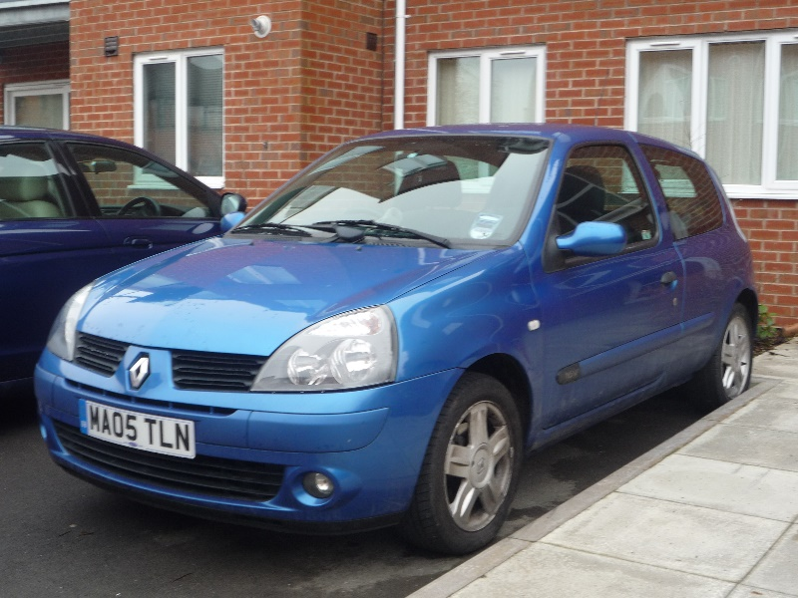
So Let’s Build a Car
Car (Clio)
Lights: Eagle Eye
Mirrors: Square
Paint: Blue
Windows: 0%
Number Plate: Standard

Slide 11
So Back To The HTML…
Lets pretend we are building our car using HTML. What would we start with? For now lets just focus on the frame.
All the structural parts of our car start out as tags as HTML is made up of a set of tags. And tags have two parts a start <tag> and an end </tag>.
<Frame></Frame> - Here’s or basic frame, but this is boring and will not sell, so we add in our attributes.
<Frame mirrors windows></Frame> - But it’s still a bit bland, so we mix in some properties.
<Frame mirrors=“chrome” windows=“50%”></Frame> - Now we have an interesting frame for our car.
Finally we put what matters the most in our car, the whole reason it was built in the first place …people!
<Frame mirrors=“chrome” windows=“50%”>People</Frame>
That’s the basics of HTML!

Slide 12
CSS & SASS
Lets get Sassy…

Slide 13

What is CSS?
Cascading Style Sheets
CSS separates the way our page is structured from how our page looks
Let’s take a look at the magic of CSS with my website…

Slide 14
So, How Does This Relate To Our Car?
<Frame mirrors=“chrome” windows=“50%”>People</Frame>
Can you imagine typing all this out over and over again?
What if there was a way we could save a template of our designs, applying them to multiple cars?
That what classes are for!

Slide 15
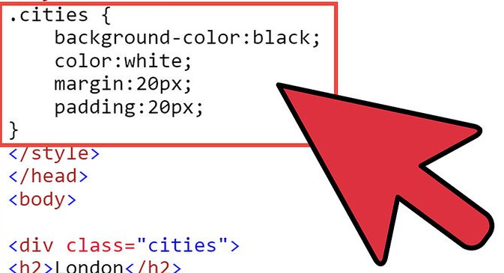
CSS Classes
In our dedicated CSS document:
.blue-car {color: blue;}
Note: We always use US spelling for CSS
In HTML document:
<tag class=“blue-car”>car</tag>
Now we can make several blue cars but only write the car’s properties once – it’s mass manufacturing for the web world!

Slide 16
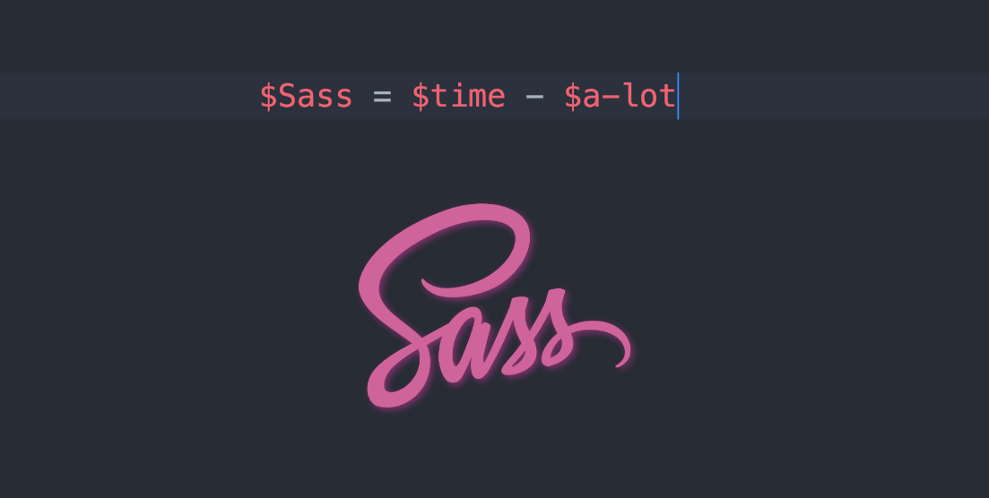
Cool! But What About SASS?
Sass (Syntactically awesome style sheets) is a style sheet language.
Sass extends the functionality of CSS and makes style sheets programmatical
This means we can save even more time when writing our page’s styles
We’ll go into how, what, why and where later in the course when we start to talk about Ionic

Slide 17
JAVASCRIPT
Making it all work…

Slide 18
Going back to our car…
This time we’re going to talk about the car’s engine. JavaScript.
JavaScript is the programming language of HTML and the Web.
JavaScript is easy to learn and once you know JavaScript, C# should come more naturally as they have a similar syntax.

Slide 19
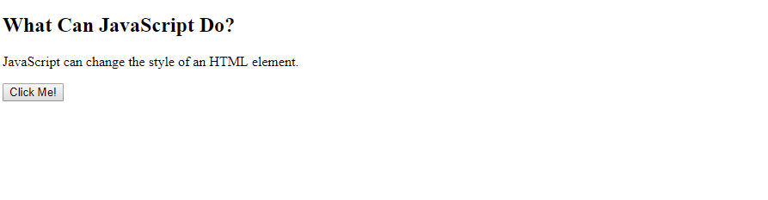
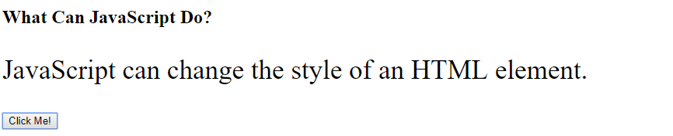
JavaScript Can Change HTML Content
document.getElementById('demo').innerHTML = 'Hello World’;
If we had a tag with an ‘id’ of ‘demo’…
<tag id=“demo”></tag>
Without JavaScript, nothing would be displayed on the screen.
With JavaScript enabled we now see…
Hello World
innerHTML is a function that injects our text into the tag programmatically
We can even use these functions to change properties too…
document.getElementById("demo").style.fontSize = "35px";
This function changes the size our font…
Hello World

Slide 20
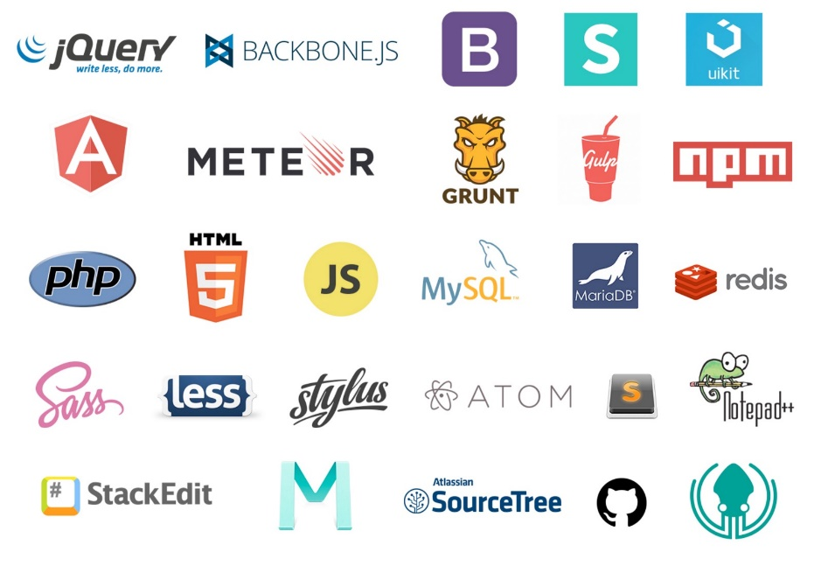
JavaScript Libraries
All the functions in JavaScript all combined are defined as a Library.
This library can be extended using other libraries such as:
jQuery
Ionic
Angular
Etc.
And that’s our JS basics!
You’ll see more JS as we progress through the course…

Slide 21
VISUAL STUDIO CODE
Our first app-building tool…

Slide 22
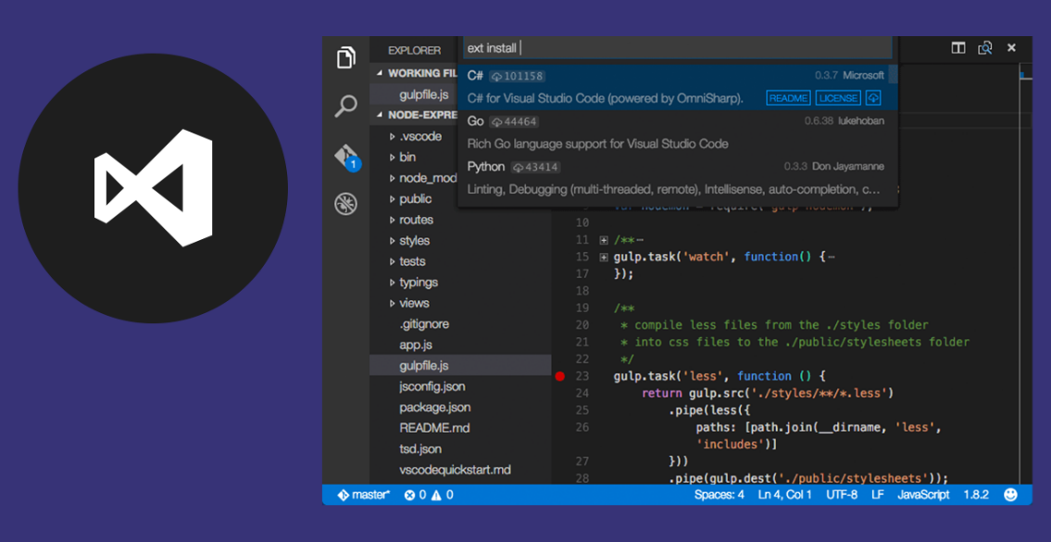
What is Visual Studio Code?
Code Editing. Redefined.
“Visual Studio Code combines the simplicity of a source code editor with powerful developer tooling, like IntelliSense code completion and debugging.”
Why can’t I just use notepad?
Well you can…but lets see how much time you can save with VS Code with a little tour…

Slide 23
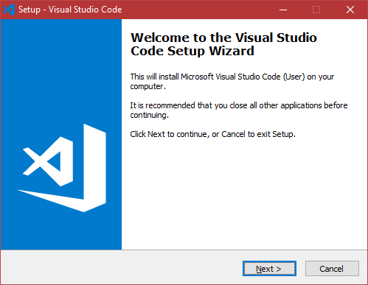
Installing Visual Studio Code
Like what you see? Let’s get it installed!
Visit http://code.visualstudio.com
Click ‘Download for Windows’ (or macOS is working on a MacBook or iMac)
Double-Click the install file
Follow the instructions
That’s it! Let’s go through it together though…

Slide 24
WHAT DID WE LEARN THIS TIME?
What HTML is
Why we need CSS (and SASS)
How JavaScript drives us forward
How awesome Visual Studio Code is!

Slide 25
CHALLENGE TIME!
Go ahead and read-up on HTML, CSS and JavaScript (a great place to start is W3Schools).
For bonus points, make your first webpage!

Slide 26
Need help?
Github:
http://www.github.com/webdevelopwolf/training
Twitter:
http://www.twitter.com/webdevelopwolf
Facebook:
http://www.facebook.com/webdevwolf
Slack Board:
http://webdevelopwolf.slack.com

Slide 27
Next Section…
We’ll take a look at how to plan your application step-by-step, so when you dive in and start coding you’ll feel like a pro!

