Slide 1
Master Detail View
am Beispiel von open dolphin

Slide 2
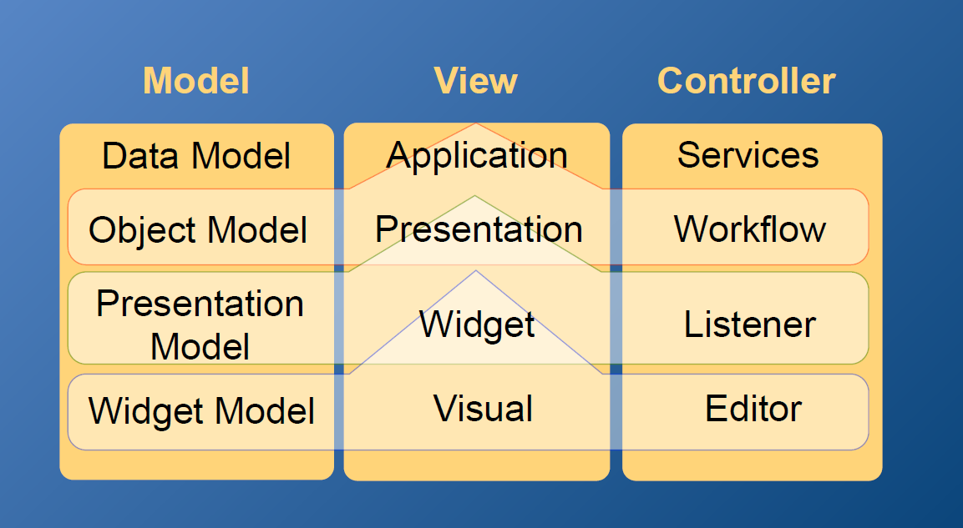
Ausgangslage

Slide 3





Concept
Client
Server
View
Controller
Model
Model
shared Model

Slide 4


Concept
ping
Client
Server
View
Controller
bind
bind
Model
Model
Notes:
Views can only "ping" the controller

Slide 5
Models
represent the current object (education)
private ClientPresentationModel educationProxy
get the attribute of the current object (name of the education)
educationProxy.getAt(
EducationAtt.EDUCATION_NAME.toString()
)
Notes:
ClientPresentationModel user =
clientDolphin.presentationModel(
CURRENT_USER, USER,
new ClientAttribute(NAME),
new ClientAttribute(FIRST_NAME),
new ClientAttribute(PERSNR)
);

Slide 6
Ping
Controller: init
subscribeToCommand(EducationCommands.SAVE, this::saveOnUserRequest);
View: ping
saveButton.setOnAction($
-> clientDolphin.send(EducationCommands.SAVE));
Controller: save
protected synchronized void saveOnUserRequest() { service.update(dtos, CREATED_PMS, DELETED_PMS); }

Slide 7
«MVC»
Client
Server
EVENTBUS
View
Controller
Model
Model
Client
Server
View
Controller
Model
Model
Client
Server
View
Controller
Model
Model

