Slide 1
Angular
Services

Slide 2
Services
We might come across a situation where we need some code to be used everywhere on the page. It can be for data connection that needs to be shared across components, etc. Services help us achieve that. With services, we can access methods and properties across other components in the entire project
To create a service.
ng g service ServiceName

Slide 3
Services
step1
To create a service.
ng g service UserService
Step 2 in AppModule.ts
import{UserService} from './user.service';
providers: [UserService],

Slide 4

Services

Slide 5
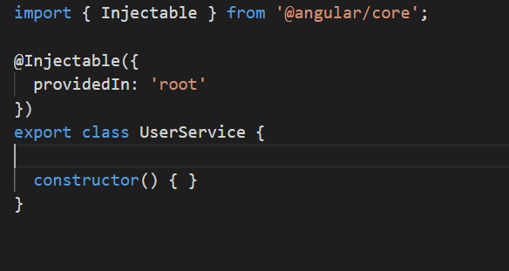
Services

Slide 6
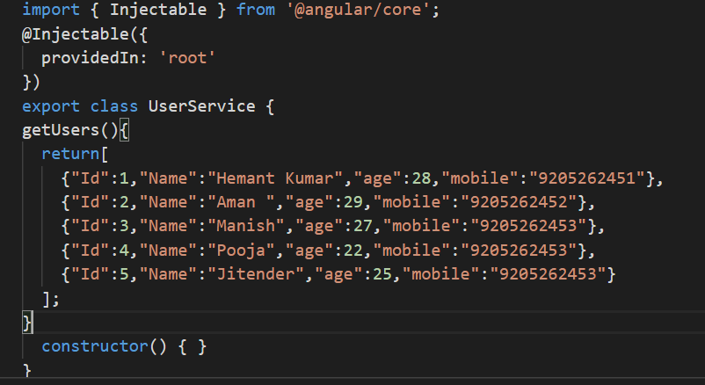
Services

Slide 7
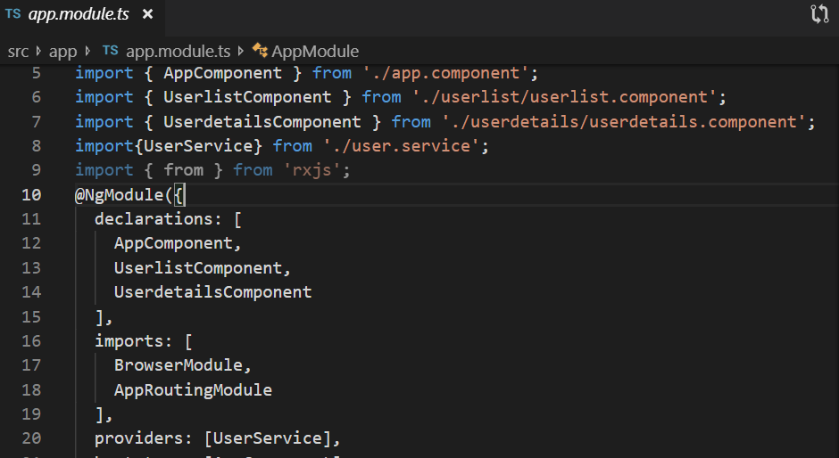
Services

Slide 8
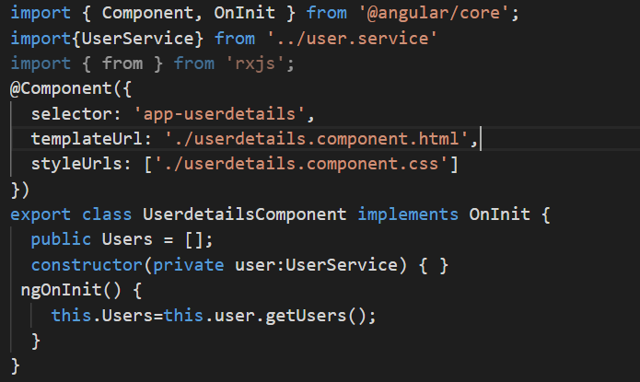
Services

Slide 9
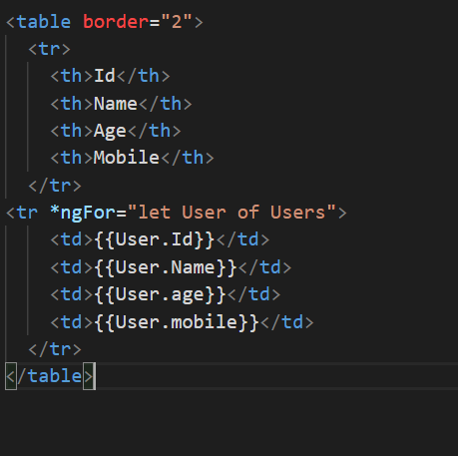
Services

Slide 10
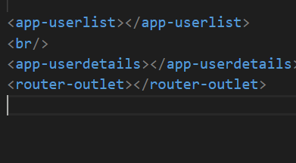
Services

