Slide 1


{Group 12}: {2048 Game}
{enrong}, {Jiaming}, {Kosi}, {Sameer}
* in alphabetical order

Slide 2
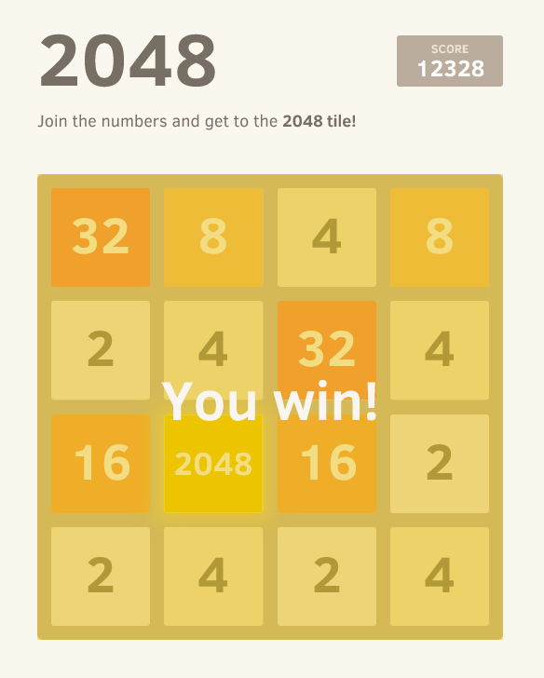
Summary
The idea of the game of 2048 is that you move and merge tiles with equivalent values to generate tiles with larger values. The grid on which you can move the tile is a 4 * 4 grid. Every time you can move in one of the four directions: up, down, left, right. Once a tile with value 2048 is being created, you win; if there is a deadlock, which means there are no possible ways to further make a move or merge, you lose the game. We would like to model the logic behind this game.
2048 (video game) - Wikipedia

Slide 3
Propositions
location (tile, loc): tile t is at location loc, the location is where on the board that things exist
adjacent(tile, orientation): check if there are adjacent tiles near t*
empty (tile, orientation): check if adjacent places are empty
is_empty (loc): check if a location loc is empty
can_merge (tile, orientation): check if the tile can merge
row_can_move (row): check if at least 1 move can be made in that row
column_can_move (column): check if at least 1 move can be made in that column
able_2_move (tile, orientation): check if at least 1 move can be made on the given orientation
random (loc): after a move, a random new tile is generated at an location
get (nextTile, orientation): check the next tile in the given orientation, if the next tile is of the same value, return true
row_or_column_can_move(orientation): check if a row or column can move

Slide 4
Constraints
No two tiles can be put to the same location. For tiles t1 and t2 with location loc:
¬ location(t1, loc) \/ ¬ location(t2, loc)
If a move can be made and there the next tile in the given orientation is as of the same value. then they can merge.
get (tile, orientation) /\ able_2_move (orientation)→ can_merge (tile, orientation)
no new tile can be generated on a not empty location
¬ is_empty (loc) → ¬ random (loc)
If the next tile in the given orientation is as of the same value, if the next tile in the direction is empty, then we can move.
get (nextTile, orientation) \/ empty (tile, orientation) → able_to_move (tile, orientation)
If at least 1 out of 4 tiles on the same row or column (depending on the orientation of movement, i.e. we use row if move left/right, use column if move up/down) can move, we are able to make at least 1 move in that orientation
able_to_move (t1, orientation) \/ able_to_move (t2, orientation) \/ able_to_move (t3, orientation) \/ able_to_move (t4, orientation) → row_or_column_can_move (orientation)
Only 1 tile is generated randomly amoung the all the empty locations.
IDK how to write it

Slide 5
End

