Slide 1

Proxy Stub Generator
OVERVIEW

Slide 2
Proxy Stub Generator
A proxy stub code generator for WPEFramework that uses C++ interface header files as input.
Main features:
generates proxy/stub code for single or multiple interface files
stubs handle proxy creation for interfaces passed/returned by pointer
POD types passed/returned by value or reference are decomposed
for older C++ compilers code may be generated with limited C++11 keyword set
ensures interface IDs are unique and correct
notifies of nonconformities in interface definitions
easily maintainable as built with Python 2.x

Slide 3
Proxy Stub Generator – Command Line
usage: StubGenerator.py [-h] [--help-tags] [--version] [-i FILE] [--scan-ids]
[--namespace NS] [--indent SIZE] [--traces]
[--old-cpp] [--no-warnings] [--keep] [--verbose]
[path [path ...]]
Generate proxy stub code out of interface header files.
positional arguments:
path Interface file(s) or a directory(ies) with interface files
optional arguments:
-h, --help show this help message and exit
--help-tags show help on supported source code tags and exit
--version display version
-i FILE include a C++ header file (default: include 'default.h')
--scan-ids scan interface IDs and exit
--namespace NS set namespace to look for interfaces in (default: ::WPEFramework::Exchange)
--indent SIZE set code indentation in spaces (default: 4)
--traces emit traces in generated proxy/stub code (default: no extra traces)
--old-cpp do not emit some C++11 keywords (default: emit modern C++ code)
--no-warnings suppress all warnings (default: show warnings)
--keep keep incomplete files (default: remove partially generated files)
--verbose enable verbose output (default: verbose output disabled)

Slide 4
Proxy Stub Generator – Example Usage
Generate proxy stubs for IComposition interface
$ ./StubGenerator.py /WPEFramework/Source/interfaces/IComposition.h
Generate proxy stubs for all plugin interfaces, with 4-space indentation
$ ./StubGenerator.py /WPEFramework/Source/interfaces/ --indent 4
Generate proxy stubs for IOCDM interface (look for classes in OCDM namespace)
$ ./StubGenerator.py /WPEFramework/Source/ocdm/IOCDM.h --namespace ::OCDM

Slide 5
Proxy Stub Generator – Special Tags
Special tags can be added to the interface header to control the behaviour of the Proxy Stub
Generator:
// @stubgen:skip
Stop parsing the file. Use for skipping of unwanted files or if the tool has issues with parsing the code.
// @stubgen:omit
Omit code generation for the next class or method.
// @stubgen:stub
Only emit empty stubs for the next class or method. Use to fill in the bodies manually.

Slide 6
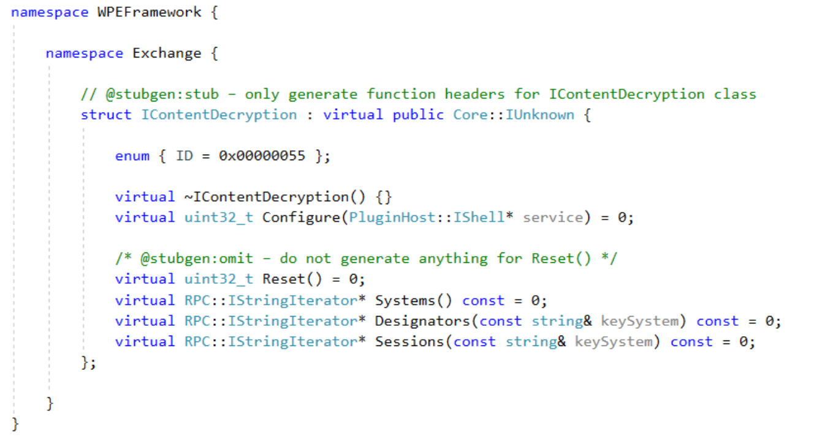
Proxy Stub Generator – Special Tags (cont.)

Slide 7
Proxy Stub Generator – Output parameters
The Proxy Stub Generator supports passing return values via parameters, either by a reference (primitives, C++ strings, PODs, interface pointers) or a pointer (primitives, PODs, buffers/arrays). Thus when passing a non-const pointer or non-const reference parameters additional tag are required:
/* @in */
Specifies an input buffer. (As if the parameter was a const pointer.)
/* @out */
Specifies an output buffer.
/* @inout */ or /* @in @out */
Specifies an input/output buffer.
/* @length:expression */
Specifies the length for the buffer. Needs to be either another parameter, a constant value,
or an expression. Expressions must be enclosed in parentheses. If the expression is void then the sizeof of the type is used instead. (e.g. bufferSize, 256, (bufferSize*4), (width*height), void, etc.)

Slide 8
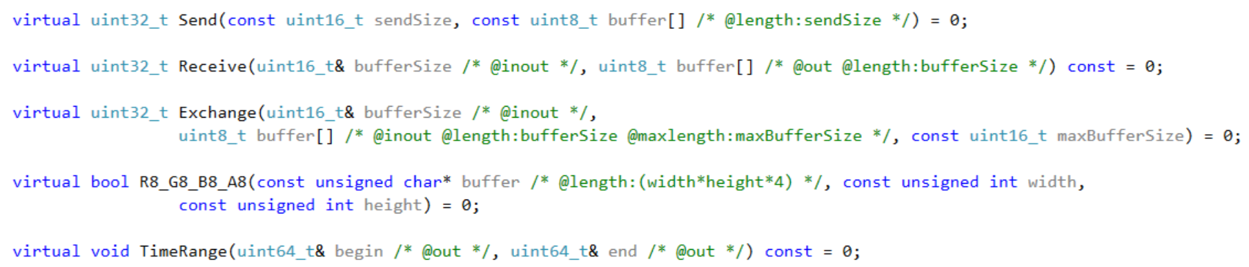
Proxy Stub Generator – Output parameters
/* @maxlength:expression */
For input/output buffers: specifies the maximum length for the buffer. If @maxlength is omitted then @length is used instead. Same rules apply as for @length.
Note: Pointers to interfaces do not require @in / @out tags as they are always input parameters. Returning
interfaces by parameter can be achieved by using a reference to pointer.
Note: C-style strings require explicit @length tags.
Examples:

Slide 9
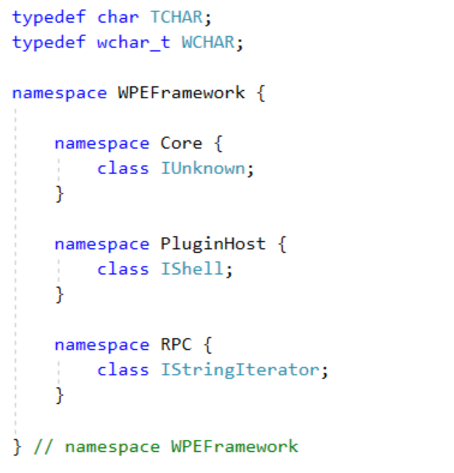
Proxy Stub Generator – Automatic Includes
Each parsed header file is automatically prepended with the following files:
Ids.h – if present in the same directory as the parsed header file
default.h – if present in the same directory as the Proxy Stub Generator (changeable via command line) – holds default definitions that may be required to successfully scan
interface headers without the need of parsing STL or WPEFramework core, for example:

Slide 10
Proxy Stub Generator – Limitations
Relevant C++ features that are not handled by the C++ parser:
pre-processor directives are skipped altogether
template declarations are not analysed
pointer to pointer types, multi-dimensional arrays, arrays of pointers, rvalue references
using namespace directive, using declarations (e.g. using Base::Method)
lambda functions
decltype definitions
alignment specifiers (e.g. alignas)
alternative operators (e.g. compl for ~)
bitfields

Slide 11
Proxy Stub Generator – Troubleshooting
If in trouble, consider the following:
only pure-virtual methods from classes that inherit from Iunknown directly and include an
un-scoped ID enumerator will be taken into account for stub generation
when scanning a directory only files matching I*.h pattern will be parsed (excluding Ids.h)
use --verbose and --keep switches
invoke ./CppParser directly on an interface to dump the parsed data tree

