Slide 1

JSON Generator
OVERVIEW

Slide 2
JSON Generator
A code and documentation generator for WPEFramework JSON-RPC interfaces.
As input the generator uses JSON files describing the plugins and their APIs. The source JSON files shall
fulfil predefined JSON schemas.
Main features:
generates C++ classes defining data structures exchanged during JSON-RPC calls
generates C++ convenience code:
endpoint and property registration code
endpoint and property function prototypes and stubs
notification methods
property getter and setter methods
enum registration macros
generates complete documentation for JSON-RPC interfaces and plugins in Markdown format
easily maintainable (built with Python 2.x)

Slide 3
JSON Generator – Command Line
usage: JsonGenerator.py [-h] [--version] [-d] [-c] [-s] [-i DIR] [-o DIR]
[--indent SIZE] [--copy-ctor] [--no-ref-names]
[--def-string STRING] [--def-int-size SIZE]
[--no-warnings]
[path [path ...]]
Generate JSON C++ classes, stub code and API documentation from JSON definition files.
positional arguments:
path JSON file(s)
optional arguments:
-h, --help show this help message and exit
--version display version
-d, --docs generate documentation
-c, --code generate JSON classes
-s, --stubs generate JSON-RPC stub code
-i DIR, --ifdir DIR for ’interface’ directive, a directory with API interfaces (default: same
directory as source file)
-o DIR, --output DIR output directory (default: output in the same directory as the source json)
--indent SIZE code indentation in spaces (default: 4)
--copy-ctor always emit a copy constructor and assignment operator for a class
(default: emit only when it appears to be needed)
--no-ref-names do not derive class names from $refs (default: derive class names from $ref)
--def-string STRING default string initialisation (default: "")
--def-int-size SIZE default integer size in bits (default: 32)
--no-warnings suppress style/wording warnings (default: show all warnings)

Slide 4
JSON Generator – Example Usage
Generate documenatation for WebKitBrowser plugin (all JSON files in same directory)
$ ./JsonGenerator.py --docs WebKitBrowserPlugin.json
Generate documenatation for WebKitBrowser plugin, specifying interface directory (typical use case)
$ ./JsonGenerator.py –i /WPEFramework/Source/interfaces/json
--docs /WPEFrameworkPlugins/WebKitBrowser/WebKitBrowserPlugin.json
Generate JSON-RPC data structures and code stubs for WebKitBrowser
$ ./JsonGenerator.py --data --stubs WebKitBrowserAPI.json

Slide 5
JSON Generator – JSON Schemas
The following JSON schemas describe how the input JSON files are structured:
schemas/interface.schema.json
Describes interface definitions (methods, properties, events).
schemas/plugin.schema.json
Describes plugin documentation.
(For methods, properties and events documentation it shall refer to the interface schema.)
The schemas are based on JSON Schema draft 7.

Slide 6
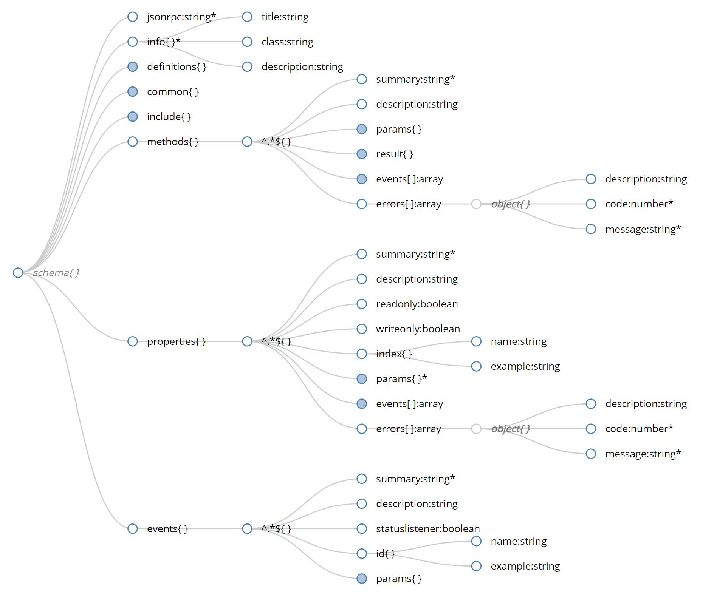
JSON Generator – Interface Schema

Slide 7
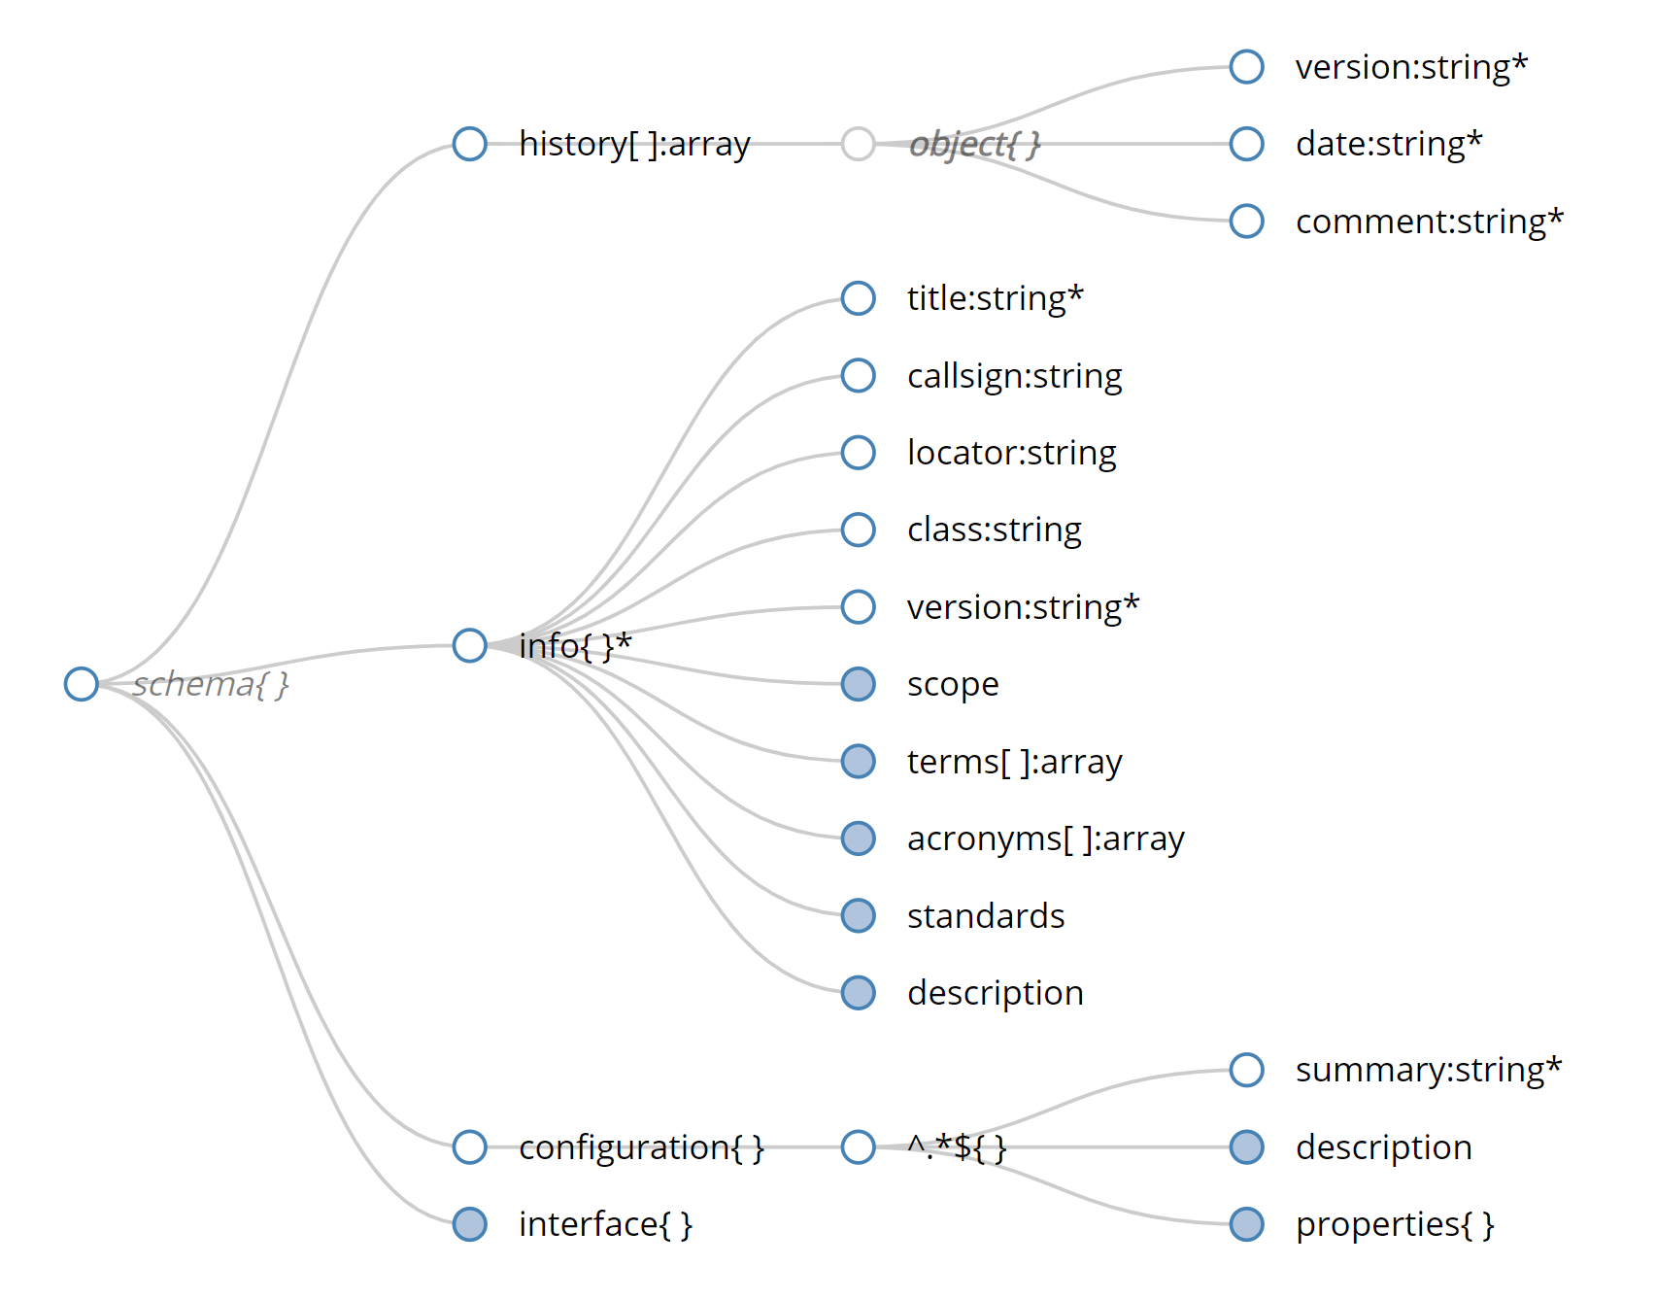
JSON Generator – Plugin Schema

Slide 8
JSON Generator – Describing Objects
Supported JSON Schema attributes of an object property:
type – type of the property (mandatory):
string, number (integer only), integer (same as number), array, object, null
variadic type (anyOf) and floating-point numbers are not supported
description – short description of the property
default – default value if the property is optional
enum – an array, denotes the property as an enum and lists the enumerators
required – lists properties that are not optional
Additional, non-JSON Schema attributes used by the generator:
class – override class name to replace the deduced name in the source code
enumvals – for integer enums: an array allowing specifing the enumerator values
example – example value (used in documentation samples only)
size – for integers: size in bits of the source integer variable (default is 32 for uint32_t)
signed – for integers: a boolean specifying if the source variable is signed (default is false)
optional – a boolean forcing the attribute to be optional

Slide 9
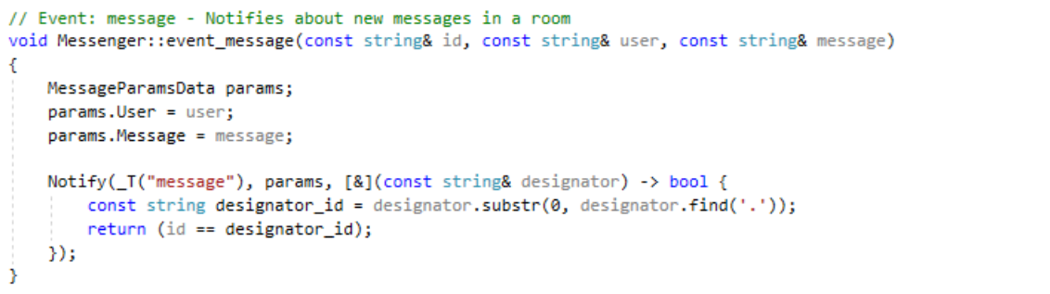
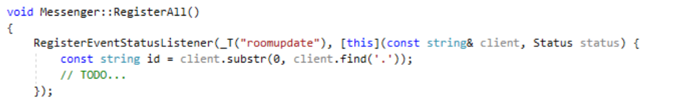
JSON Generator – Events
Extra attributes for event handling:
id (object) – if defined, the method will include an id parameter for event filtering
statuslistener (boolean) – if set to true, event status registration will be emitted

Slide 10
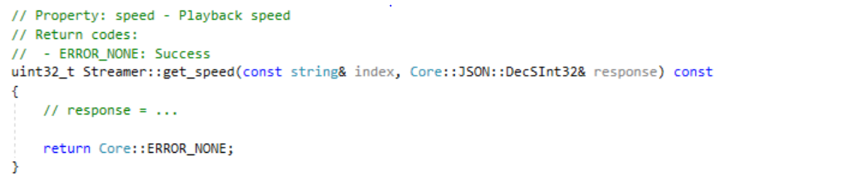
JSON Generator – Properties
Extra attributes for property handling:
index (object) – if defined, the method will include an index parameter for child properties
readonly, writeonly (boolean) – if set to true, the property will be a read or write only, with only a getter or seter emitted

Slide 11
JSON Generator – Commons
In order to reduce code duplication and ease mainatance, the JSON files shall make use of $ref
links wherever possible.
The following JSON files are used to hold items that are common across interfaces and plugins:
json/common.json
Holds a pool of items for inclusion in interface defitions (e.g. error codes, results, etc).
json/document.json
Holds a pool of items for inclusion in documentation descriptions (terms, references, etc).
global.json
Holds common documentation sections that are always included in the plugin documentation
(e.g. common abbreviations, terms, etc).

Slide 12
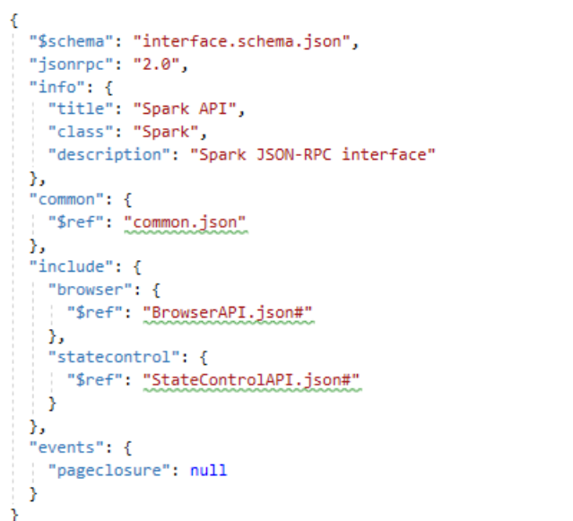
JSON Generator – API Definition Reuse
If an interface is inheriting or aggregating another interface, its JSON file can be reused by adding a special tag:
include – an object listing $ref’s to other JSON-RPC interface files
The documentation and code will be adjusted accoringly (also with extra commentary).

Slide 13
JSON Generator – Typical Workflow
Create a JSON file with JSON-RPC interfaces, i.e. with methods, properties and events
Create a JSON file with plugin description, configuration, etc.
refer to the JSON-RPC interfaces for methods, properties and events definitions
Use the tool to generate data structures and stub code for the interface
*JsonRpc.cpp – stub and convenience code
JsonData_*.h – API data structers, move to interfaces/json
Move the generated endpoint prototypes to the class definition that implements the functionality
Call the generated RegisterAll and UnregisterAll methods from ctor and dtor of the class
If applicable, move the enum registration code to interfaces/json/Interface.cpp
Fill in the generated endpoint and property stubs
Call the generated event methods from the appropriate callbacks, notifications, etc
Use the tool generate documentation for the plugin (an *.md file is generated)

Slide 14
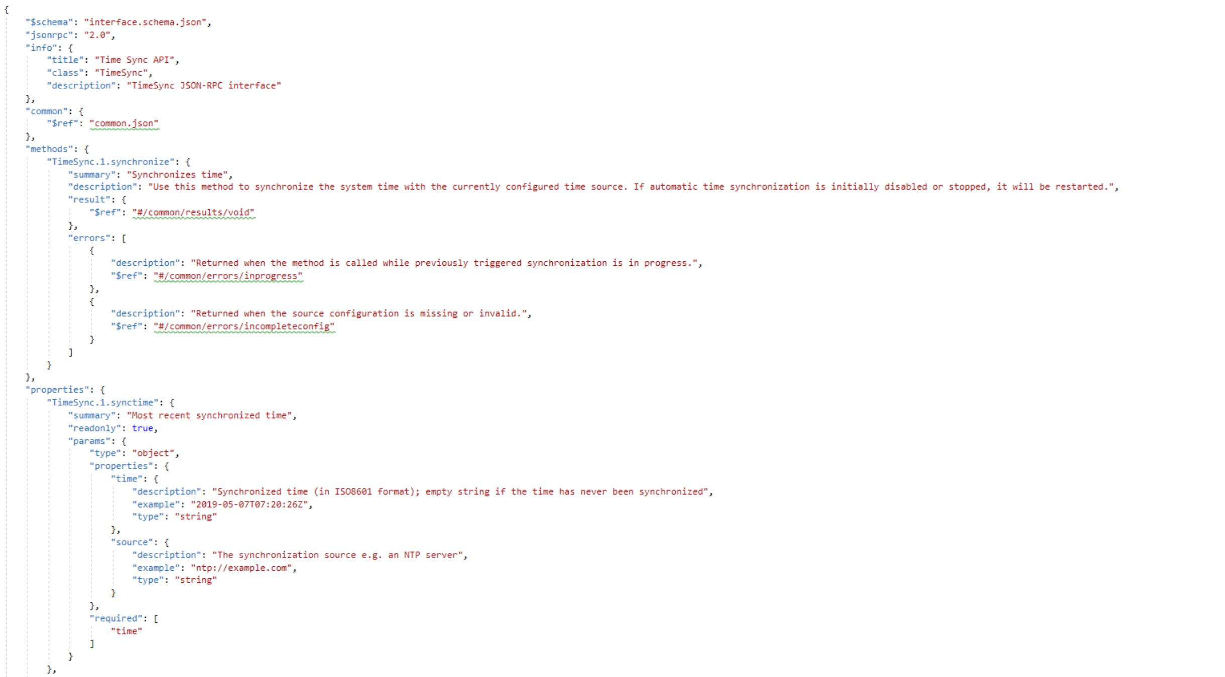
JSON Generator – Sample Interface JSON

Slide 15
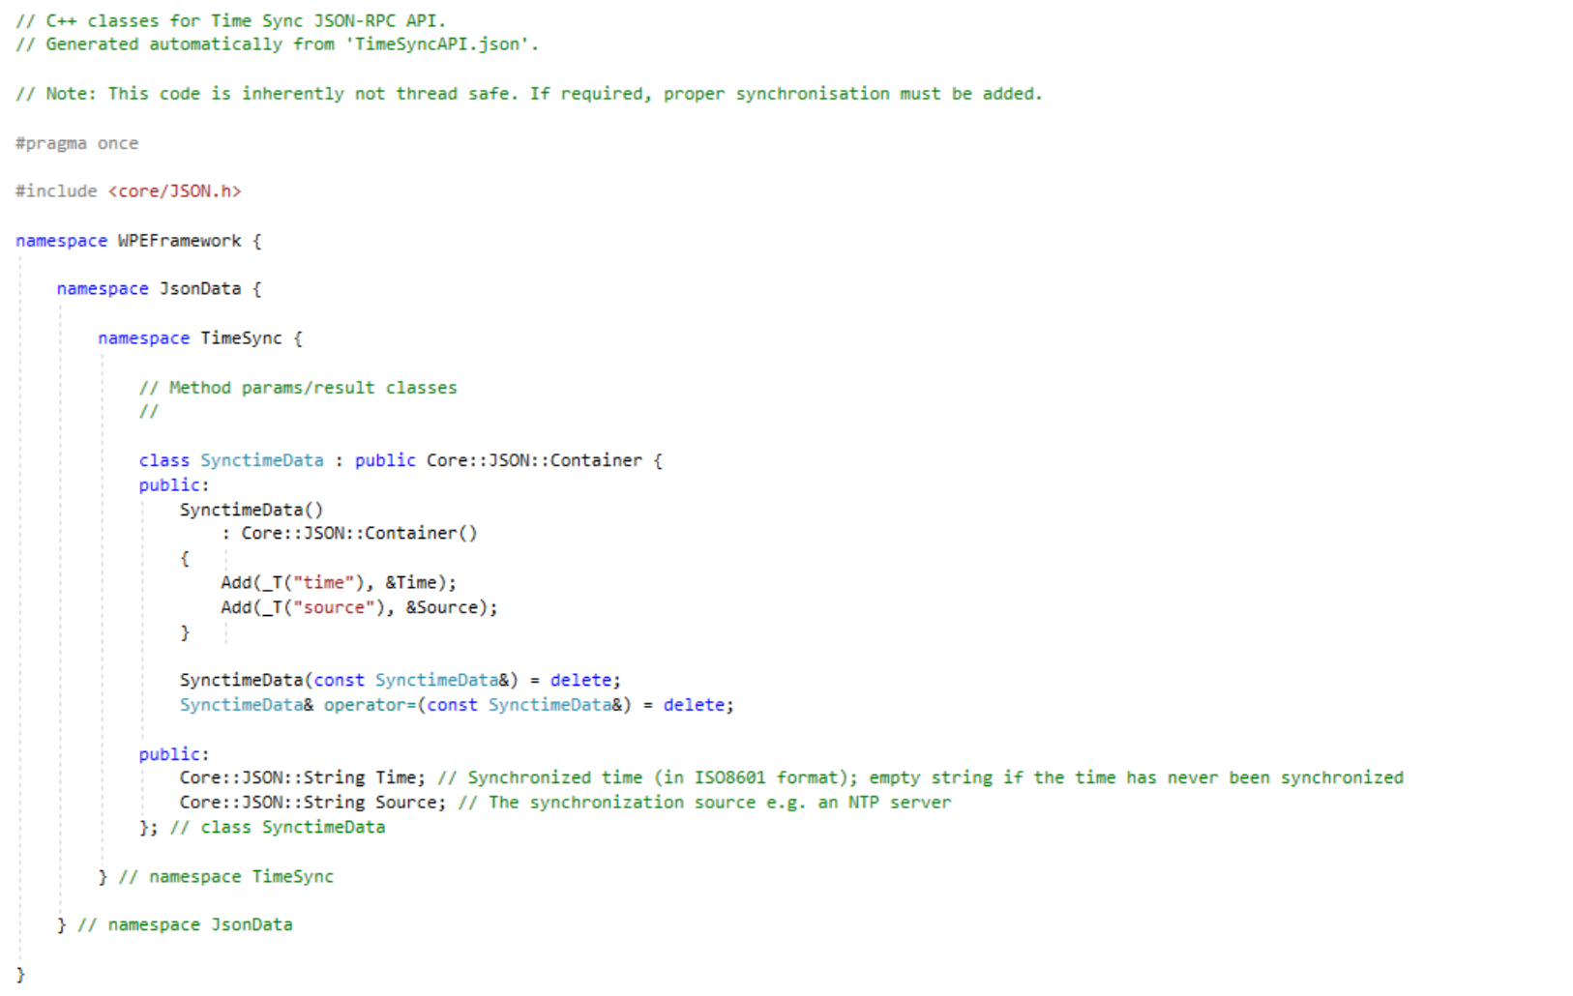
JSON Generator – Sample Generated Classes

Slide 16
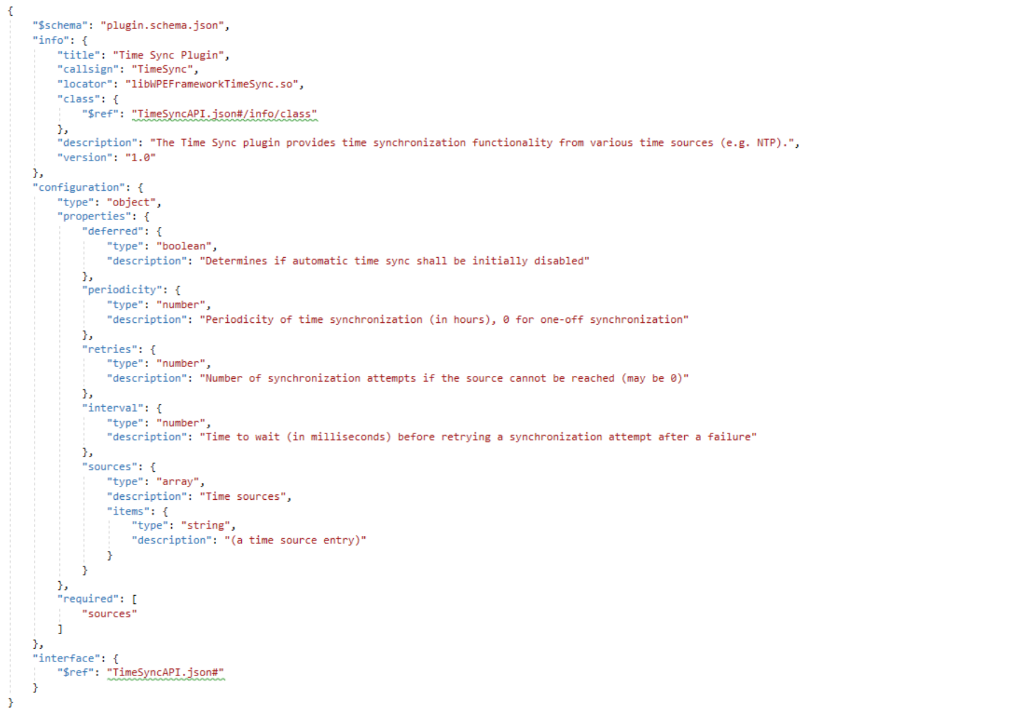
JSON Generator – Sample Plugin JSON

Slide 17
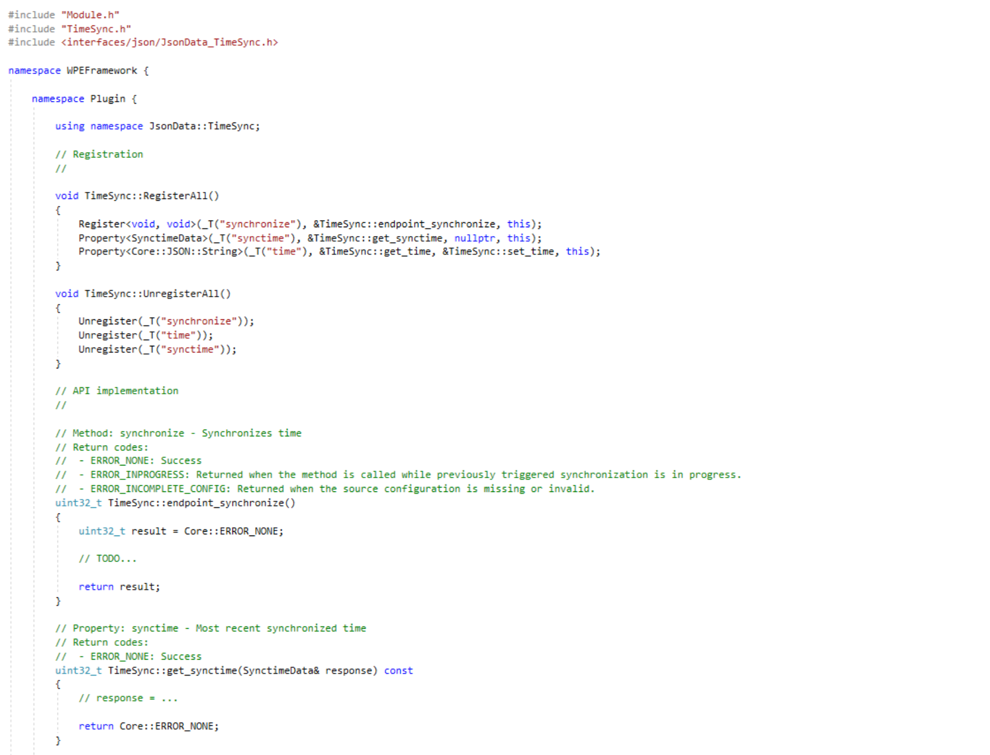
JSON Generator – Sample Stub Code

Slide 18
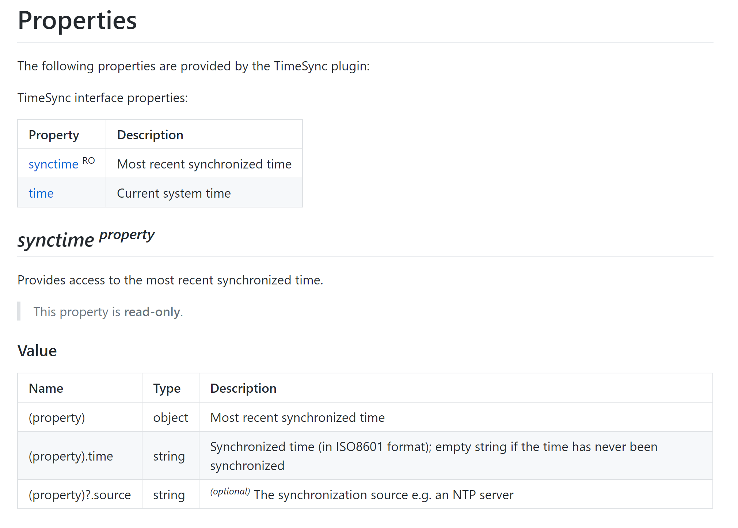
JSON Generator – Sample Documentation

