Slide 1
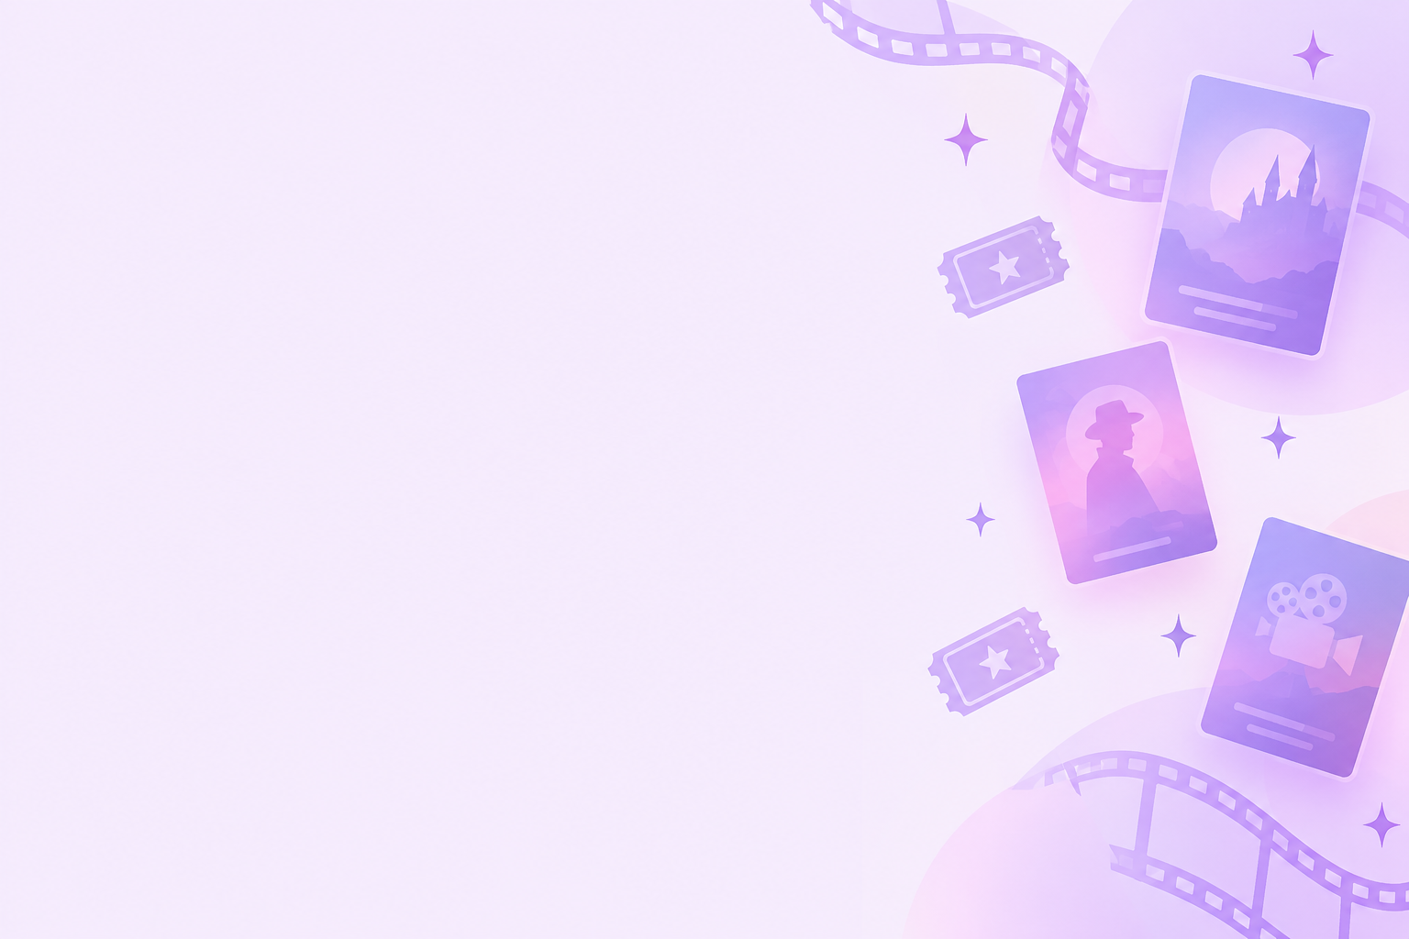
Filmio
Movie web app
TVT25KMO · Group 17
Tiina Heponiemi · Joni Koskela · Mariia Sheykina · Juan Ju
Notes:
Tiina: Good evening, ladies and gentlemen. My name is Tiina, and together with Mariia, Juan and Joni I am here to present our web programming project. It is called Filmio. Filmio is a movie website. You can search for films and see information about them, write reviews, save your favourites and share them, create and join groups, and chat with other group members.

Slide 2
Team and roles
Tiina
Juan
Joni
Mariia
Styles
Responsive design
Sharing favourites
Chat
User accounts
Reviews
Movie search
Groups page
Single group page
Main page
Single group
Single movie page
84 hours
78 hours
56 hours
156 hours
Teamwork: we all worked on the same features – nobody built a feature alone
Notes:
Tiina: Let's start with our team. Everyone contributed to all features, but we each focused on different areas. I spent most of my time on styling, responsive design, and the favourites feature. Now I'll hand over to Juan.
Juan: Thank you. I am Juan. I spent most of my time on the chat, the user accounts and the reviews. Next is Joni.
Joni: I am Joni. I spent most of my time on movie search and the page with the list of groups. Mariia will continue.
Mariia: And I am Mariia. I spent most of my time on the main page, the page of one group and the page of one movie.

Slide 3
Key features / demo
1. Tiina
2.Joni
Now in cinemas· Sign up · Login · Search · One movie page · Reviews
Create group · Invitations · Requests · Deleted user · Chat
3.Juan
Favourites · Share link · My account: invitations · Delete · Logout
Notes:
Tiina: Now let's look at the key features.

Slide 4
Feature checklist
Feature | Description | Status
1. Responsiveness | All pages adapt to different screen sizes, including desktop, tablet, and mobile. | Done
2. Sign up | Users can create an account using their email address and a password containing at least 8 characters, one uppercase letter, and one number. | Done
3. Log in | Users can log in with their registered credentials and log out of their accounts. | Done
4. Delete account | Users can delete their accounts, including their reviews and favourites. If a group owner deletes their account, ownership is transferred to the designated deleted user. | Done
5. Search | Users can search for movies using at least three criteria: title, year, and genre. Searching does not require logging in. | Done
6. Now in cinemas | Users can view movies currently showing in cinemas in Finland without logging in. | Done
7. Group page | All users can browse the group list. Logged-in users can create groups, and only group members can view group details. Group owners can delete their groups. | Done
8. Add member to group | Users can request to join a group, and group owners can accept or reject requests. Group members can also invite users by email. | Done
Notes:
Tiina:
Here you can see all the required features and our implementations. We completed all the requirements, and everything works. The database diagram, User Interface designs, timesheet, and API(ay-pee-eye) documentation are available in our Git repository. Now Mariia will talk about our challenges

Slide 5
Feature checklist
Feature | Description | Status
9. Remove member | Group owners can remove members and members can leave groups themselves. | Done
10. Group page customization | Group members can add movies to their group page from the search results and remove movies. | Done
11. Movie review | Group members can add movies to their group page from the search results and remove movies. | Done
12. Browsing reviews | Movie reviews are visible to all users, including those who are not logged in. | Done
13. Favourites | Logged-in users can create and manage a personal list of favourite movies, accessible through its own page. | Done
14. Sharing favourites | Users can share their favourite movie lists through a URL that other users can open. | Done
15. Extra feature: Group chat | Group members can communicate through a group chat. | Done

Slide 6
Challenges
Technical: My Account page
Teamwork
Merge conflicts in Git
Pull requests waiting with conflicts
Code appeared twice → chat messages doubled
We resolve our own conflicts and review each other's code
Page was empty after the token expired
Cause: code related to the token
→ Found and fixed, page works correctly
Notes:
Mariia: We are all beginners in web development, so we faced and overcame several challenges. Our biggest technical challenge was the My Account page, which became blank when the token expired, preventing users from logging in or out. We fixed the issue, and now the page works correctly. Now Juan will talk about our teamwork challenges.
Juan: Our biggest teamwork challenge was working on the same codebase. We often faced merge conflicts that took time to resolve. Once, duplicated code even caused every chat message to appear twice! Now Joni will explain what we learned.

Slide 7
Lessons learned
Technical
Security & web
Teamwork
React
Node.js
PostgreSQL
Tests
Docker
Cookies
CORS
Password validation
Database transactions
Socket.io chat
Security vulnerabilities
Plan small tasks
Test often
Ask for help early
Notes:
Joni: So, what did we learn? Since we are all beginners, almost everything was new to us. We learned how to build a web application using React, Node.js (node jay-as ->EI DOT!), and a Post-gres-Q-L database, as well as how to write basic tests. Now Mariia will continue.
Mariia: We also learned to use Socket.IO for our chat, work with cookies and CORS, handle database transactions, validate passwords using regular expressions, and understand common security vulnerabilities. We also learned how to run the application in Docker. Now each of us will share a short personal reflection.

Slide 8
Personal reflection
Tiina
Joni
Learning React
Task estimation
Reviewing teammates’ code
Styles and responsiveness
Time management
Time planning
Mariia
Juan
Writing tests
Resolving Git conflicts
Understanding syntax
Improving conflict resolution skills
Breaking tasks into smaller steps
Codebase organization
Notes:
Tiina: My biggest challenge was learning react. I learned how to review my teammates’ code. In future projects I would Improve my time management.
Joni: I found task estimation challenging. I became more confident in styling web pages and making them responsive. Next time I would manage my time more effectively
Mariia: What I struggled with most was writing tests. I learned more about syntax. In the future, I would break larger tasks into smaller.
Juan: One thing I had difficulty with was resolving git conflicts. I developed my skills in resolving them. Next time I would keep codebase better organized.

Slide 9
Conclusion
Result
Teamwork
Fully working movie website
All requirements completed
Secure application
Second project together
Friendly, supportive atmosphere
Everyone responsible for their part
Future improvements
Breaking tasks into smaller steps
Notes:
Juan: To sum up, Filmio is a fully working movie website application. We are proud that we have completed all the requirements and built a secure application.
We are also happy to have worked together for the second project in a row. We worked smoothly as a team, had a friendly and supportive environment, and everyone was responsible for their part of the project. In future projects, we aim to break down tasks into smaller, more manageable steps. Thank you for your time, and we hope you enjoyed our presentation.

Slide 10
Thank you!

