Slide 1
Runtime-terror project 04
Derek Yong, Michael Hosein, Ryan Salter & Tomy Tran

Slide 2
Goal
The overall goal for this project was to create virtual agents that would allow users to:
1) Select a rental car from an inventory
2) Pre-pay for parking at a kiosk
3) Place an order and complete payment for the above
In order to accomplish this we were required to use a combination of HTML, CSS, PHP, JavaScript and MySQL

Slide 3
General requirements
As mentioned, we were required to use all of the coding languages we learned throughout the semester
The biggest requirement/focus was the use of databases in MySQL
Needed to be able to store data and then later access and display that same data in individual instances
PHP was also a major component as it was used to not only store the user inputs but also served for our views, controls and modeling of the virtual agent

Slide 4
Solution Overview & Key features
In order to achieve our goal and create the virtual agent, we used a series of forms to take the user’s selections and then sent those selections into a php form.
Simultaneously, that data needed to be later accessed and displayed like it would in a real online transaction of this sort
The admin controls served the purpose of manipulating the inventory and orders as needed
Cars could be added or removed from the inventory
Access to all of the orders and transactions
Users needed to be able to login to their own unique profile or create one if it did not already exist
Username, password, e-mail, etc.

Slide 5
Testing
Testing was mostly conducted using random sets of data to simulate user decisions and inputs
Once data was supplied we used the echo construct to print any errors that may have occurred within the database
Example: If a query returned false, echo “Error creating table: “ . $conn->error; was used to tell what went wrong
Testing text inputs: JavaScript functions, html input pattern attribute
Abcdef in fields that require a numerical input would prompt that it was incorrect and not execute the action call
Blank inputs returned an error msg
Logging in: test various usernames and passwords, if they did not work it was because they were not stored in the database.
In creation of a new user, if the passwords fields did not match an error is promted
The approach used to check the type of card being used in the parking checkout works for the most part however if the user enters backspace it resets the function call and reads the next input as the identifier causing the card type to display improperly– this bug was not fixed

Slide 6
HTML
The primary purpose of HTML in this project was just to add forms to the page even though most of the files were saved as a .PHP
Common tags used were <form>, <input>, <option> and <select> among others
A few attributes used were type[radio, password, tel and text]

Slide 7
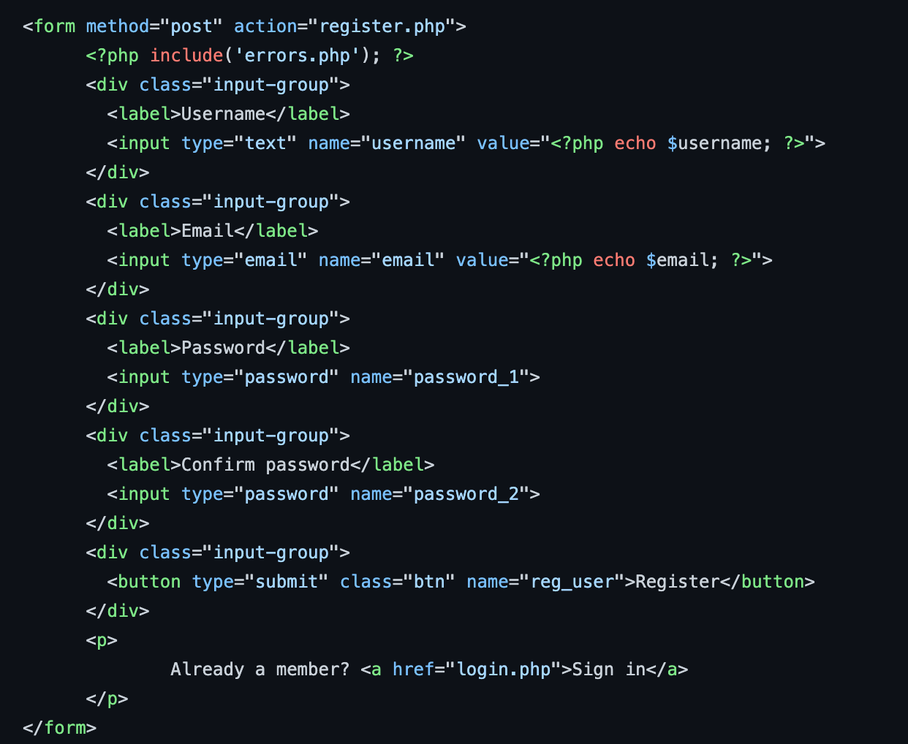
Registration COding
Both the registration and login forms used a similar format that consisted of a series of input fields working in tandem with php coding

Slide 8
JavaScript
JavaScript was not used much but in two instances: form validation and checking card type specifically in the process of picking a parking space.
Form validation was completed using specific regexp statements within if statements to check if the field was either empty or containing illegal characters and/or numbers
The type of card used was checked using EventListeners that checked what key or keycode the user input and printed the appropriate logo based on that input
Specifically the keydown event

Slide 9
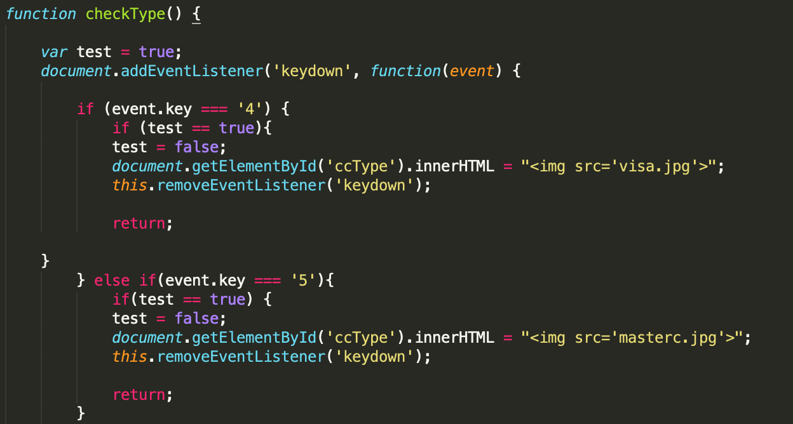
Checking card iin (Pre-pay parking)

Slide 10
PHP
As mentioned PHP was mostly responsible for storing inputs and data then passed that data to the data through MySQL
A connection was established with the database by passing server, username, password and database name as variables to the MySQL server
In the case of logging in, the form validation was completed through PHP array_push()
In some cases echo statements were used to add HTML tags and content to the page as well
Example: echo “<p> Insert text to be printed </p>”;

Slide 11
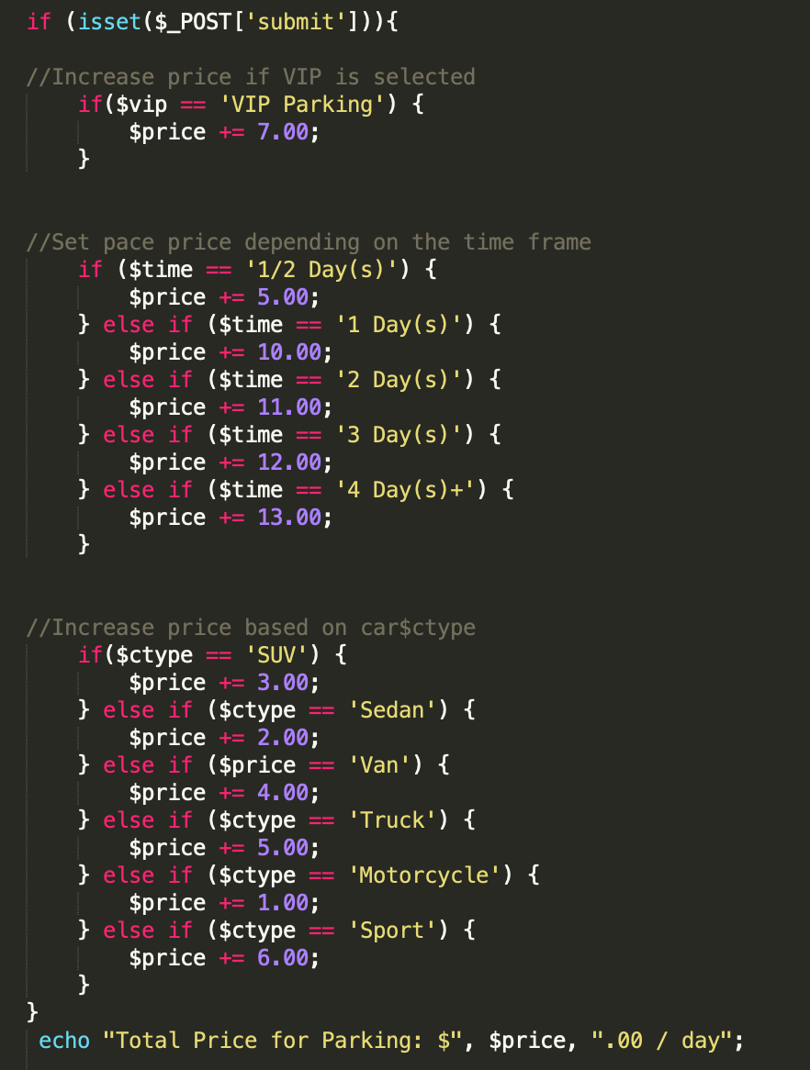
Checking inputs and setting price
In the case of the pre-paid parking, inputs were read using the $_POST method and stored in representative variables
Prices were set using a series of if-statements that checked what the input was and updated the price accordingly

Slide 12
MySQl
The main component of MySQL used in the coding portion specifically was the data defining statement CREATE
CREATE as expected is used to create a new table assuming that it does not already exist within the database. If the table does exist, an error is given unless we use ‘IF NOT EXIST’ within the statement. After CREATE TABLE comes the name of the table followed by the parameters we want to store in the rows and columns
Data manipulating statements included: INSERT and SELECT
INSERT takes the given data from the user or code and stores it inside of the table
SELECT is how we access that stored data in order to display it onto the pages

Slide 13
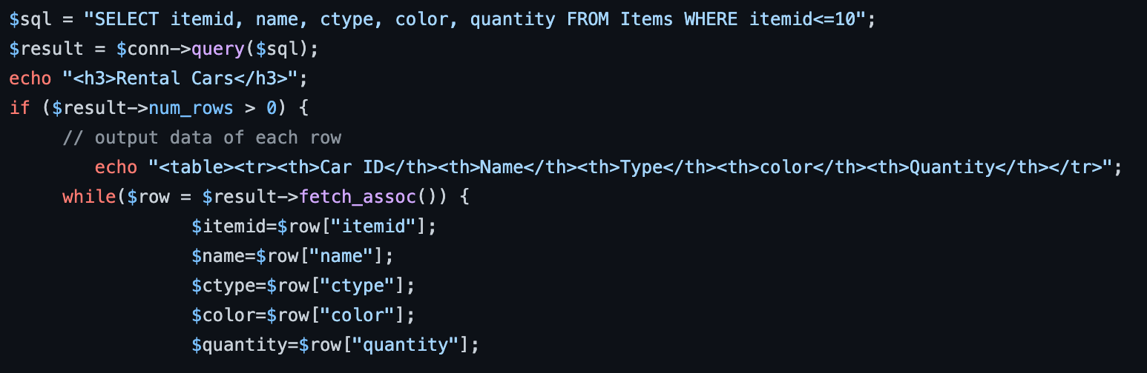
Mysql data manipulation

Slide 14
Role distribution
Derek Y: Created the login and registration process. Established the skeleton of the car rental webpages. With the combined effort of Ryan, connected those pages to the databases and ensured that it flowed accordingly
Ryan S: Created and modified the various databases that were used the car rental portion of the project. Tested said databases to check for any errors and resolved them if found. Ensured that all members knew what they needed to do and provided assistance where required
Tomy T: Created the Credit Card form and checkout process used on the Rental aspect of the project
Michael H: Created the pre-paid parking process and all associated aspects. Created and modified databases that were used in the Pre-Pay service portion. Tested databases for any errors and resolved any that were found.

