Slide 1

Project 1 [insert title of project]
Tomy Tran, Derek Yong, Michael Hosein, & ryan salter

Slide 2

Goal
The goal for this project was to design an interactive and creative webpage. As such, our group decided to create a Choose-Your-Own-Adventure game!

Slide 3
Objective 1 – Creating a Story
A key component of any choose your own adventure scenario is a storyline. When creating a webpage of this nature, it is important to think about the story you want to tell so that you may not only format the page appropriately but also design it a suitable manner.
For our project, the story is essentially a day in the life a college student here at Georgia State University

Slide 4
Objective 2 – HTML Coding
The first step in writing the HTML code for the webpage is to consider what key components need to be present in order for our game to function smoothly.
Because it is a choose your own adventure game, the main function we need is the option to choose the path that you want to take at every turn
Another important component is taking into account right and wrong decisions
What happens if they make a good decision?
What happens if they make a poor decision?

Slide 5
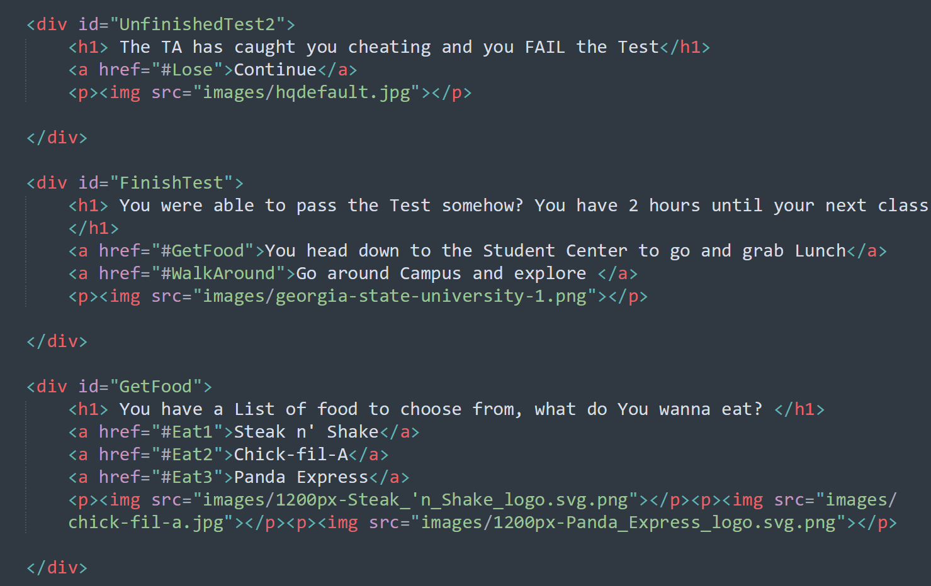

Slide 6
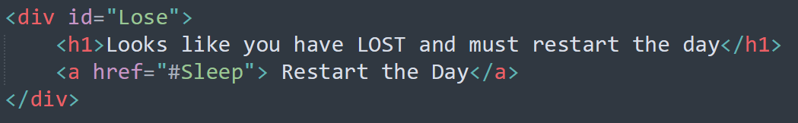
Formatting – General Requirements
<div>
<h1>
<img>
A basic step in formatting the webpage
was to take into account dedicated
spaces in which any text would appear. The simplest way to do this is to place these components inside of a DIV
In order to consistently format the story on every page of the game, we used the <h1> tag. This heading tag ensures that the text maintained the same size and weight.
Another frequently used tag was the <img> tag which served the purpose of adding visuals to the webpage. With each possible choice through the game, an image was included using this class

Slide 7
Making Decisions
The best way to implement decision-making was to use buttons. In order to accomplish this, we used the <A> tag paired with the href attribute in order to create hyperlinks to the appropriate pages
Within the HTML coding, each individual page had its own ID created so that it could be referenced in the <A> tag
Example: #UnfinishedTest2 as shown to the right

Slide 8
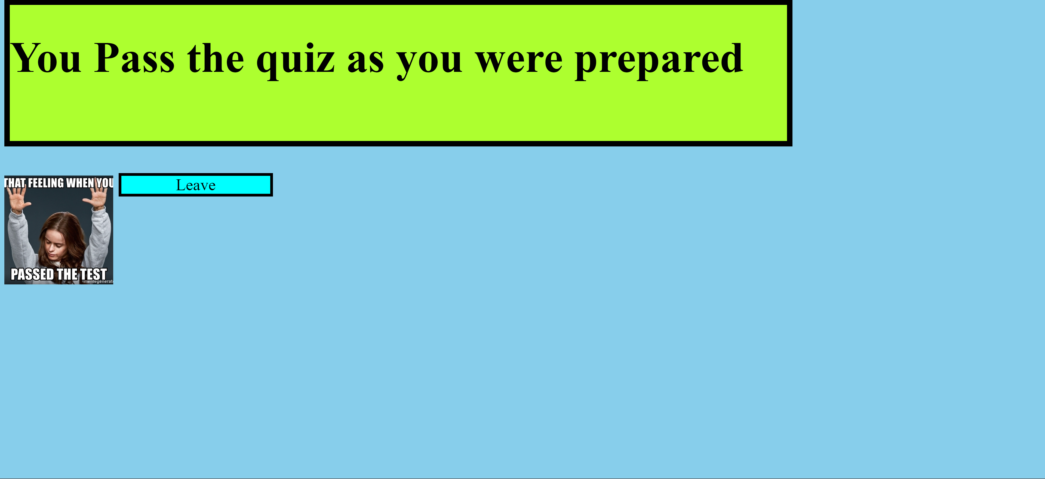
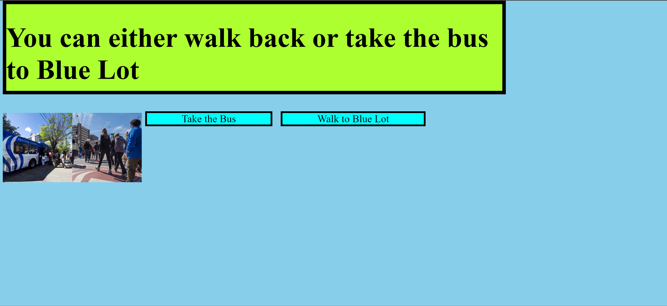
Good Choices
When the user makes good decisions, they are able to progress to the next part of the story and are taken to the next page

Slide 9
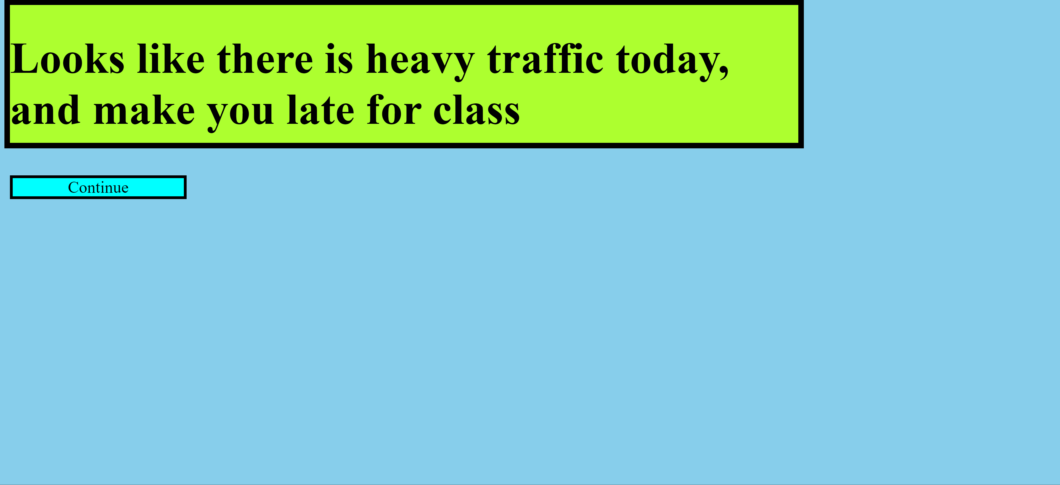
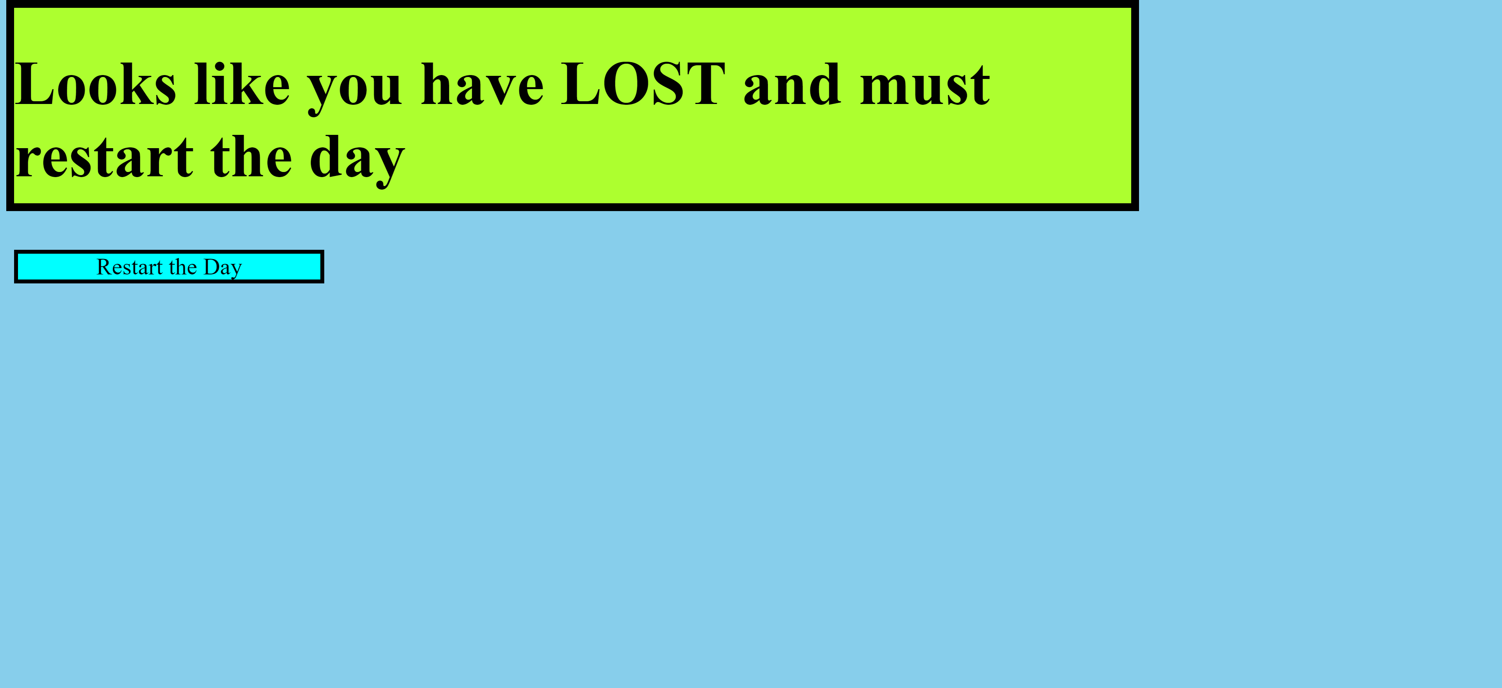
Poor Choices
When the user makes Poor decisions, they are unable to progress to the next part of the story and instead are returned to the beginning of the game and allowed to try again

Slide 10
Objective 3 – CSS Styling
Another important component of not just any webpage but also any game is that it catches the user’s eye
In order to accomplishes this, we utilized the external CSS styling method

Slide 11
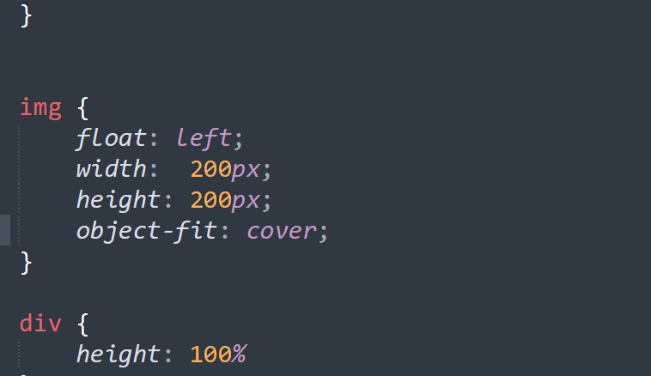

Slide 12
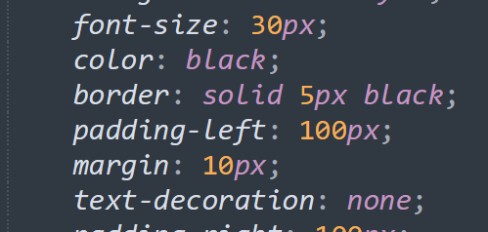
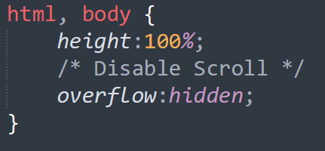
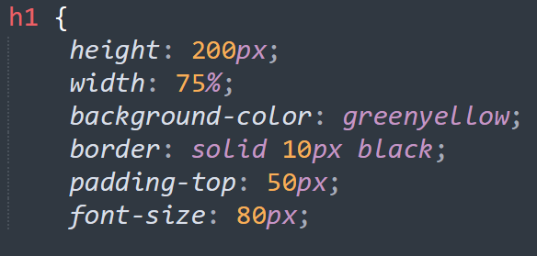
Used Attributes
Overflow – In order to ensure that all content fit to the screen and there was no scrolling necessary, the hidden attribute was used throughout the body of the HTML coding
Background-color – The background color of the story container, as well as the button containers, were altered using this attribute. When specifying a color, we are able to either use any simple color name (i.e “greenyellow”) or include the hex code for the desired color
Border – Borders were created around the story and choice button containers in order to add appeal to the webpages

