Slide 1

Project 1 A Day In the Life: College Edition
Tomy Tran, Derek Yong, Michael Hosein, & ryan salter

Slide 2

Goal
The goal for this project was to design an interactive and creative webpage. As such, our group decided to create a Choose-Your-Own-Adventure game!

Slide 3
Objective 1 – Creating a Story
A key component of any choose your own adventure scenario is a storyline. When creating a webpage of this nature, it is important to think about the story you want to tell so that you may not only format the page appropriately but also design it a suitable manner.
For our project, the story is essentially a day in the life a college student here at Georgia State University

Slide 4
Objective 2 – HTML Coding
The first step in writing the HTML code for the webpage is to consider what key components need to be present in order for our game to function smoothly.
Because it is a choose your own adventure game, the main function we need is the option to choose the path that you want to take at every turn
Another important component is taking into account right and wrong decisions
What happens if they make a good decision?
What happens if they make a poor decision?

Slide 5
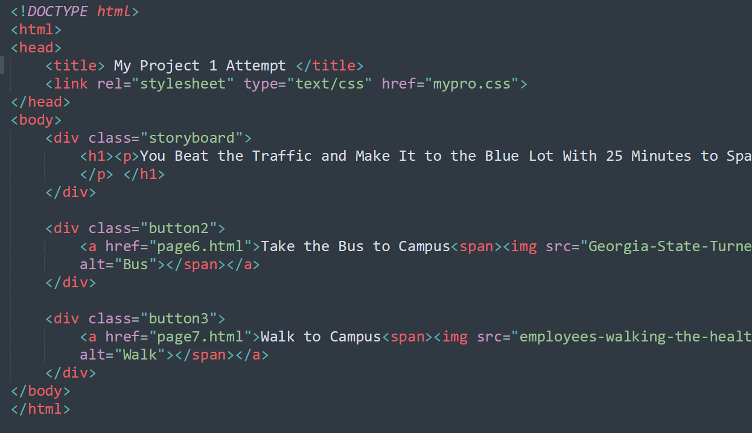

Slide 6
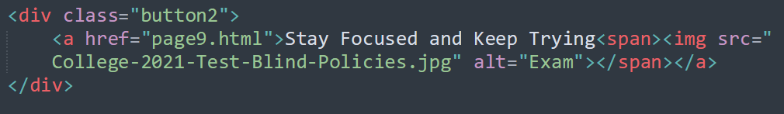

Formatting – General Requirements
<div>
<h1>
<img>
A basic step in formatting the webpage
was to take into account dedicated
spaces in which any text would appear. The simplest way to do this is to place these components inside of a DIV
In order to consistently format the story on every page of the game, we used the <h1> tag. This heading tag ensures that the text maintained the same size and weight.
Another frequently used tag was the <img> tag which served the purpose of adding visuals to the webpage. With each possible choice through the game, an image was included using this class

Slide 7
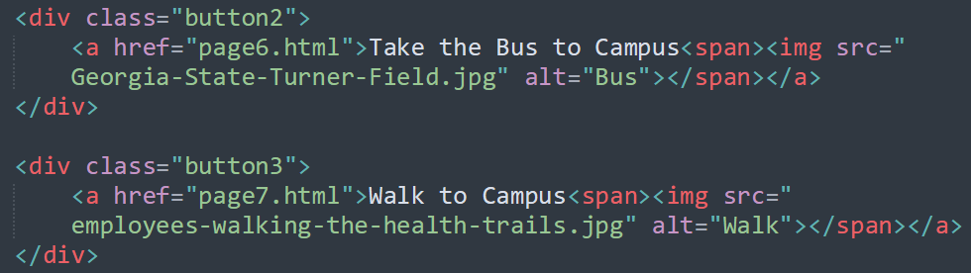
Making Decisions
The best way to implement decision-making was to use “buttons”. In order to accomplish this, we used the <A> tag paired with the href attribute in order to create hyperlinks to the appropriate pages
Most of the choices also had an embedded image that appeared when hovered over in order to give the user a visual of that decision. This was accomplished with the use of the <span> tag

Slide 8
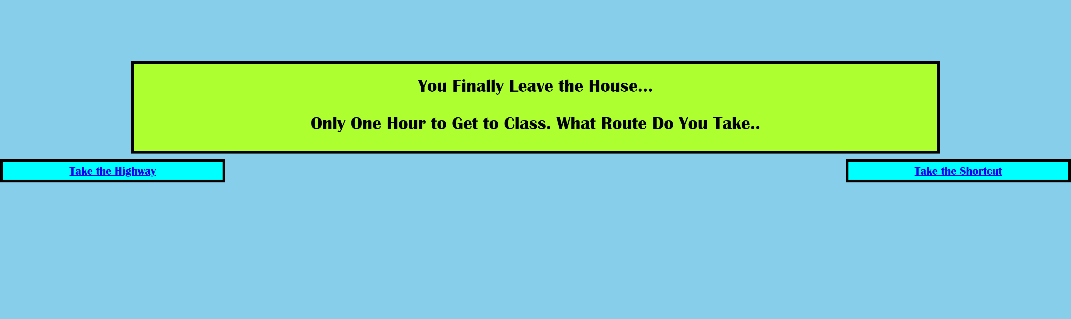
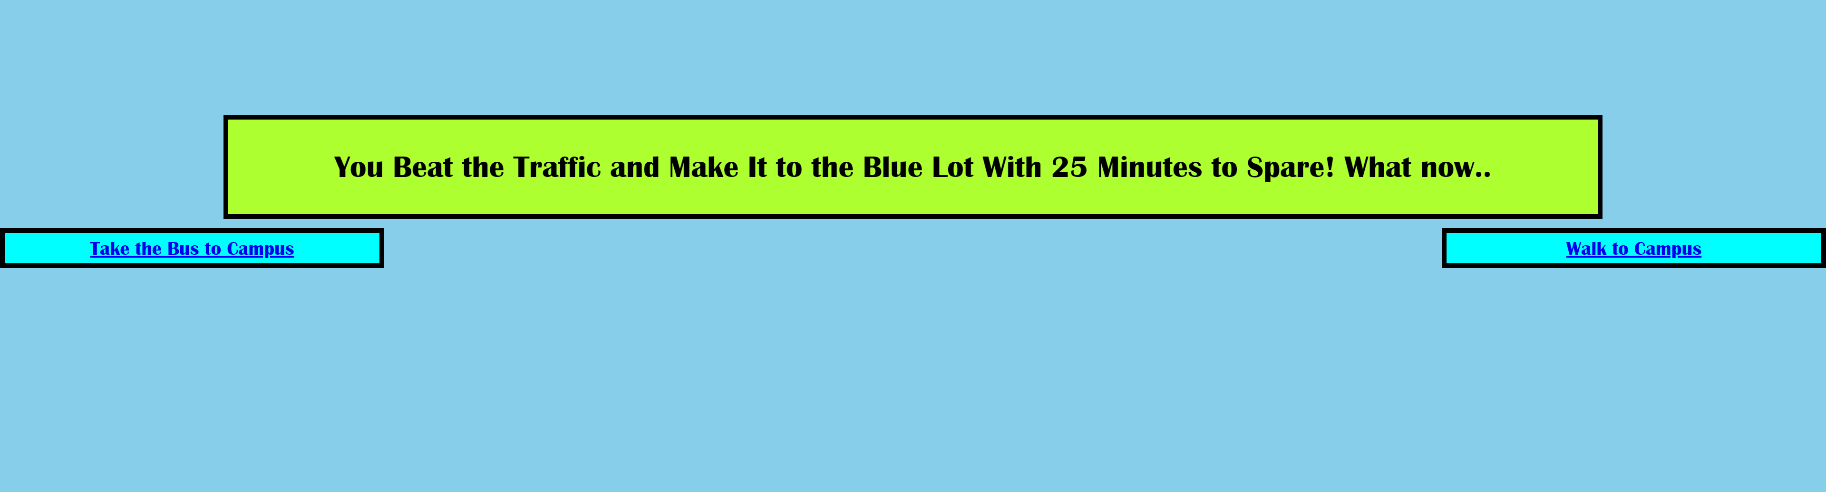
Good Choices
When the user makes good decisions, they are able to progress to the next part of the story and are taken to the next page

Slide 9


Poor Choices
When the user makes Poor decisions, they are unable to progress to the next part of the story and instead are returned to the beginning of the game and allowed to try again

Slide 10
Objective 3 – CSS Styling
Another important component of not just any webpage but also any game is that it catches the user’s eye
In order to accomplishes this, we utilized the external CSS styling method

Slide 11
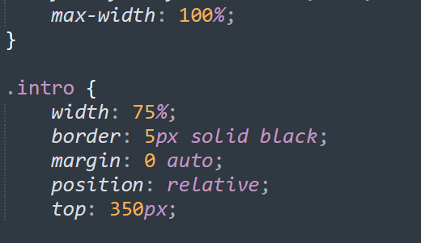

Slide 12
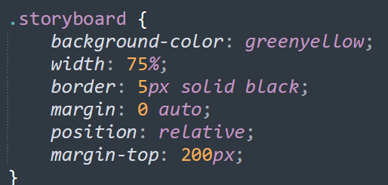
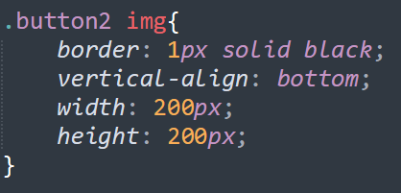
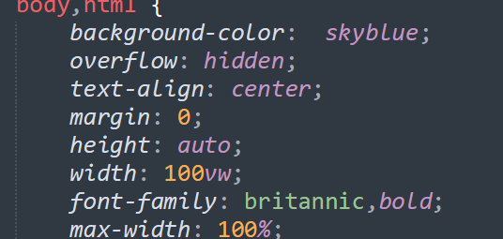
A Few CSS Techniques Used
Overflow – In order to ensure that all content fit to the screen and there was no scrolling necessary, the hidden attribute was used throughout the body of the HTML coding
Background-color – The background color of the story container, as well as the button containers, were altered using this attribute. When specifying a color, we are able to either use any simple color name (i.e “greenyellow”) or include the hex code for the desired color
.class – Throughout the CSS Stylesheet we used numerous classes in order to create a generalized format for specific parts of our webpage. In the event that we wanted to override a specific tag when our classes were called, we were able to overcome this by creating separate classes with the tags attached.
I.e: .button2 img {

Slide 13
Challenges
Creative Way to Display Images
Positioning
Organization

Slide 14
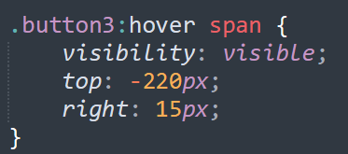

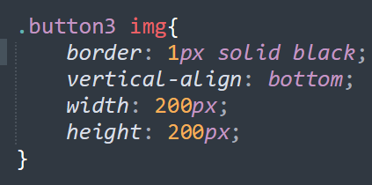
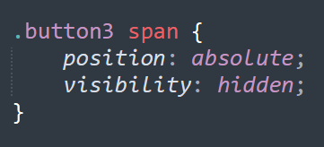
Displaying Images
One way to display images was to simply place them sporadically around the different pages. However, in order to add a more creative element, we decided to instead find a way to combine the interactive aspect of making your decision with seeing a visual for those decisions as well
In order to accomplish this, we messed around with not only the <img> tag but also the <span> tag as well as the hover selector
By combining these three tools were able to overcome the challenge of how to incorporate images into our webpage without making it look random and/or messy.

Slide 15
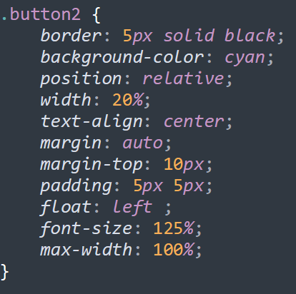
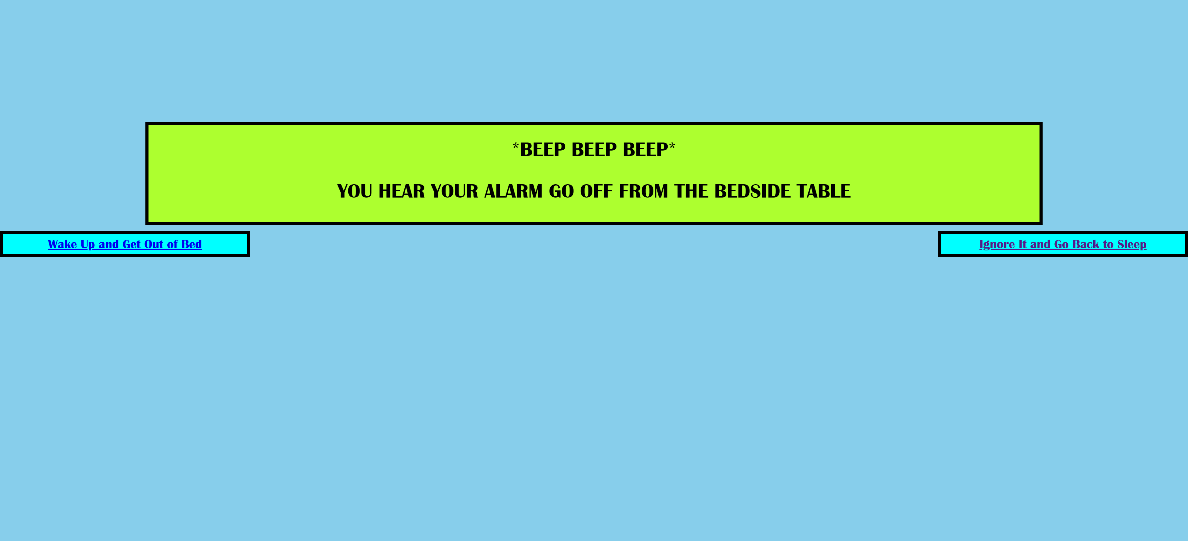
Positioning
Another common challenge that arose from creating the webpage was considering how to position everything present on the screen.
The basics were used such as padding, margins, as well as text-align
In order to position the buttons, the way that they are, we used the usual relative position attribute but also included float
The float property allowed us to place these DIVs on either the right or left side of the containers that were created

Slide 16
Organization and Design
The difficult part of choosing how to organize the webpage is taking into account the type of game we created and how we want to influence the user. Choose Your Own Adventure games are typically simple and easy on the eye
Because of this, it was better keep the layout of the pages simplistic but also use colors to ensure that the attention of the user remained. Every page was also positioned relatively in the middle of the screen as well in order to maintain a sense of “flow” for the user as they progressed through their story
Similarly, the decision to not show the image until the user hovers over their choice was made with the intent of preventing influence on that particular decision. If the user were to see the images beforehand, they might be more inclined to choose based on what “looks” better instead of what “feels” better

