Slide 1
Project 2 Jeopardy! [PHP & CSC]
Tomy Tran Derek Yong Ryan Salter Michael Hosein

Slide 2
Goal
The goal of this project was to take our previous knowledge of CSS and HTML and combine it with what we’ve learned about PHP coding.
This time, the team chose to recreate Jeopardy! PHP is used in this format by allowing the player to login before they begin playing as well as displaying their accumulated points as the game progresses.

Slide 3
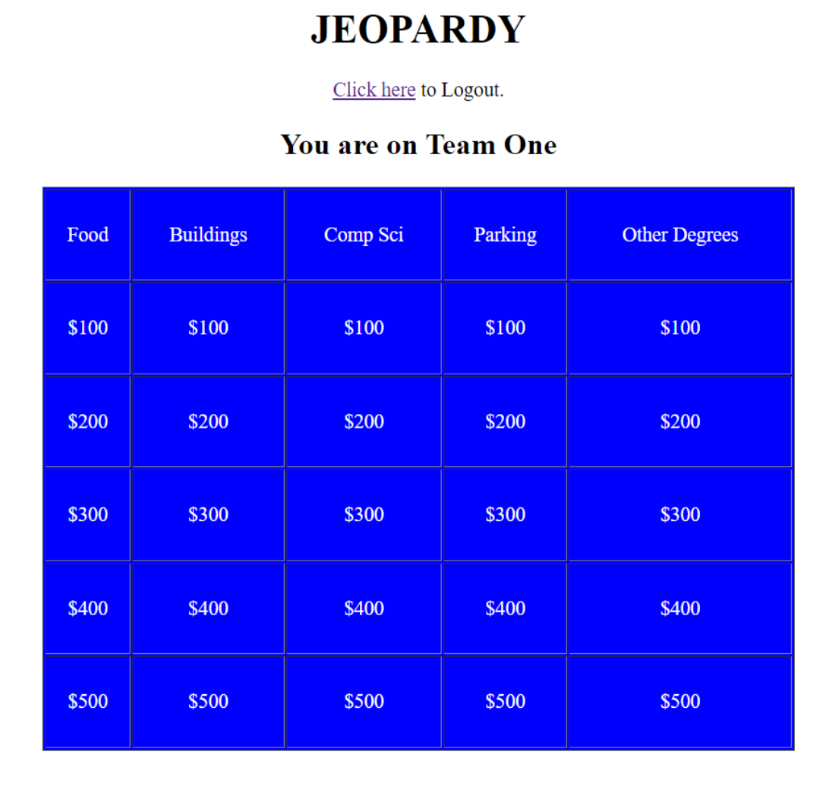
Objective 1 – Jeopardy! Template
In order to replicate the format of the popular TV game show, we simply needed to utilize HTML and CSS
This comprised primarily of tables to create the spaces that held the questions, answers, categories, etc.

Slide 4

<td> and <tr>
As mentioned tables made up a large portion of the creation of our Jeopardy game
The <tr> tag is used to define the rows within the table
The <td> tag is for defining the content of the cells within the table
Ex: <td>Buildings</td> creates a cell that contains the text “Buildings”

Slide 5
Choosing An Answer
Similar to our last project, this webpage requires the users to make a decision following each question
If the answer is correct, the user is rewarded the appropriate amount of points

Slide 6
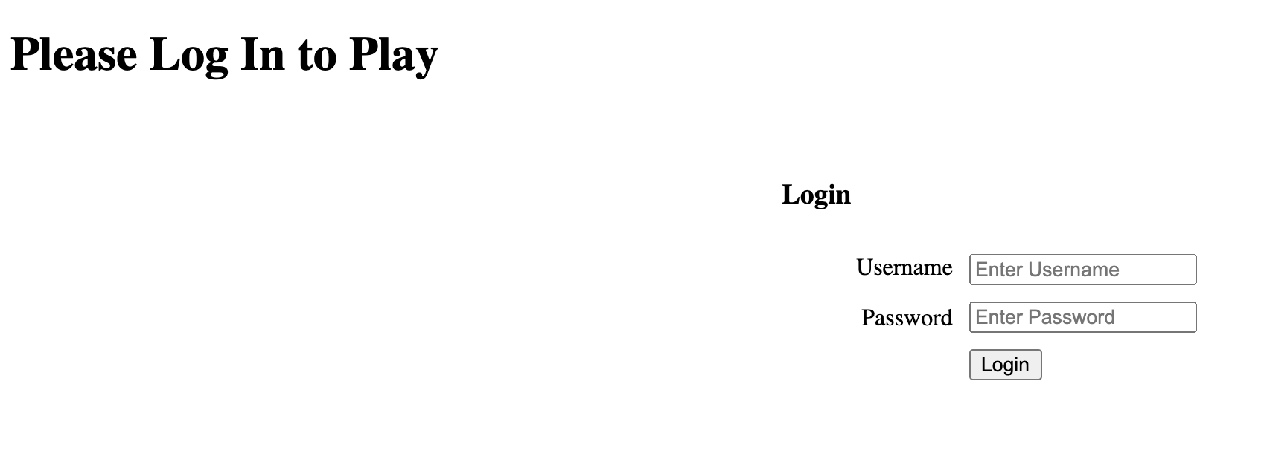
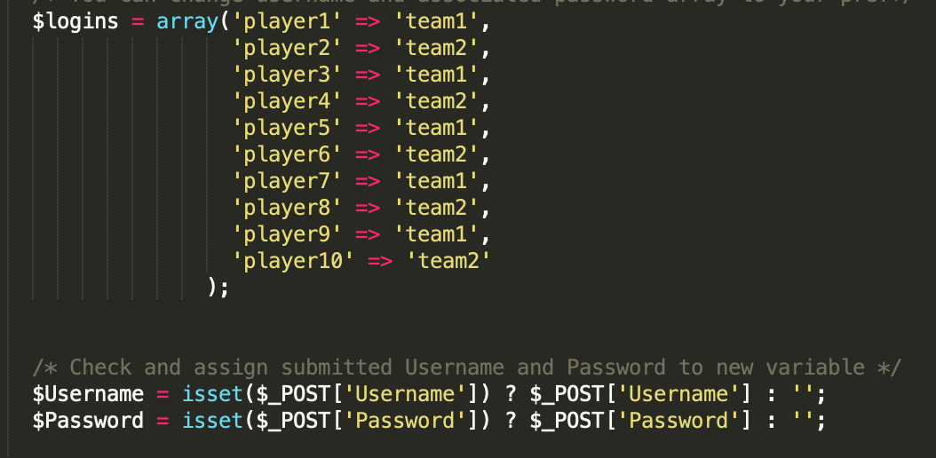
Objective 2 – Joining the Game
In order for the player to join the game, they must input a username before they are assigned a team
After logging in, data is stored in an array
Credentials are stored in variables

Slide 7
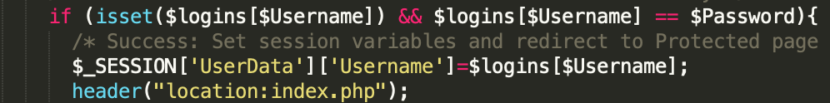
SESSION & POST
Sessions are used to store the user data so that it is accessible acroos multiple pages in the game
Post is a super global variable used to actually get the user’s data

Slide 8
Form Handling
In order to use the $_POST super global variable, we need to use the <form> action tool
The <form> tag creates a form field for the user to input their data
The action attribute tells the program where to send that information

Slide 9
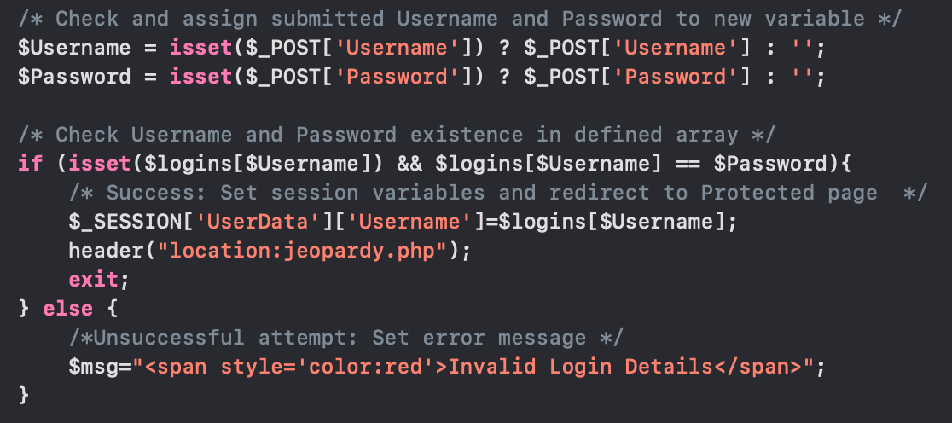
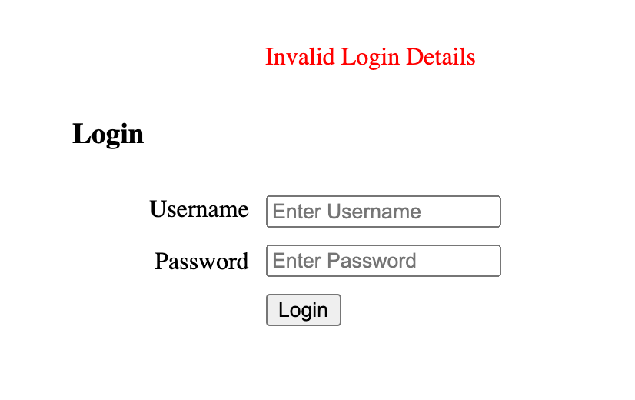
Login
When prompted to log in, if the user enters the appropriate credentials, they are successfully assigned a team and allowed to begin playing the game
If the credentials are invalid, they receive an error message and are allowed to try again

Slide 10
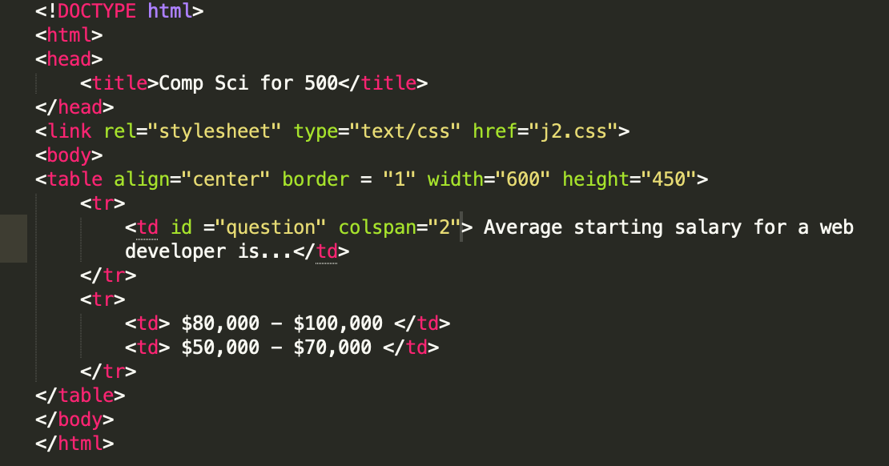

Slide 11
Objective 3 – Score Keeping
An important part of any game show is the points that the players win as they play
In Jeopardy, the difficulty of the question is denoted by the money value within in category
As such, it was crucial that we kept this aspect of the game in our webpage, if a player gets the question correct they are rewarded with the set value of the question they chose

Slide 12
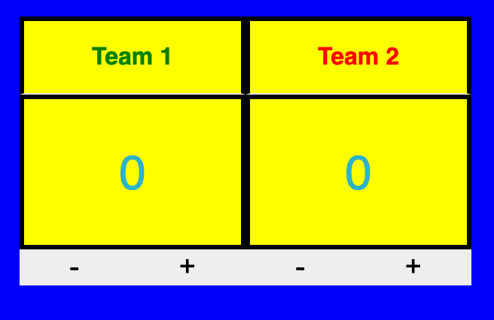

Slide 13

Coding Challenges
One challenge that came up was finding a way to designate the teams using PHP
-The best way to do this in the end was to use the previously created array to distinguish which team they would be assigned based on their sequential order.
Another challenge was how to increment the score after each question
-The best route for this was to allow the users to do this manually. The isset() function allows the program to check whether the user attempts to add or remove points and performs the appropriate action.

