Slide 1
Conway’s Game of Life
TOMY TRAN, DEREK YONG & RYAN SALTER

Slide 2
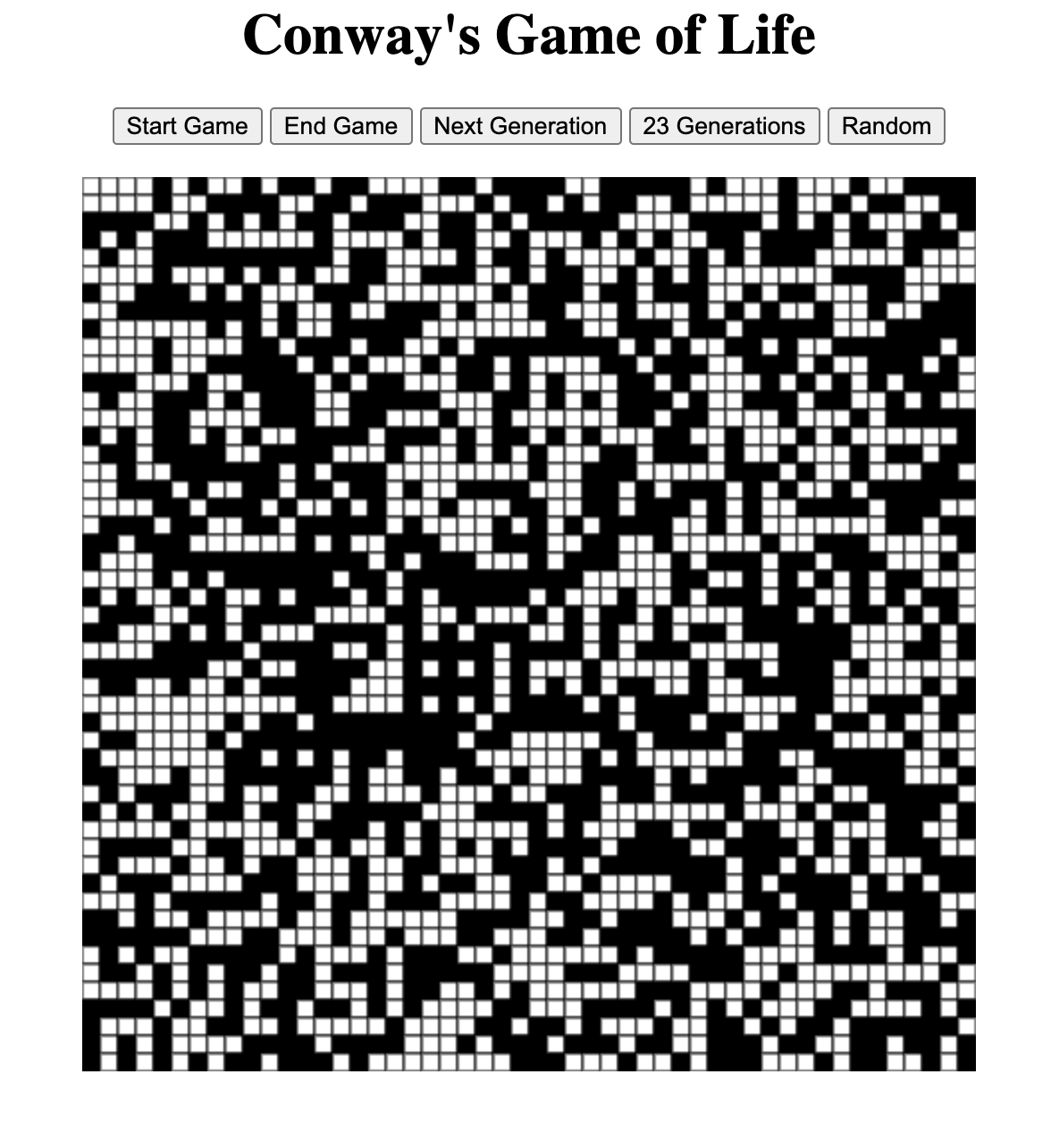

Slide 3
Goal
The goal was to find a way to replicate Conway’s Game of Life in which a grid of cells represent a state of being alive or dead. Each generation of the game depends on the current state of any given cell as well as a given set of rules

Slide 4
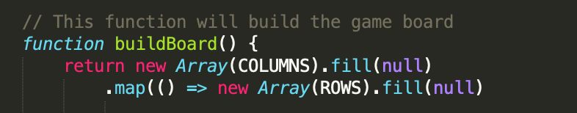
Objective 1 – Building The Grid
In order to create the logic behind Conway’s Game of Life, the game board needs to be created first
In this case, the board was a simple grid generated using the the Array( ) method in tandem with the fill( ) method inside of a canvas.
Two arrays were created, one for the construct of rows and another for the construct of columns;

Slide 5
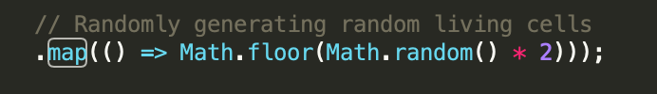
Generating Live Cells
When the page is loaded, the grid is automatically filled with a series of randomly selected live cells
This is made possible by pairing the map( ) method with the Math.random function

Slide 6
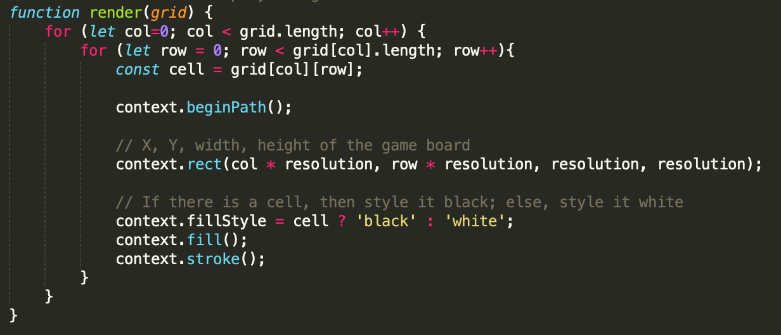
Displaying Live Vs Dead Cells
The canvas fillStyle property is used to distinguish live cells from dead cells by switching the cell’s color from white to black or vice versa depending on the case.

Slide 7
Objective 2- Game Logic
The base of the game logic is incorporating the basic rules of Conway’s Game of Life. These rules being:
Any live cell with fewer than two live neighbors dies, which is caused by under population.
Any live cell with more than three live neighbors dies, as if by overcrowding.
Any live cell with two or three live neighbors’ lives on to the next generation.
Any dead cell with exactly three live neighbors becomes a live cell.
If a dead cell has exactly three live neighbors, it comes to
If a live cell has less than two live neighbors, it dies
If a live cell has more than three live neighbors, it dies
If a live cell has two or three live neighbors, it continues living. life - Therefore by repeating the cycle over and over, these simple rules create interesting, often unpredictable patterns.

Slide 8
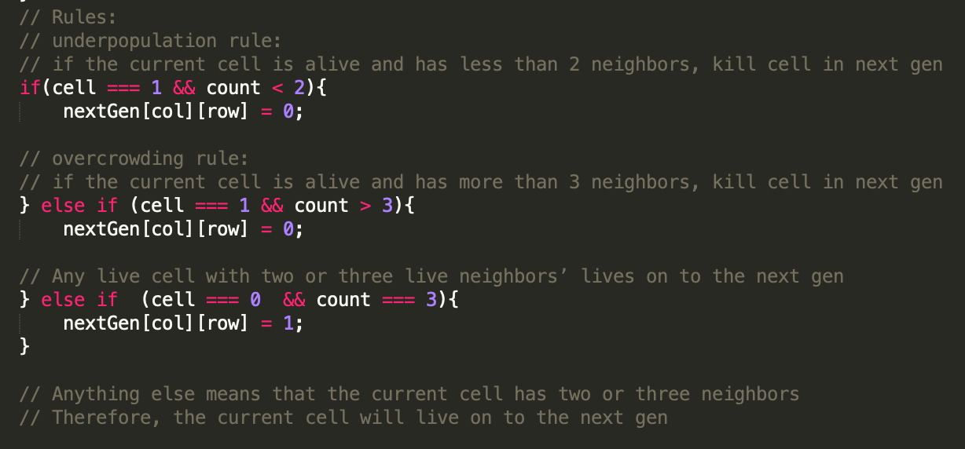
Integrating Game Rules
The program uses nested for-loops in order to visit each neighboring cell of a particular live cell and keeps track of how many live cells are around it
Using the updated count variable, a series of if-statements are used to determine if a cell lives or dies based on the number of neighbors that were found

Slide 9
Objective 3- Button Functionality
Another major component of the game is the various buttons that are used to control the experience
Start – Although the cells are randomly filled when the page is loaded, the game does not start until the user clicks the Start button. Once they do, they will see rules start to be implemented and the board will begin to change
Generation – Two generation buttons were created to allow the user to manually step to the next iteration of the game. When the ‘Next Generation’ button is clicked, the board increments one generation. When the 23 Generations button is clicked, it immediately increments by 23.
Random – The random button serves to allow the user to create a new randomly generated population and begin the process again

Slide 10
