Slide 1
Conway’s Game of Life
TOMY TRAN, DEREK YONG & RYAN SALTER

Slide 2
Problem
The problem was to find a way to replicate Conway’s Game of Life in which a grid of cells represent a state of being alive or dead. Each generation of the game depends on the current state of any given cell based on a given set of rules

Slide 3
Why Option 2?
Option 2 of the Project assignment wasn't the first choice. We started with option 1, the puzzle problem. Initially, we were able to figure how to create a 3x3 board complete with unique tiles. As well as a fully functioning ‘Shuffle’ button that would rearrange each of the tiles randomly. However, that was as far as we were able to get. The required logic behind getting the tiles to move when they were clicked proved to be more of a challenge than we were expecting. As such, the group decided to try Option 2 which upon second glance seemed like the easier option for us.
This is not to say that Option 2 was easy, by any means. In fact, the core reason for choosing Option 2 was that none of us had ever heard of “Conway’s Game of Life” before now. Because of this, attempting to recreate this game would provide a much-needed source of insight on how to approach such a challenge in the future.

Slide 4
Objective 2 – Game Logic
The base of the game logic is incorporating the basic rules of Conway’s Game of Life. These rules being:
Any live cell with fewer than two live neighbors dies, which is caused by under population.
Any live cell with more than three live neighbors dies, as if by overcrowding.
Any live cell with two or three live neighbors’ lives on to the next generation.
Any dead cell with exactly three live neighbors becomes a live cell.
If a dead cell has exactly three live neighbors, it comes to
If a live cell has less than two live neighbors, it dies
If a live cell has more than three live neighbors, it dies
If a live cell has two or three live neighbors, it continues living. life - Therefore by repeating the cycle over and over, these simple rules create interesting, often unpredictable patterns.

Slide 5
Requirements
Basic Functionality
Start, Stop, Reset
Different Patterns
Oscillators, Guns, Gliders, etc.
Different Size Boards
Small, Medium, Large
Notes:
Talk about what the buttons and patterns are and what their output is on the board.

Slide 6
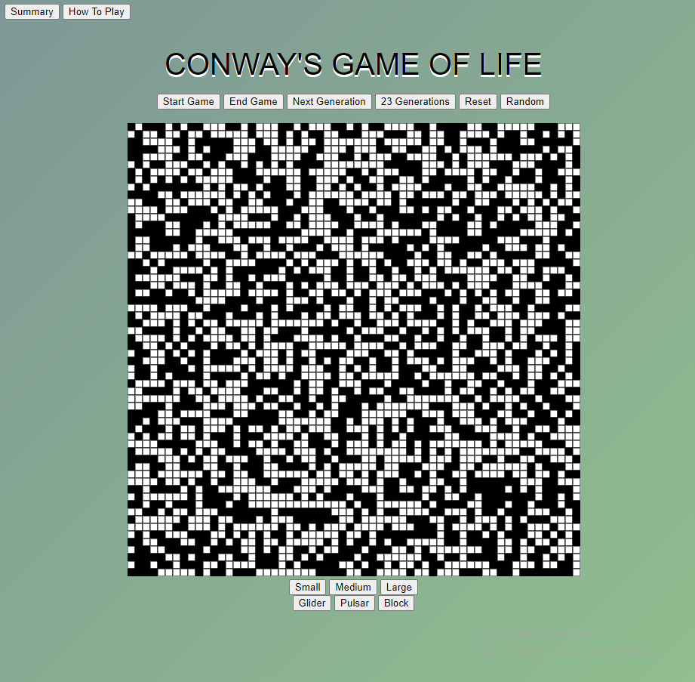

Slide 7
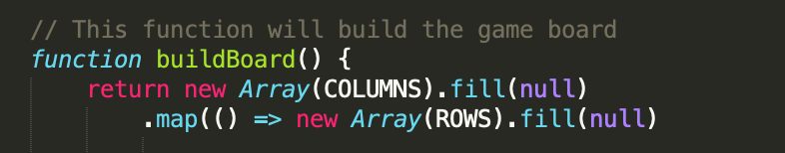
Objective 1 – Building The Grid
In order to create the logic behind Conway’s Game of Life, the game board needs to be created first
In this case, the board was a simple grid generated using the the Array( ) method in tandem with the fill( ) method inside of a canvas.
Two arrays were created, one for the construct of rows and another for the construct of columns;

Slide 8
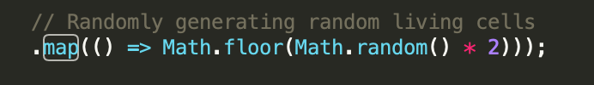
Generating Live Cells
When the page is loaded, the grid is automatically filled with a series of randomly selected live cells
This is made possible by pairing the map( ) method with the Math.random function

Slide 9
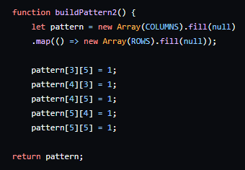
Generating Patterns
When the page is loaded, the grid is automatically filled with a series of randomly selected live cells
This is made possible by pairing the map( ) method with the Math.random function

Slide 10
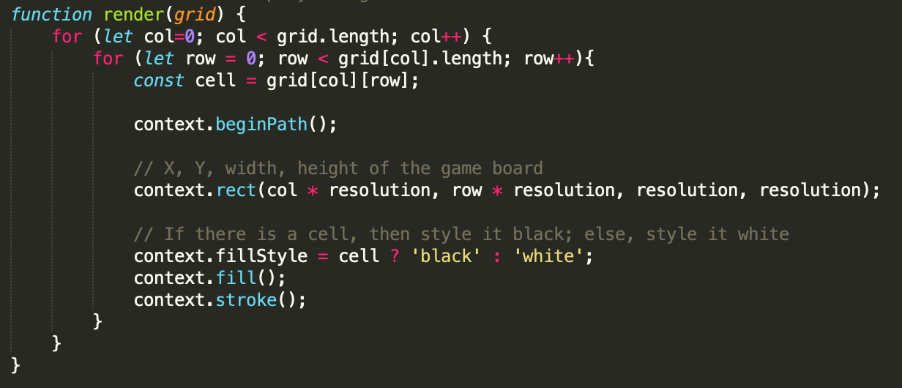
Displaying Live vs Dead Cells
The canvas fillStyle property is used to distinguish live cells from dead cells by switching the cell’s color from white to black or vice versa depending on the case.

Slide 11
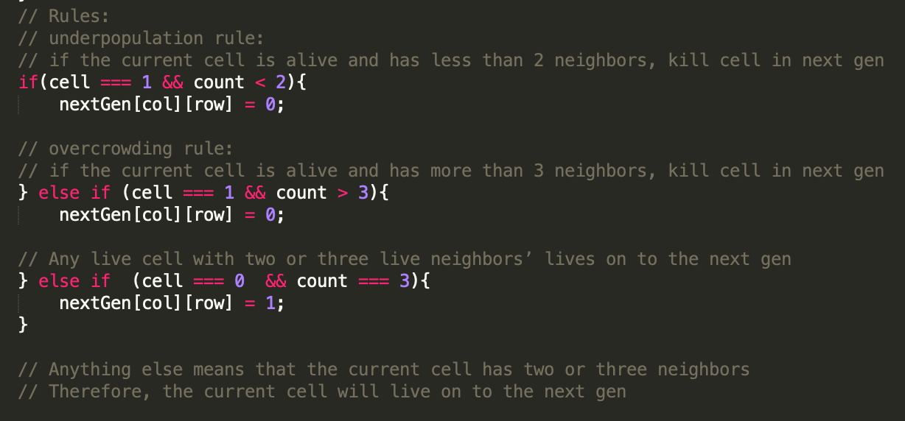
Integrating Game Rules
The program uses nested for-loops in order to visit each neighboring cell of a particular live cell and keeps track of how many live cells are around it
Using the updated count variable, a series of if-statements are used to determine if a cell lives or dies based on the number of neighbors that were found

Slide 12
Objective 3 – Button Functionality
Another major component of the game is the various buttons that are used to control the experience
Start – Although the cells are randomly filled when the page is loaded, the game does not start until the user clicks the Start button. Once they do, they will see rules start to be implemented and the board will begin to change
End Game – The end game button serves to terminate the current iteration of the game and creates a new population of lives cell
Generation – Two generation buttons were created to allow the user to manually step to the next iteration of the game. When the ‘Next Generation’ button is clicked, the board increments one generation. When the 23 Generations button is clicked, it immediately increments by 23.
Random – The random button serves to allow the user to create a new randomly generated population and begin the process again

Slide 13
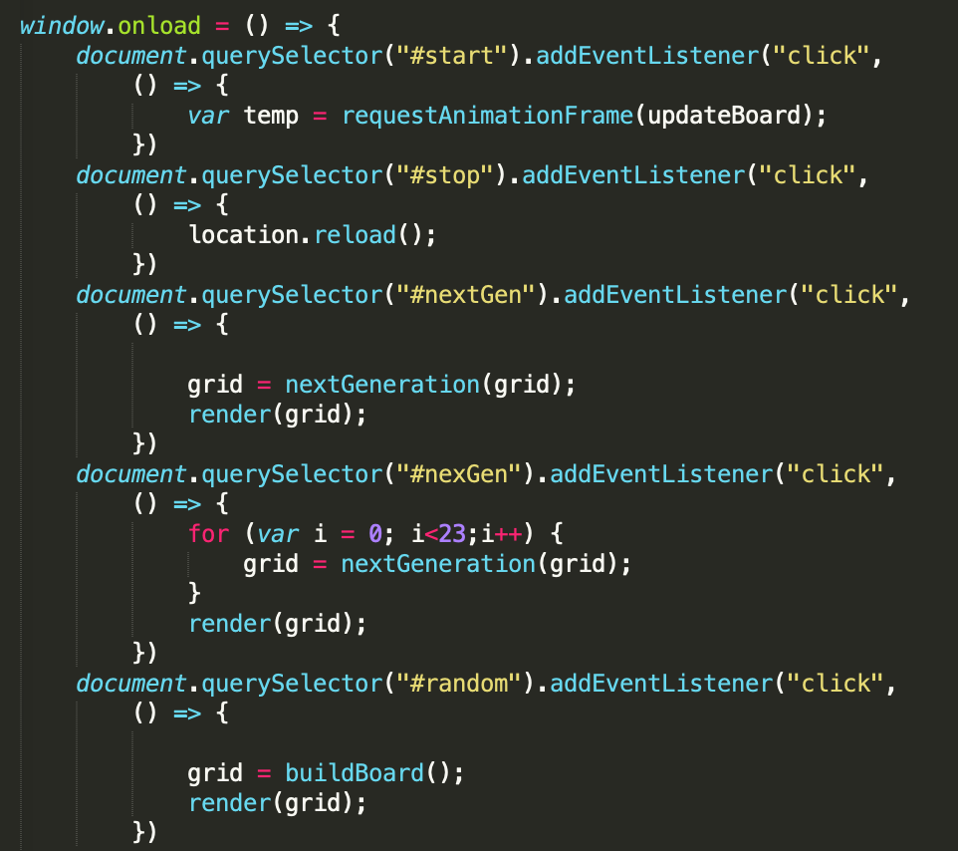

Slide 14

Button Functionality (cont.)
In addition to the previously mentioned buttons included on the webpage, the group added a few more
Sizes – Various buttons were created to allow the user to choose how big, or small, they wanted the grid to be before they started their game. These buttons included: ‘Small’, ‘Medium’ and ‘Large’
Patterns – These buttons provided the user with unique patterns that would fill the grid before having the rules of Conway’s Game of Life applied to said patterns just as it would with the randomly generated board. These buttons included: ‘Glider’ and ‘Pulsar’

Slide 15
Testing
Mainly done by placing alert(); functions at strategic points in the code to see…
If they run
How often they run
In what order they run

Slide 16
Challenges
The primary challenge that the group faced when tackling this project was figuring out how to meet Objective #3, the buttons.
Specifically, the start/end and reset buttons proved to be an unexpected obstacle
Implementing the patterns – Glider, Pulsar, and Block – also proved difficult.
In the end, there turned out to be a few outside resources that provided the insight and guidance that the group needed not only to resolve the button issue, but also in understanding just how Conway’s Game of Life works. Thus, making the creation of our webpage slightly easier than it would have been otherwise.

