Slide 1
E-Commerce

Slide 2
Đinh Xuân Thanh Vũ Phương Tuấn Vương Lâm Kiệt

Slide 3
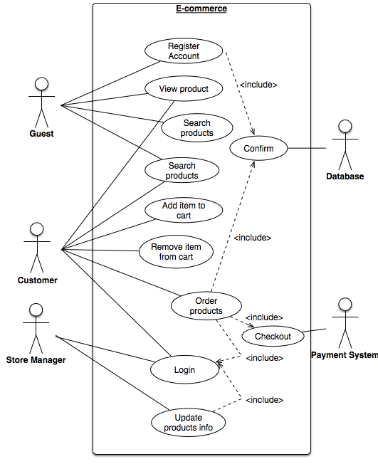
Use case diagram

Slide 4

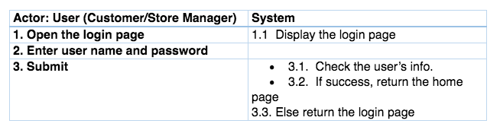



Interaction between user and system

Slide 5
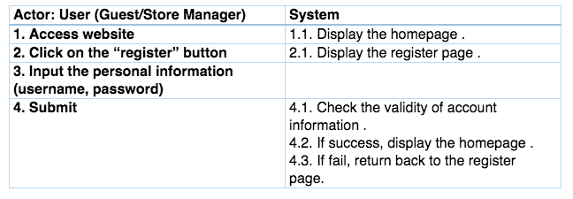
Interaction between user and system

Slide 6

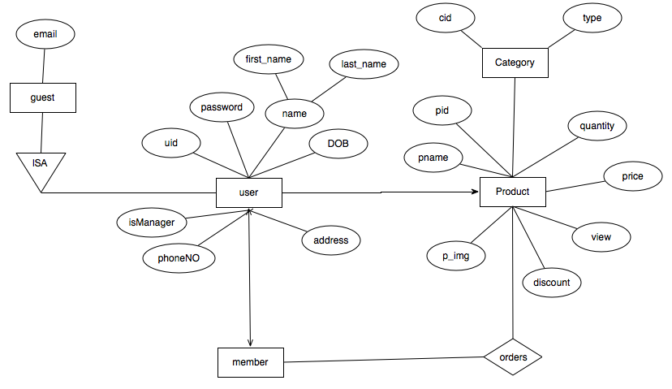

Slide 7
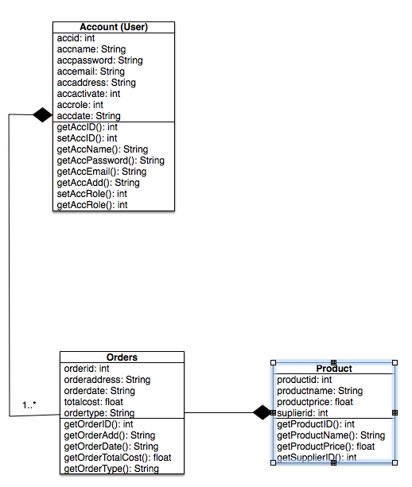

Slide 8
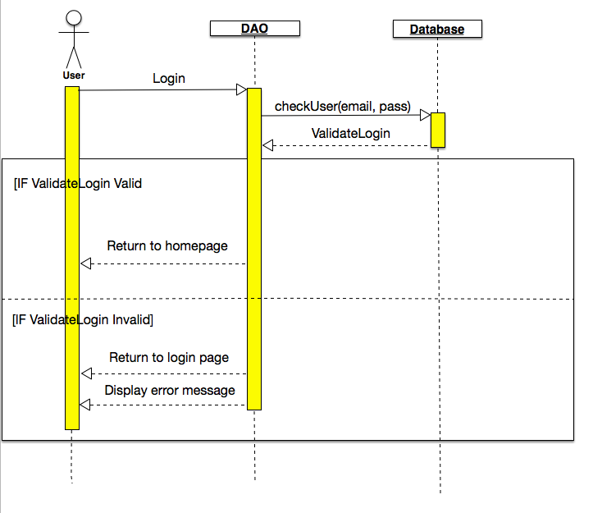
Login

Slide 9
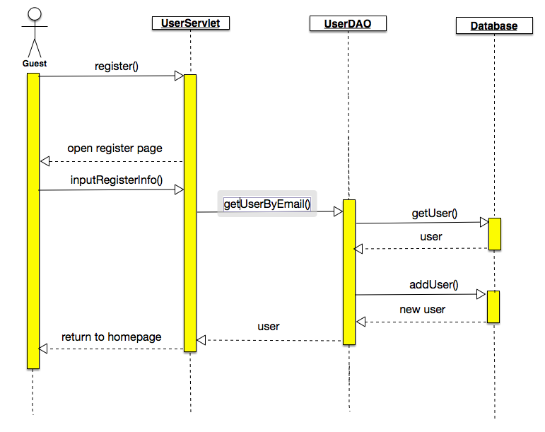
Add new user

Slide 10
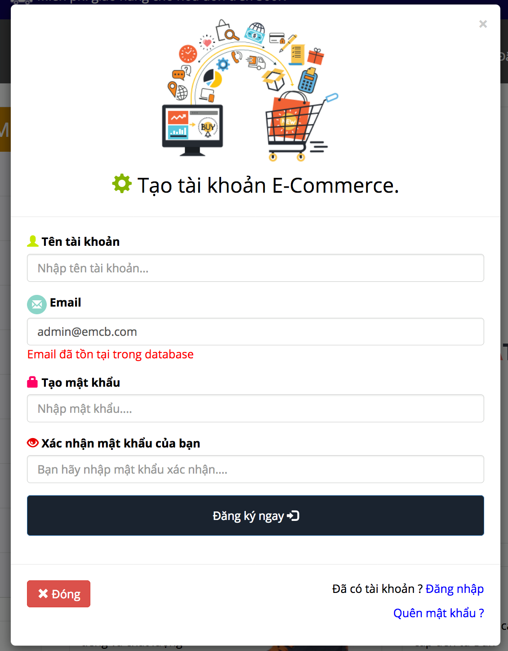
First features

Slide 11
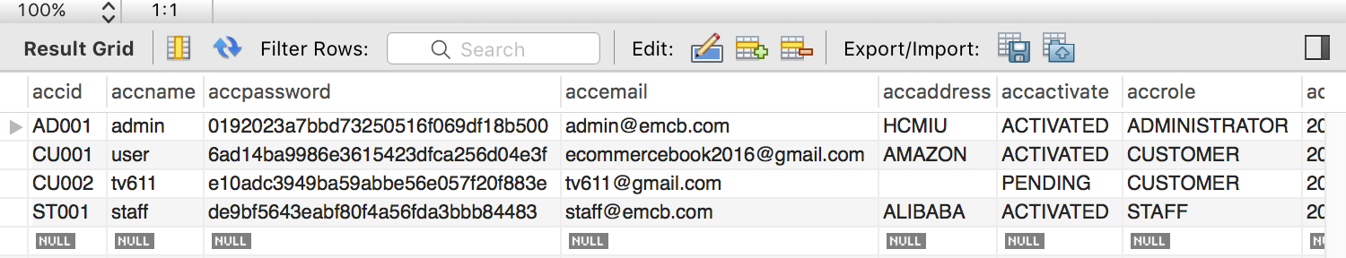
1.

