Slide 1
E-Commerce

Slide 2
Đinh Xuân Thanh Vũ Phương Tuấn Vương Lâm Kiệt

Slide 3
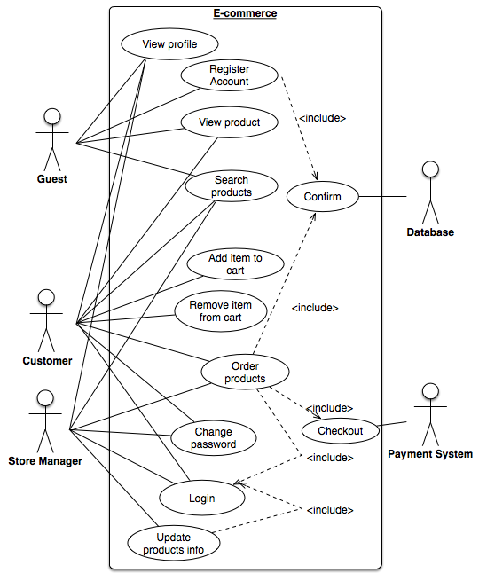
Use case diagram

Slide 4




Interaction between user and system
User (Customer/Store Manager) | System
1. Open the login page | Display the login page
2. Enter user name and password
3. Submit | 3.1. Check the user’s info in database 3.2. If success, return the homepage. 3.3. If fail, return the login page.

Slide 5
Interaction between user and system
User (Guest/StoreManager) | System
1. Access website | Display the homepage
2.Click on the ‘Sign up’ button | Display the register page
3. Fill in the form
4. Submit | 4.1. Check the validity of the account information. 4.2. If success, send a confirmation link to user’s email. 4.3. If fail, warn then reload the register page.

Slide 6

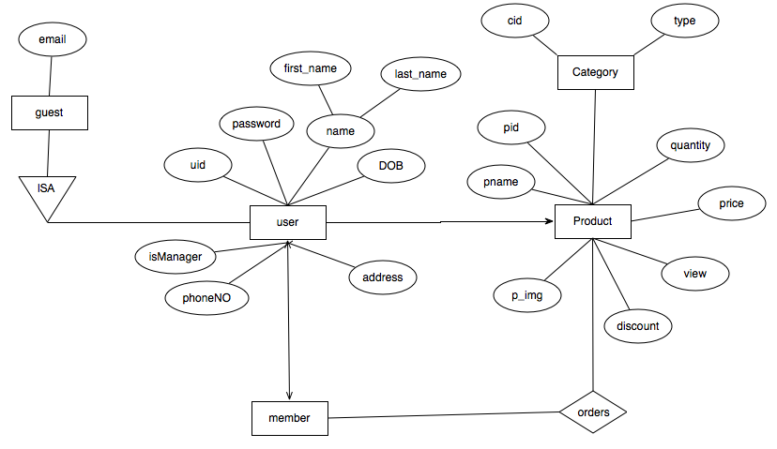

Slide 7
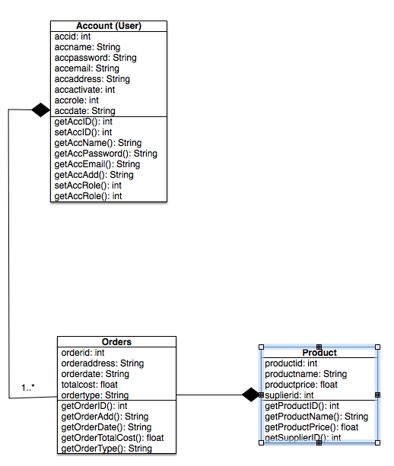

Slide 8
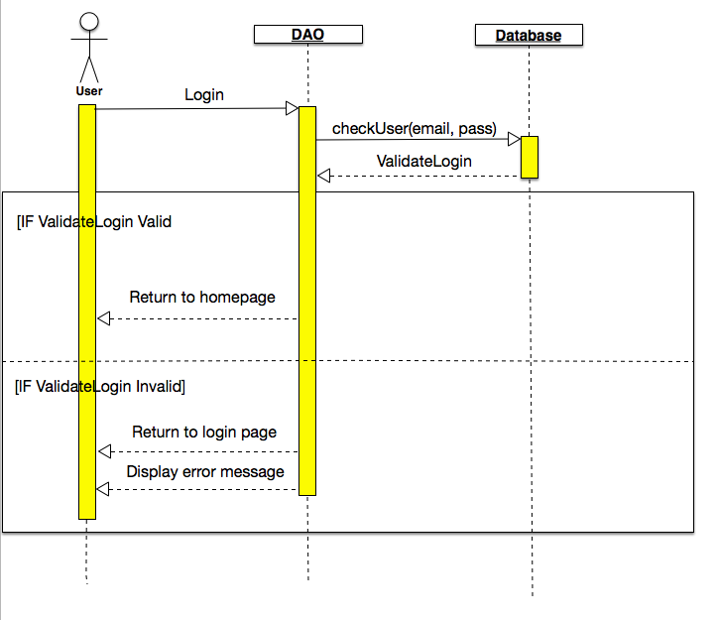
Login

Slide 9
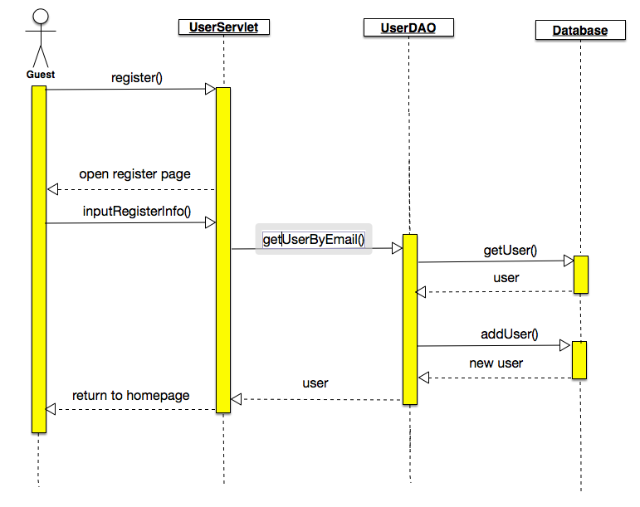
Add new user

Slide 10
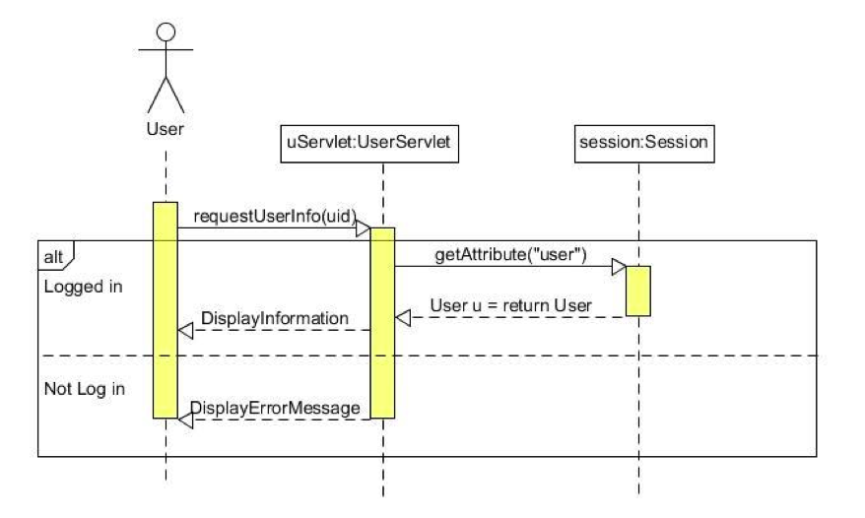
View user’s profile

Slide 11
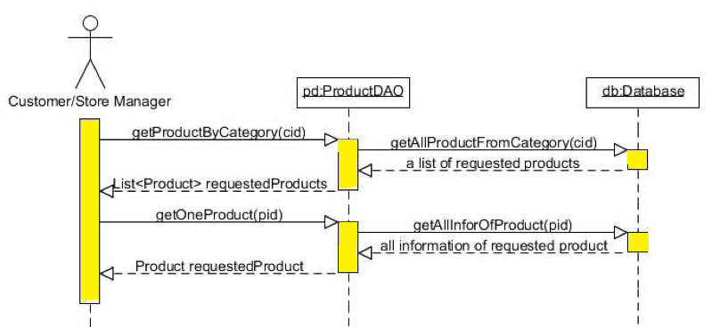
View product’s info

Slide 12
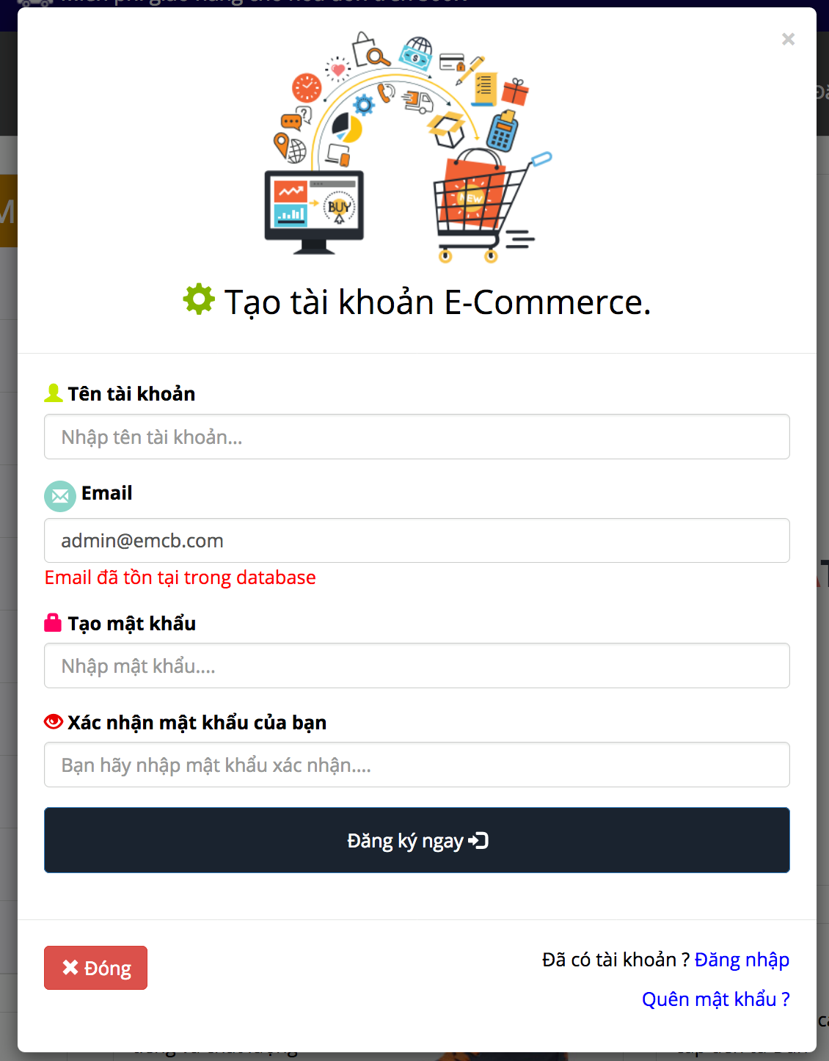
First features

Slide 13
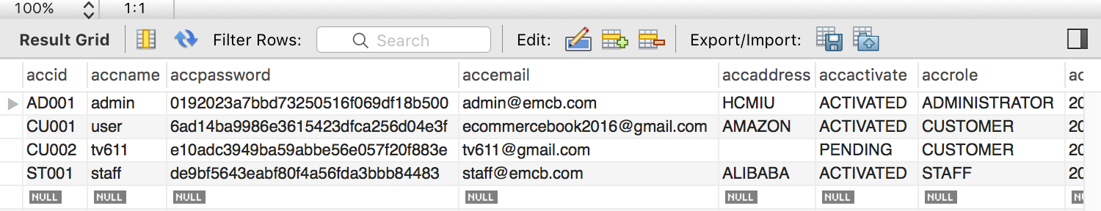
1.

