Slide 1

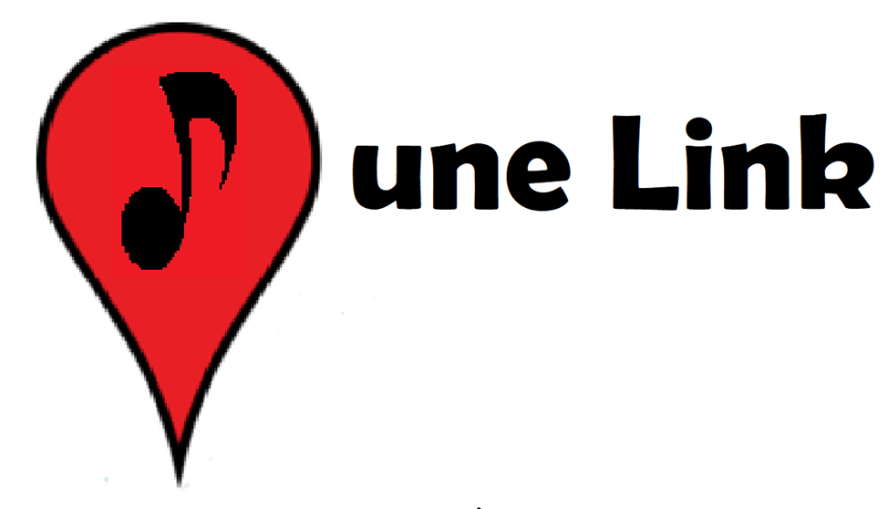
TuneLink
Joe Moon, Jasmine Naraine, Keenan Flynn, Nathan Cheney

Slide 2

Welcome to TuneLink
Introducing TuneLink, interactive concert search engine
Search for live music with meaningful criteria
Search by Spotify ID
Search by Location
Search by Artist name
Search algorithm factors in personal music preference to find vibrant local events

Slide 3
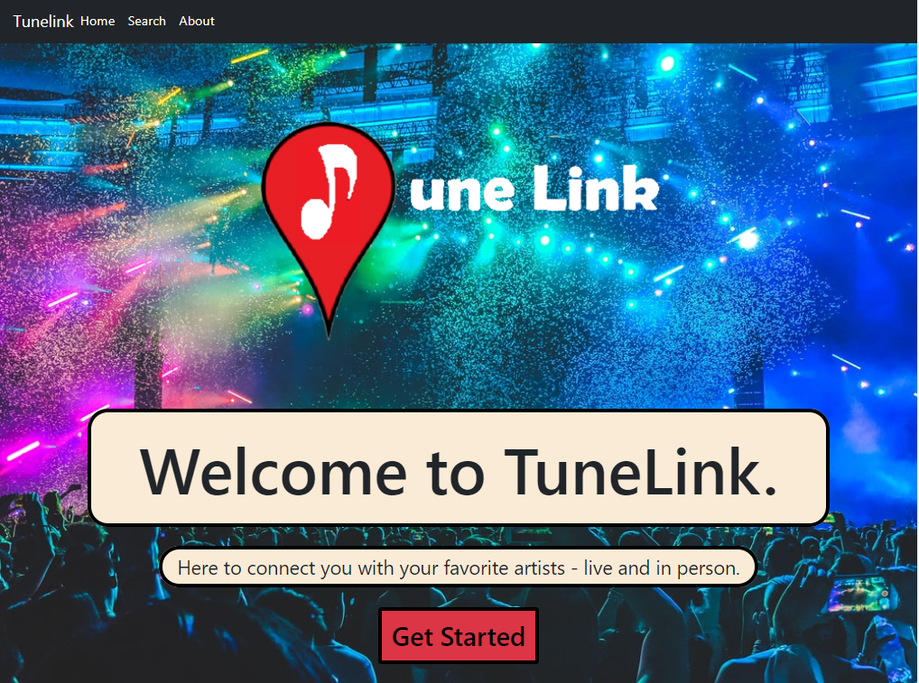
TITLE
Text

Slide 4
Why TuneLink?
Post-Covid resurgence of in-person events/concerts
Competitors: Spotify and SongKick
Spotify
Pro: Premier music streaming service
Con: Concerts are not a primary revenue driver
SongKick
Pro: Allows users to search for upcoming concert events
Con: Music listeners need to import music preferences
TuneLink bridges the gap

Slide 5
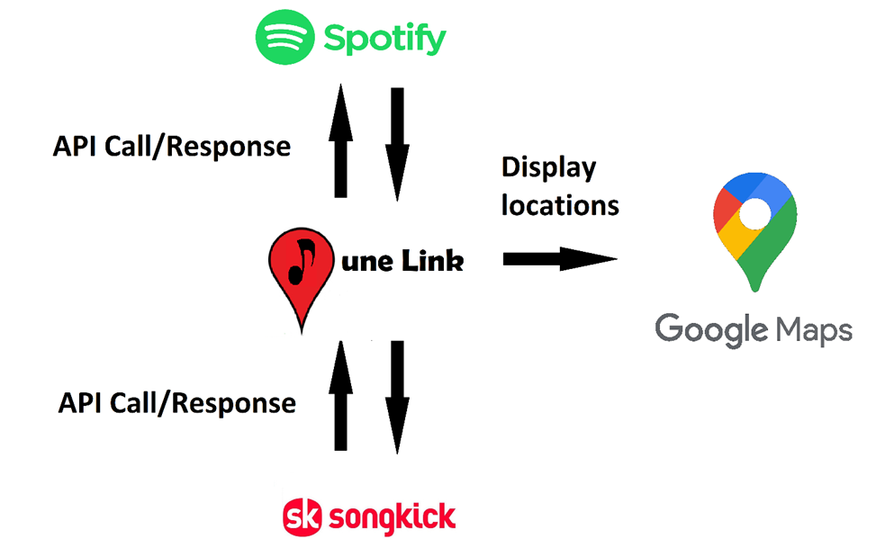
TuneLink Structure

Slide 6
Search by Spotify ID
Enter a Spotify ID and instantly connect with concerts tailored to you
TuneLink queries SongKick database with Artists scraped from Spotify
another bullet point

Slide 7
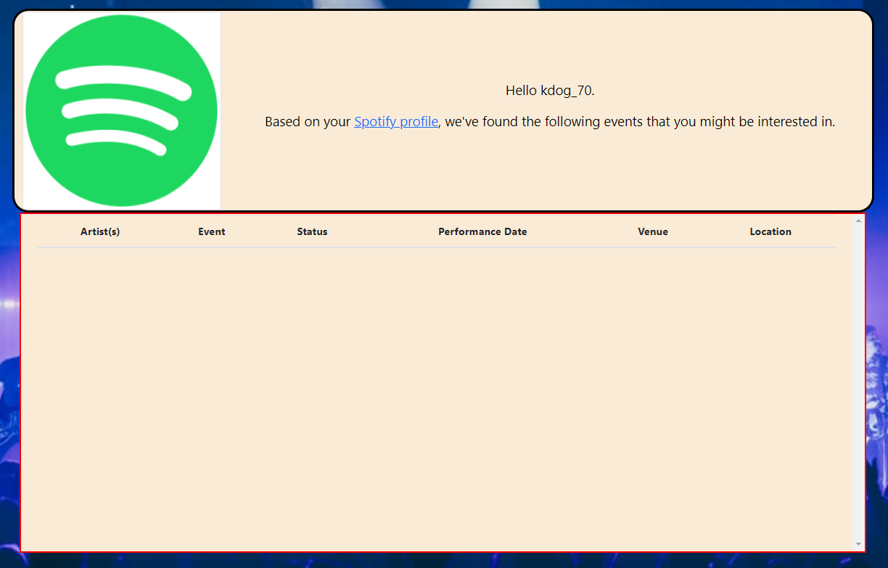
Search by Spotify ID

Slide 8
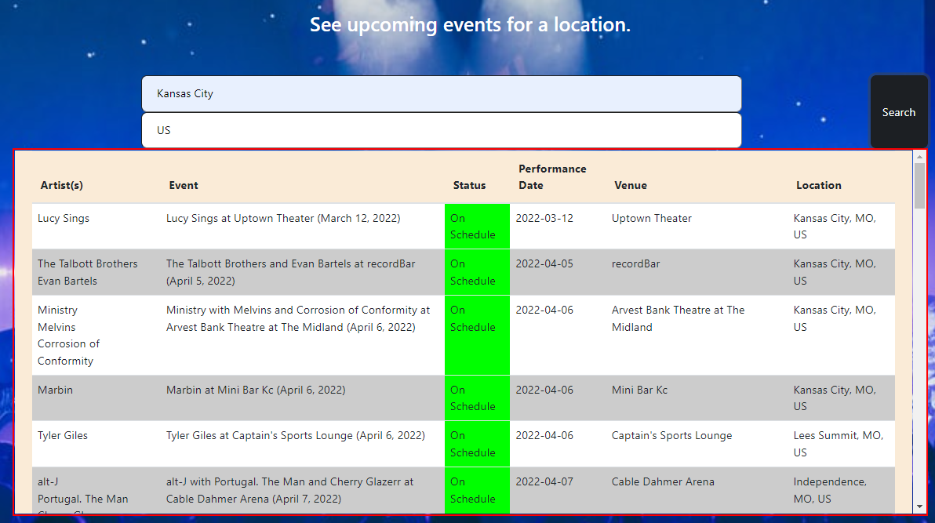
Search by Location
Location event search for users looking for local concerts

Slide 9
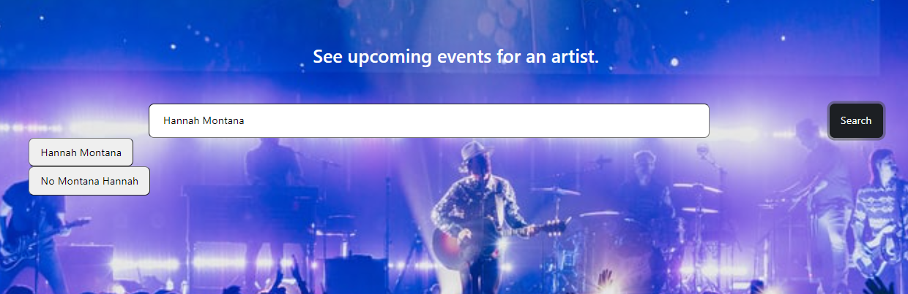
Search by Artist
Artist search for when you can’t get that one song out of your head

Slide 10
Q & A?

