Slide 1
What are Custom Elements ?
Web Components demystification
unveiling the real power of
Custom Elements
by Andrea Giammarchi
@WebReflection

Slide 2
A “brief” history about Web Components

Slide 3
A “brief” history about Web Components
In July 2000, a revolutionary browser went out paving the path for custom elements behavior

Slide 4

A “brief” history about Web Components
In July 2000, a revolutionary browser went out paving the path for custom elements behavior

Slide 5
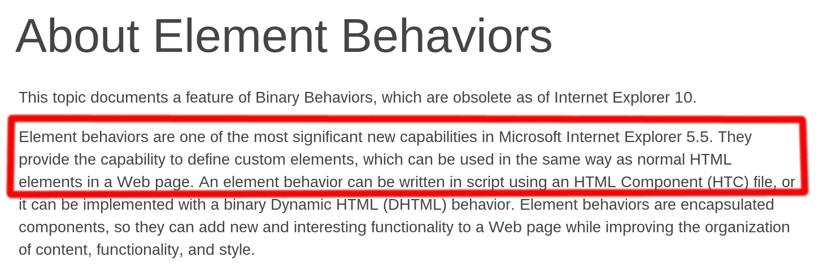
A “brief” history about Web Components
In July 2000, a revolutionary browser went out paving the path for custom elements behavior

Slide 6
A “brief” history about Web Components
In July 2000, a revolutionary browser went out paving the path for custom elements behavior
In May 2012 W3C published a Web Components Working Draft ( edited entirely by Googlers )

Slide 7
A “brief” history about Web Components
In July 2000, a revolutionary browser went out paving the path for custom elements behavior
In May 2012 W3C published a Web Components Working Draft ( edited entirely by Googlers )
In September 2012 Microsoft released IE10

Slide 8

A “brief” history about Web Components
In July 2000, a revolutionary browser went out paving the path for custom elements behavior
In May 2012 W3C published a Web Components Working Draft ( edited entirely by Googlers )
In September 2012 Microsoft released IE10

Slide 9
A “brief” history about Web Components

Slide 10
What are Web Components ?

Slide 11
What are Web Components ?
HTML Templates

Slide 12

What are Web Components ?
HTML Templates

Slide 13
What are Web Components ?
HTML Templates
Shadow DOM

Slide 14
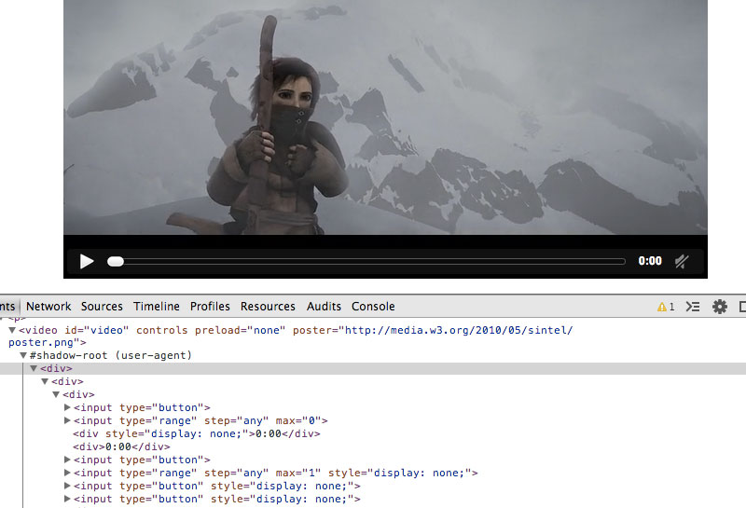
What are Web Components ?
HTML Templates
Shadow DOM

Slide 15
What are Web Components ?
HTML Templates
Shadow DOM
HTML Imports

Slide 16
What are Web Components ?
HTML Templates
Shadow DOM
HTML Imports
Custom Elements

Slide 17
Which browser supports what ?

Slide 18
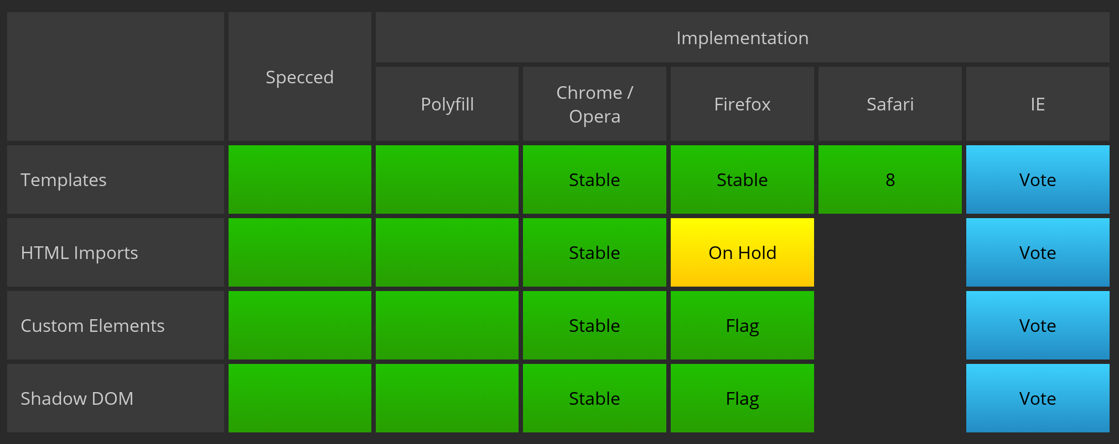
Which browser supports what ?
http://jonrimmer.github.io/are-we-componentized-yet

Slide 19

Which browser supports what ?

Slide 20

Which browser supports what ?

Slide 21
Which browser supports what ?
Dear browsers vendors, you know there's a W3C specification about Web Components, right ?

Slide 22

Which browser supports what ?

Slide 23
Which polyfill for what ?

Slide 24
Which polyfill for what ?
Polymer

Slide 25
Which polyfill for what ?
Polymer
X-Tag

Slide 26
Which polyfill for what ?
Polymer
X-Tag
both based on the same webcomponents.js file

Slide 27
Which polyfill for what ?
Polymer
X-Tag
both based on the same webcomponents.js file
… mine … and for Custom Elements only

Slide 28
Which polyfill for what ?
Polymer
X-Tag
both based on the same webcomponents.js file
… mine … and for Custom Elements only
LIVE DEMO \o/

Slide 29
document-register-element
https://github.com/WebReflection/document-register-element
About 2.1 KB minzipped

Slide 30
document-register-element
https://github.com/WebReflection/document-register-element
About 2.1 KB minzipped
tested against iOS 5.1+, Android 2.2+, FirefoxOS 1.1+, KindleFire 3+, Windows Phone 7+, Opera Mobile 12+, Blackberry OS 7+, webOS 2+, Samsung Bada OS 2+, NOKIA Asha with Express Browser

Slide 31
document-register-element
https://github.com/WebReflection/document-register-element
About 2.1 KB minzipped
tested against iOS 5.1+, Android 2.2+, FirefoxOS 1.1+, KindleFire 3+, Windows Phone 7+, Opera Mobile 12+, Blackberry OS 7+, webOS 2+, Samsung Bada OS 2+, NOKIA Asha with Express Browser
Compatible with every Desktop browser, compatible with IE9+

Slide 32
document-register-element
https://github.com/WebReflection/document-register-element
About 2.1 KB minzipped
tested against iOS 5.1+, Android 2.2+, FirefoxOS 1.1+, KindleFire 3+, Windows Phone 7+, Opera Mobile 12+, Blackberry OS 7+, webOS 2+, Samsung Bada OS 2+, NOKIA Asha with Express Browser
Compatible with every Desktop browser, compatible with IE9+
Automatically compatible with everything else if we do things the right way

Slide 33
What are Custom Elements ?

Slide 34
What are Custom Elements ?
a great opportunity to improve the Web,
improve re-usability for developers,
and improve compatibility for Users!
by Andrea Giammarchi
@WebReflection

Slide 35
What are Custom Elements ?
Thank You!
by Andrea Giammarchi
@WebReflection

