Slide 1
Async & JS
A walkthrough common asynchronous patterns for the client, the server and the Internet Of Things
by Andrea Giammarchi
@WebReflection

Slide 2
quick story about me
Created first offline HTML5 Map navigation in 2011 ( async WebSQL based tileServer, like ServiceWorkers, but in production 4 years ago )
Worked on high traffic fully-async Mobile and Desktop Web applications ( fb, twitter, TweetDeck )
Maniac about performance on constrained environments such ARM, MIPS, or x86 boards
once defined as “the most annoying guy on es-discussion” …

Slide 3
quick story about me
Created first offline HTML5 Map navigation in 2011 ( async WebSQL based tileServer, like ServiceWorkers, but in production 4 years ago )
Worked on high traffic fully-async Mobile and Desktop Web applications ( fb, twitter, TweetDeck )
Maniac about performance on constrained environments such ARM, MIPS, or x86 boards
often complaining about everything I don't understand as developer on es-discuss

Slide 4

quick story about me
Created first offline HTML5 Map navigation in 2011 ( async WebSQL based tileServer, like ServiceWorkers, but in production 4 years ago )
Worked on high traffic fully-async Mobile and Desktop Web applications ( fb, twitter, TweetDeck )
Maniac about performance on constrained environments such ARM, MIPS, or x86 boards
often complaining about everything I don't understand as developer on es-discuss

Slide 5
Buzzboard
XHR
Events
Promises
Generators
Standards, fetch, autocomplete, network ...

Slide 6
XHR
function getContentType(url, callback) {
var xhr = new XMLHttpRequest;
xhr.onload = function () {
callback(this.getResponseHeader('content-type'));
};
xhr.open('HEAD', url, true);
xhr.send(null);
}
getContentType('?xhr', function (contentType) {
console.log(contentType);
});

Slide 7
XHR
function getContentType(url, callback) {
var xhr = new XMLHttpRequest;
xhr.onload = function () {
callback(this.getResponseHeader('content-type'));
};
xhr.open('HEAD', url, true);
xhr.send(null);
}
getContentType('?xhr', function (contentType) {
console.log(contentType);
});

Slide 8
XHR
function getContentType(url, callback) {
var xhr = new XMLHttpRequest;
xhr.onerror = function (e) { callback(e, null); };
xhr.onload = function () {
callback(null, xhr.getResponseHeader('content-type'));
};
xhr.open('HEAD', url, true);
xhr.send(null);
}
getContentType('?xhr', function (err, result) {
console.log(err || result);
});

Slide 9
Events
function getContentType(url, callback) {
var xhr = new XMLHttpRequest;
xhr.addEventListener('error', function (e) { callback(e, null); });
xhr.addEventListener('load', function () {
callback(null, xhr.getResponseHeader('content-type'));
});
xhr.open('HEAD', url, true);
xhr.send(null);
return xhr;
}
getContentType('?xhr', function (err, result) {
console.log(err || result);
}).onload = function (pe) {
// do something else ...
};

Slide 10

Promises

Slide 11
Promises
function getContentType(url) {
return new Promise(function (resolve, reject) {
var xhr = new XMLHttpRequest;
xhr.onerror = reject;
xhr.onload = function () {
resolve(xhr.getResponseHeader('content-type'));
};
xhr.open('HEAD', url, true);
xhr.send(null);
});
}
getContentType('?promise')
.then(function (result) { console.log(result); })
.catch(function (err) { console.warn(err); })
;

Slide 12
Promises
where is the progress ?

Slide 13

Promises
where is the progress ?

Slide 14

Promises
where is the progress ?

Slide 15
Promises
can I cancel that request ?

Slide 16

Promises
can I cancel that request ?

Slide 17

Promises
can I cancel that request ?

Slide 18

Promises
can I cancel that request ?

Slide 19
Promises
Rationale: xhr.abort(); is an explicit intent that triggers an 'abort' event. It is not an error, it is not a completed operation, it's very often needed but is not possible via Promises (yet)

Slide 20
Promises
Rationale: xhr.abort(); is an explicit intent that triggers an 'abort' event. It is not an error, it is not a completed operation, it's very often needed but is not possible via Promises (yet)
Dozen of different discussions all over the web about how to cancel, when, why, and how again

Slide 21
Promises
Rationale: xhr.abort(); is an explicit intent that triggers an 'abort' event. It is not an error, it is not a completed operation, it's very often needed but is not possible via Promises (yet)
Dozen of different discussions all over the web about how to cancel, when, why, and how again
…fetch on autocomplete as very basic example

Slide 22
autocomplete
Shorter is the text, slower the result.

Slide 23
autocomplete
Shorter is the text, slower the result.
Searches start shorter, slower comes later

Slide 24
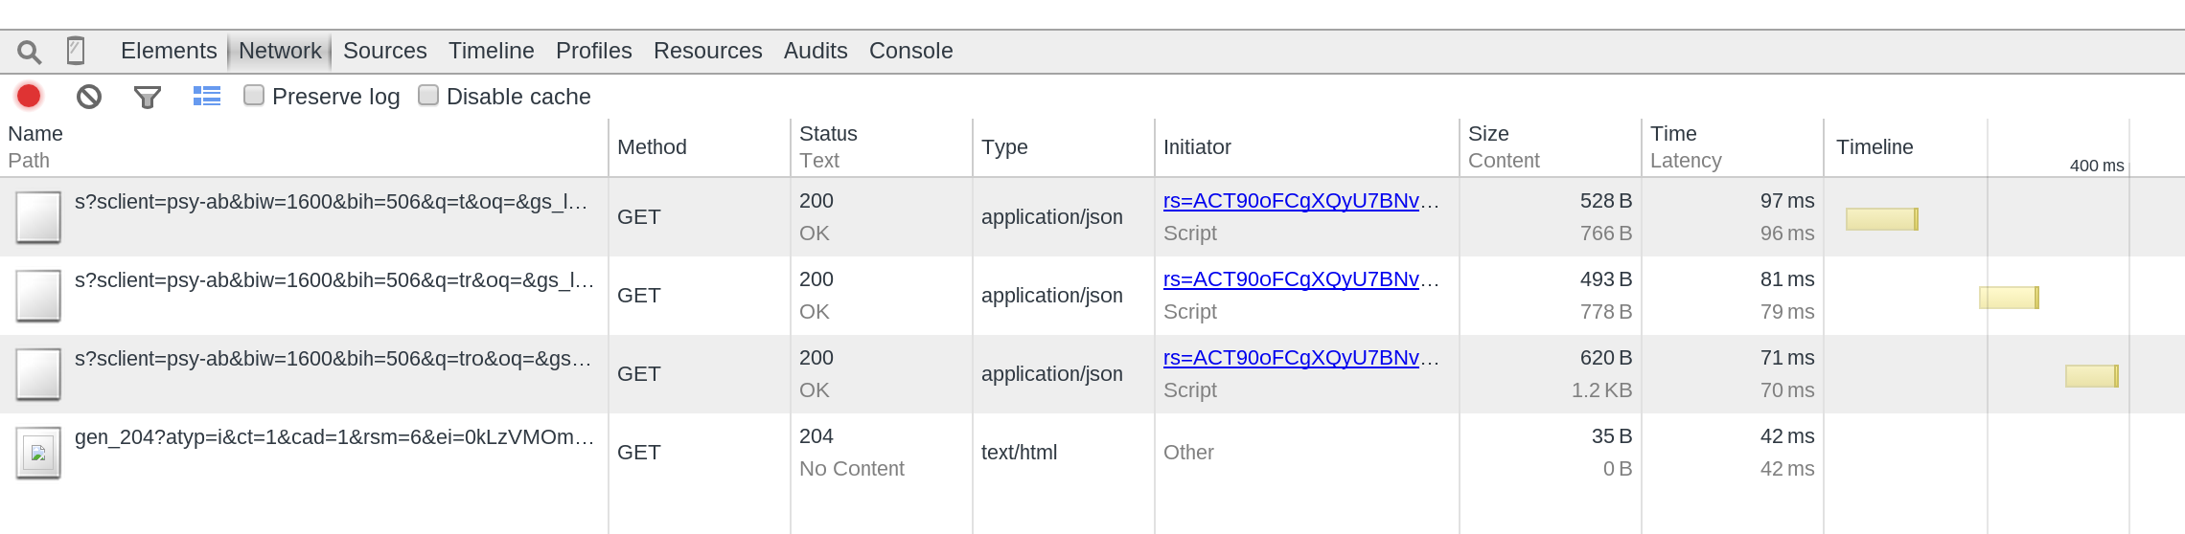
autocomplete
Shorter is the text, slower the result.
Searches start shorter, slower comes later

Slide 25
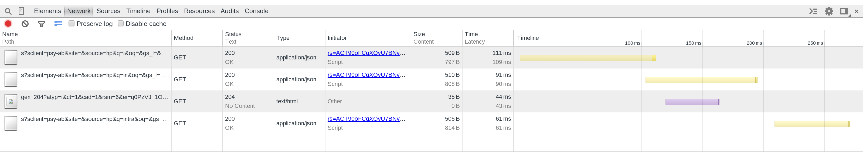
autocomplete
Shorter is the text, slower the result.
Searches start shorter, slower comes later

Slide 26
Fetch API
A Promise based XHRish like API whatwg proposal: https://fetch.spec.whatwg.org

Slide 27
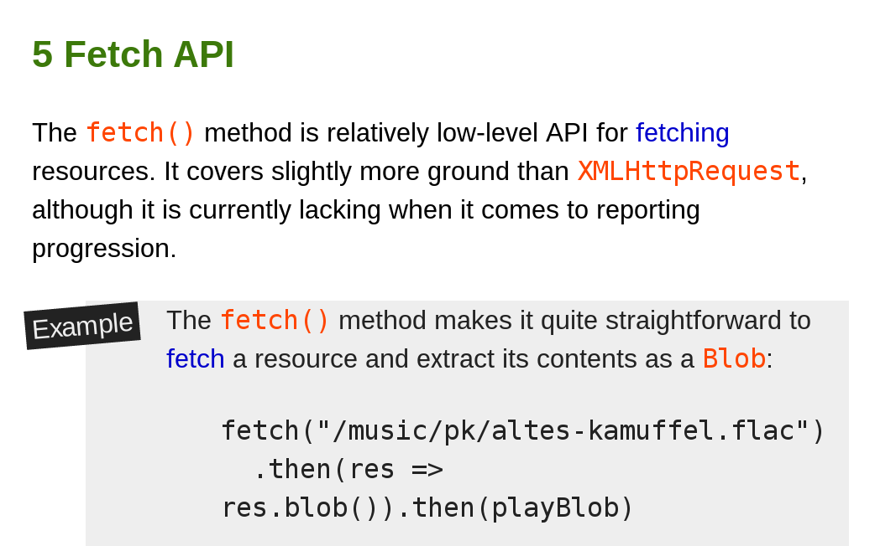
Fetch API
A Promise based XHRish like API whatwg proposal: https://fetch.spec.whatwg.org

Slide 28
Fetch API
A Promise based XHRish like API whatwg proposal: https://fetch.spec.whatwg.org
… AND YOU CANNOT CANCEL IT !!!

Slide 29

Fetch API
A Promise based XHRish like API whatwg proposal: https://fetch.spec.whatwg.org
… AND YOU CANNOT CANCEL IT !!!

Slide 30
Fetch API
Good for actions that do not require progress indication
Good for operations performed behind the scene
Good for one shot / quick read of some lightweight data

Slide 31
Fetch API
Good for actions that do not require progress indication
Good for operations performed behind the scene
Good for one shot / quick read of some lightweight data
But **not** necessarily better than XHR

Slide 32
Generators

Slide 33
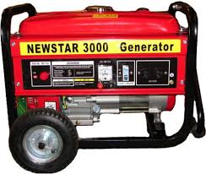
Generators

Slide 34
Generators
function* getTextContent(url) {
var xhr = new XMLHttpRequest;
xhr.open('GET', url, true);
xhr.send(null);
while (xhr.readyState != 4) {
yield Math.floor(((xhr.loaded / xhr.total) || 0) * 100) + '%';
}
yield xhr.responseText;
}
(function loader(gen) {
var status = gen.next();
console.log(status.value);
if (!status.done) setTimeout(loader, 33, gen);
}(getTextContent('?generator')));

Slide 35
Generators
function* getTextContent(url) {
var xhr = new XMLHttpRequest;
xhr.open('GET', url, true);
xhr.send(null);
while (xhr.readyState != 4) {
yield Math.floor(((xhr.loaded / xhr.total) || 0) * 100) + '%';
}
yield xhr.responseText;
}
(function loader(gen) {
var status = gen.next();
console.log(status.value);
if (!status.done) setTimeout(loader, 33, gen);
}(getTextContent('?generator')));

Slide 36

Generators
function* getTextContent(url) {
var xhr = new XMLHttpRequest;
xhr.open('GET', url, true);
xhr.send(null);
while (xhr.readyState != 4) {
yield Math.floor(((xhr.loaded / xhr.total) || 0) * 100) + '%';
}
yield xhr.responseText;
}
(function loader(gen) {
var status = gen.next();
console.log(status.value);
if (!status.done) setTimeout(loader, 33, gen);
}(getTextContent('?generator')));

Slide 37
Generators
var getTextContent = async(function* (url) {
var value = yield fetch(url);
return value;
});
getTextContent('?generator')
.then(function (value) {
console.log(value);
})
.catch(function (error) {
console.warn(error);
});

Slide 38
Generators
function async(generator) {
return function () {
var
g = generator.apply(this, arguments),
handle = function (op) {
var p = Promise.resolve(op.value);
return op.done ? p : p.then(next, fail);
},
next = function (v) { return handle(g.next(v)); },
fail = function (e) { return handle(g.throw(e)); }
;
try { return next(null); } catch (e) {
return Promise.reject(e);
}
};
} // borrowed and modified from https://www.promisejs.org/generators/

Slide 39
Generators
function later() {
return (later.promise = new Promise(function (resolve, reject) {
later.resolve = resolve;
later.reject = reject;
}));
}
function *createGenerator() {
console.log('created');
later.value = yield later();
console.log(later.value);
}
var g = createGenerator(); // nothing logged
g.next(); // created, {value: Promise, done: false}
Promise.resolve(later.promise).then(function (value) {
g.next(value);
});
later.resolve(Math.random());

Slide 40
Generators
function later() {
return (later.promise = new Promise(function (resolve, reject) {
later.resolve = resolve;
later.reject = reject;
}));
}
function* createGenerator() {
console.log('spinned');
later.value = yield later();
console.log(later.value);
}
var g = createGenerator(); // nothing logged
g.next(); // created, {value: Promise, done: false}
Promise.resolve(later.promise).then(function (value) {
g.next(value);
});
later.resolve(Math.random());

Slide 41
Generators
function later() {
return (later.promise = new Promise(function (resolve, reject) {
later.resolve = resolve;
later.reject = reject;
}));
}
function* createGenerator() {
console.log('spinned');
later.value = yield later();
console.log(later.value);
}
var g = createGenerator(); // nothing logged
g.next(); // created, {value: Promise, done: false}
Promise.resolve(later.promise).then(function (value) {
g.next(value);
});
later.resolve(Math.random());

Slide 42
Generators
function later() {
return (later.promise = new Promise(function (resolve, reject) {
later.resolve = resolve;
later.reject = reject;
}));
}
function* createGenerator() {
console.log('spinned');
later.value = yield later();
console.log(later.value);
}
var g = createGenerator(); // nothing logged
g.next(); // spinned, {value: Promise, done: false}
Promise.resolve(later.promise).then(function (value) {
g.next(value);
});
later.resolve(Math.random());

Slide 43
Generators
function later() {
return (later.promise = new Promise(function (resolve, reject) {
later.resolve = resolve;
later.reject = reject;
}));
}
function* createGenerator() {
console.log('spinned');
later.value = yield later();
console.log(later.value);
}
var g = createGenerator(); // nothing logged
g.next(); // spinned, {value: Promise, done: false}
later.promise.then(function (value) {
g.next(value); // {value: undefined, done: true}
});
later.resolve(Math.random());

Slide 44
Generators
function later() {
return (later.promise = new Promise(function (resolve, reject) {
later.resolve = resolve;
later.reject = reject;
}));
}
function* createGenerator() {
console.log('spinned');
later.value = yield later();
console.log(later.value);
}
var g = createGenerator(); // nothing logged
g.next(); // spinned, {value: Promise, done: false}
later.promise.then(function (value) {
g.next(value); // {value: undefined, done: true}
});
later.resolve(Math.random());

Slide 45
Generators
function async(generator) {
return function () {
var
g = generator.apply(this, arguments),
handle = function (op) {
var p = Promise.resolve(op.value);
return op.done ? p : p.then(next, fail);
},
next = function (v) { return handle(g.next(v)); },
fail = function (e) { return handle(g.throw(e)); }
;
try { return next(null); } catch (e) {
return Promise.reject(e);
}
};
} // borrowed and modified from https://www.promisejs.org/generators/

Slide 46
...and what about progress?

Slide 47
Events + Generators + Promises
function loadWithProgress(url, onprogress) {
return new Promise(function (resolve, reject) {
var xhr = new XMLHttpRequest;
xhr.addEventListener('load', function (pe) { resolve(xhr); });
xhr.addEventListener('error', reject);
xhr.addEventListener('progress', onprogress);
xhr.open('GET', url, true);
xhr.send(null);
});
}
var load = async(function *(url, onprogress) {
return yield loadWithProgress(url, onprogress || function (pe) {
console.log(Math.floor(((pe.loaded / pe.total) || 0) * 100) + '%');
});
});
load('/img/activity-launcher.png').then(function (pe) {
console.log(pe.currentTarget.getResponseHeader('Content-Type'));
});

Slide 48
Events + Generators + Promises
function loadWithProgress(url, onprogress) {
return new Promise(function (resolve, reject) {
var xhr = new XMLHttpRequest;
xhr.addEventListener('load', function (pe) { resolve(xhr); });
xhr.addEventListener('error', reject);
xhr.addEventListener('progress', onprogress);
xhr.open('GET', url, true);
xhr.send(null);
});
}
var load = async(function* (url, onprogress) {
return yield loadWithProgress(url, onprogress || function (pe) {
console.log(Math.floor(((pe.loaded / pe.total) || 0) * 100) + '%');
});
});
load('/img/activity-launcher.png').then(function (pe) {
console.log(pe.currentTarget.getResponseHeader('Content-Type'));
});

Slide 49
Events + Generators + Promises
function loadWithProgress(url, onprogress) {
return new Promise(function (resolve, reject) {
var xhr = new XMLHttpRequest;
xhr.addEventListener('load', function (pe) { resolve(xhr); });
xhr.addEventListener('error', reject);
xhr.addEventListener('progress', onprogress);
xhr.open('GET', url, true);
xhr.send(null);
});
}
var load = async(function* (url, onprogress) {
return yield loadWithProgress(url, onprogress || function (pe) {
console.log(Math.floor(((pe.loaded / pe.total) || 0) * 100) + '%');
});
});
load('/img/activity-launcher.png').then(function (xhr) {
console.log(xhr.getResponseHeader('Content-Type'));
});

Slide 50
...any parallel execution?

Slide 51
...any parallel execution?
function read(files) {
return Promise.all(files.map(function (file) {
return new Promise(function (resolve, reject) {
fs.readFile(file, function (err, data) {
if (err) reject(err);
else resolve(data);
});
});
}));
}
async(function* () {
var [a, b] = yield read(['a.txt', 'b.txt']);
})();

Slide 52
Async / Await
async function getTextContent(url) {
var value = await fetch(url);
return value;
}
(async function() {
console.log(
getTextContent('?await')
);
}());

Slide 53
Async & JS
Thank You!
Andrea Giammarchi
@WebReflection

Slide 54
Async & JS
Questions ?
Andrea Giammarchi
@WebReflection

