Slide 1
Paper : Discovering governing equations from data by sparse identification of nonlinear dynamical systems
Reviewed BY-
Suraj Ahirwar

Slide 2
Table of contents:
Paper Description____ 03 - 03
SINDy ? 04 - 04
Steps involved in SINDy____ 05 - 09
Data Collection 06 - 06
Candidate functions library 07 - 07
Sparse Regression techniques and coefficients vectors 08 - 08
SINDy’s mathematical overview 09 - 09
Conclusion and Ref.____
_______________________________________________________!!!!

Slide 3
Discovering governing equations from data by sparse identification of nonlinear dynamical systems
Information:
Title: Discovering governing equations from data by sparse identification of nonlinear dynamical systems
Authors: Steven L. Bruntona, Joshua L. Proctorb , and J. Nathan Kutzc
Publishing Year: 2016
Data-Driven Model Discovery: The primary objective of the paper is to introduce and demonstrate the effectiveness of the Sparse Identification of Nonlinear Dynamical Systems (SINDy) approach for discovering governing equations directly from observational time-series data. The goal is to enable data-driven modeling without prior knowledge of the underlying physics, providing a powerful tool for understanding complex systems.
Interpretable and Generalizable models: SINDy discovers low-dimensional models that are both interpretable and generalizable, unlocking valuable insights into the dynamics of complex systems. The algorithm's ability to provide interpretable models makes it an invaluable tool for understanding system behavior and predicting their future trajectories. The paper showcases successful applications of SINDy in diverse scientific and engineering domains, highlighting its potential to revolutionize system identification and enhance our understanding of complex phenomena.

Slide 4
SINDy ?
Sparse identification of nonlinear dynamical systems!
Sparse Regression and Model Sparsity:
SINDy (Sparse Identification of Nonlinear Dynamical Systems) identifies governing equations from time-series data without explicit physical models.
SINDy employs sparse regression, yielding concise and interpretable models.
Essential terms are retained, promoting model interpretability and reducing overfitting.
Applications and Advantages:
Applied in physics, engineering, biology, finance, and climate science.
Generalizable for accurate predictions beyond training data, facilitating system analysis and control.
Data Quality and Quantity: SINDy's accuracy depends on data quality and quantity, inadequate or noisy data can lead to inaccuracies.
Limitations:
Data Quality and Quantity: SINDy's accuracy depends on data quality and quantity, inadequate or noisy data can lead to inaccuracies.
Model Selection and Overfitting: Selecting appropriate sparsity levels and avoiding overfitting can be challenging, requiring validation.
Nonlinear Interactions: SINDy may struggle with complex nonlinear interactions, particularly with noisy or chaotic data.
Dependency on Data Sampling: Model accuracy can be influenced by the data sampling rate, requiring careful selection.

Slide 5
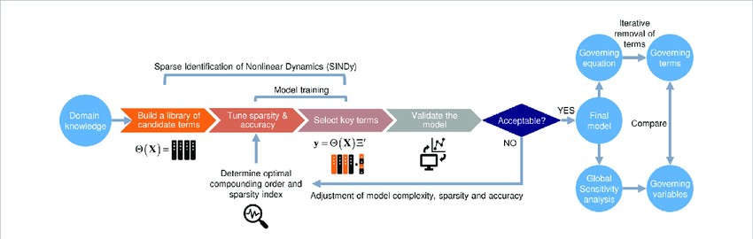

Steps involved in SINDy algorithm:
Data Collection and Preprocessing: Gather time-series data of the system's state variables. Ensure data quality by sufficient sampling and noise removal.
State-Space Reconstruction: Transform time-series data into a state-space matrix (X) with lagged state variable versions.
Library Function Creation: Generate a library of candidate functions representing nonlinear combinations of state variables and derivatives.
Sparse Regression: Perform sparse regression on (X) to find coefficients approximating state variable time derivatives.
Coefficient Thresholding: Apply a small threshold to retain significant coefficients, promoting model sparsity.
Governing Equation Identification: Identify significant terms and coefficients to construct the dynamical system model.
Model Validation and Selection: Validate the model against data, using cross-validation for accuracy assessment. Refine the model to avoid overfitting.
Interpretation and Analysis: Gain insights into system dynamics by analyzing and interpreting the identified governing equations and their terms.

Slide 6

Data collections and preprocessing:
Steps of Collecting Time Series Data and Preparing for Algorithm:
Defining Coordinate Variables or system states:
Coordinate variables represent the system's evolving state variables. Their selection determines state-space complexity:
E.g., a simple pendulum has angular displacement and velocity as coordinate variables.
Let’s assume x_1, x_2, ….x_n are state variables which contributes in the system behaviour, the data X = (x1, x2, ………x_n)
,
Measuring the Data variables at different time intervals:
Sampling Rate: Choose an appropriate rate to capture system dynamics without excessive data or missing critical details.
Data Length: Ensure sufficient duration to cover the system's complete behavior, including transients and steady states.
Measurement Noise: Minimize noise using high-quality sensors, calibration, and repeated measurements.
Filtering the noise from the data:
Polynomial smoothing: It fits a polynomial function to noisy data, capturing the underlying trend while reducing noise impact.
Total Variation Denoising: It minimizes the total variation of the signal while maintaining important features, effectively denoising the data.
Calculating the Derivative:
Use finite difference methods or interpolation techniques to estimate derivatives from discrete data.
Challenges in Performing These Steps:
Measurement Noise and Outliers: If still the data have noise even after applying denoising techniques.
Data Dimensionality: Handling high-dimensional data may require dimensionality reduction techniques due to computational complexity.
Limited Data Availability: Obtaining sufficient high-quality data is challenging for complex systems with limited observations or costly experiments.

Slide 7


Candidate functions library(Θ(x)):
Candidate functions:
The candidate functions library is a set of basis functions from which the potential terms in the governing equations are chosen.
These candidate functions represent different nonlinear combinations of the system's state variables and their derivatives.
The choice of candidate functions plays a crucial role in the success of SINDy in identifying the correct governing equations.
The library should be rich enough to capture the nonlinear interactions present in the system while also being sparse to avoid overfitting.
The candidate functions covers a wide range of functions used in mathematics, polynomials, trigonometric functions, exponentials, logarithmic functions, cross terms of state variables, custom nonlinear functions and constants etc.
Suppose are the candidate functions, then the library matrix can be calculated as,
We uses dimensionality reduction method to optimize the candidate library and filter out the relevant candidates.

Slide 8
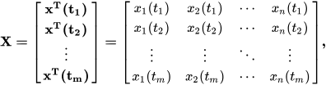


Sparse Regression techniques and sparse coefficients vectors:
Sparse Regression techniques:
Lasso Regression
Sequential Threshold least square: This approach aims to overcome this limitation by iteratively refining the identified model.
Assumption:Only few candidate functions contributes to govern the system dynamics, so that the equations are sparse in space of possible functions
Assumed non linear dynamical system and data calculated over m time samples n states:
Applying Regression over the library matrix and calculating coefficients vectors:
Regression Optimization:

Slide 9
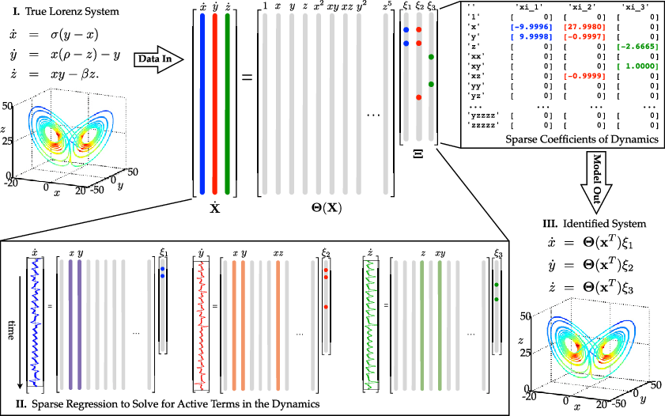
SINDy’s mathematical overview:

Slide 10
Conclusion:
In conclusion, the Sparse Identification of Nonlinear Dynamical Systems (SINDy) algorithm offers a data-driven and interpretable approach for discovering governing equations from time-series data. By leveraging sparsity-promoting techniques, SINDy automatically identifies the most significant terms in complex dynamical systems, resulting in concise and interpretable models.
With SINDy, we can extract underlying dynamics, capture nonlinear interactions, and handle noisy data, making it applicable to a wide range of scientific and engineering domains. The algorithm's ability to provide interpretable models allows for valuable insights into system behavior.
SINDy's robustness and generalizability, combined with techniques like Sequential Threshold Least Squares (STLSQ), enhance the stability and reliability of the model identification process.

Slide 11
References:
Discovering governing equations from data by sparse identification of nonlinear dynamical systems
Supporting Information for: Discovering governing equations from data: Sparse identification of nonlinear dynamical systems
Implementation of SINDy over the food data
—--------- x —--------- x —--------- x—---------
I’m very glad to read this paper!
Thank You!

