Slide 1
CSS: Media Queries
Creating Responsive Web Designs
Мельничук Андрій, 511 група

Slide 2
Importance of responsive web design and role of CSS media queries
Responsive web design is crucial in today's digital landscape due to the widespread use of various devices with different screen sizes and resolutions. It refers to the practice of designing and developing websites that adapt and display appropriately on different devices, such as desktop computers, laptops, tablets, and smartphones.
CSS media queries are an essential component of responsive web design. They allow developers to apply different styles and layout rules based on the characteristics of the device or viewport that the website is being viewed on. Media queries enable websites to adapt and provide an optimal user experience across a wide range of devices, including desktops, laptops, tablets, and mobile phones.

Slide 3
What are Media Queries?
Media queries are a CSS feature that allows you to apply different styles and layout rules based on the characteristics of the device or viewport that a web page is being viewed on. They enable you to create responsive designs that can adapt and provide an optimal user experience across a variety of devices and screen sizes.
Media queries work by evaluating specified conditions and applying the associated styles only when those conditions are met. These conditions typically involve checking properties such as screen width, screen height, device orientation, device resolution, and more. When the conditions are satisfied, the styles within the media query are applied, overriding any previous styles.

Slide 4

Media Query Syntax
Media queries are a fundamental part of responsive web design, allowing developers to apply different styles or layouts based on the characteristics of the device or viewport. The syntax for media queries is relatively straightforward. Here's the basic structure:
@media: This is the keyword that indicates the start of a media query rule.
media_type: It specifies the type of media the query is targeting, such as screen, print, speech, all, or specific media types like tv or projection.
and: This is an operator used to combine multiple conditions within a media query. It allows you to specify additional features or requirements for the media query to match.
media_feature: It represents a specific feature or characteristic of the targeted media, such as width, height, orientation, color, resolution, etc. There are many available media features to choose from.
value: It denotes the value or range of values for the specified media feature. For example, width: 768px or orientation: landscape.

Slide 5
Media Features
Media queries in CSS allow you to apply different styles based on the characteristics of the device or browser being used to view your web page. They are commonly used to create responsive designs that adapt to different screen sizes and orientations. Here are some common media features that can be used in CSS media queries:
1) Width and Height (‘min-width’ and ‘max-width’: Sets the minimum and maximum width of the viewport. ‘min-height’ and ‘max-height’: Sets the minimum and maximum height of the viewport.)
2) Orientation (‘orientation: portrait’: Applies styles when the viewport is in portrait mode. ‘orientation: landscape’: Applies styles when the viewport is in landscape mode.)
3) Resolution (‘min-resolution’ and ‘max-resolution’: Sets the minimum and maximum resolution of the output device, usually in dots per inch (DPI) or dots per centimeter (DPCM).)
4) Device aspect ratio: (‘aspect-ratio’: Sets the aspect ratio of the viewport. ‘min-aspect-ratio’ and ‘max-aspect-ratio’: Sets the minimum and maximum aspect ratio of the viewport.)

Slide 6
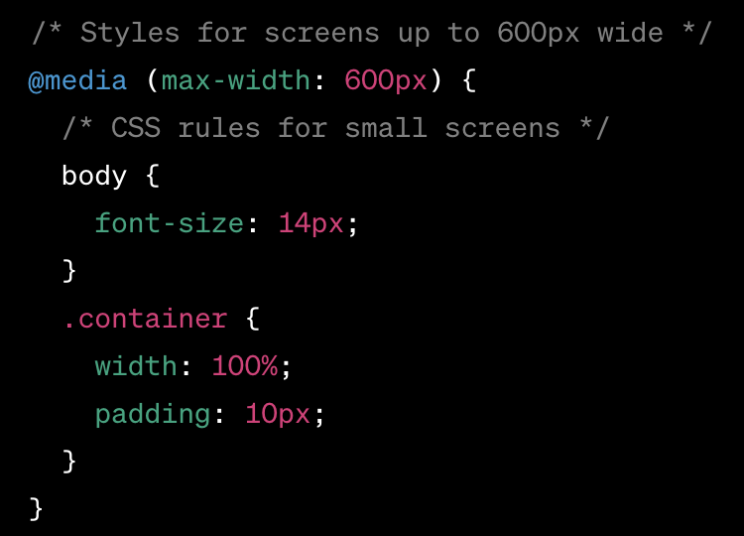
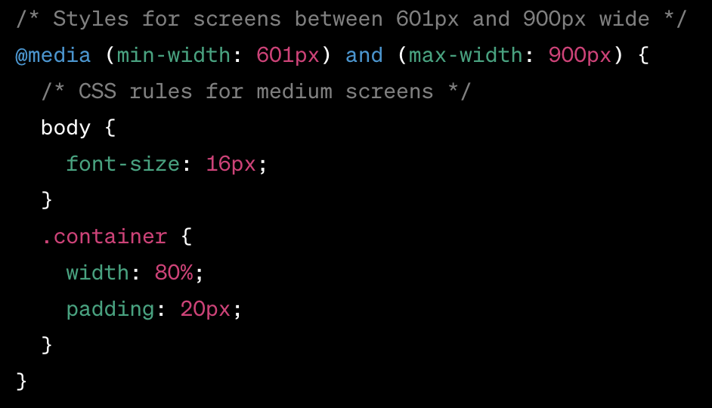
Breakpoints
In CSS, breakpoints are used to define different styles for different screen sizes or devices. They allow you to create responsive designs that adapt to the available viewport space. Breakpoints are typically used in conjunction with media queries to apply specific CSS rules based on the width of the screen.

Slide 7
CSS Layout Adjustments
CSS layout adjustments refer to modifications made to the positioning, size, and spacing of elements on a webpage using CSS (Cascading Style Sheets). CSS provides a set of rules and properties that allow web developers to control the visual presentation of HTML elements. Here are some common CSS techniques used for layout adjustments:
Box Model;
Positioning;
Floats;
Flexbox;
Grid;
Media Queries;

Slide 8
Flexible Grid Systems
Flexible grid systems are a popular approach to create responsive and flexible layouts in web design. These systems allow you to create grids that adapt and reflow based on the available screen space. Here are two commonly used flexible grid systems:
CSS Grid. CSS Grid is a powerful layout system that provides a flexible grid structure for web pages. It allows you to define rows and columns and position elements within them.
Bootstrap Grid System. Bootstrap is a popular front-end framework that provides a flexible grid system along with many other UI components. The Bootstrap grid system uses a 12-column layout and offers responsive classes to control the layout at different screen sizes.
Both CSS Grid and the Bootstrap grid system offer powerful and flexible ways to create responsive layouts. You can choose the one that best fits your project requirements and familiarity with the frameworks or CSS features.

Slide 9
Testing and Debugging
Testing and debugging CSS media queries can be done using various methods and tools. Here are some approaches you can take:
Browser Developer Tools: Most modern web browsers come with built-in developer tools that allow you to inspect and debug CSS.
Responsive Design View: Many browsers also offer a responsive design view that allows you to quickly switch between different device sizes.
Device Emulators: If you need to test on specific devices or screen resolutions, you can use device emulators or simulators.
Online Testing Tools: Several online tools are available specifically for testing and previewing responsive designs.
Manual Testing: While automated testing tools can be useful, it's also important to manually test your website on different devices and screen sizes.

Slide 10
Best Practices and Conclusion
Keep media queries organized
Avoid using too many breakpoints
Use mobile-first approach
Prioritize content and functionality
Media queries play a critical role in creating responsive web designs that adapt to different devices and screen sizes. By using media queries, we can apply specific styles based on the device's characteristics, allowing us to create a consistent and optimized user experience across a range of platforms.

