Slide 1
Exploring Efficiency: An In-depth Analysis of Parallelism and Distribution in Computing Systems

Slide 2


1. Introduction to
Parallelism
This presentation explores the e ciencies of parallelism and distribution in computing systems. We will examine the potential for increased performance through the understanding and application of parallel architectures, algorithms and paradigms. We will also analyze the implications of distribution on current and future systems.

Slide 3


2. Distribution in
Computing
Distribution in computing involves distributing parts of a process or a workload across multiple physical or virtual machines. This allows for increased scalability, cost reduction, and resilience which are key for modern systems. Understanding the implications of distributed computing and its role in the future of computing will enable us to maximize e ciency

Slide 4


3. Types of Parallel
Computing
Parallel computing enables multiple tasks to be processed concurrently and can speed up a process signi cantly. It can be implemented using shared and distributed memory systems, as well as using distributed computing solutions such as message passing.
Understanding the di erent types of parallel computing will help to maximize system e ciency.

Slide 5

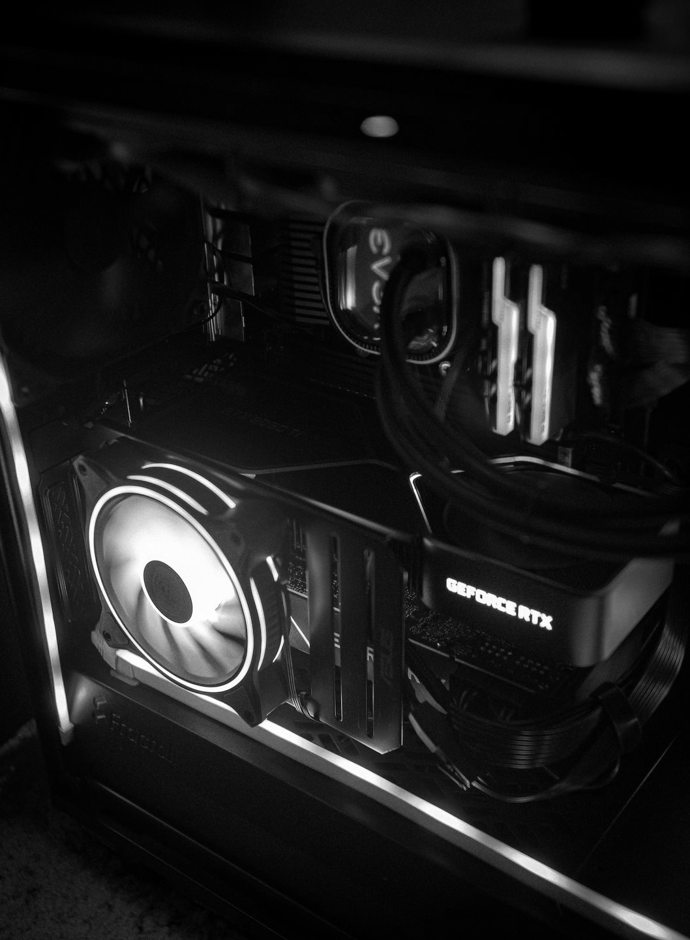
4. Modern
Hardware Advancements
Modern hardware advancements have enabled high levels of parallelism and distribution in computing systems. These advances, such as GPUs and distributed systems, can greatly improve system e ciency. New software solutions such as MapReduce and vector alignment have also been developed to take advantage of these new hardware technologies.

Slide 6
5. Effective
Parallel Algorithms
Parallel algorithms allow multiple processes to work on the same problem in an e cient manner, enabling signi cant improvements in speed and e ciency. E ective parallel algorithms can dramatically reduce computation time and cost, leading to more powerful and
e cient computing systems.

Slide 7


6. Methods for
Data Distribution
There are various methods for distributing data in parallel algorithms, including repartitioning, decomposition, scattering, replication, and global address space. Each has its own advantages and disadvantages, making it important to consider the best option when deploying a parallel algorithm.

Slide 8


7. Performance
Metrics
Performance metrics such as timeliness, scalability, and cost
e ectiveness are essential to consider when developing parallel algorithms. Di erent metrics can be used to determine how well a distributed system is performing on each task, such as the time taken to complete the task, the amount of data that has been processed

Slide 9


8. Case Studies
Various case studies have been conducted to explore the functionality of distributed and parallel computing systems, including distributed databases, distributed le systems, and cluster computing. These studies have provided insight into system performance, revealing the strengths and weaknesses of di erent architectures and algorithms.

