Slide 1

Token Based Security

Slide 2
Token-based security
Token-based security is a type of security that involves the use of tokens to authenticate and authorize access to resources
Instead of relying on traditional session-based authentication, token-based security uses tokens to authenticate and authorize access to resources.

Slide 3
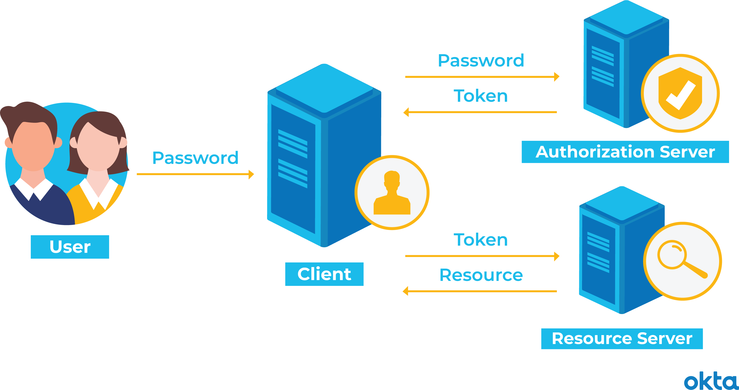
Tokens
Tokens are digital credentials that are used to authenticate and authorize access to resources.
Tokens can be used to authenticate users or machines and can contain information about the user's identity, permissions, and authentication status.
Tokens are typically issued by an authorization server and are used to grant access to specific resources.

Slide 4
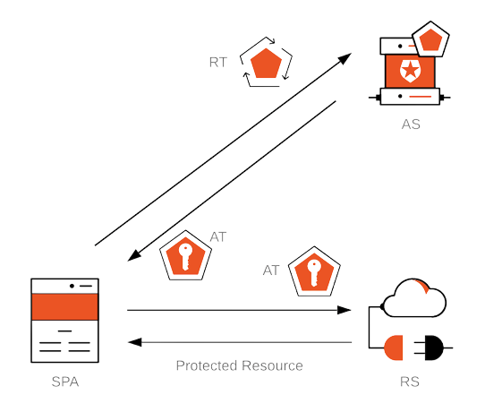
Types of Tokens
There are two main types of tokens: access tokens and refresh tokens.
Access tokens are short-lived tokens that grant access to specific resources for a limited period of time.
Refresh tokens are long-lived tokens that can be used to obtain new access tokens when they expire.

Slide 5
Token Formats
There are several token formats that can be used in token-based security, including JWT, OAuth, and SAML.
Each format has its own advantages and disadvantages, and the choice of format depends on the specific requirements of your application.
JWT is often preferred for its ease of use and flexibility, as it allows you to include custom claims and has good support in many programming languages and frameworks.
However, OAuth and SAML may be a better fit for certain use cases, such as social login or federated identity scenarios where a third-party identity provider is involved.

Slide 6
JSON Web Tokens (JWT)
JWT (JSON Web Token) is one of the most widely used token formats in token-based security
JWT is a compact, URL-safe means of representing claims to be transferred between two parties.
JWT consists of three parts: a header, a payload, and a signature.

Slide 7
JWT Payload
The JWT payload contains the claims or assertions about the user, such as their ID, roles, and permissions.
The claims are stored as key-value pairs and can be used by the application to authorize access to specific resources.
JWT also supports custom claims, which can be used to store additional information about the user.

Slide 8
JWT Signature
The JWT signature is used to verify the integrity of the token.
The signature is generated by combining the encoded header, encoded payload, and a secret key known only to the server.
When the token is received, the server verifies the signature to ensure that the token has not been tampered with.

Slide 9
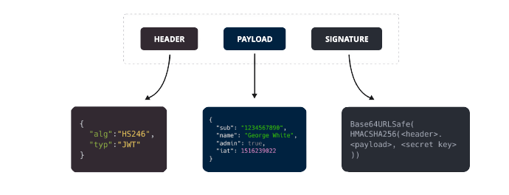
Structure of a JWT

Slide 10
Conclusion
Token-based security is a powerful tool for securing your web application or API.
By using tokens to authenticate and authorize access to resources, you can improve the security, scalability, and flexibility of your authentication system.
When choosing a token format, consider the specific requirements of your application and choose a format that meets those requirements.

Slide 11

Thanks!

