Slide 1

Working Effectively With Legacy Code
Підготував: студент 511 групи Сірий Святослав

Slide 2


Working Effectively With Legacy Code
Legacy code exists in every software project. In this presentation, we will explore strategies for working with legacy code and discuss techniques for improving its quality and maintaining it over time.

Slide 3

Understanding Legacy Code
1 2
What is Legacy Code?
Why Is Legacy Code Important?
Legacy code is code written in a language or technology that is no longer current, tends to be hard to maintain due to its complexity, and was not written with modern best practices.
Legacy code is crucial for a business. It's in constant use and affecting millions of people. Ignoring it can lead to business-wide issues.
3
Challenges in Understanding Legacy Code
Legacy code can be difficult to understand due to its complexity, lack of documentation, and the people who initially wrote it may no longer be available to explain it.

Slide 4
Strategies for Working with Legacy Code
Testing the Code Applying Patterns
Write extensive tests to ensure that your changes do not break existing functionality.
Apply design patterns to keep the code understandable and manageable.
1
2
3
4
Understanding the Code
Refactoring the Code
Change the existing code without affecting its external behavior to make it more maintainable.
Take time to understand the code before making changes.

Slide 5


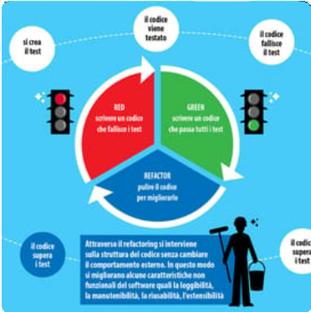
Refactoring Techniques for Legacy Code
Extract Method
Introduce Parameter Object
Replace Conditional with Polymorphism
Divide a larger method into smaller, more manageable pieces.
Group variables that are used together as a single parameter object.
Create a hierarchy of classes to handle different cases instead of using numerous conditionals.

Slide 6
Code Coverage By Testing
Type of Tesľiną Descripľion
Unit testing | Testing individual units of code in isolation.
Integration testing Testing how multiple code units interact with each other.
Acceptance testing | Testing software from a user's perspective.

Slide 7
Test-Driven Development (TDD) and Legacy Code
Benefits of TDD
Workiną with Legacy Code and TDD
Challenges of TDD on Legacy Code
Provides a safety net, prevents regression, and ties testing to implementation.
Tests require dependencies to be isolated; introducing dependencies on previously untested code can be a challenge.
Start by creating high-level tests, followed by more specific tests. As you refactor code, keep improving the suite of regression tests.

Slide 8
Applying Design Patterns to Legacy Code
1
Singleton Pattern
Ensure that a class only has one instance and provide a global point of access to it.
2
Adapter Pattern
Convert the interface of a class into another interface that clients expect.
3
Bridge Pattern
Separate an object's interface from its implementation.
4
Factory Method Pattern
Define an interface for creating objects and allow subclasses to decide which class to instantiate.

Slide 9



Maintaining Legacy Code Quality
Code Reviews
Pair Programming
Audit your Code
A formal process that involves examining the code, identifying bugs, and suggesting improvements.
Two people work together on a code project, sharing knowledge and skills to solve coding challenges.
Perform manual and automated reviews to ensure that your code meets best practices and adhere to your coding standards.

Slide 10
Legacy Code Migration and Modernization
Migration Legacy Code
Modernizing Legacy Code
Replacing Legacy Code
Port the legacy code to a new technology stack.
Refactor the legacy code directly in the older technology stack to make it easier to maintain and enhance.
Replacing legacy code is an excellent option if it proves difficult to work with.

Slide 11
Conclusion
Legacy code can be difficult to work with, but it's essential to maintain and improve it to retain the value it adds to your organization. Be patient when working with legacy code, plan your refactoring well, and never forget to test your changes.

Slide 12
Thank You!
Thank you for joining us for this journey through legacy code. We hope that you found it informative and insightful. Remember, working with legacy code can be challenging, but with the right strategies and techniques, you can make it a rewarding experience.

