Slide 1
Cloud Solutions (GCP, AWS, Azure)
Olexiy Mitskan 511 group

Slide 2
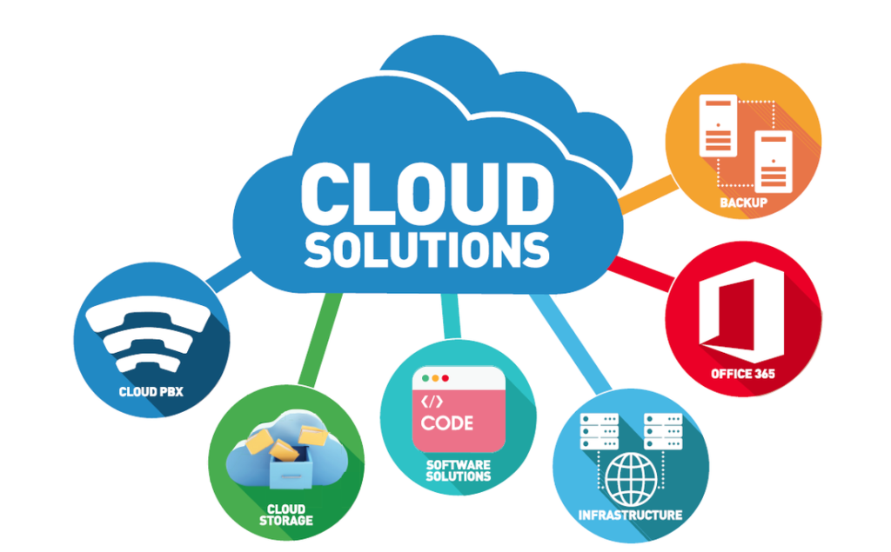
Introduction
Cloud solutions have revolutionized the way businesses operate by offering flexible, scalable, and cost-effective computing resources.
Three major players in the cloud market are GCP (Google Cloud Platform), AWS (Amazon Web Services), and Azure (Microsoft Azure).
In this presentation, we will explore these cloud solutions and their key features.

Slide 3
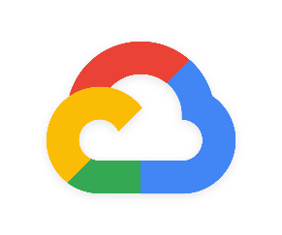
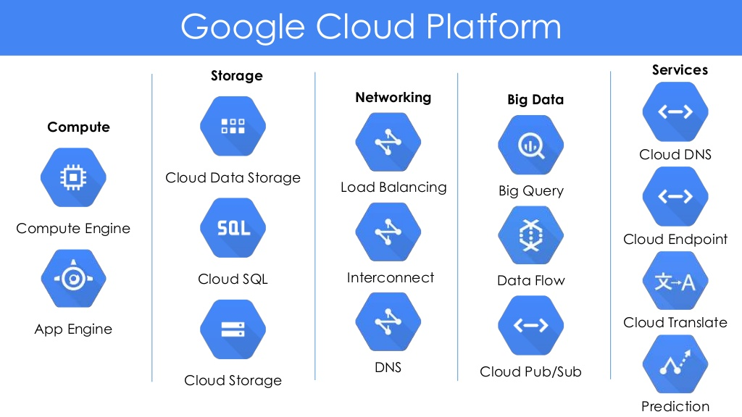
Google Cloud Platform (GCP)
Developed by Google, GCP offers a wide range of cloud services.
Key features:
Compute Engine: Provides virtual machines for computing power.
App Engine: Offers a platform for building and hosting web applications.
Big Query: Allows for fast and efficient big data analytics.
Cloud Storage: Provides scalable storage solutions.
Machine Learning: Offers tools and services for machine learning and AI applications.

Slide 4
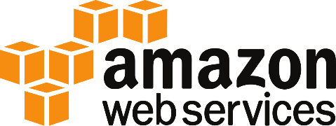
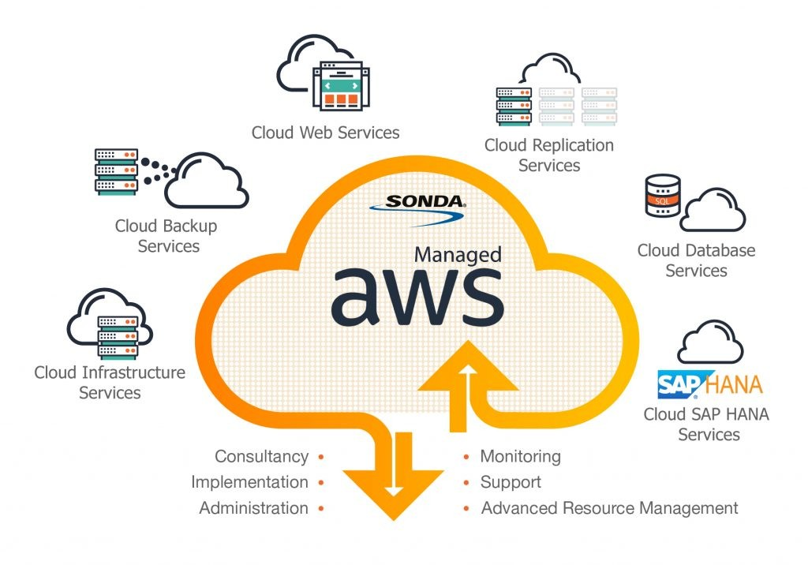
Amazon Web Services (AWS)
AWS, provided by Amazon, is the leading cloud platform.
Key features:
Elastic Compute Cloud (EC2): Provides resizable compute capacity in the cloud.
Simple Storage Service (S3): Offers scalable object storage for data storage and retrieval.
Lambda: Enables server less computing for running code without provisioning or managing servers.
Amazon RDS: Provides managed relational databases in the cloud.
Amazon Dynamo DB: Offers a fast and flexible NoSQL database service.

Slide 5
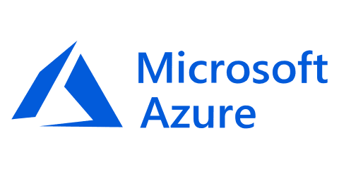
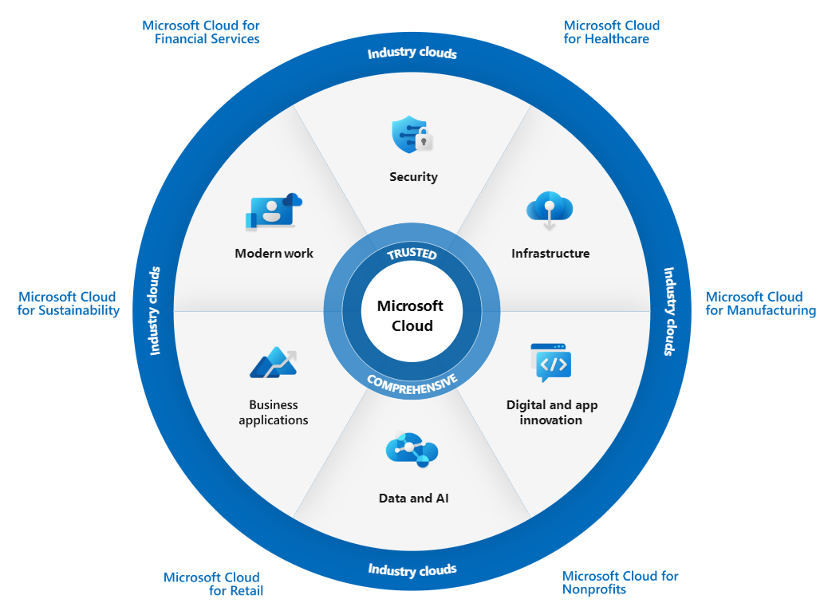
Microsoft Azure
Azure, developed by Microsoft, is a comprehensive cloud platform.
Key features:
Virtual Machines: Provides scalable compute power with virtual machines.
Azure Storage: Offers various storage options, including blob, file, and table storage.
Azure Functions: Enables server less computing similar to AWS Lambda.
Azure SQL Database: Provides a fully managed relational database service.
Azure Cognitive Services: Offers AI services for vision, speech, language, and more.

Slide 6
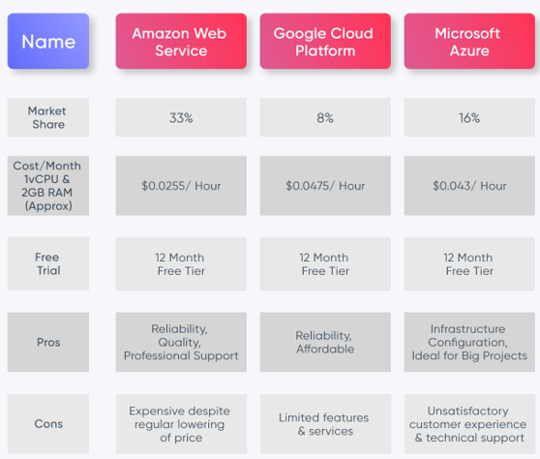
Comparison of cloud solutions
Market Dominance: AWS has the largest market share, followed by Azure and GCP.
Pricing and Cost Structure:
AWS: Offers a pay-as-you-go pricing model, providing flexibility and cost optimization options, but it can be complex to estimate costs.
Azure: Provides various pricing options, including pay-as-you-go, reserved instances, and hybrid benefits. It offers cost management tools for better cost control.
GCP: Utilizes a similar pay-as-you-go pricing model with discounts for sustained usage. It also provides cost management tools and transparent pricing.

Slide 7
Comparison of cloud solutions
Global Infrastructure:
AWS: Operates a vast global infrastructure with data centers located in multiple regions worldwide, allowing for high availability and low latency.
Azure: Has an extensive global presence with data centers across regions, offering global scalability and compliance with local regulations.
GCP: Expanding its global footprint, GCP has data centers in various regions, providing a reliable infrastructure for global deployments.
Integration and Ecosystem:
AWS: Integrates well with other Amazon services and has a rich ecosystem of third-party integrations and tools.
Azure: Seamlessly integrates with Microsoft products, such as Windows Server, Active Directory, Office 365, and more. It offers a comprehensive ecosystem with extensive developer tools.
GCP: Integrates well with Google services and products, leveraging the power of Google's infrastructure and data analytics capabilities.

Slide 8

Benefits of Cloud Solutions
Scalability: Easily scale resources up or down based on demand.
Flexibility: Choose from a wide range of services to meet specific business needs.
Reliability: Benefit from high availability and data redundancy.
Cost Efficiency: Pay only for the resources you use, avoiding upfront infrastructure costs.
Global Reach: Access to data centers worldwide for improved latency and performance.

Slide 9
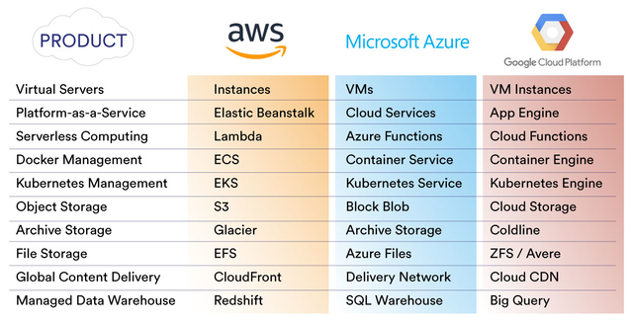
Conclusion
GCP, AWS, and Azure are leading cloud solutions with a wide range of services to support businesses' digital transformation.
It's important to note that the choice of cloud solution depends on specific business needs, requirements, and preferences.
Each platform has its strengths and weaknesses, and it's recommended to evaluate them based on factors such as service offerings, pricing, support, scalability, and integration capabilities.
Embracing cloud solutions can enhance scalability, flexibility, reliability, and cost efficiency for businesses.

Slide 10


