Slide 1
VIBE2SHIP HACKATHON 2026
🏛️ CivicResolve AI
From Citizen Report to Verified Resolution
A smart, AI-powered platform that transforms how cities handle municipal complaints.
🤖 Gemini AI Triage
📊 Priority Scoring
📸 Photo Verification
🔍 Duplicate Detection

Slide 2
THE PROBLEM
Municipal complaint systems are broken
🕳️
No Transparency
Citizens file complaints and never hear back
🐌
Slow Routing
Nobody knows which department handles the issue
⚖️
No Prioritization
A live wire gets same urgency as a cracked tile
📋
Duplicate Flooding
20 people report the same pothole = 20 tickets
🤥
No Proof of Repair
Departments mark 'fixed' without evidence
🔒
No Citizen Recourse
Once closed, no way to reopen a bad fix

Slide 3
OUR SOLUTION
CivicResolve AI fixes all of it
🤖
📊
🔍
AI Auto-Classification
Priority Scoring (0-100)
Duplicate Detection
Gemini AI reads the complaint and instantly identifies category, severity & correct department
Formula-based ranking so critical hazards like electrical risks always come first
Reports within 150m of each other for the same category get auto-clustered
📸
🔁
📝
Photo Verification
Citizen Reopen
Full Audit Trail
Departments must upload repair proof. Admin compares Before vs After side-by-side
If the fix is bad, citizens can reopen the case with justification
Every action permanently logged as an immutable event — nothing deleted

Slide 4
WORKFLOW
How It Works — End to End
👤
🤖
👨‍💼
🔧
✅
🎉
Citizen
Reports
→
AI
Analyzes
→
Admin
Reviews
→
Dept
Repairs
→
Admin
Verifies
→
Resolved!
Photo + GPS
Category, Severity
Approves & Routes
Fix + Upload Proof
Before vs After
Citizen Notified
🔁 If repair is bad → Citizen can REOPEN → Goes back to Admin

Slide 5
USER ROLES
Three Distinct Roles
👤
👨‍💼
🔧
Citizen
Municipal Admin
Department Manager
Sarah Jenkins
Arthur Pendelton
Marcus Vance (Roads)
Reports issues with photos & GPS
Tracks status of own reports
Upvotes others' reports
Can reopen bad fixes
Full stats dashboard
Reviews AI triage suggestions
Dispatches to departments
Verifies repairs & closes cases
Sees only own dept queue
Accepts assigned tickets
Performs repairs
Uploads mandatory photo evidence

Slide 6
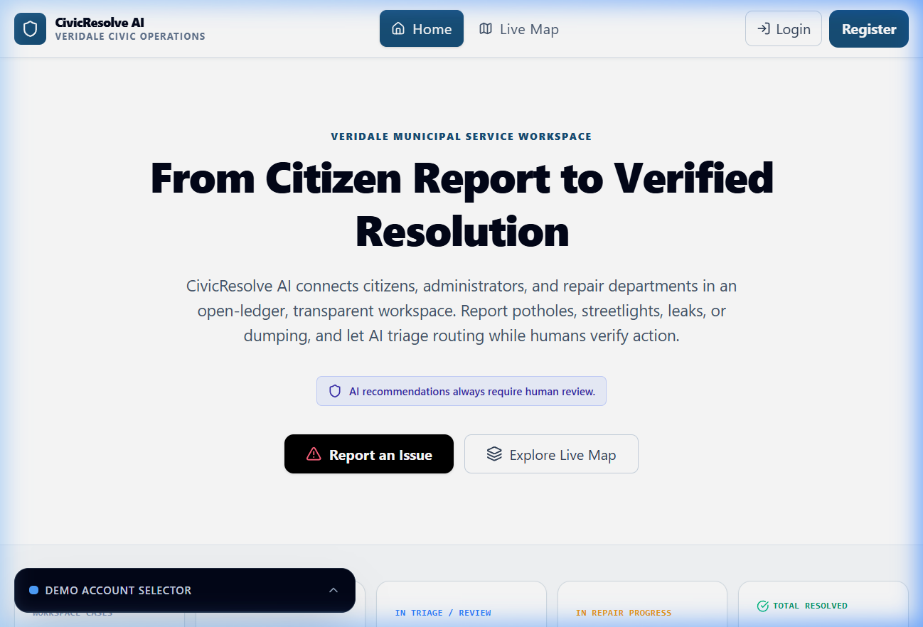
LIVE DEMO
Landing Page
✓ Clean hero with 'Report an Issue' CTA
✓ Live Map explorer for public issues
✓ Real-time workspace stats dashboard
✓ Demo account selector for role switching
✓ AI disclaimer badge visible

Slide 7
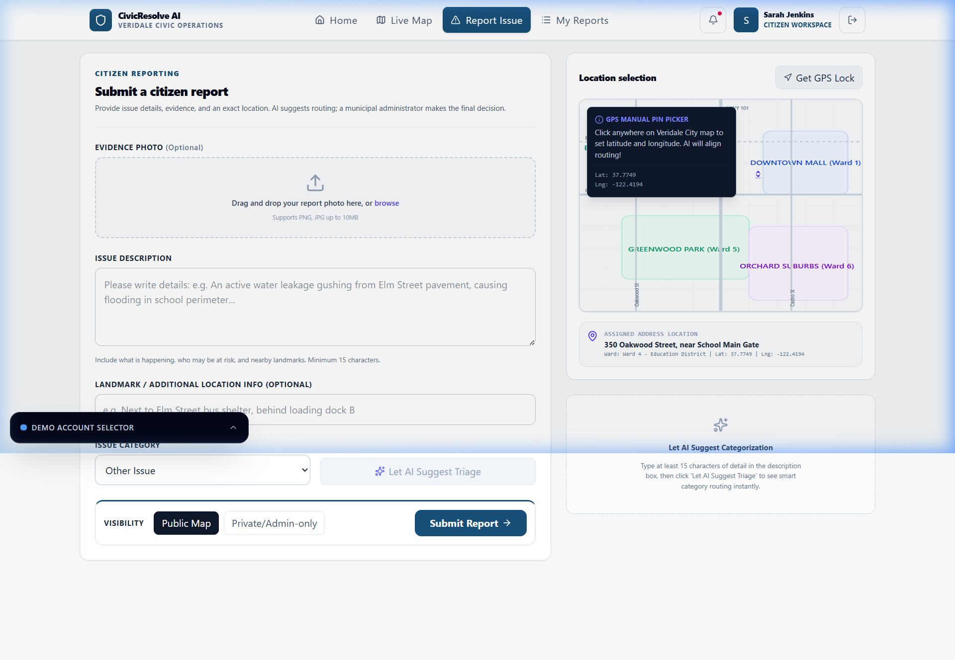
CITIZEN VIEW
Report Submission
✓ Upload evidence photo (drag & drop)
✓ Detailed issue description box
✓ Interactive GPS map to pin location
✓ Category with 'Let AI Suggest' button
✓ Public or Private visibility toggle

Slide 8
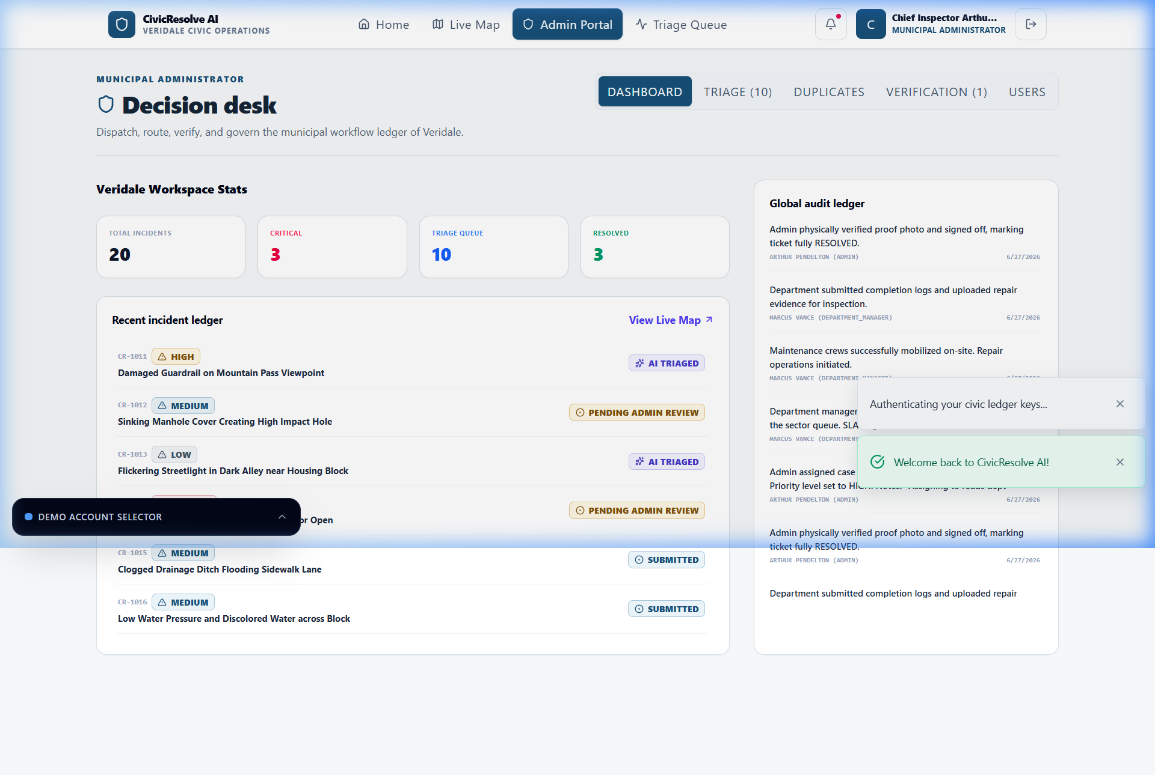
ADMIN VIEW
Decision Desk
✓ Stats: Total, Critical, Triage, Resolved
✓ Recent incident ledger with priority badges
✓ Global audit log (every action recorded)
✓ Tabs: Dashboard, Triage, Duplicates, Verify
✓ AI labels on every recommendation

Slide 9
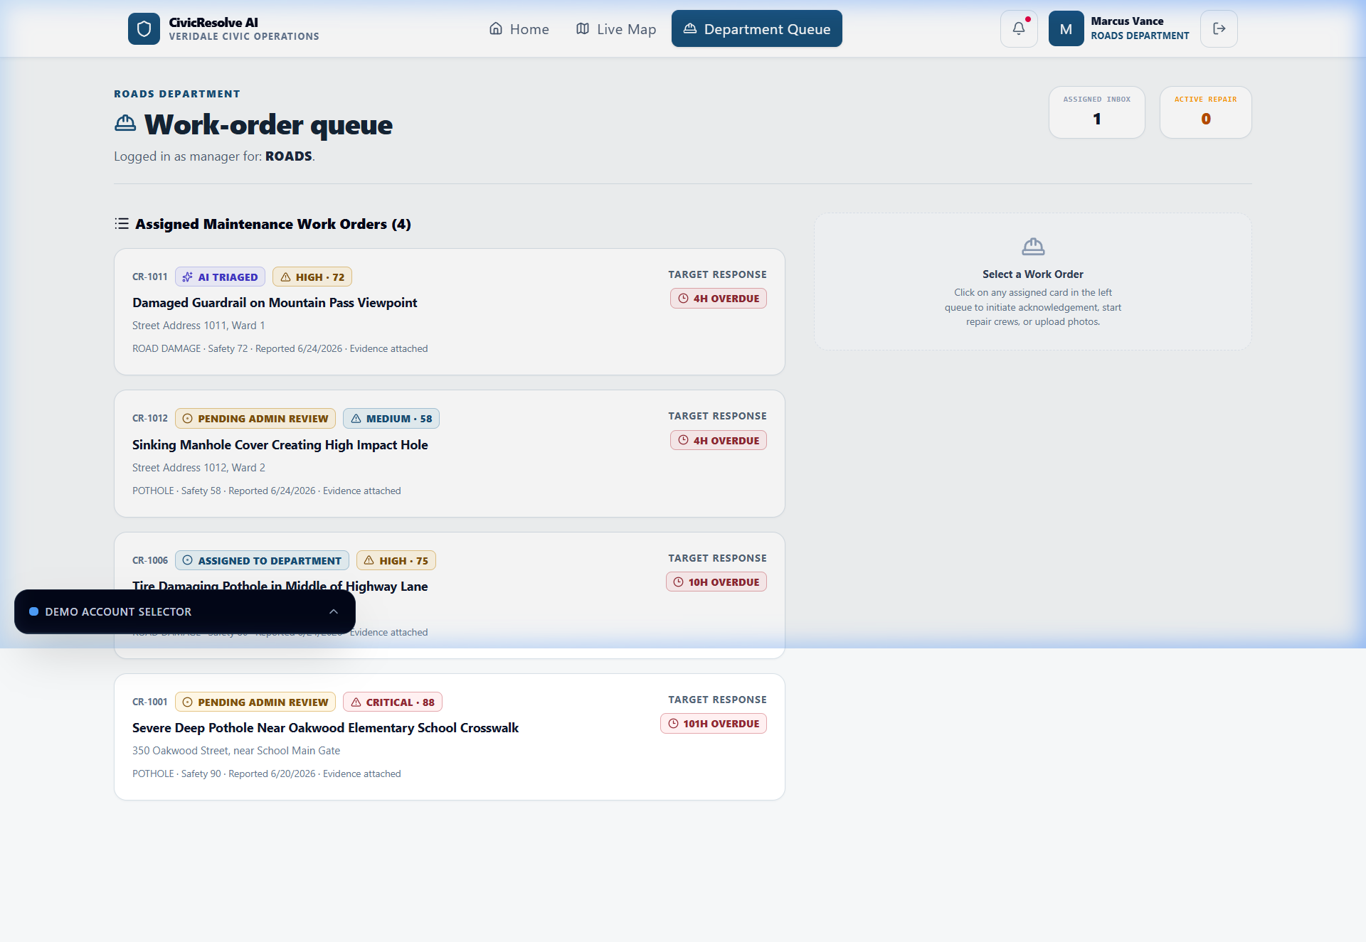
DEPARTMENT VIEW
Work-Order Queue
✓ Isolated queue — own department only
✓ CRITICAL / HIGH / MEDIUM priority badges
✓ SLA target timers with overdue alerts
✓ Accept → Repair → Upload Evidence flow
✓ Assigned Inbox & Active Repair counters

Slide 10
AI ENGINE
🧠 Gemini AI Under the Hood
What AI Does
Safety Guardrails
✓ Reads citizen description & analyzes photo
⚡ Graceful Fallback
✓ Predicts category (POTHOLE, ELECTRICAL, etc.)
No API key? Rule-based heuristics take over
✓ Assigns severity level (1–5)
⚡ Human-in-the-Loop
✓ Evaluates safety risk (LOW → CRITICAL)
AI only recommends. Admin decides.
✓ Suggests department routing
⚡ Clearly Labeled
✓ Flags sensitive content
All outputs carry 'AI Recommendation' badge
✓ Returns confidence score (0–100%)
⚡ Server-Side Only
No client-side API key exposure
Priority Score = (Severity × 12) + Category Weight + Evidence Pts + Upvote Bonus

Slide 11
TECH STACK
Built With
LAYER
TECHNOLOGY
🚀
🖥️ Frontend
React 19, Vite, Tailwind CSS 4, Lucide Icons
⚙️ Backend
Node.js, Express.js
Run in 2 Commands
🤖 AI Engine
Google Gemini 2.5 Flash (@google/genai)
npm install
npm run dev
💾 Database
Local JSON Mock (Firebase-compatible)
🔐 Auth
Demo Auth (Firebase-ready)
Boots at localhost:3000
📦 Language
TypeScript end-to-end
🎨 Icons
Lucide React
✨ Animations
Motion library

Slide 12
Thank You! 🙏
CivicResolve AI brings transparency, accountability,
and AI-powered efficiency to municipal complaint resolution.
🤖
🔍
👥
✅
AI-Powered
Transparent
3 Roles
Verified
Gemini 2.5 Flash
Full Audit Trail
Citizen, Admin, Dept
Before vs After
VIBE2SHIP Hackathon 2026

