Slide 1
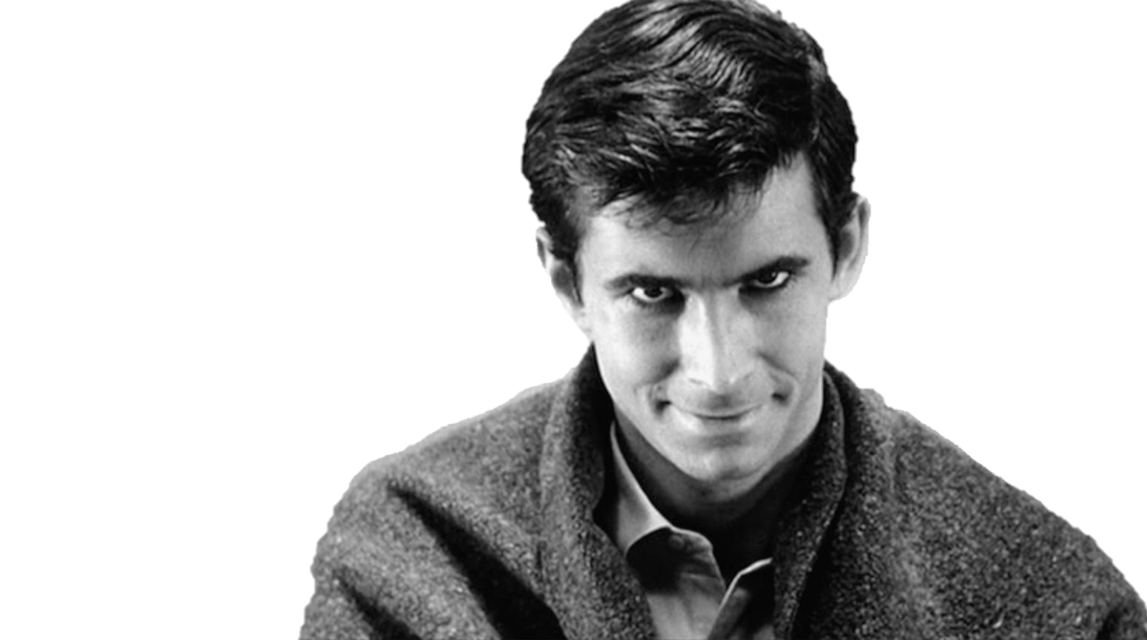
Strings Are Evil
Strings Are Evil
…and they are out to get you.

