Slide 1


Hunting for Exploding Stars Using Vera C. Rubin
Riley Webster
& Anais Möller
Centre for Astrophysics and Supercomputing, Swinburne University of Technology
Honours Project A
Semester 1, 2026
Notes:
Introduce yourself and welcome everyone to the presentation of the current literature and proposed method for a study of Early Excess SNe Ia and their Host galaxy properties.

Slide 2
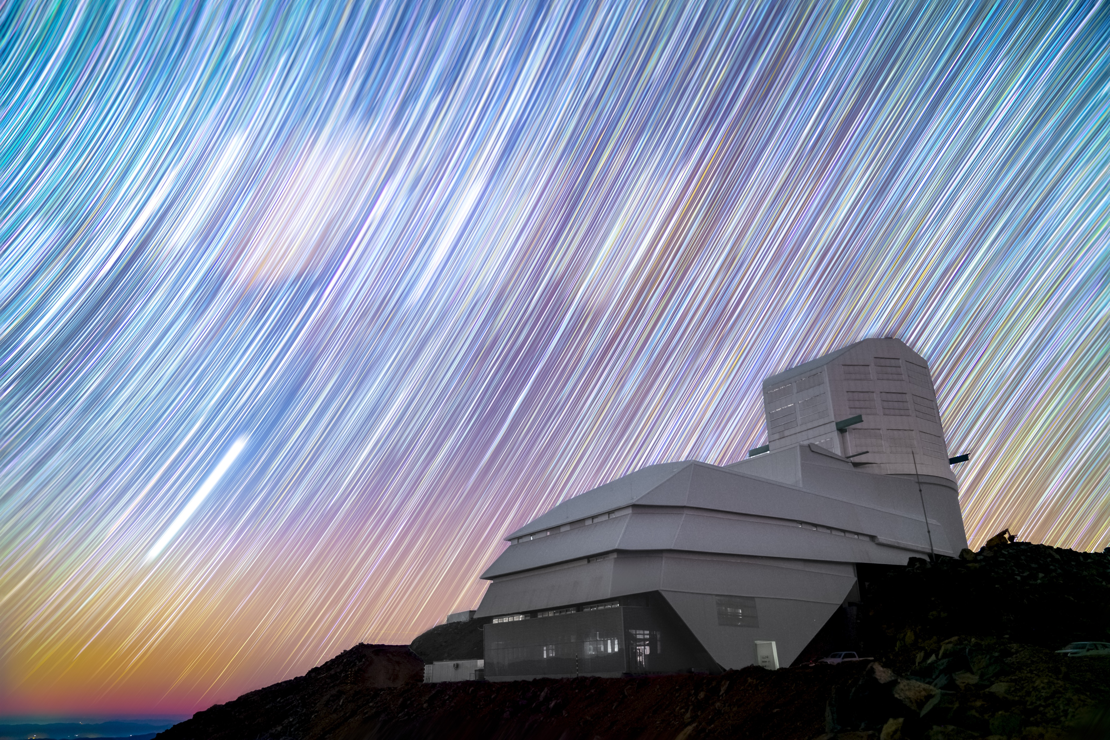
Rubin, LSST and Fink
Rubin Observatory
8.5 metre aperture (Bianco et al., 2022)
Near UV, visual and near IR coverage.
Images the sky when a change is detected.
Produce 10 million alerts per night, for 10 years.
Fink (Möller et al., 2021)
  Filter and classify the alerts.
(Vera C. Rubin Press Release)
1
Notes:
The new technology that will enable this study is the Vera C. Rubin Observatory located in Chile, with an 8.36 metre aperture and filters that span 320 to 1084 nm this enables deep observations like never before.
Along with the relatively large aperture of Rubin the strategy of the survey that Rubin will operate under will produce a staggering number of transient alerts in the southern hemisphere of the sky, this means that Rubin is in a unique position to find transients. The main survey, the wide fast deep survey, will have a cadence for each pointing of approximately 3 days across all filters. The smaller surveys such as the deep drilling fields will have a much higher cadence of approximately less than a day. This will result in the SN Ia data unlike previous surveys.

Slide 3
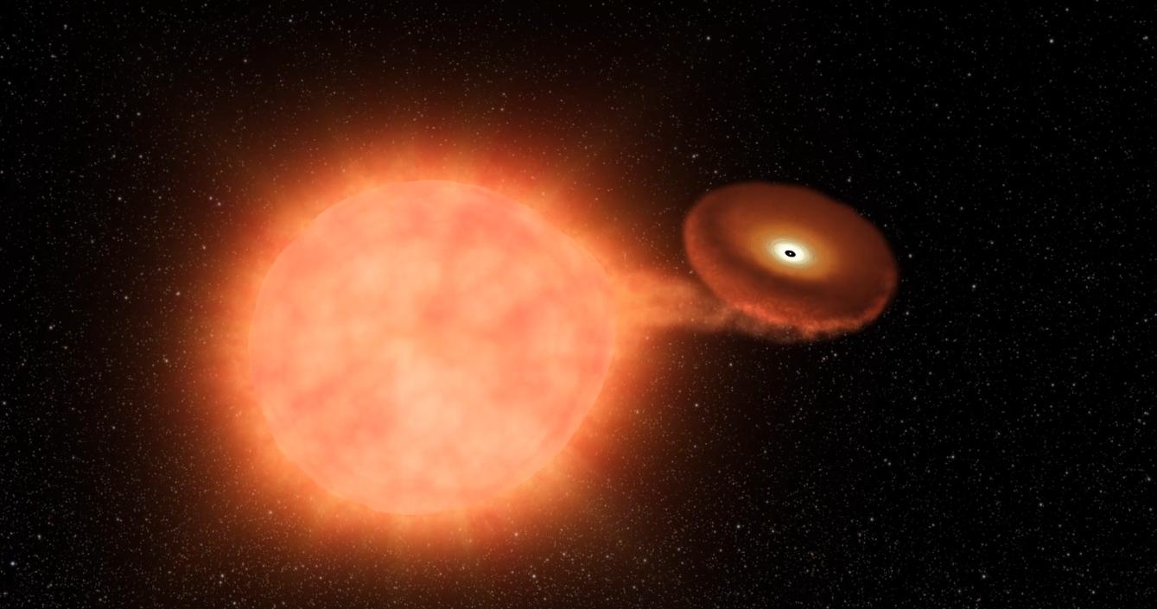
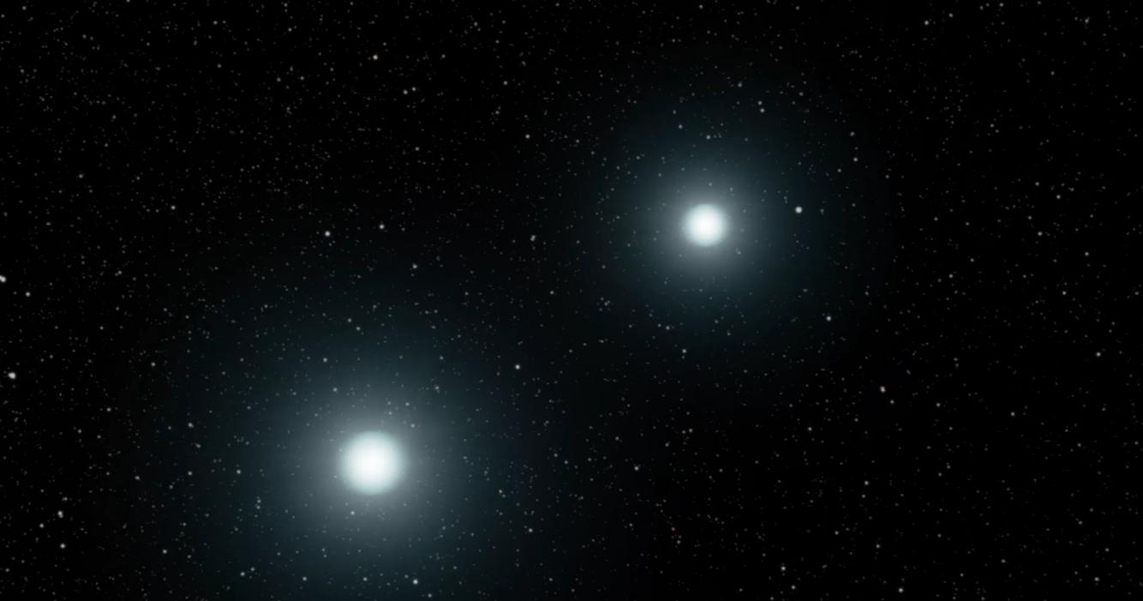
What are SN Ia?
The explosion of a carbon-oxygen white dwarf (Lim et al., 2023)
(NASA Image and Video Library)
(NASA Image and Video Library)
Single Degenerate Scenario
Double Degenerate Scenario
2
Notes:
So what is a type Ia supernova? There are two main ideas proposed that have been successful in modelling and explaining explosion mechanisms the first being the single degenerate scenario where the primary start has become a white dwarf. This white dwarf then accretes mass from its main sequence companion star, accreting enough mass beyond the Chandrashekar limit which triggers fusion of the carbon in the core triggering this thermal runaway event that produces a shockwave in the white dwarf that rips it. On the right is the double degenerate scenario where a binary white dwarf system eventually merges triggering the same thermal runaway burning of carbon that produces the shockwaves that produce the elements that decay into the light that we observe.

Slide 4
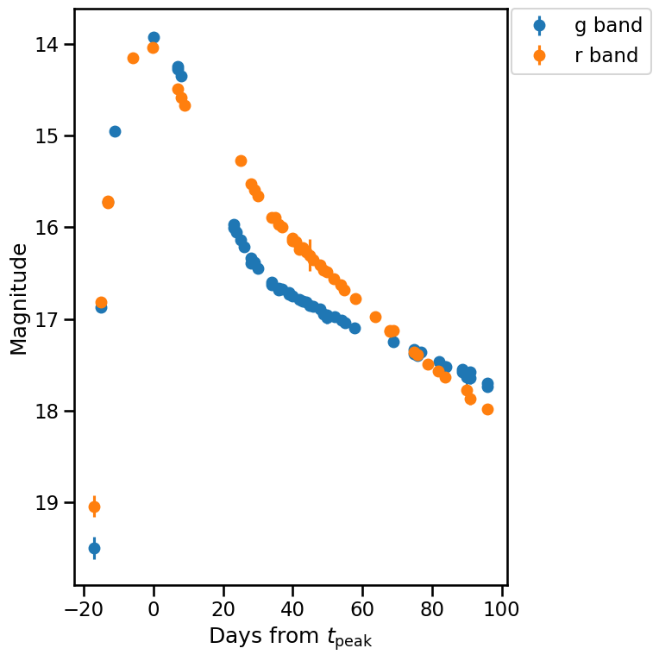

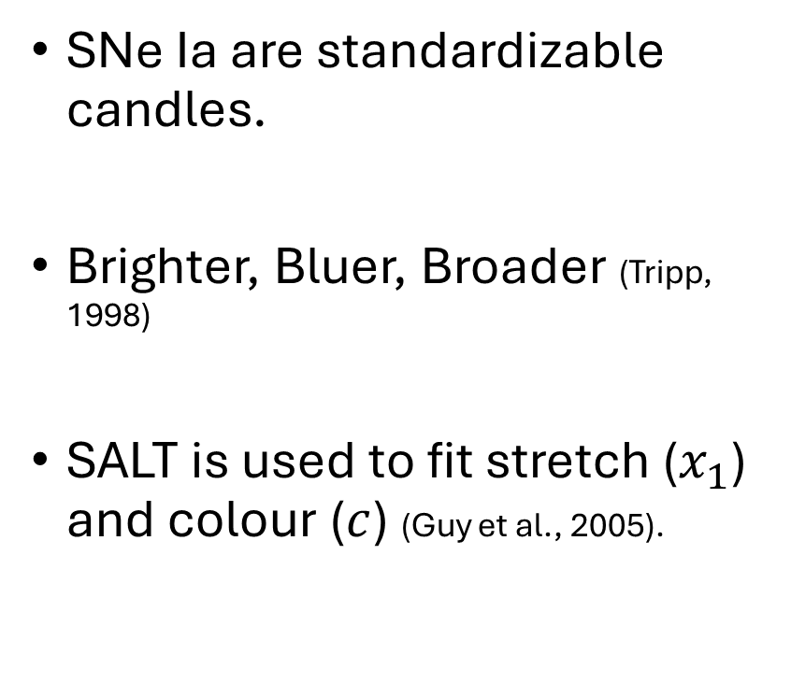
Why are SNe Ia Important?
SN 2026ACD
SNe Ia are standardizable candles.
Brighter, Bluer, Broader (Tripp, 1998)
SALT is used to fit stretch ($x_{1}$) and colour ($c$) (Guy et al., 2005).
Light curve obtained from the Fink broker.
3
Notes:
We are interested in these types of supernova because of the unique thermonuclear explosion that happens at the Chandrashekar mass limit. This means it produces roughly the same amount of nickel-56 and then cobalt-56 which produces the photons that we observe with our telescopes. Because of this typical peak flux, luminosity or magnitude these types of supernova can be standardised. This means that we adjust the light curve by correcting for the colour of the SNe Ia which is due to the occlusion due to dust and other small variations that will vary the properties of the progenitor such as the temperature and metallicity. The stretch parameter is how we adjust light curves that are broader and take longer to fade. Empirical fitting of the light curves with models that adjust the masses distributions of nickel – 56 after the supernova suggest that the stretch is primarily due to varying masses and distributions.

Slide 5
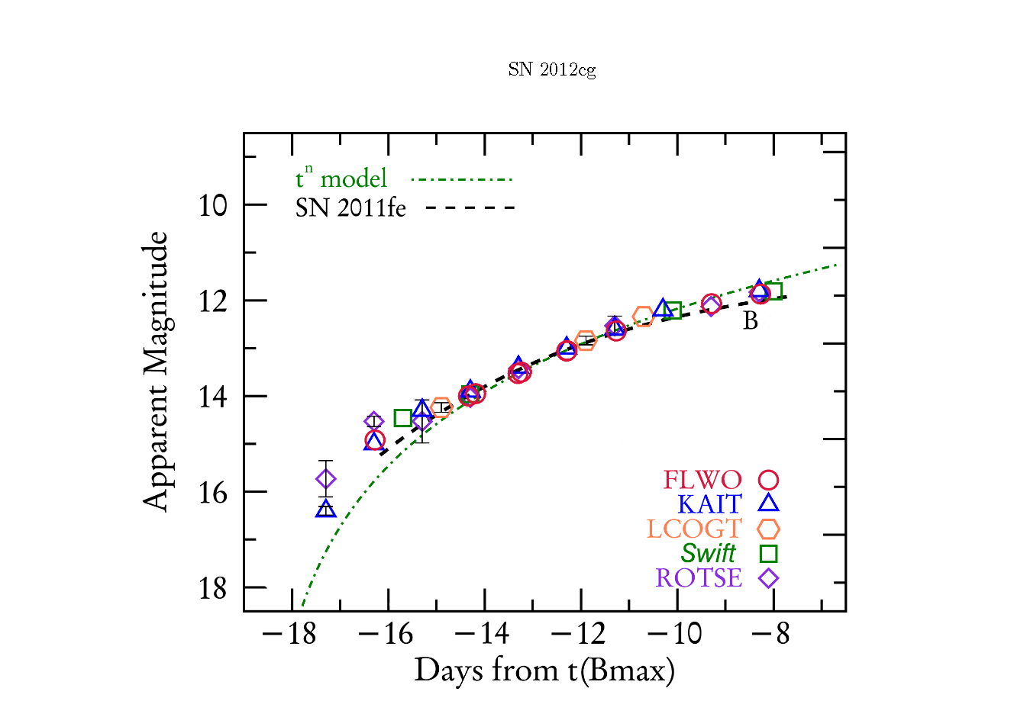
Early Excess
In some cases, observation of SNe Ia have a bump in the light curve.
Reasons For Excess
  Companion interaction (Burke et al., 2022) and (Lim et al., 2023).
  Clumping of nickel 56 and interactions with CSM (Deckers et al., 2022).
Colour evolution and duration of excess leads to different interpretations (Deckers et al., 2022).
4
(Marion et al., 2016)
Notes:
A rare subtype of SNe Ia are these type Ias that have an excess in their fluxes or magnitudes early in the evolution of the light curve. The plot shows the evolution of the light curve for SN 2012cg which was the first normal SNe Ia that had this excess light in that’s highlighted in the red ellipse. The comparison to SN 2011fe is there as SN 2011fe is one of the earliest caught supernovas thus having early light curve data that can be compared. The population of discovered early excess SNe Ia is very limited at this time, but recently estimates have shown pushed for higher cadences in observations could improve the discoveries of the early excess.

Slide 6
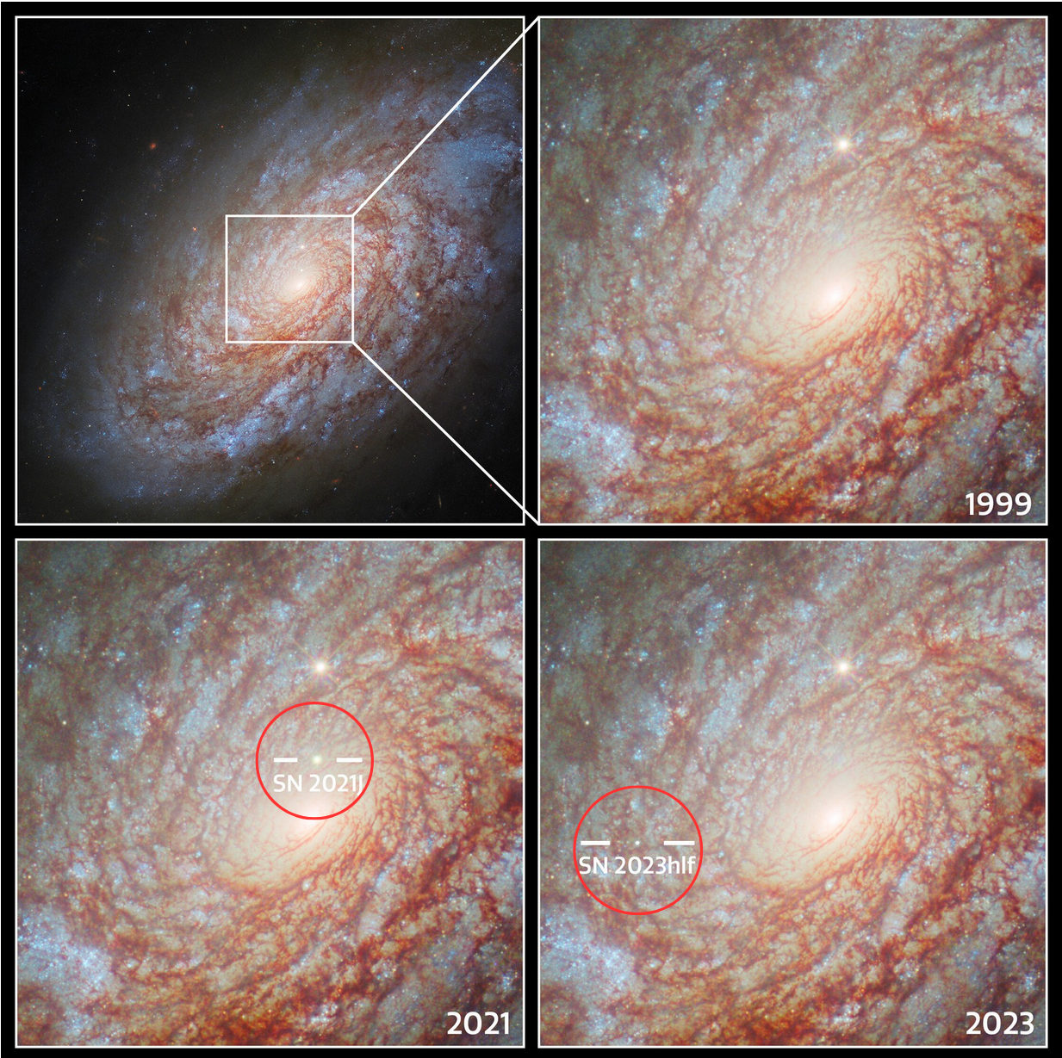
Host Galaxy Environments
Properties
  Stellar mass
  Inner region and outer regions
(Supernovae in NGC 4414, n.d.)
5
Notes:
To improve standardisation of the light curves of type Ia supernovae, population studies are done to see how the difference between the predicted peak magnitude of a supernova varies with the predicted brightness given a particular cosmology. In this figure from Toy et al we see the difference in the observed brightness of the supernova and the brightness calculated in a standard cosmology, as a function of the separation from the centre of the host galaxy. These correlation studies with populations of supernovae are found to determine what properties of the host environment affect the difference in the observed and predicted peak magnitudes because if an intrinsic property of the host environment is affecting the observed brightness that isn’t being corrected for it can provide more insight on the physics that affect SNe Ia data used in cosmology.

Slide 7
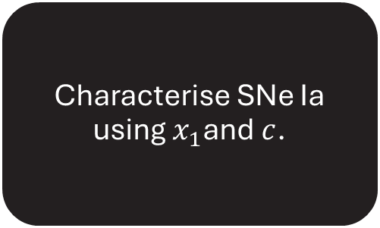
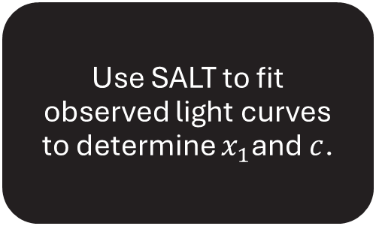
Proposed Method
Assemble a catalogue of extragalactic candidates from Rubin using Fink.
Use machine learning classifiers to find potential SNe Ia.
Use SALT to fit observed light curves to determine $x_{1}$and $c$.
Characterise SNe Ia using $x_{1}$and $c$.
Search for excess flux by finding residuals between fits and observed light curves.
If scope permits, correlate SN properties with the host galaxy properties.
6

Slide 8
Key Takeaways
SN 2026ACD
Observe, filter and classify transients using Rubin and Fink.
Characterise SN using SALT.
Search for early excess SNe Ia.
Light curve obtained from the Fink broker.
(Marion et al., 2016)
7

Slide 9
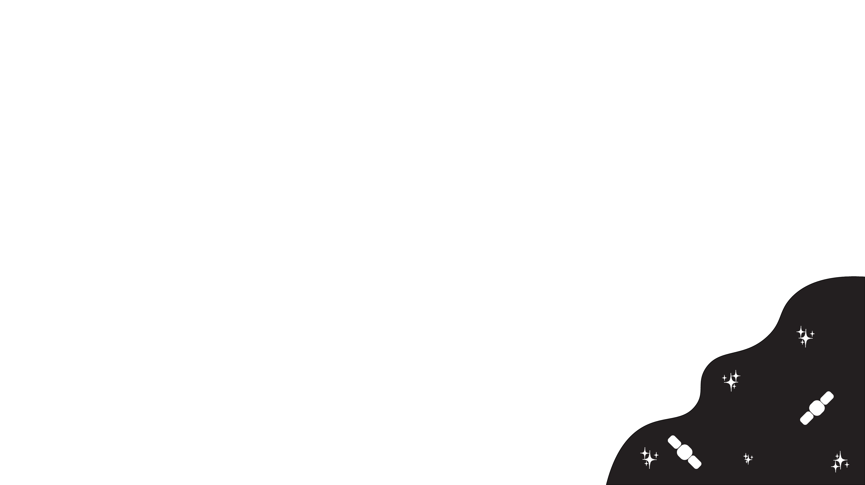
Summary
Rubin, LSST and Fink

Slide 10
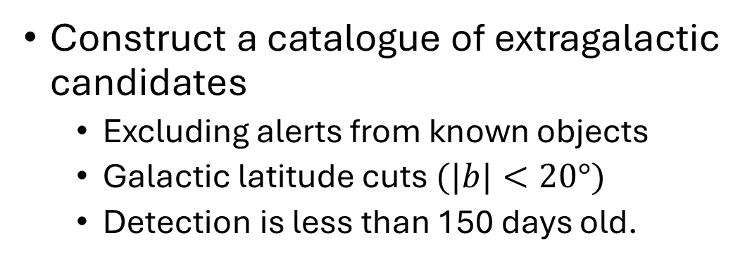
Finding SNe Ia
Construct a catalogue of extragalactic candidates
  Excluding alerts from known objects
  Galactic latitude cuts $(|b|<20°)$
  Detection is less than 150 days old.
Use the machine learning classifiers within fink to find SNe Ia candidates.
Notes:
The plan is to use the high cadence of the Rubin observatory through the LSST survey to find more early excess supernovae assign host’s to these supernovae and then correlate them with their host’s properties. But first we actually need to find the supernovae, for this the Fink broker will be used to find extragalactic candidates by removing any alerts that pass that could be confused for SNe like variable stars and AGNs. Having a galactic latitude cut off which eliminates any objects that could be found within our galaxy, this ensures that objects that pass the filter are extra-galactic and we only want new candidates which will also eliminate objects that are clearly not a new supernova. Following the construction of a catalogue of extragalactic candidates we will then classify these objects by using the EarlySNIa classifier to determine if these objects have been identified as SNe Ia.

Slide 11
Host Galaxy Properties
Use template fits to estimate the following host properties.
  SFR
  Stellar Mass
  Colour
Use the position of the SNe Ia to determine the DLR.
Notes:
Now with a sample of SNe Ia we can use the normalised DLR method mentioned in slide 5 to associate host galaxies with the SNe Ia. Then using the photometry of the host galaxy without the supernova we can use fits to the galaxy spectral energy distribution templates to estimate the star formation rate, the stellar mass and the global colour of the galaxy.

Slide 12
What’s Next
Use SALT modelled light curves to find flux residuals in the SNe Ia.
  This may give us a sample of early excess flux SNe Ia.
If sample size is significant, the correlations with the host galaxy properties of the early excess flux can be found!
Notes:
Finally, we will use the empirical light fitting model for SNe Ia called SALT to derive the colour and stretch parameters for the SNe Ia in our sample, we will use these colour and stretch parameters to classify our SNe Ia in our sample even further into blue and red. Now to find early excess flux SNe Ia the method followed by Deckers et al., 2022 will be used. Deckers finds the residuals in the observed light curve and the fitted light curve within 6 days of the peak flux, identifying positive residuals in the early curve at this stage in its evolution as an early excess. If early excess flux are found how they correlate with the host galaxy properties will be determined which given a significant sample size would be the first of its kind with these early excess SNe Ia.

