Slide 1
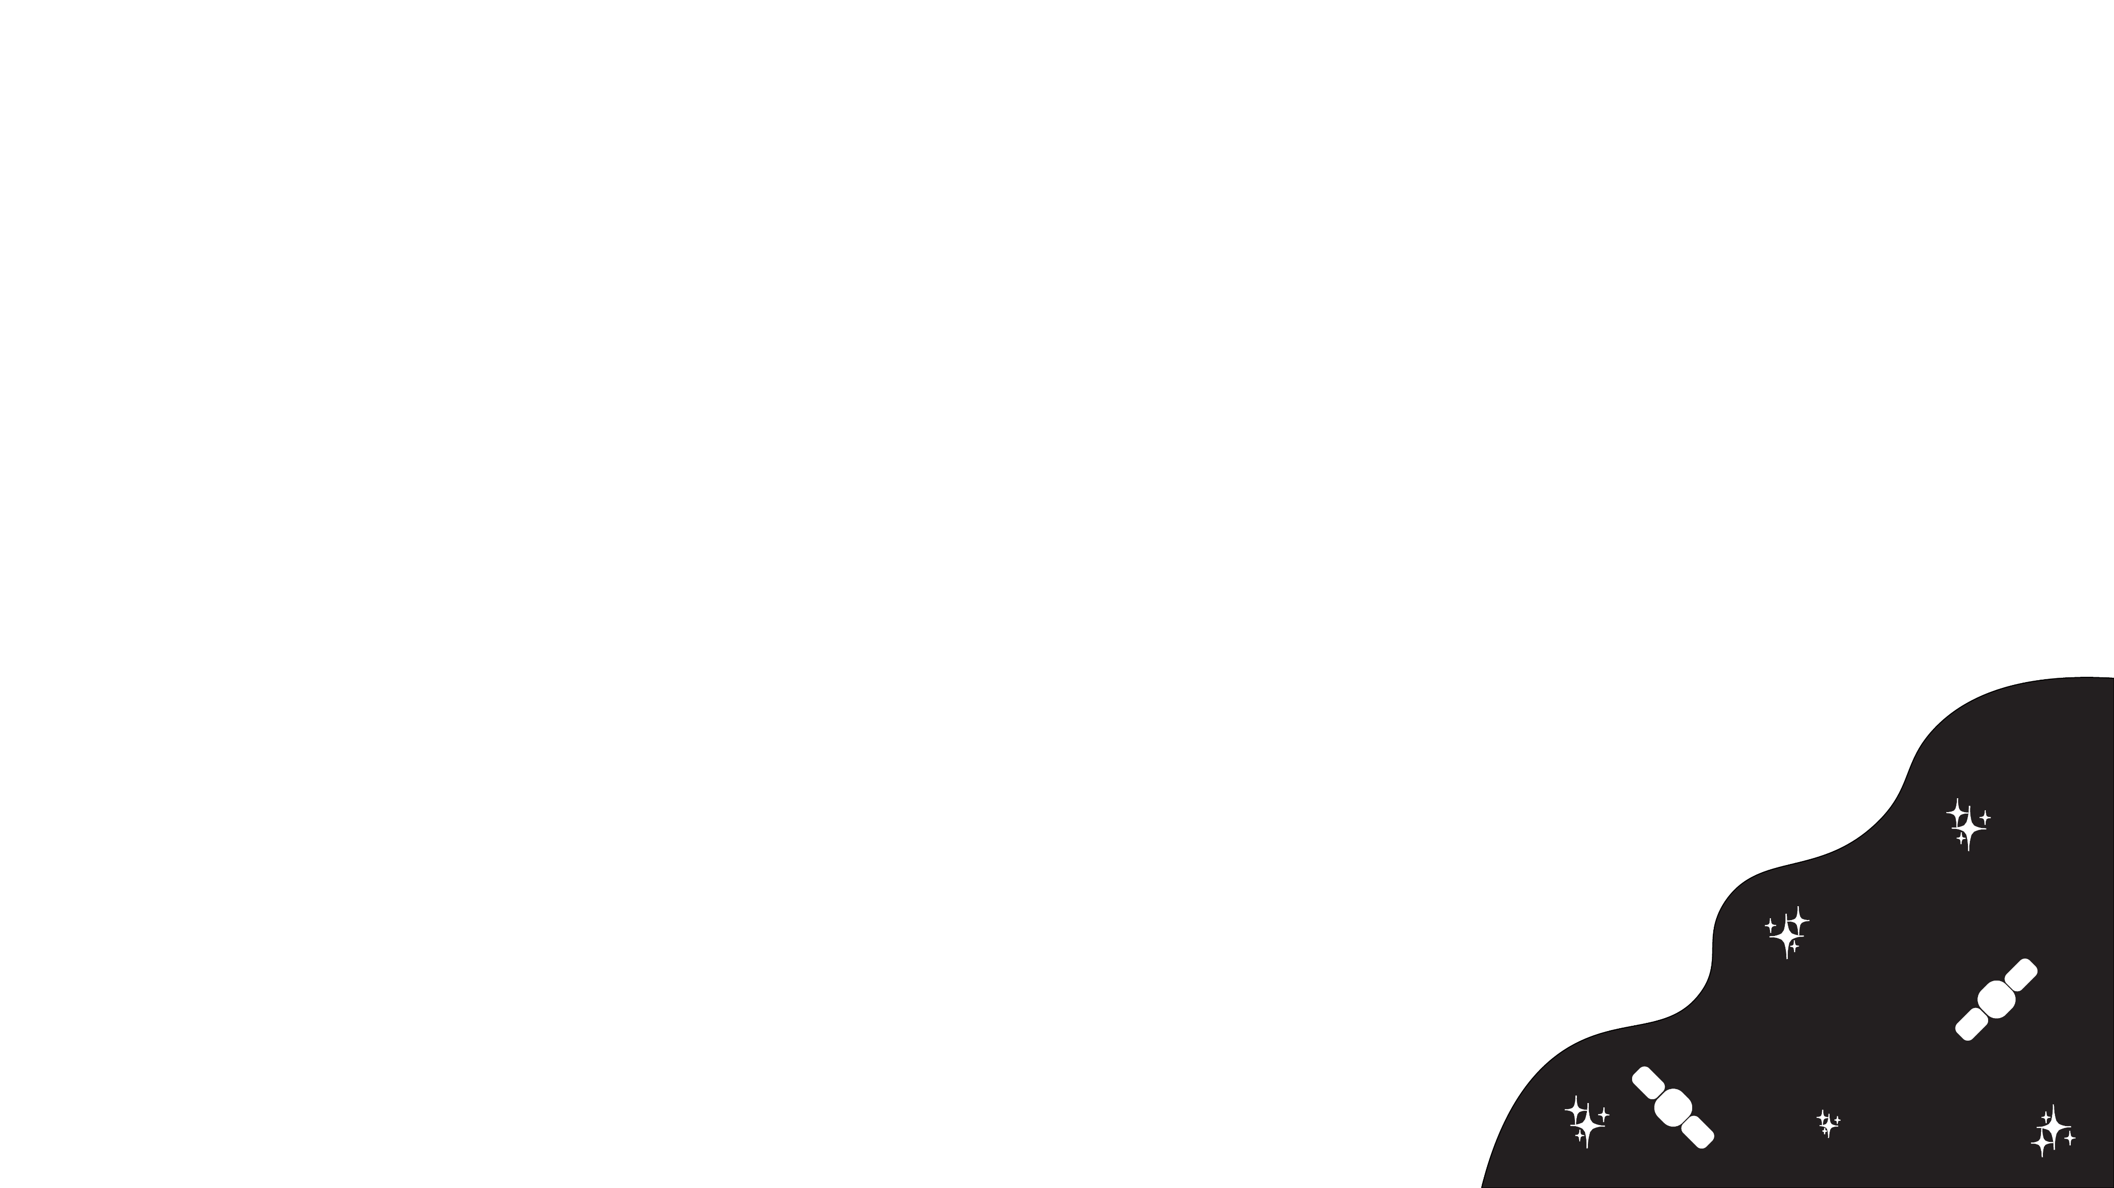
A Review of Early Excess Flux SNe Ia and Their Hosts
Riley Webster
Honours Project A
Semester 1, 2026

Slide 2
Introduction
Define transients with a focus on type Ia supernova.
How the motivator is understanding more about explosion mechanics can result in better standardisability in light curves
Show the residual scatter in some current Hubble diagram.
Mention how LSST, Rubin and Fink provide the tools that enable research.

Slide 3
SNe Ia Physics
Explain how standardisation using colour and light curve stretch is done for SNe Ia light curves using the Tripp equation
Describe the different progenitor channels and how the two popular ones (SD and DD) are determined.
Discuss how different progenitors require different nickel 56 masses and distributions

Slide 4
SNe Ia Physics
Describe early excess flux light curves (show a plot)
Describe the proposed physical mechanism that produce the early excess such as the nickel distributions, ejecta companion interaction and possible CSM interaction.
Mention how Decker et al., 2022 determined what light curves were considered excess flux.

Slide 5
Host Galaxy Environments
Describe the spatial distributions of SNe Ia in their hosts,
Discuss the host galaxy mass step and how SNe Ia appear brighter in hosts with higher stellar masses and lower sSFR post standardisation.
Describe how correlations with local environment variables such as lsSFR and EW [OII] are improved standardisation tools than the mass step.

Slide 6
Early Excess and Host Environments
If early flux excesses correlate with specific environmental properties this could help identify the progenitor properties of early excess and it could help constrain SNe Ia to include in cosmological samples.
Due to how limited sample sizes have been of early excess SNe Ia have been they have been difficult to study. Now with LSST the chances of finding them are greater, opening up the possibility of studying the objects.

Slide 7
Rubin, LSST and Fink
Describe how Rubin enables the LSST survey which produces a high volume of alerts per night.
High volume of alerts necessitates the use of the Fink broker to derive samples for study without tedious visual inspection.
Describe how Fink’s specific active learning architecture will help enable faster initial analysis of the interesting alerts.

Slide 8
Aims
To detect and classify the early excess flux SNe Ia and investigate incidence rate as a function of host galaxy properties such as stellar mass, sSFR and colour.
If first aim is achieved, constraints on the progenitor channels of early excess SNe Ia will be determined.

Slide 9
Planned Method
Use Fink to create the sample of early excess flux candidates for Ias.
Use Decker et al., 2022 classification method for early excess detection and follow the analysis of the properties to see how this study fits within previous work.
Host matching using DLR method to determine the hosts of the samples SNe Ia.
Binning of Eex SNe Ia against host galaxy properties to determine if there is a trend in where SNe Ia occur.
Determine possible implications this has on Hubble residuals if these SNe contaminate datasets.

