Slide 1
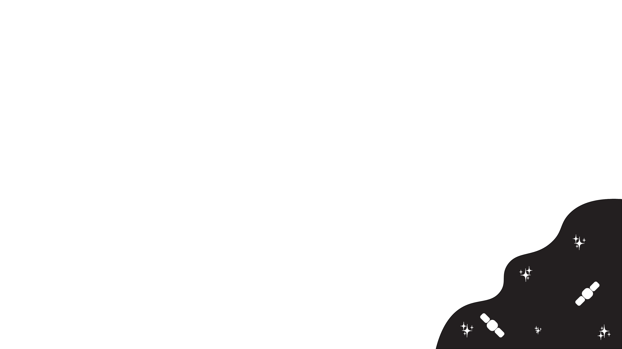
A Review of Early Excess Flux SNe Ia and Their Hosts
Riley Webster and Anais Möller
Honours Project A
Semester 1, 2026

Slide 2
Introduction
Communicate why SNe Ia are important because they are standardizable candles and can be used for cosmological calculations.

Slide 3
SNe Ia Physics
Mention how that the two popular progenitor channels for SNe Ia are single degenerate and double degenerate cases.
Explain how standardisation is by explaining what colour and stretch are and how the Tripp equation corrects for colour and stretch.

Slide 4
SNe Ia Physics
Introduce the early excess flux SNe Ia and show their light curves compared to a ‘normal’ SNe Ia light curve.
Describe the proposed physical mechanism that produce the early excess such as the nickel distributions, ejecta companion interaction and possible CSM interaction.

Slide 5
Host Galaxy Environments
Describe the host galaxy mass step and how SNe Ia appear brighter in hosts with higher stellar masses and lower sSFR post standardisation.
Describe how correlations with local environment variables such as lsSFR and EW [OII] are improved standardisation tools than the mass step.

Slide 6
Early Excess and Host Environments
If early flux excesses correlate with specific environmental properties this could help identify the progenitor properties of early excess and it could help constrain SNe Ia to include in cosmological samples
Due to how limited sample sizes have been of early excess SNe Ia have been they have been difficult to study. Now with LSST the chances of finding them are greater, opening up the possibility of studying the objects.

Slide 7
Rubin, LSST and Fink
Describe how Rubin enables the LSST survey which produces a high volume of alerts per night.
High volume of alerts necessitates the use of the Fink broker to derive samples for study without tedious visual inspection.
Describe how Fink’s specific active learning architecture will help enable faster initial analysis of the interesting alerts.

Slide 8
Aims
To detect and classify the early excess flux SNe Ia and investigate incidence rate as a function of host galaxy properties such as stellar mass, sSFR and colour.

Slide 9
Planned Method
Use Fink to gather the sample of early excess flux candidates for Ias.
Using SALT3 light curve fitting model to correct for stretch and colour and identify SNe. Using residuals method from Deckers et al., 2022 to find Eex.
Host matching using DLR method to determine the hosts of the samples SNe Ia.
Binning of EEx SNe Ia against host galaxy properties to determine if there is a trend in where SNe Ia occur.

