Slide 1
Advertisement Content Classifier
Yen-Chun, Huang Engineer
doudi853@gmail.com

Slide 2

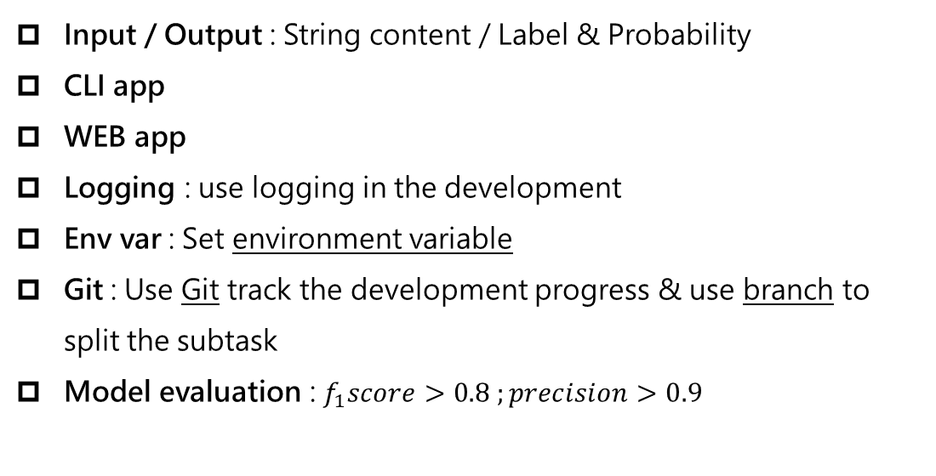
Development Goals
Input / Output : String content / Label & Probability
CLI app
WEB app
Logging : use logging in the development
Env var : Set environment variable
Git : Use Git track the development progress & use branch to split the subtask
Model evaluation : $f_{1}score>0.8 ;precision>0.9$

Slide 3











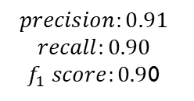
ADCC
Workflow
The main goal of this workflow is to build a Command-Line Interface and Web applications that can classify the advertisement content.
Data crawling
Key word filtering
Output
Label
Score
Web application
Output
Label
Score
Annotating
Data preprocess
CLI application
$$precision:0.91$$
$$recall:0.90$$
$f_{1} score:0.9$0

Slide 4

Problem statement
Advertisement copywriting definition:
An copywriting which is developed from the advertisement industry is the manuscript used in newspapers, magazines, posters and other print media or electronic media, TV commercials, web banners, etc., to promote products, companies, or ideas, or people who do this.

Slide 5
Data source
Using the pymysql to access the database
Use environment variable to set host, user and password
Select title and content columns
Scrap the data and use keyword pattern to filter the positive, negative samples.
In this stage, I build small datasets positive and negative for each contains 250 data

Slide 6
Data preprocess
Check the dataset and annotate manually
Using jupyter and pandas to perform a primary data analysis
Merge the title with content
Concatenate the positive sample with negative sample
Generate an output file includes 500 raw data contains text content and binary label

Slide 7
Data description
 | label | title_length | content_length | text_length
count | 500.00 | 500.00 | 500.00 | 500.00
mean | 0.50 | 19.42 | 479.71 | 499.13
std | 0.50 | 10.75 | 706.56 | 709.19
min | 0.00 | 1.00 | 0.00 | 1.00
25% | 0.00 | 11.00 | 69.00 | 88.75
50% | 0.50 | 18.00 | 253.50 | 268.00
75% | 1.00 | 26.00 | 507.75 | 536.50
max | 1.00 | 68.00 | 5977.00 | 6001.00
Top words (AD):
2018 館、台北、車展、健康、保濕、酒店、快樂、髮、霜、親子館、店、遊戲、公園、台灣、專業、餐廳、精、美食、親子

Slide 8
Training & Evaluating
Training info
Validating info
Argument info
Precision
Recall
F1-score
Introducing albert from huggingface transformers
Build data loader object to fit in the pre-trained language model.
Split dataset into training and validation set (8 : 2)
Using Pytorch to build classifier
Create training and evaluation strategies
Store the training log and classification report
Data
log
report
build.py
albert
evalute.py
Data loader
train.py
Pytorch

Slide 9







CLI application
First, I tried to build a primary version that can allow the user to input string content in Command-Line Interface (CLI) and output the result.
How about some users who require the multiple input? Such as a .txt file input?
I extended the command application that can also allow user to input a file location, and generate a new file including the {label : probability}
台中市玩具圖書館就在…也歡迎分享出來給玩具圖書館哦。
This content is an AD article, the probability is 0.948

Slide 10

WEB application
In this application, I apply fast API, html, css and jinja2 to build a WEB service of classifier.
Users can type the content inside the text area and add the new content by pressing ENTER.
The WEB service will calculate and show the result.
Advertisement Classifier
Hint: Input string and return the result (label & probability)
Type here, change line (press ENTER) if you want to add new content
Submit
Reset
No result yet …

Slide 11
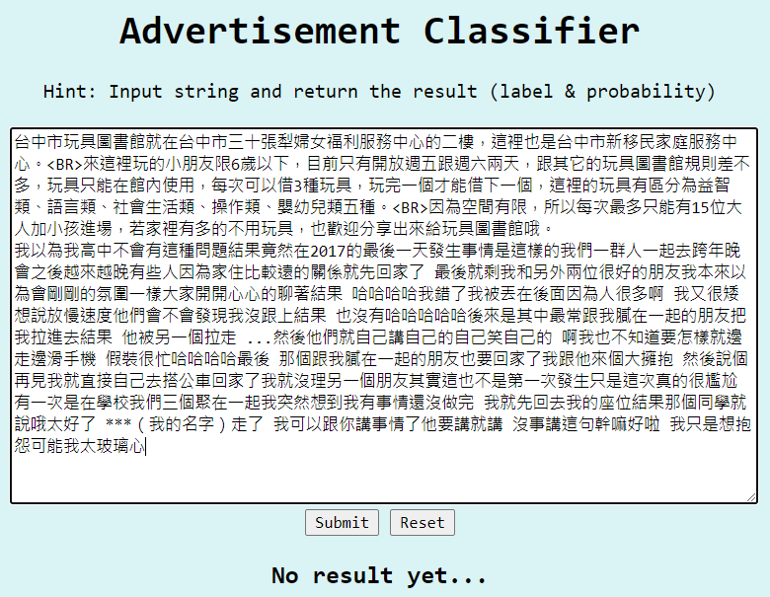
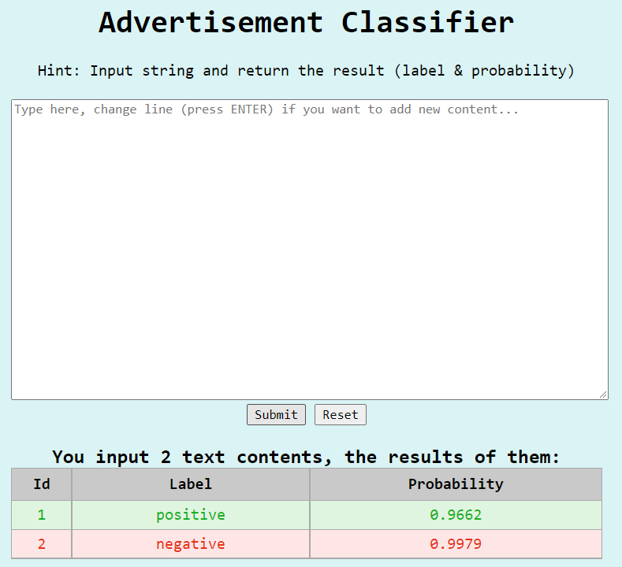
WEB application
Success !!
Output a table of id, label and probability. Id indicate the content order

Slide 12


Result
The best model result (run 33)
 | precision | recall | f1-score | support
0 | 0.98 | 0.84 | 0.90 | 55
1 | 0.83 | 0.98 | 0.90 | 45
accuracy | 0.90 | 0.90 | 0.90 | 0.90
macro avg | 0.90 | 0.91 | 0.90 | 100
weighted avg | 0.91 | 0.90 | 0.90 | 100
parameter | value
device | cpu
n_classes | 2
epochs | 10
batch_size | 32
learning_rate | 5e-6
max_len | 300
loss_func | CrossEntropyLoss
{0: negative, 1: positive}
Notes:
Class 0 recall is low : 非廣告文資料中，非廣告文卻被誤判為廣告文的比例相對高 (FN)
Class 1 precision is low : 預測結果為廣告文的 “非”廣告文比例大，相較預測結果為非廣告文的廣告文比例 (FP)
結論是我們希望過濾掉廣告文，以利於後續情緒分析或是下游的NLP任務，所以我們不希望相關資料中的廣告文存在

Slide 13
Discussion
False prediction
Annotation Error
Prediction Error
A non-AD content has more probability to be false predicted as an AD content.
All of AD content which are false predicted as non-AD content are all Prediction Error in with sponsored post or product promotion content.

Slide 14

Conclusion
Data:
More thoroughly understand the data source
Add more data patterns to annotation step
Model:
Best model hyper parameter and dynamic tuning technique
Feature engineering for annotation and training
Tokenizing implement for optimize the tokenizer

Slide 15


25 %
30 %
Total
Working
Time
(1w)
45 %

Slide 16
Roadmap
Jul 22
Jul 23
Jul 24
Jul 25
Jul 26
Classifier
scrap data
annotation
preprocess
build classifier
test classifier
modify classifier
CLI app
build CLI app
test CLI app
add function
WEB app
build WEB API
build WEB interface
test WEB app

Slide 17
Git Roadmap
master
master
master
master
master
click
web
fastapi_web

Slide 18

Development Goals
Input / Output : String content / Label & Probability
CLI app
WEB app
Logging : use logging in the development
Env var : Set environment variable
Git : Use Git track the development progress & use branch to split the subtask
Model evaluation : $f_{1}score>0.8 ;precision>0.9$

Slide 19


Thanks for listening !!
Project github link

