Slide 1
機器學習與深度學習期中報告 TMU ML Course Team Battle 1
組別 : 鎮瀾宮的骰子(Feat. 標太郎水餃)

Slide 2
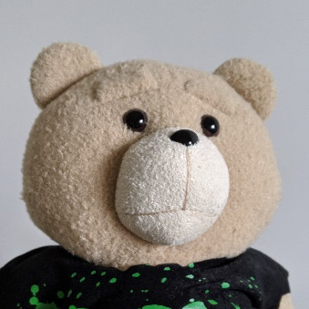
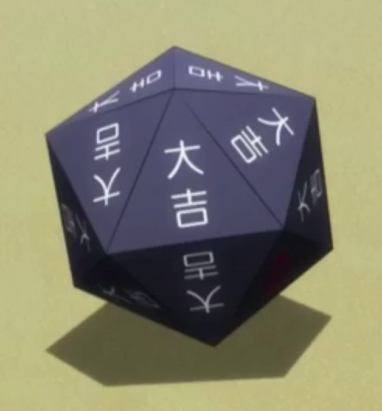
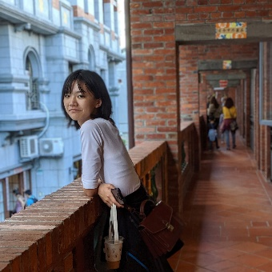
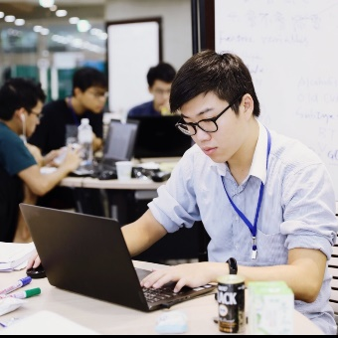
小組成員
黃彥鈞 (鈞鈞)
M946018006
石家宜 (石石)
M946018003
趙上涵 (涵涵)
M946018004

Slide 3
報告大綱
資料集
競賽結果
Basic Methods
Dnn & Bert
問題與限制
結論

Slide 4
資料集

Slide 5
Title and Content Layout with Chart

Slide 6
Two Content Layout with Table
First bullet point here
Second bullet point here
Third bullet point here
Class | Group 1 | Group 2
Class 1 | 82 | 95
Class 2 | 76 | 88
Class 3 | 84 | 90

Slide 7
Title and Content Layout with SmartArt
Step 1 Title
Task description
Task description
Task description
Task description
Step 2 Title
Task description
Task description
Task description
Step 3 Title
Task description
Task description
Step 4 Title
Task description
Task description

Slide 8
Add a Slide Title - 1

Slide 9
Add a Slide Title - 2

Slide 10
Add a Slide Title - 3

Slide 12
Add a Slide Title - 4

