Slide 1
顯示單日每一個小時的總量 (5 千多個檔)
$ time hive -S -e "use twmask;select substring(dt,12,8), sum(adult)/10000 from daily_mask where substring(dt,1,10)='2020/03/11' group by substring(dt,12,8) order by substring(dt,12,8)"
.......
09:27:45 345.9417
10:27:42 330.4863
11:27:43 315.1788
11:50:43 312.8909
12:28:43 311.5457
13:26:45 313.9223
14:28:43 314.3895
15:28:45 298.2945
16:28:43 280.1536
17:28:43 268.9917
18:28:43 261.1264
19:28:43 256.3648
........
real 1m37.670s
user 1m23.124s
sys 0m4.360s
Notes:
$ time hive -S -e "use twmask;select substring(dt,12,8), sum(adult)/10000 from daily_mask where substring(dt,1,10)='2020/03/13' group by substring(dt,12,8) order by substring(dt,12,8)" 2>/dev/null
00:13:46 208.0668
01:13:54 208.0668
02:13:42 208.0668
03:13:43 208.0668
04:13:43 208.0668
05:13:41 208.0668
06:13:42 208.0668
07:13:43 218.3
08:13:43 285.1477
09:13:45 328.9486
11:10:47 275.0826
12:10:44 267.1048
13:10:46 267.1519
14:10:47 268.5454
15:10:48 246.247
16:10:47 221.9211
17:10:51 210.2601
18:10:49 203.6159
19:10:47 200.1165
20:10:45 189.8601
21:10:45 182.497
22:10:47 181.7898
23:10:44 181.9289
real 1m37.670s
user 1m23.124s
sys 0m4.360s

Slide 2
使用壓實資料集目錄
$ hdfs dfs -ls /dataset/twmcompact
Found 18 items
-rw-r--r-- 3 bigred bigboss 0 2020-05-11 10:49 /dataset/twmcompact/_SUCCESS
-rw-r--r-- 3 bigred bigboss 133023022 2020-05-11 10:49 /dataset/twmcompact/part-m-00000
-rw-r--r-- 3 bigred bigboss 133027814 2020-05-11 10:49 /dataset/twmcompact/part-m-00001
.........
-rw-r--r-- 3 bigred bigboss 133023145 2020-05-11 10:49 /dataset/twmcompact/part-m-00014
-rw-r--r-- 3 bigred bigboss 104278929 2020-05-11 10:49 /dataset/twmcompact/part-m-00015
-rw-r--r-- 3 bigred bigboss 79860307 2020-05-11 10:49 /dataset/twmcompact/part-m-00016

Slide 3
建立 twmcompact 外部資料表
$ cat twmcompact.hsql
USE twmask;
DROP TABLE IF EXISTS twmcompact;
CREATE EXTERNAL TABLE twmcompact (
code string,
name string,
address string,
tel string,
adult INT,
child INT,
dt string
)
ROW FORMAT DELIMITED FIELDS TERMINATED BY ','
STORED AS TEXTFILE LOCATION '/dataset/twmcompact';
$ hive -S -f twmcompact.hsql

Slide 4
顯示單日每一個小時的總量 (16 個檔)
$ time hive -S -e "use twmask;select substring(dt,12,8), sum(adult)/10000 from twmcompact where substring(dt,1,10)='2020/03/13' group by substring(dt,12,8) order by substring(dt,12,8)" 2>/dev/null
......
07:13:43 218.3
08:13:43 285.1477
09:13:45 328.9486
11:10:47 275.0826
12:10:44 267.1048
13:10:46 267.1519
14:10:47 268.5454
15:10:48 246.247
16:10:47 221.9211
17:10:51 210.2601
18:10:49 203.6159
........
real 1m19.393s
user 1m13.292s
sys 0m4.500s

Slide 5


Slide 6
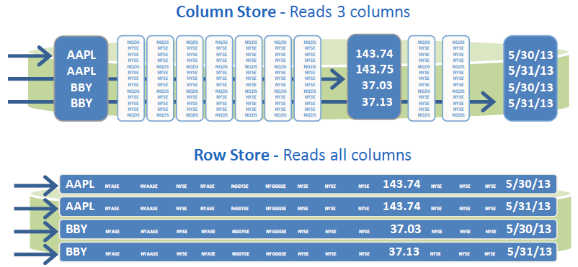
Column Storage
Vertica stores data in a column format so it can be queried for best performance. Compared to row-based storage, column storage reduces disk I/O making it ideal for read-intensive workloads. VERTICA reads only the columns needed to answer the query. For example:
=> SELECT avg(price) FROM tickstore WHERE symbol - 'AAPL' and date = '5/31/13';

Slide 7
Apache Parquet Format

Slide 8
使用 Parquet 資料集檔
$ hdfs dfs -ls /dataset/twmparquet
Found 20 items
-rw-r--r-- 3 bigred bigboss 0 2020-05-15 12:55 /dataset/twmparquet/_SUCCESS
-rw-r--r-- 3 bigred bigboss 318 2020-05-15 12:55 /dataset/twmparquet/_common_metadata
-rw-r--r-- 3 bigred bigboss 12551 2020-05-15 12:55 /dataset/twmparquet/_metadata
-rw-r--r-- 3 bigred bigboss 12037871 2020-05-15 12:55 /dataset/twmparquet/part-m-00000.parquet
.........
-rw-r--r-- 3 bigred bigboss 7554152 2020-05-15 12:55 /dataset/twmparquet/part-m-00016.parquet

Slide 9
建立可讀取 Parquet 資料集的外部資料表
$ nano twmparquet.hsql
USE twmask;
DROP TABLE IF EXISTS twmparquet;
CREATE EXTERNAL TABLE twmparquet (
code string,
name string,
address string,
tel string,
adult INT,
child INT,
dt string
)
ROW FORMAT DELIMITED FIELDS TERMINATED BY ','
STORED AS Parquet LOCATION '/dataset/twmparquet';
$ hive -S -f twmparquet.hsql
Notes:
1. How to control the file numbers of hive table after inserting data on MapR-FS.
http://www.openkb.info/2014/12/how-to-control-file-numbers-of-hive.html
Before adding the below properties each of my partition created size is 20 to 30 MB and after adding props size become 298 to 310 MB. Any way am getting some what better but problem is with block size, partition size greater than 250 MB occupies two blocks. I have to fix it to block size, so that my cluster utilization is good.
建立 內部資料表
$ nano twmparquet.hsql
USE twmask;
DROP TABLE IF EXISTS twmparquet;
CREATE TABLE twmparquet (
code string,
name string,
address string,
tel string,
adult INT,
child INT,
dt string
)
ROW FORMAT DELIMITED FIELDS TERMINATED BY ','
STORED AS Parquet LOCATION 'twmparquet';
匯入資料至 twmparquet 資料表
$ nano intoparquet.hsql
SET hive.merge.mapfiles=true;
SET hive.merge.mapredfiles=true;
SET hive.merge.size.per.task=256000000;
SET hive.merge.smallfiles.avgsize=256000000;
use twmask;
INSERT OVERWRITE TABLE twmparquet SELECT * FROM twmcompact
$ hive -S -f intoparquet.hsql
$ hdfs dfs -ls -h twmparquet
Found 1 items
-rw-r--r-- 3 bigred bigred 183.9 M 2020-05-11 16:50 twmparquet/000000_0

Slide 10
顯示單日每一個小時的總量 (5 千多個檔)
$ time hive -S -e "use twmask;select substring(dt,12,8), sum(adult)/10000 from twmparquet where substring(dt,1,10)='2020/03/13' group by substring(dt,12,8) order by substring(dt,12,8)" 2>/dev/null
........
06:13:42 208.0668
07:13:43 218.3
08:13:43 285.1477
09:13:45 328.9486
11:10:47 275.0826
12:10:44 267.1048
13:10:46 267.1519
14:10:47 268.5454
15:10:48 246.247
.......
real 1m17.092s
user 1m13.973s
sys 0m4.102s

