Slide 1
Smart Meds
Basic work-flow

Slide 2

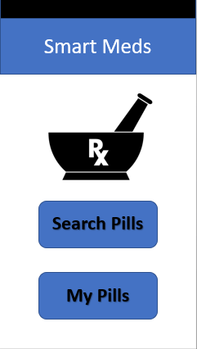
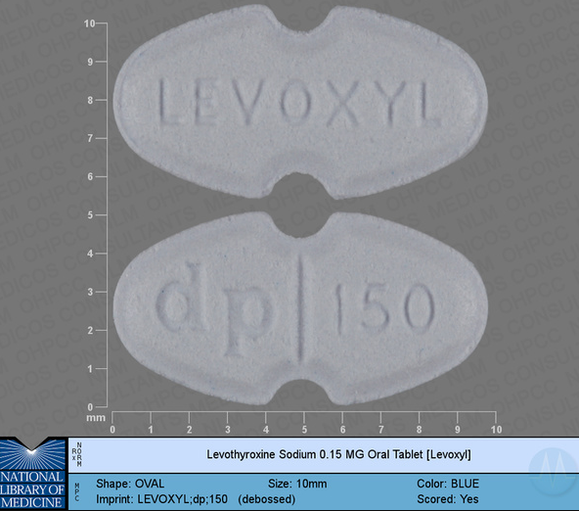



Menu Activity
Search Activity
RxInfo Fragment
Interaction Fragment
Name: _
Inscription: dp
Shape spinner \/
Drug interactions
Color spinner \/
Drug - Symptom
Xanadu :
Birth control:
Death
Balding
Uses: Sedative
Breastfeeding: not advised
Active ingredient: Hydrochloric acid
Prescription only: yes
Gender specific: female only
Narcotic: yes
Drug interactions (3)
Api request gets list of names and images based on search parameters
Multiple Api calls get all required fields and count of interactions
Api call to RxNav using rxcui as parameter
https://rximage.nlm.nih.gov/api/rximage/1/rxnav?&resolution=600&imprint=dp&rLimit=8
https://rxnav.nlm.nih.gov/REST/rxclass/class/byRxcui.json?rxcui=7052&relaSource=NDFRT&relas=may_treat
https://rxnav.nlm.nih.gov/REST/interaction/interaction.json?rxcui=88014&sources=ONCHigh

Slide 3
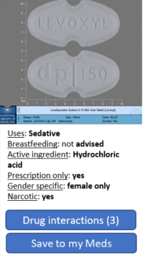
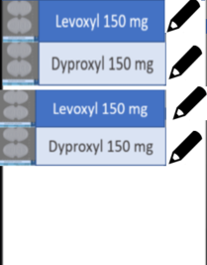
Menu Activity
Med Cabinet Activity
RxInfo Fragment
Interaction Fragment
My medicines
Drug interactions
Drug - Symptom
Xanadu :
Birth control:
Death
Balding
Uses: Sedative
Breastfeeding: not advised
Active ingredient: Hydrochloric acid
Prescription only: yes
Gender specific: female only
Narcotic: yes
+
Drug interactions (3)
Query sql-lite db
Pass rxcui or name to get info from API

Slide 4
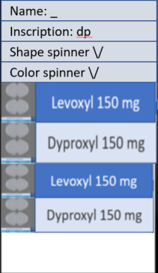

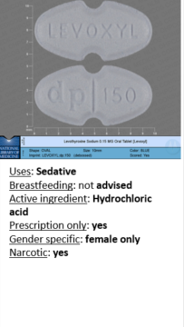

Menu Activity
Med Cabinet Activity
Search Activity
RxInfo Fragment
My medicines
+
Save to my Meds
If it is in meds, don’t show save, show delete
Store info in sql-lite db

